Slide 1
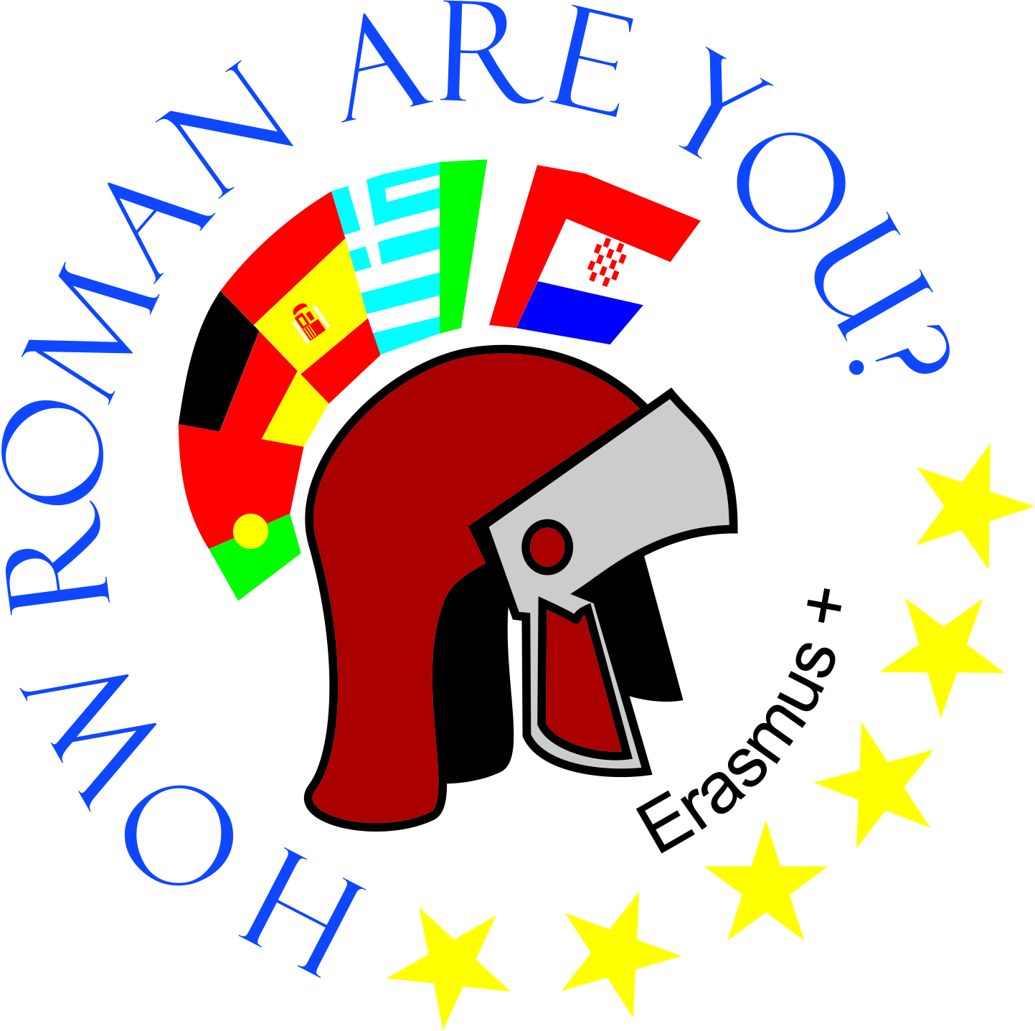
OŠ Bartola Kašića Vinkovci Erasmus+ project 2020-2022 How Roman are you?
The Ancients Walk Among Us

Slide 2
Every day, all around us, we encounter words that connect us to the ancient Roman Empire. Companies, their products, beauty salons, sports clubs, etc. have the names of Roman gods and goddesses, places, significant people and names inspired by myths. There are lots of examples in the world, even planets
in our Solar System were named after Roman gods. (We can also see numerous names inspired by ancient Greece. )

Slide 3
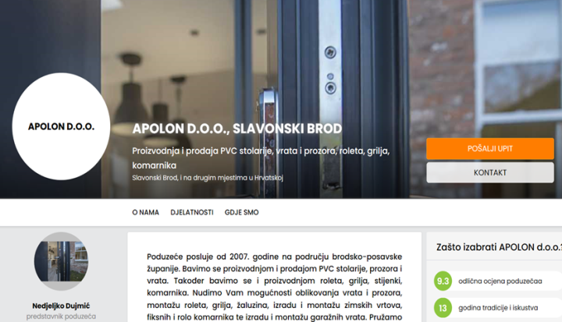
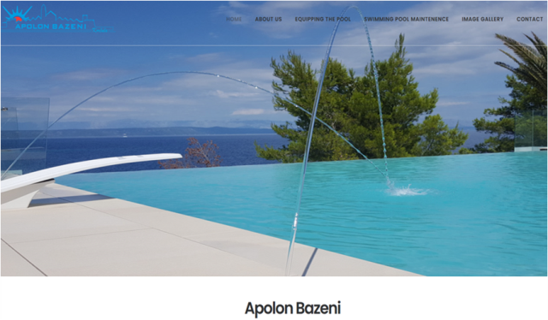
APOLON (Apollo)

Slide 4
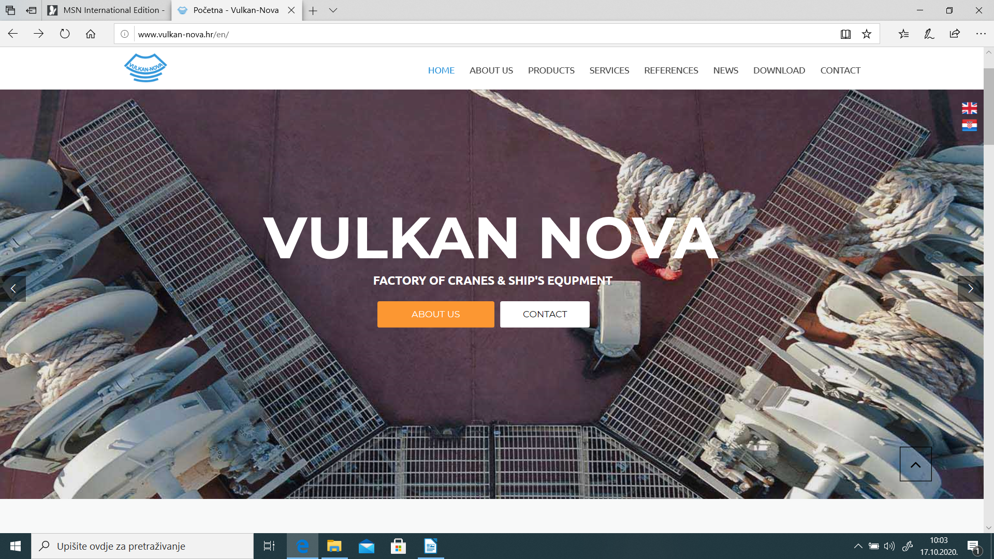
VULKAN (Vulcan)
god of fire, deserts, metalworking and the forge

Slide 5
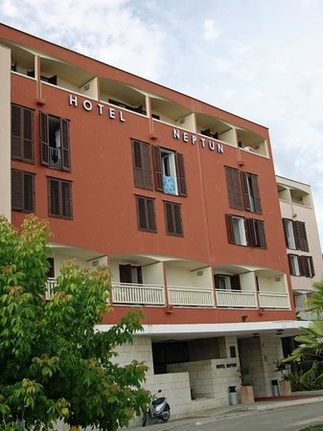
NEPTUN (Neptune) - god of freshwater and the sea - restaurants with sea food, hotels, diving clubs

Slide 6
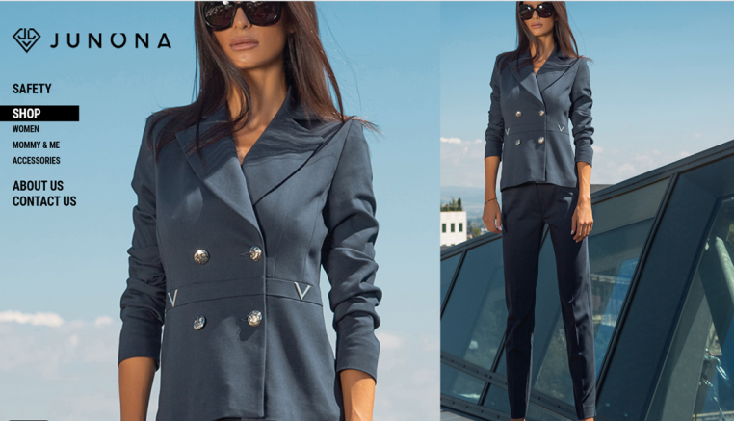
JUNONA (Juno)

Slide 7
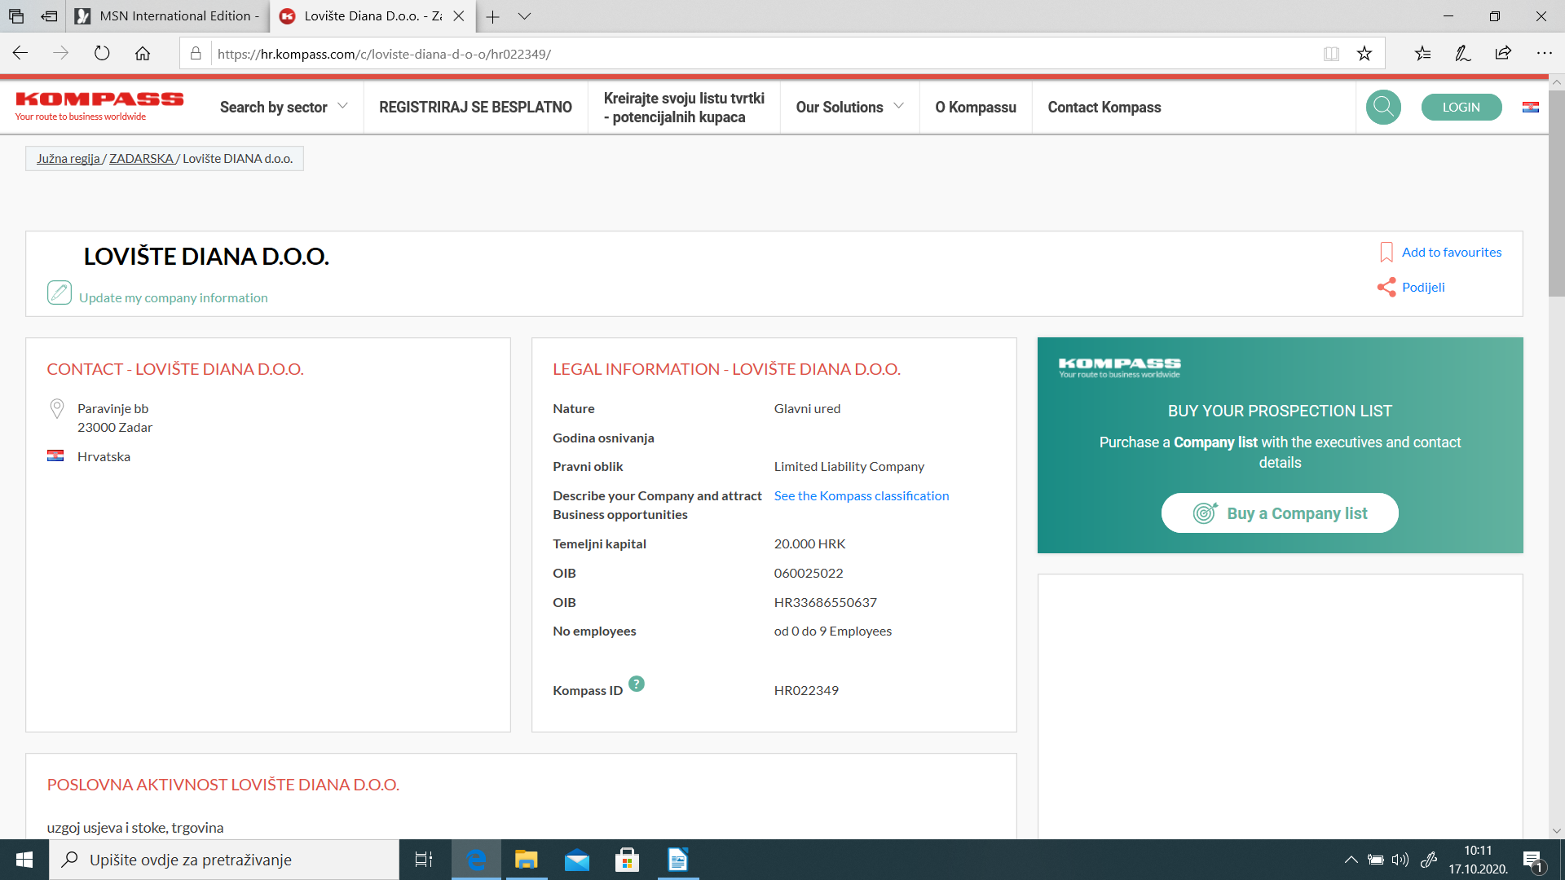
DIANA patroness of the countryside, hunters,...

Slide 8
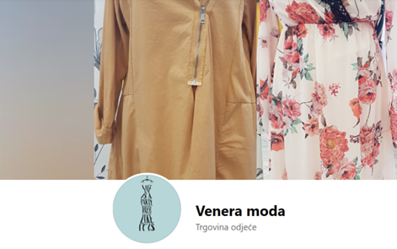
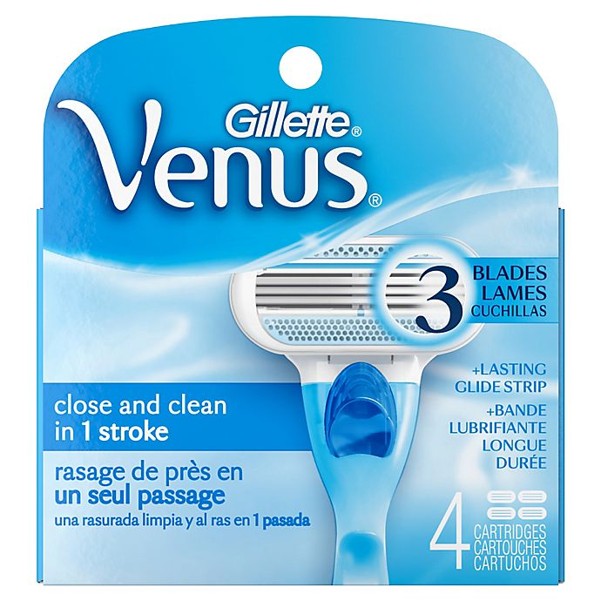
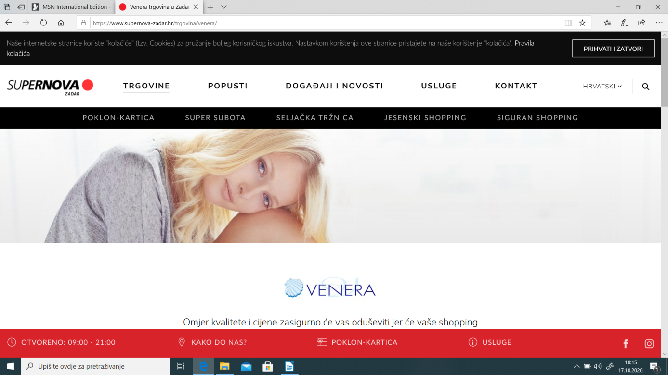
VENERA (Venus) – goddess of love and beauty

Slide 9
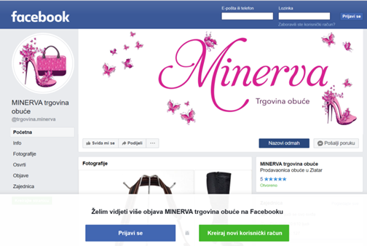
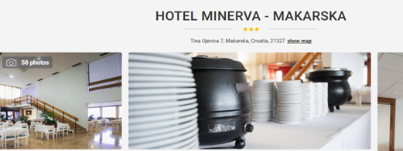
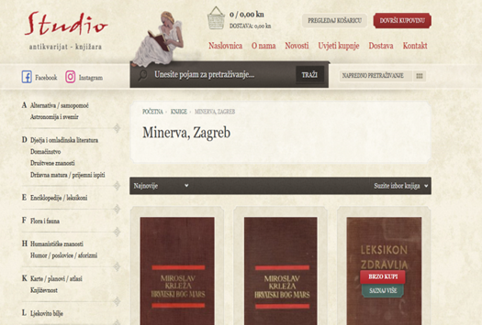
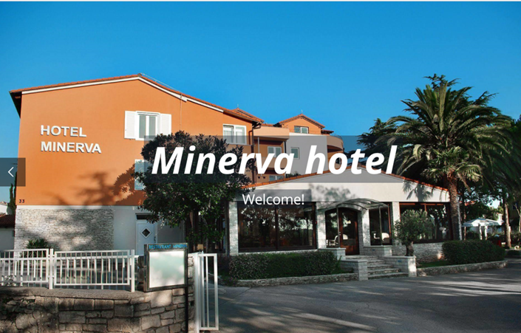
MINERVA

Slide 10
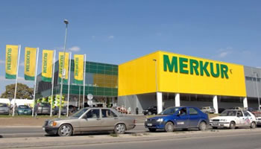
MERKUR (Mercury) - god of financial gain, commerce, ...

Slide 11
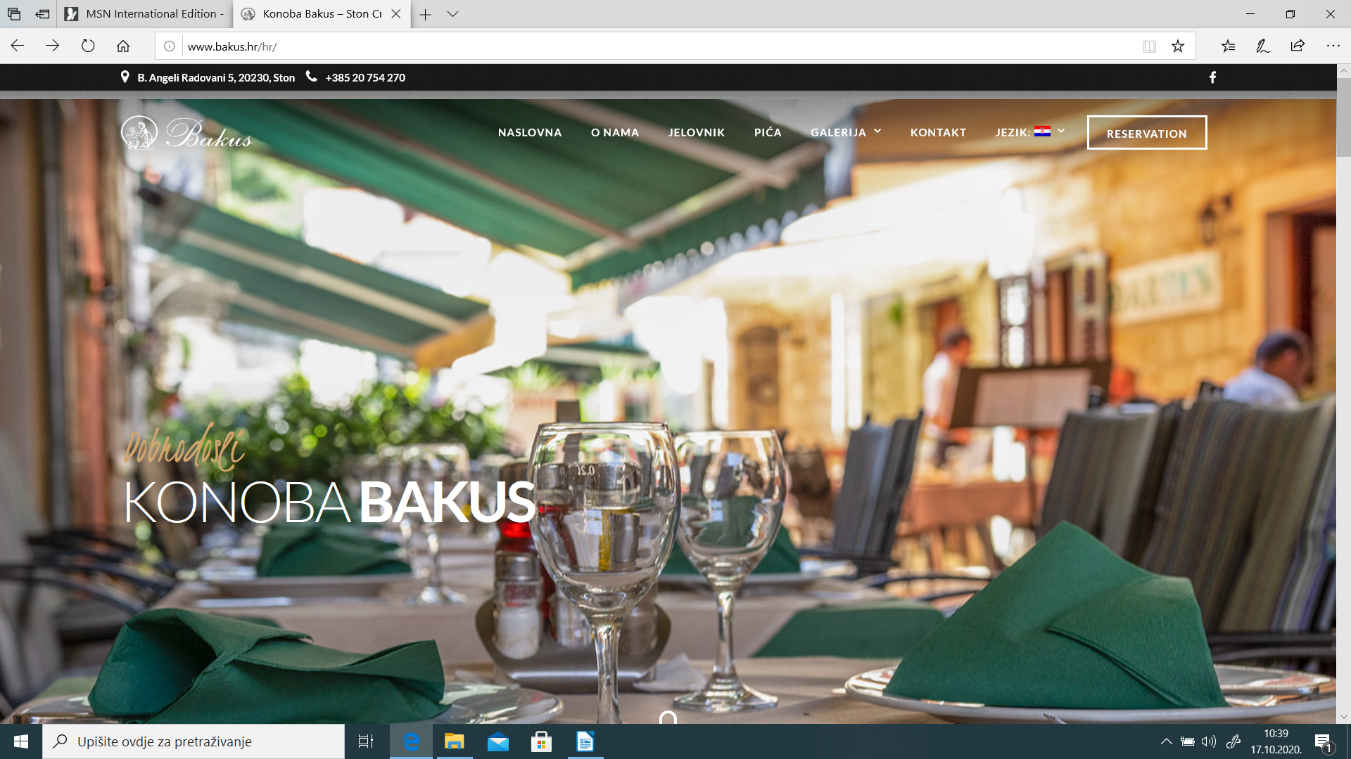
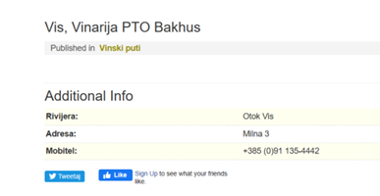
BAKUS (Bacchus) - god of the grape-harvest, winemaking and wine,festivity,...

Slide 12
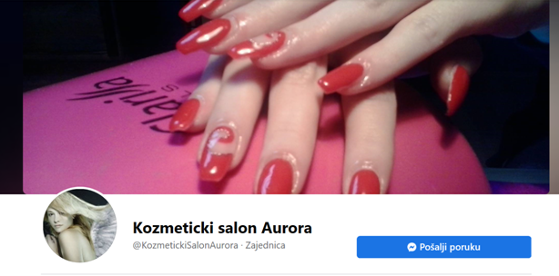
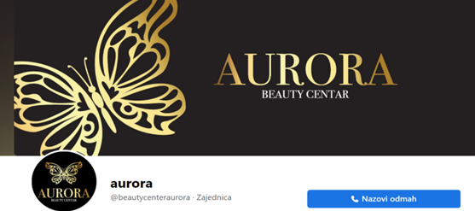
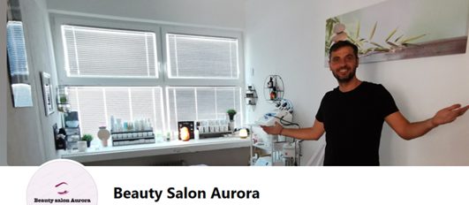
AURORA - goddess of dawn, renews herself every morning

Slide 13
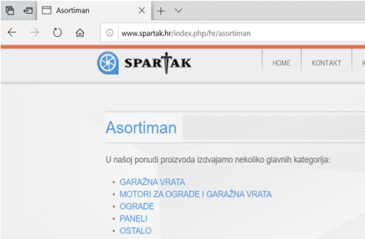
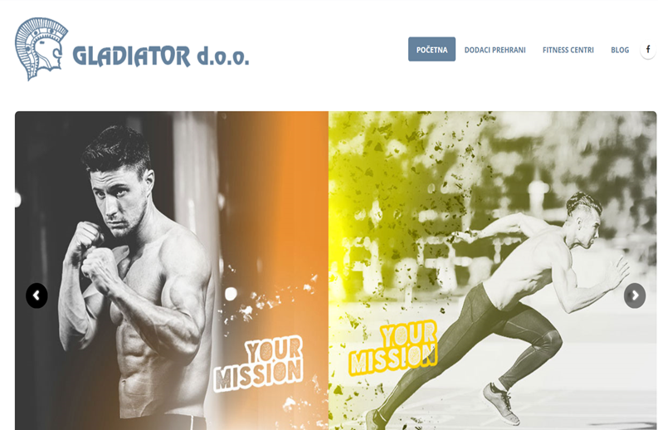
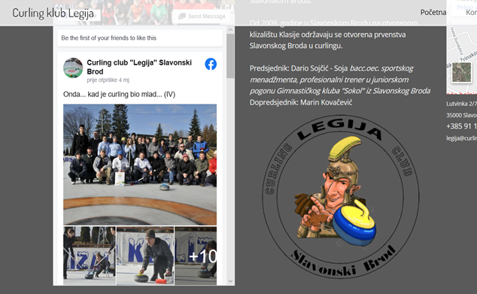
LEGIJA, GLADIJATOR, SPARTAK (legion, gladiator, Spartacus)

Slide 14
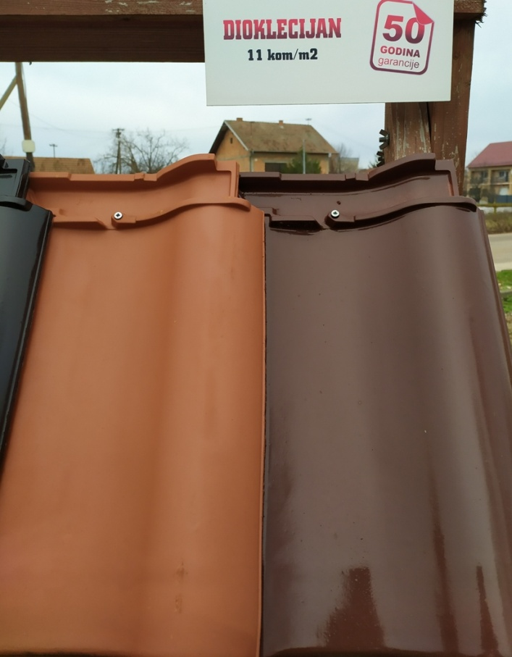
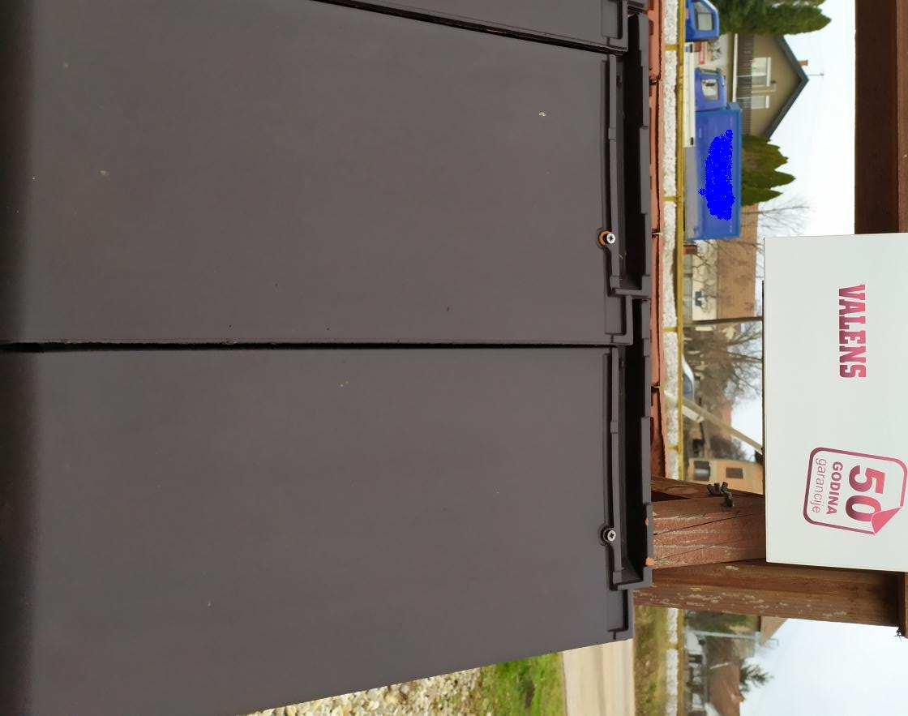
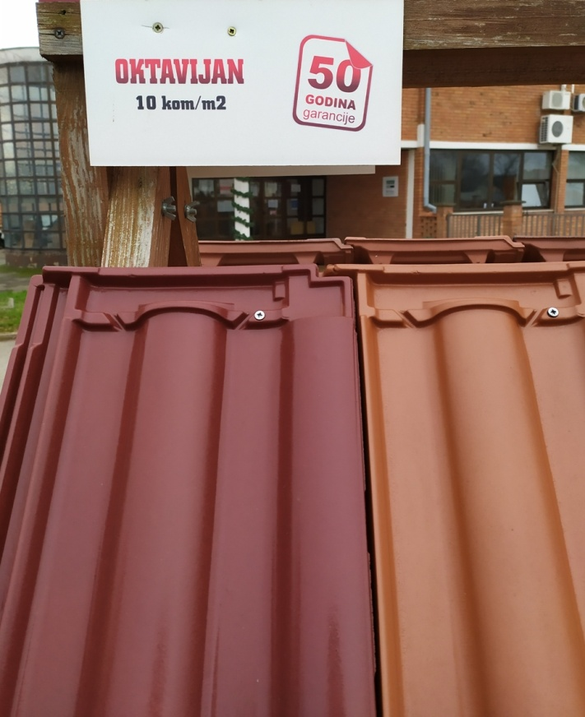
OKTAVIJAN, DIOKLECIJAN (Octavian, Diocletian, Valens) roof tiles

Slide 15
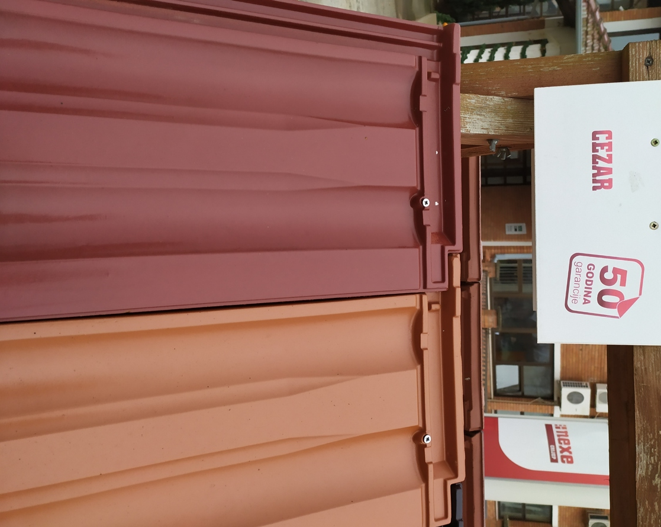
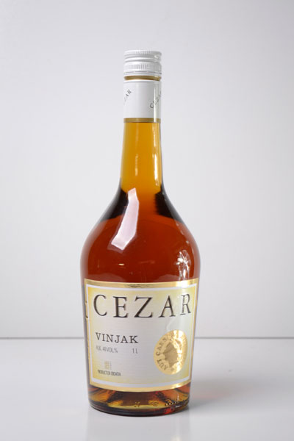
CAESAR

Slide 16
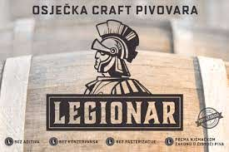
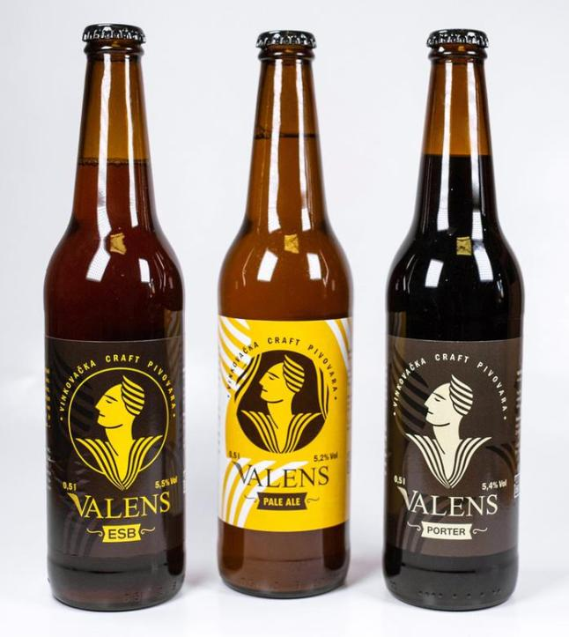
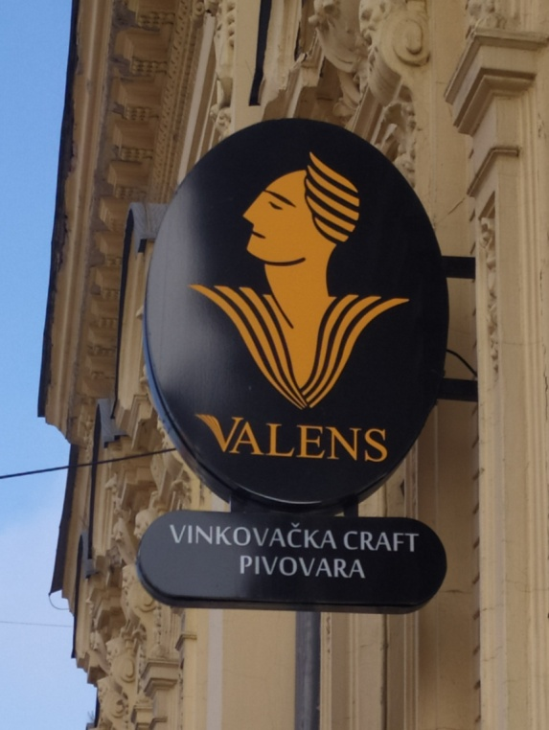
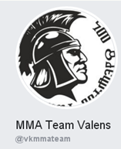
VALENS (Roman emperor) – Valens beer LEGIONAR (legionary) - beer
MMA club Valens, Vinkovci

Slide 17
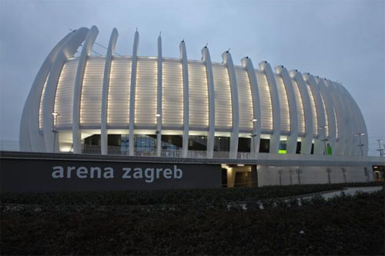
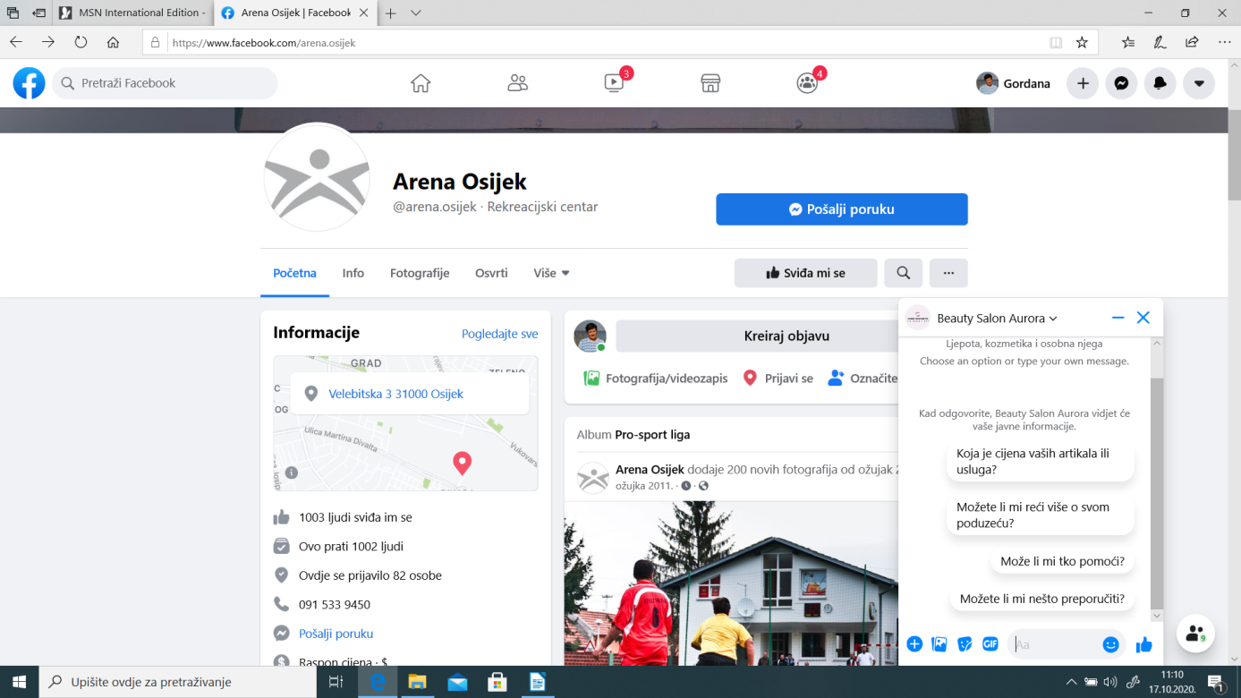
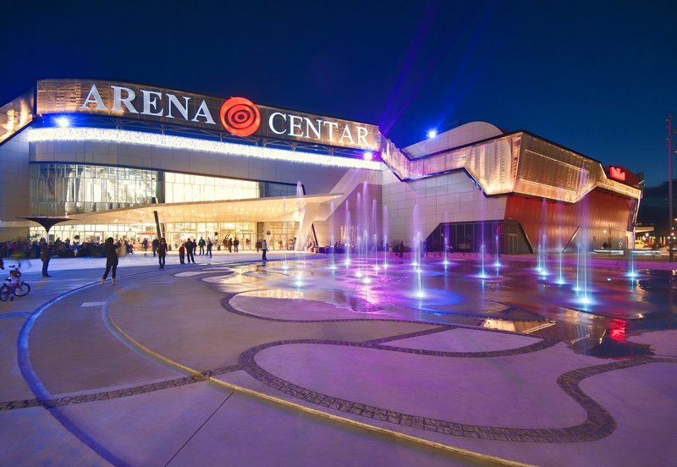
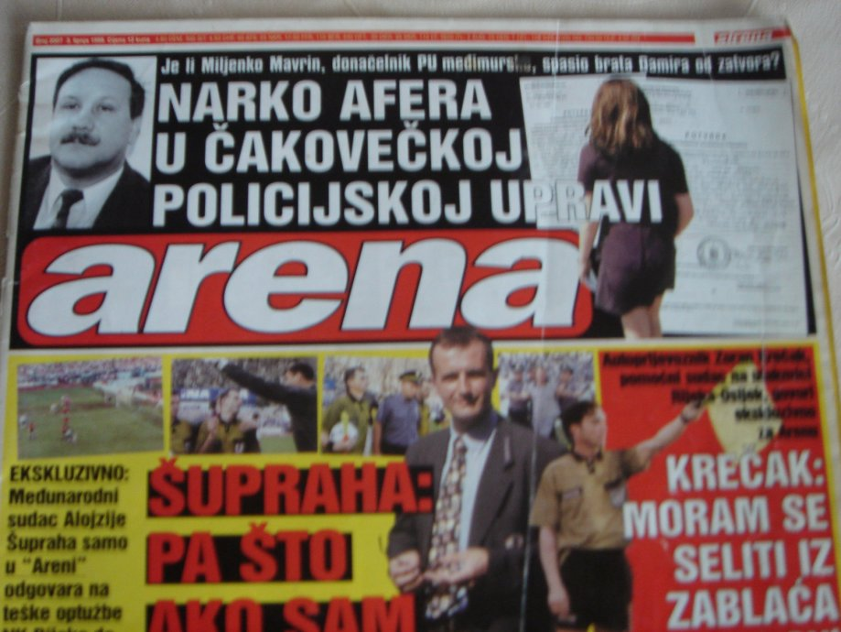
ARENA

Slide 18
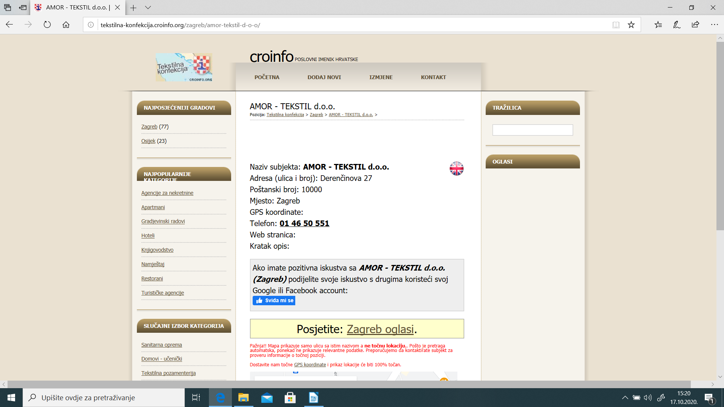
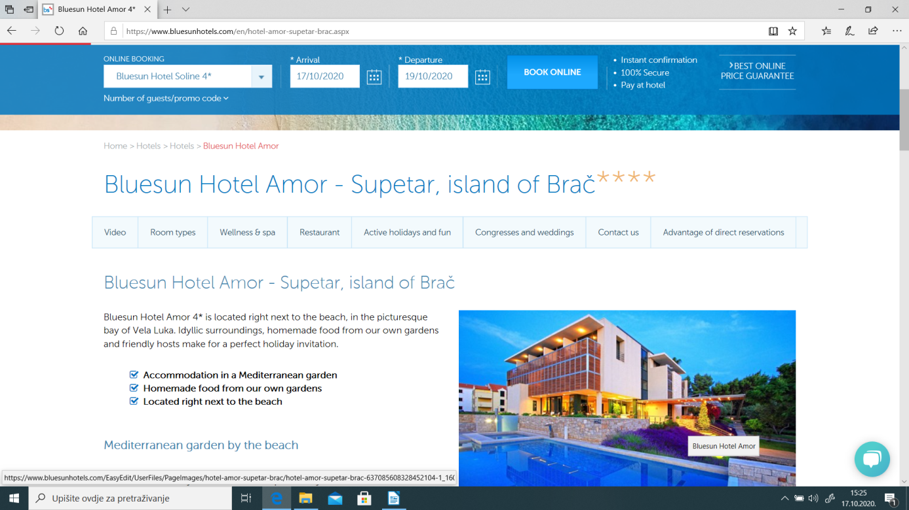
AMOR (also Cupid)

Slide 19
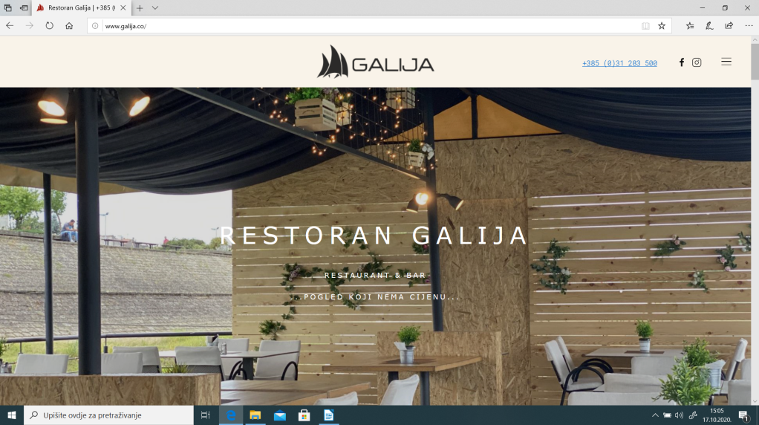
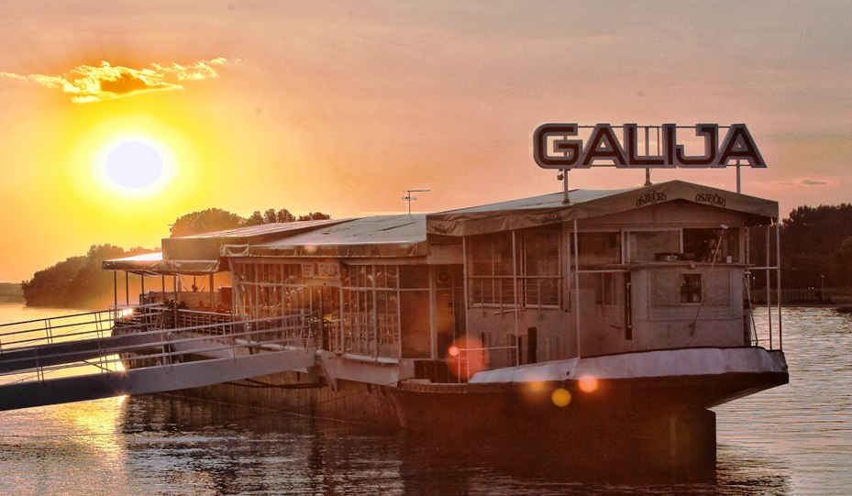
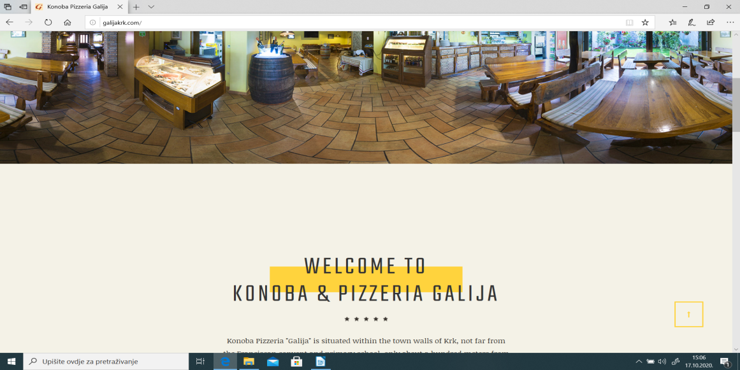
GALIJA (galley) – common name for restaurants near water or on ships

Slide 20
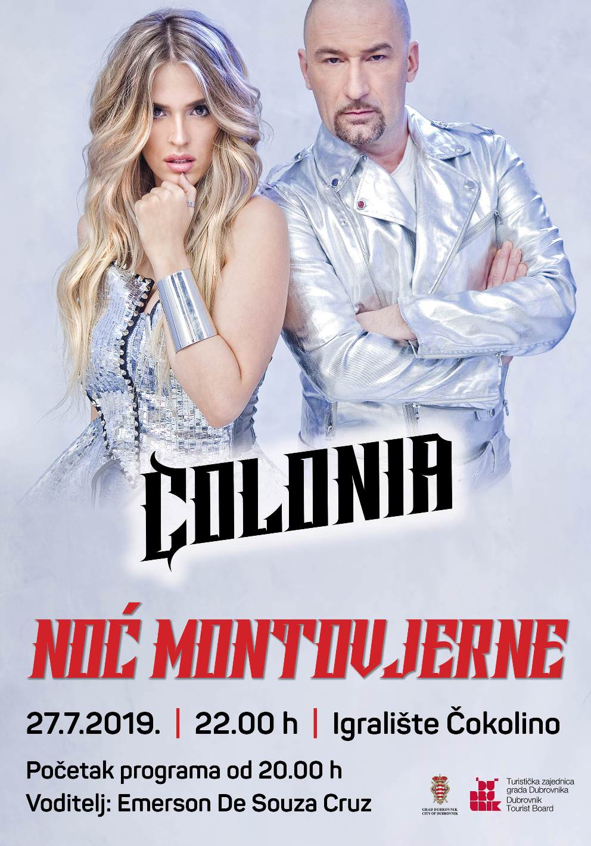
COLONIA AURELIA CIBALAE – Vinkovci

Slide 21
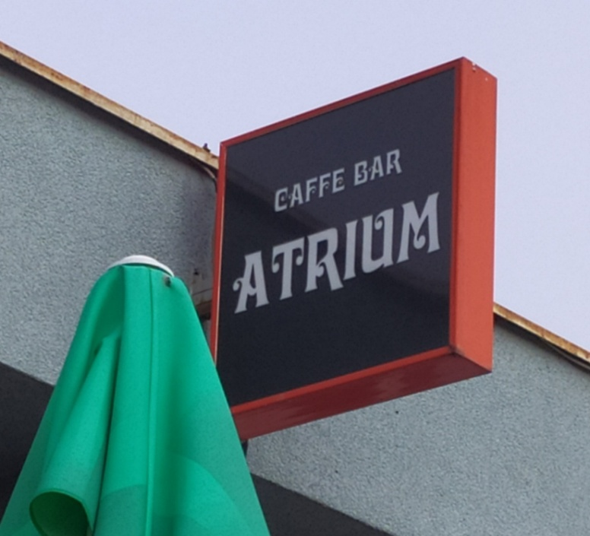
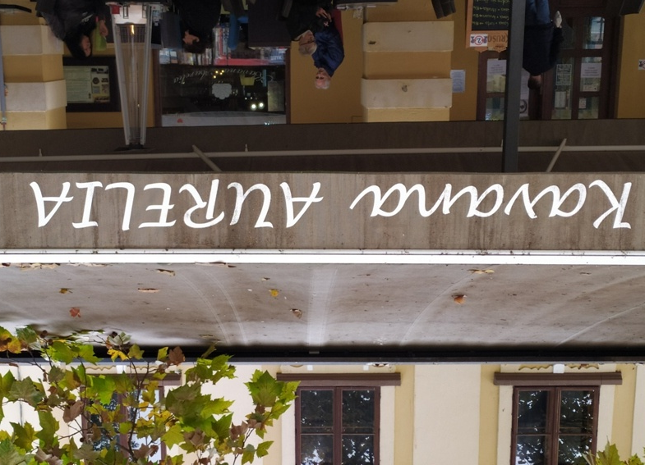
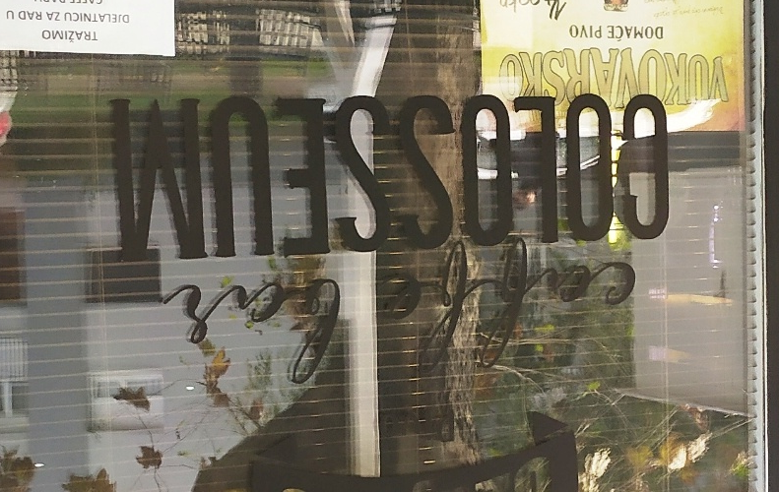
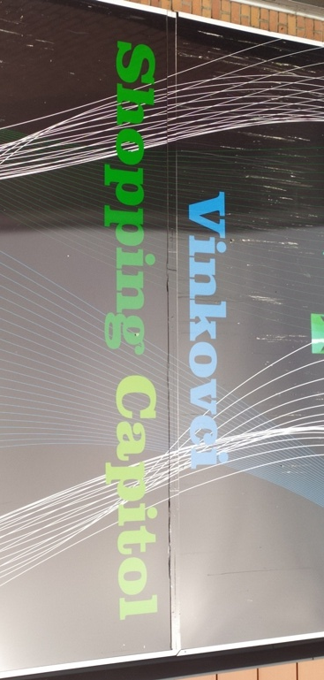
Shops and cafes in Vinkovci:

Slide 22
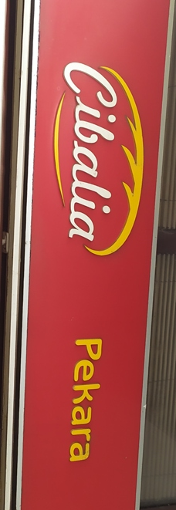
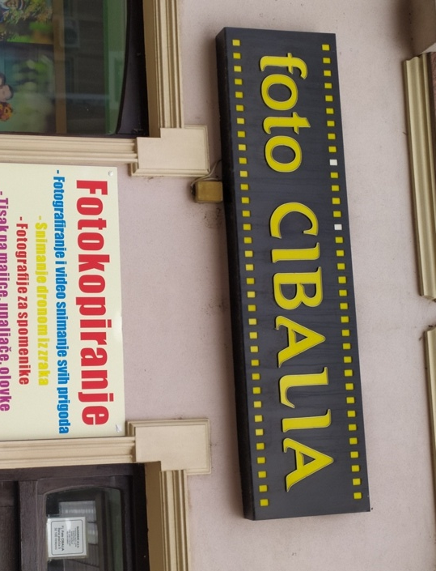
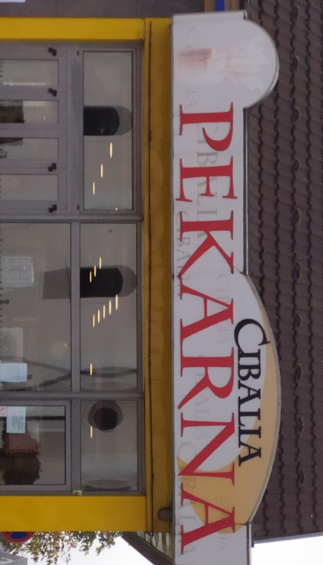

Slide 23
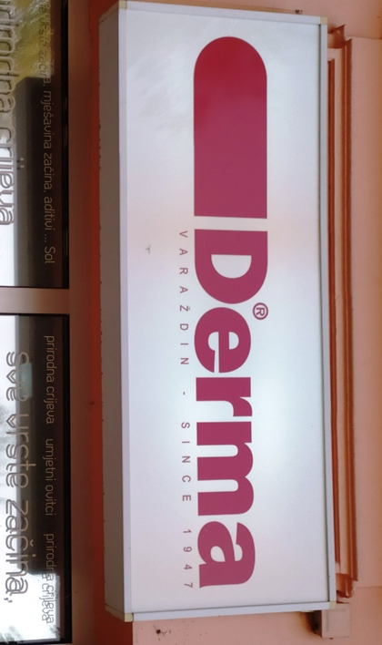

Slide 24
PROPRIUM – special feature, PORTA – gate, entrance property, possession NOVUS, NOVA - new
OCULUS – an eye

Slide 26
MARSONIA - Slavonski Brod MURSA - Osijek

