Slide 1
Osnovna škola Bartola Kašića Erasmus+ project 2020-2023 S.O.F.T. – Start our Future Today 2020-1-PL01-KA229-081533_4
MEETING IN VINKOVCI
September 2022

Slide 2
The fourth short-term exchange of groups of pupils of the project S.O.F.T.- Start our Future Today took place in Vinkovci from 25 September untill 1 October 2022. Host school was Osnovna škola Bartola Kašića and the guests, 11 teachers and 20 pupils, came from Poland, Bulgaria, Italy, Spain and Turkey. The title of this meeting was “We are healthy and happy entrepreneurs” and all the activities were prepared accordingly.

Slide 3
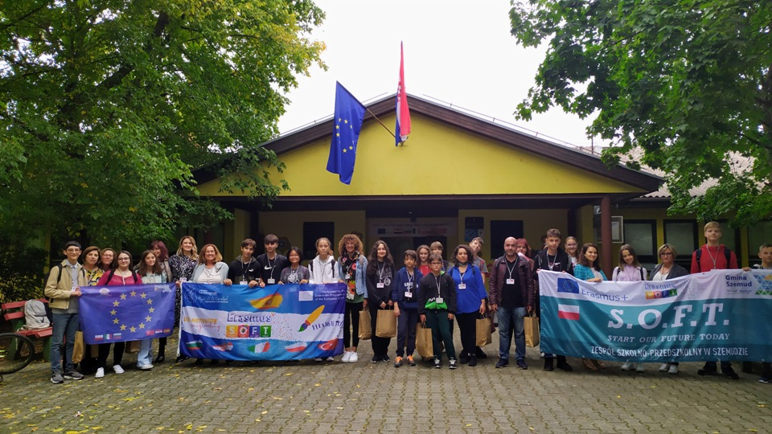
Our guests from 5 European countries

Slide 4
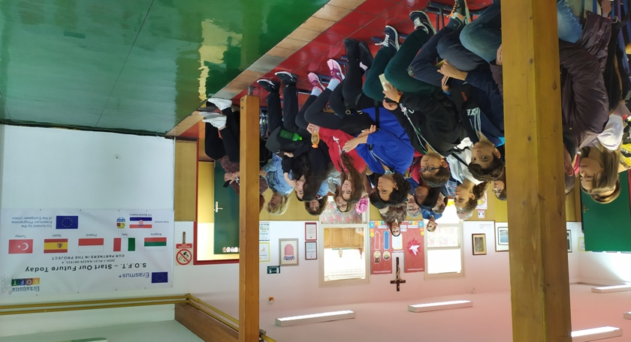
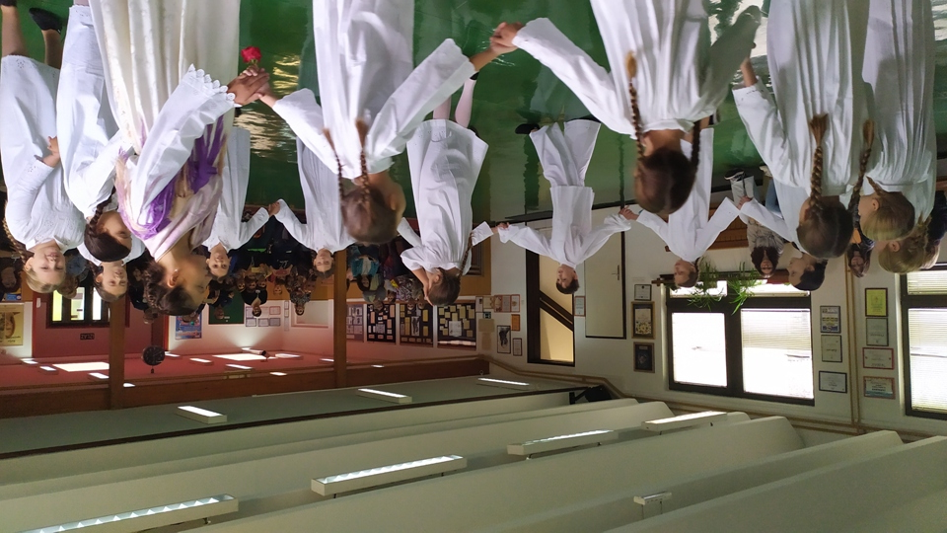
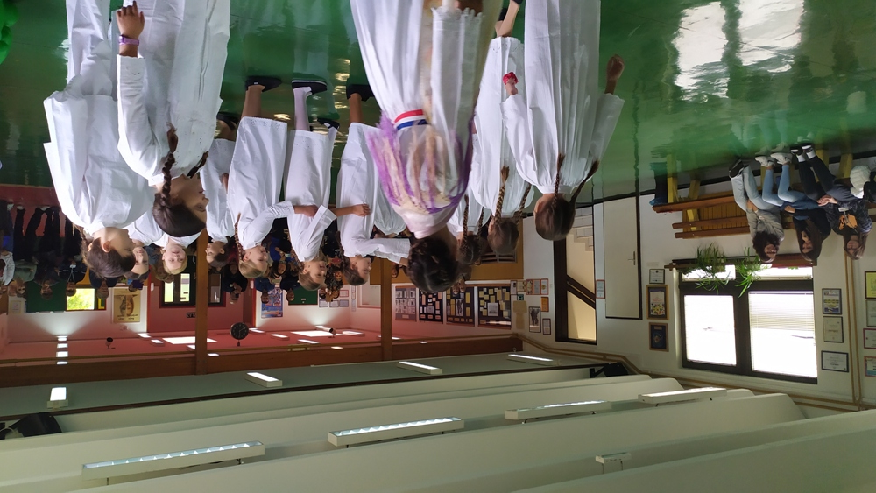
Welcoming ceremony for the guests folklore club “Šumari” performed traditional songs and dances.

Slide 5
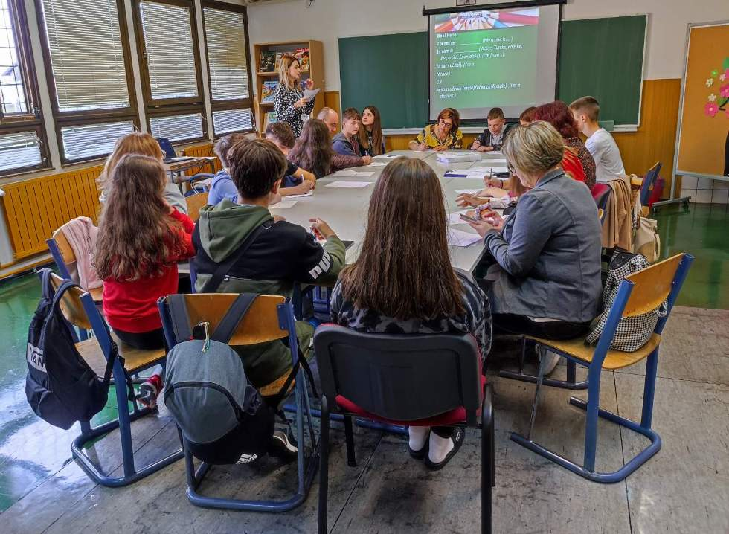
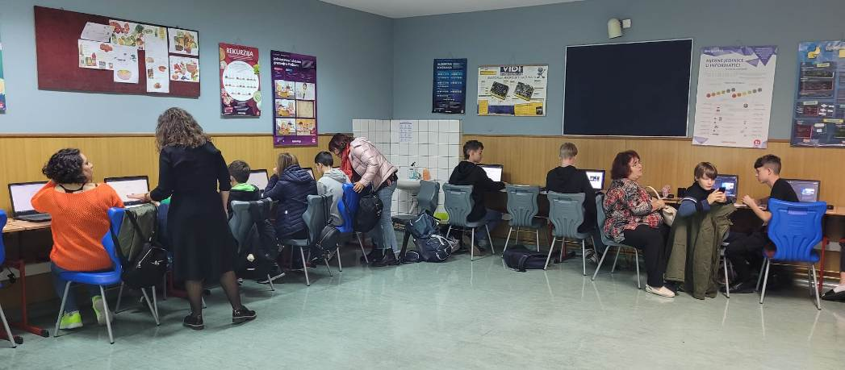
Lessons and workshops conducted by host and guest teachers

Slide 6
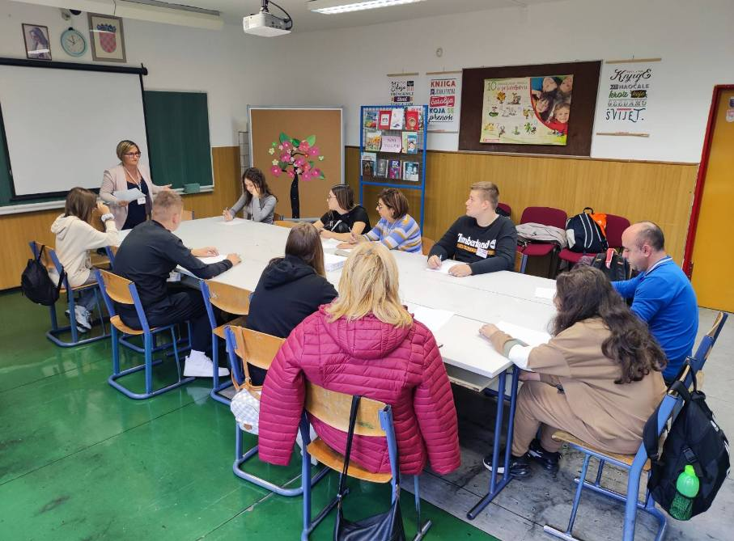
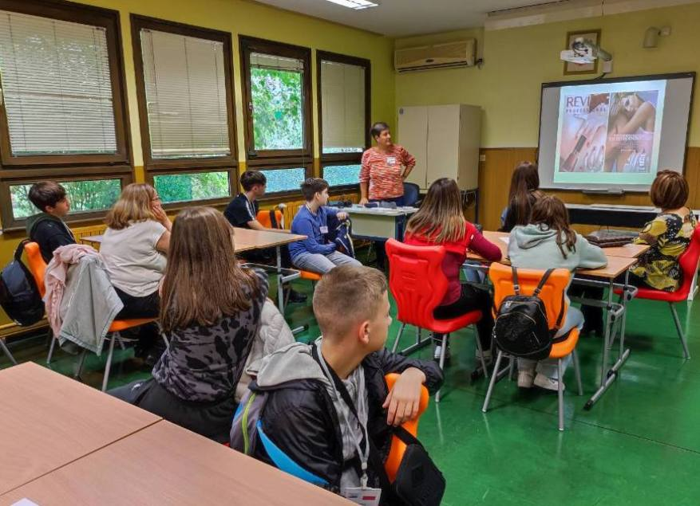
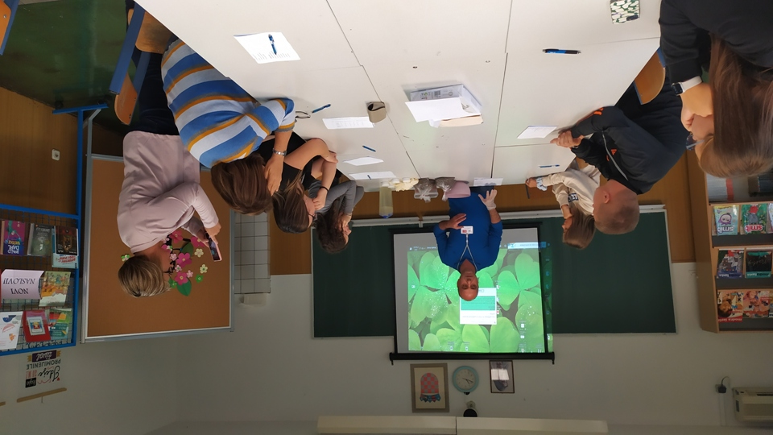

Slide 7
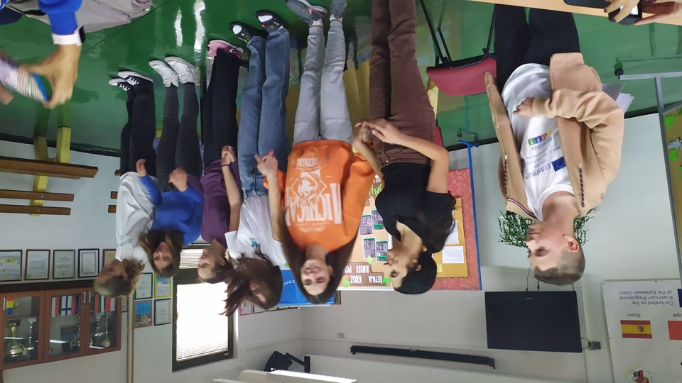
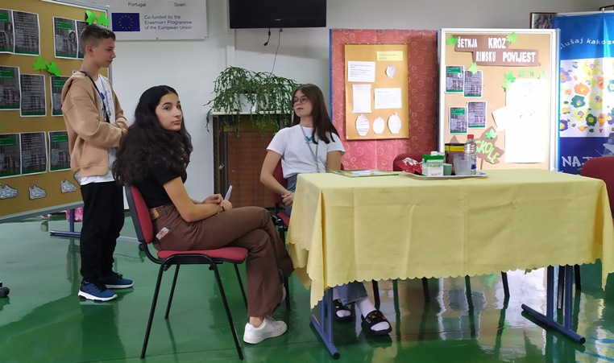
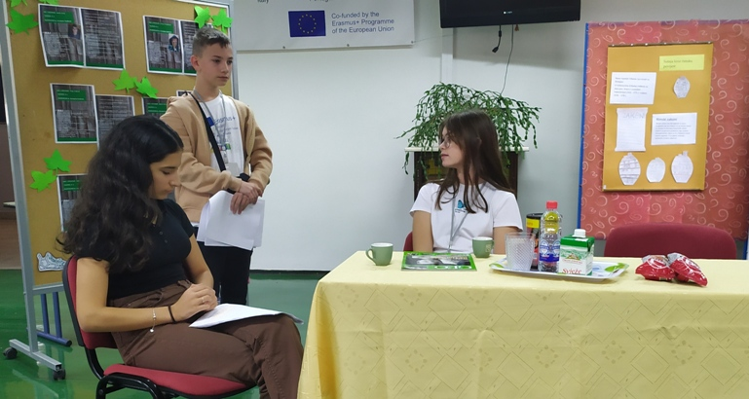
Schoolplay “The Road to Health” had an international cast of characters

Slide 8
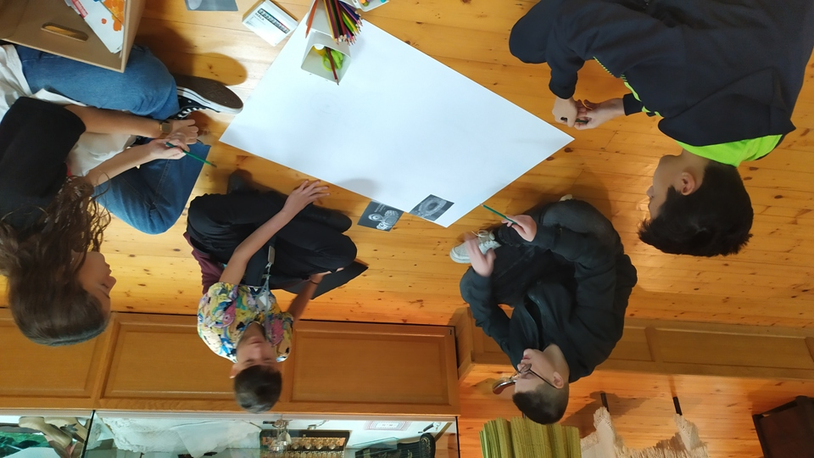
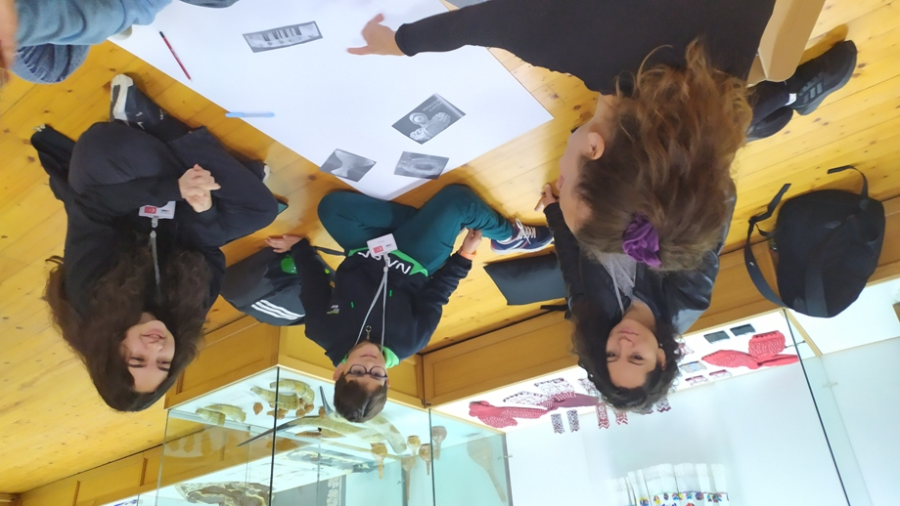
Activities at the museum

Slide 9
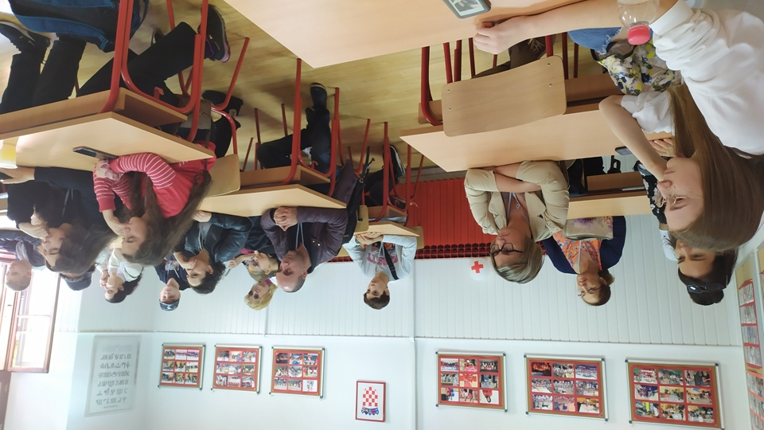
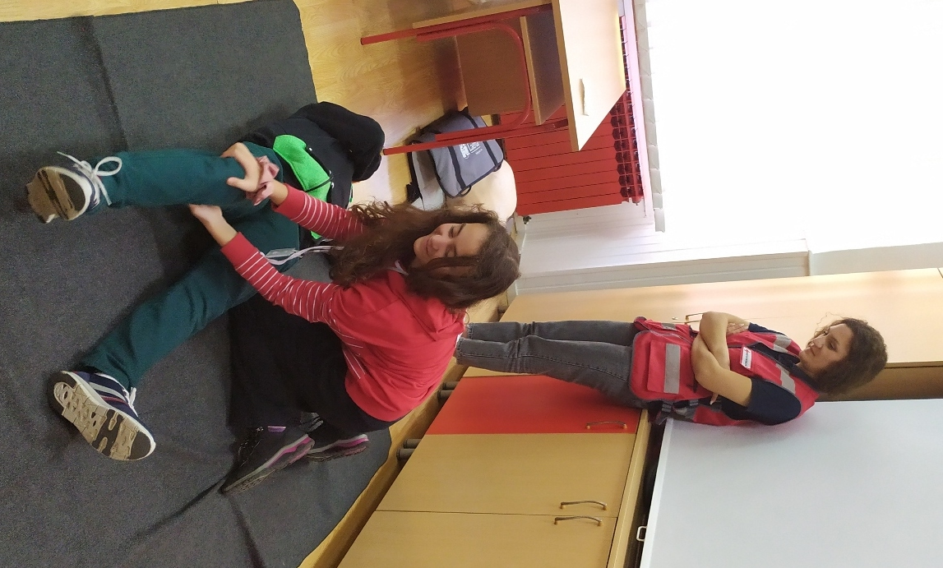
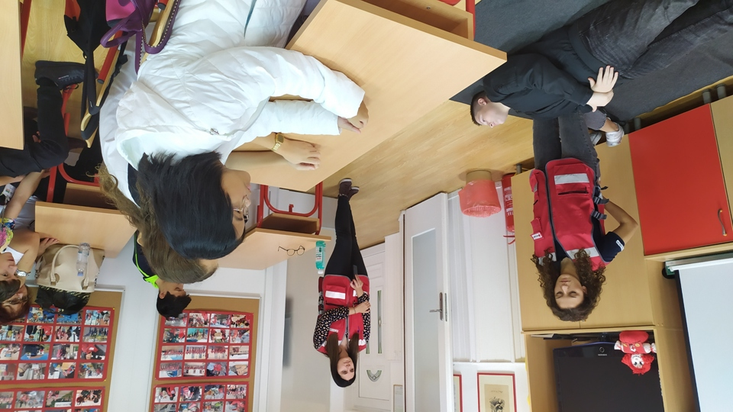
Activities at the Red Cross organisation

Slide 10
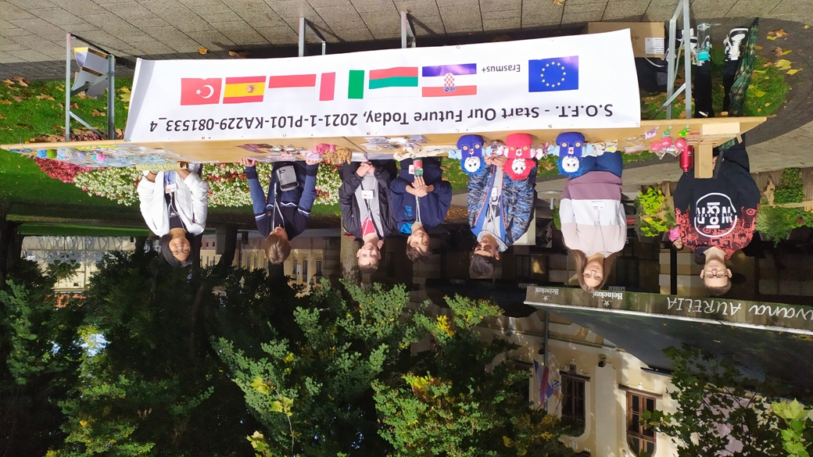
Project dissemination and raising money for charity

Slide 11
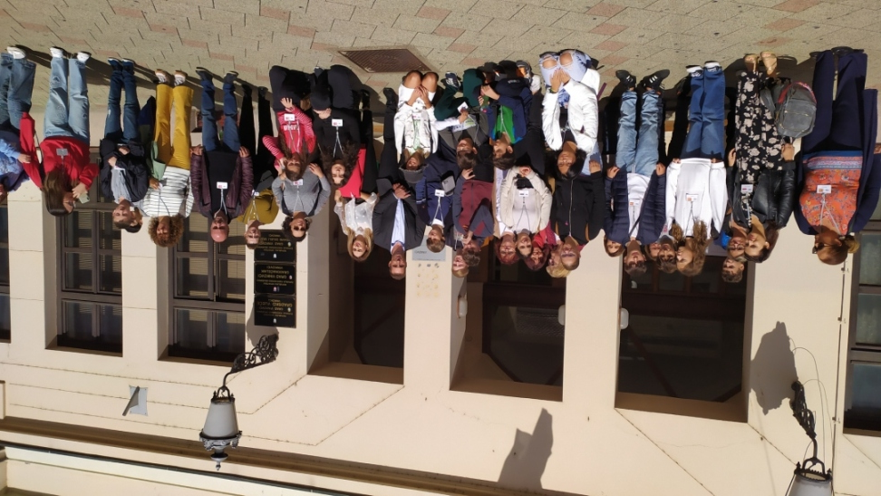
Reception at the mayor’s office

Slide 12
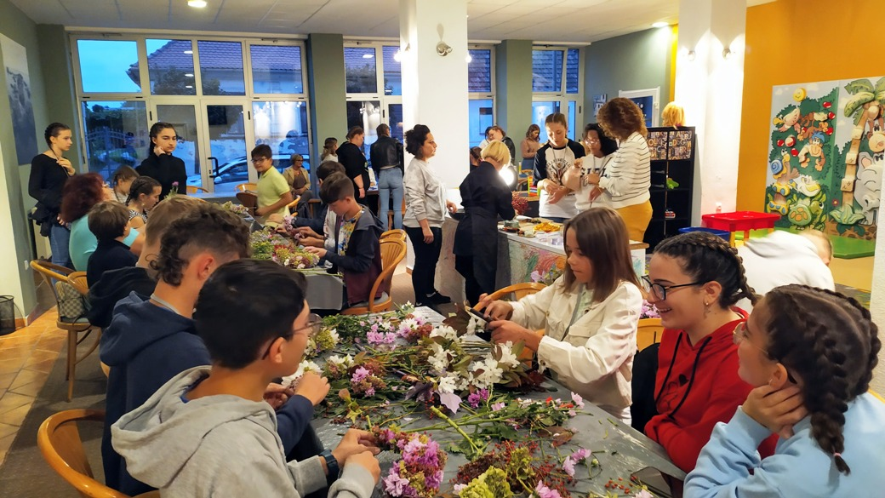
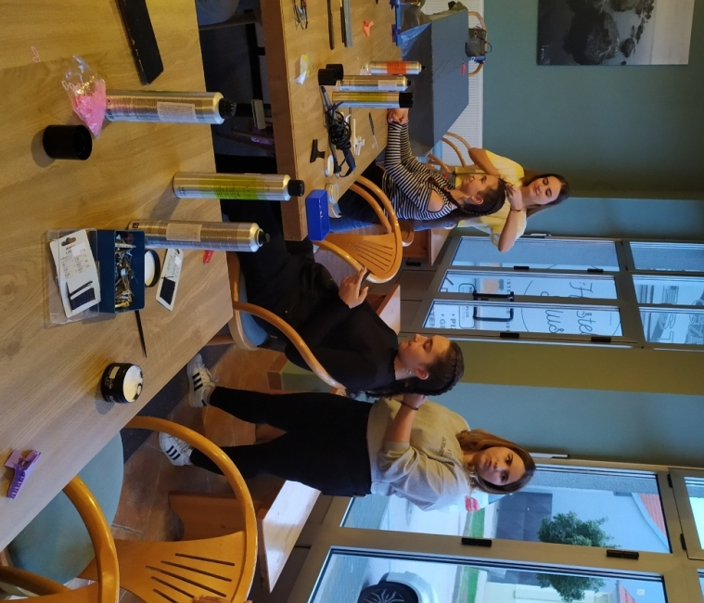
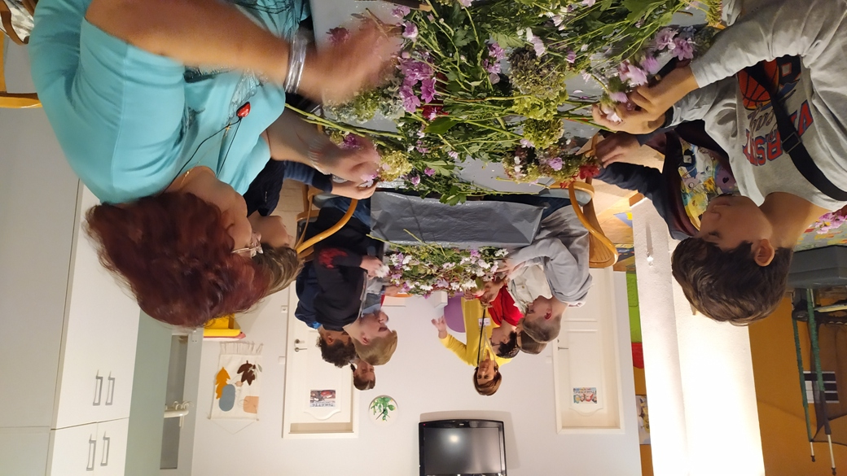
Workshops: arranging flowers and doing hairstyles

Slide 13
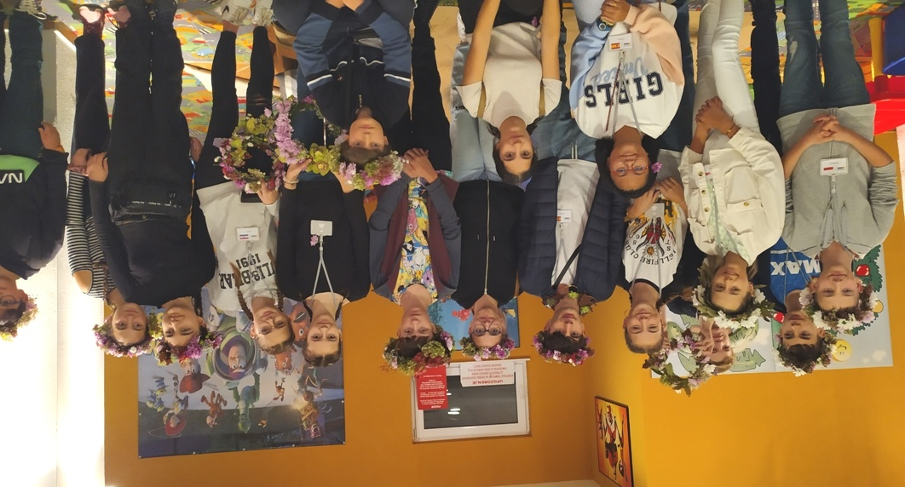

Slide 14
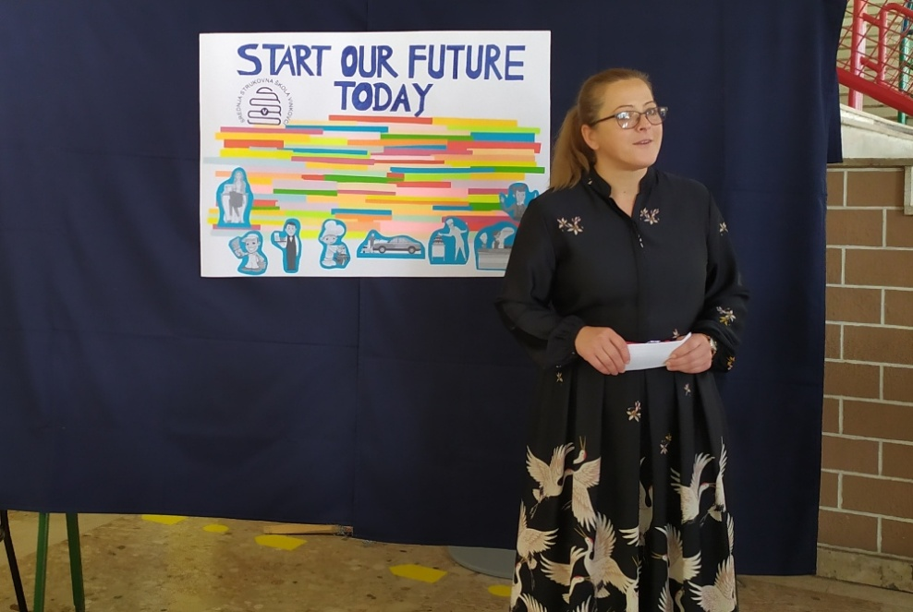
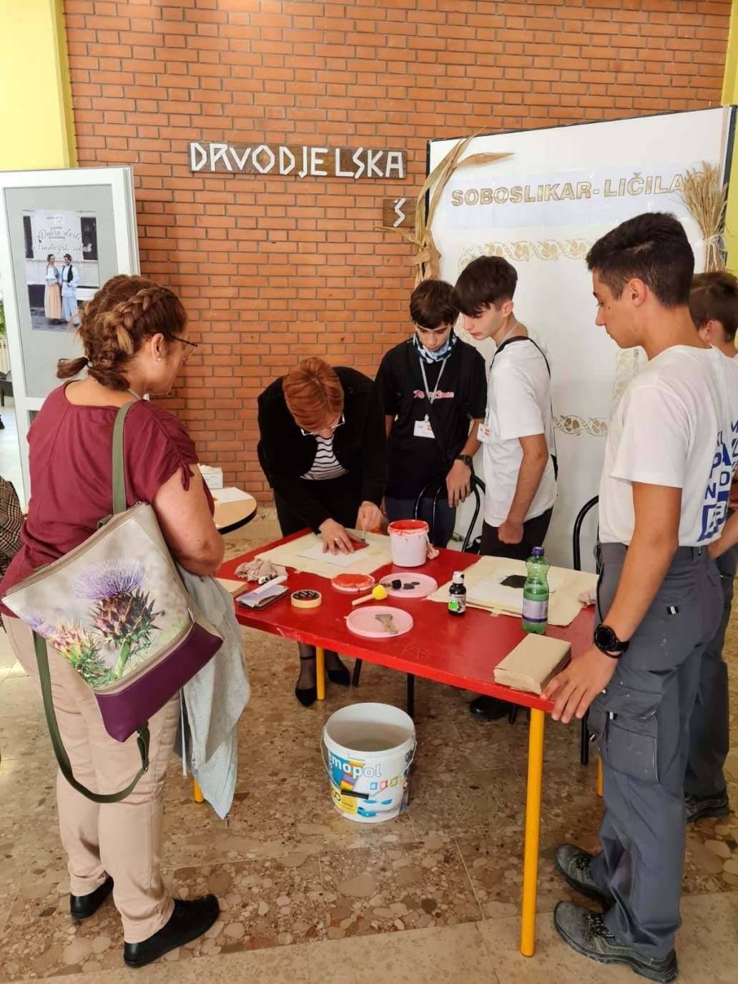
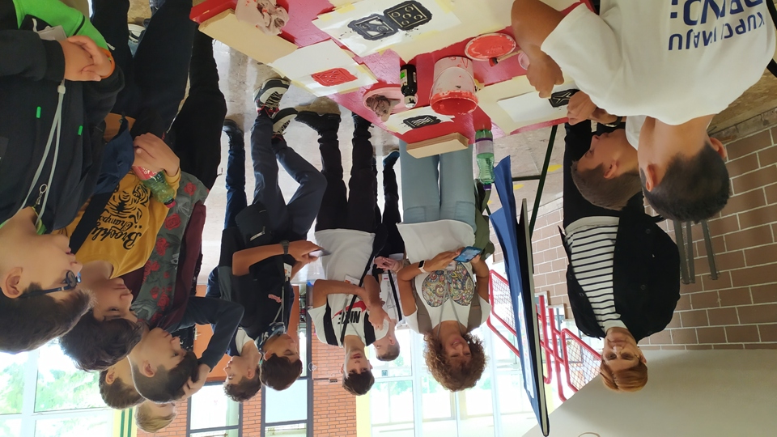
Vocational school prepared workshops for us:

Slide 15
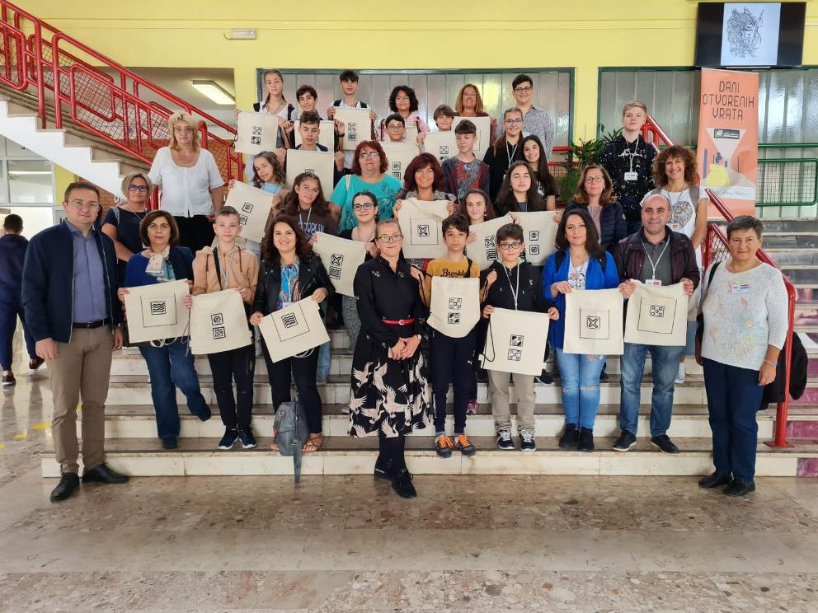
We even got gifts from our hosts

Slide 16
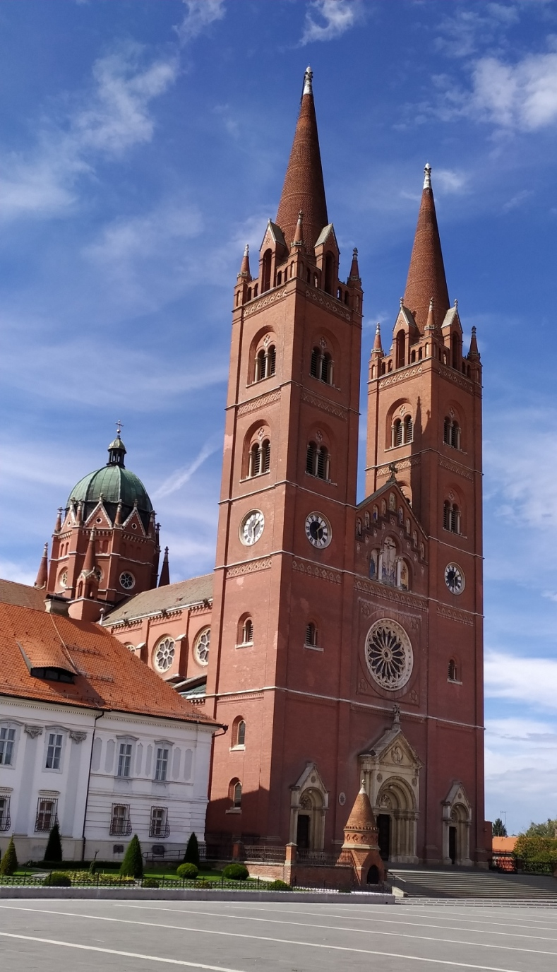
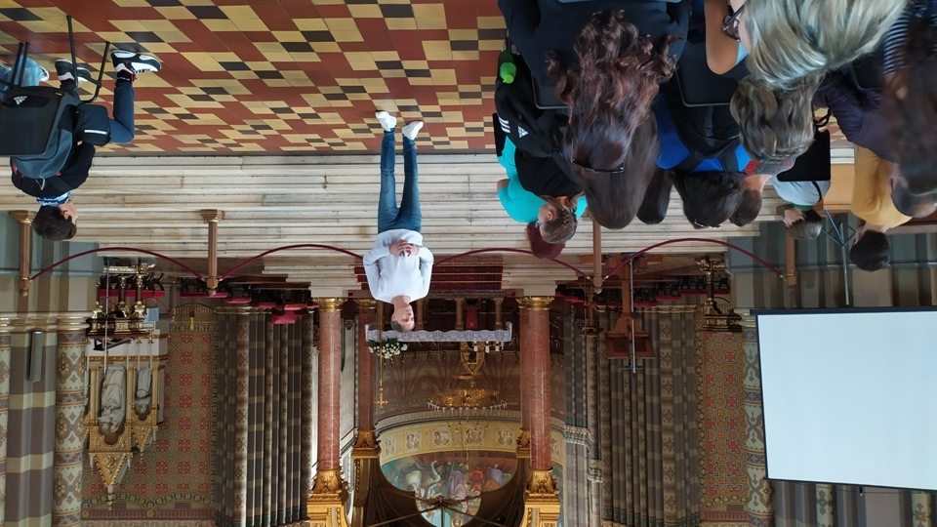
Trip to Đakovo, a nearby town, visit to the cathedral and wine cellars

Slide 17
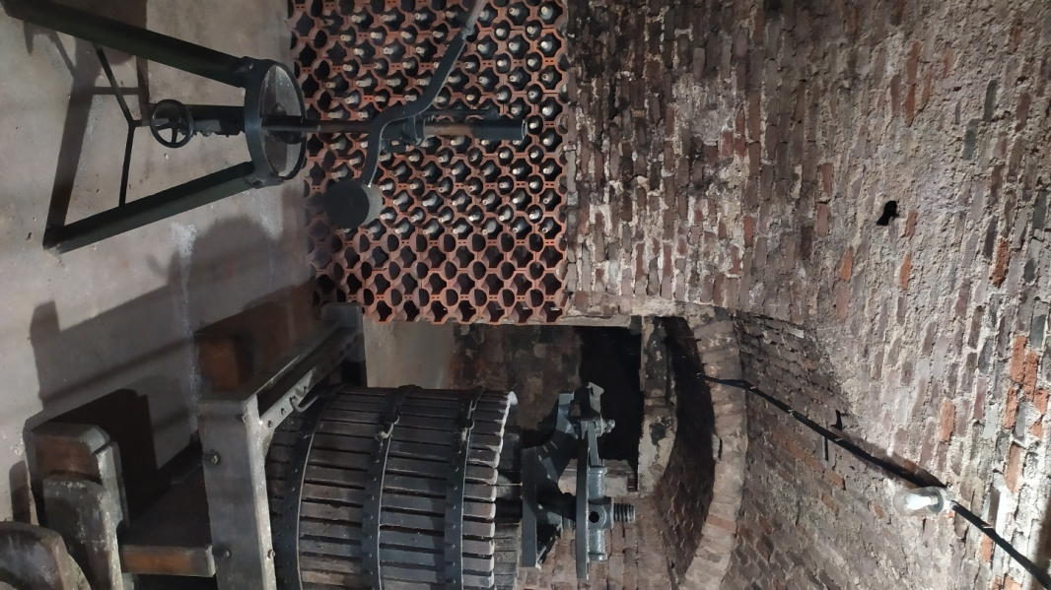
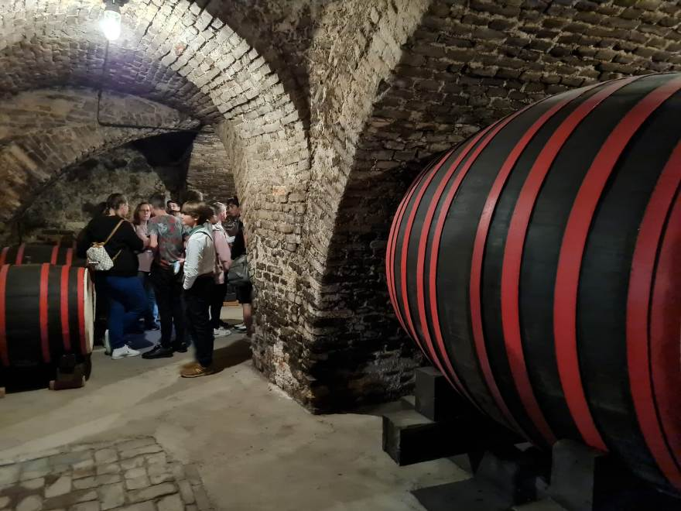
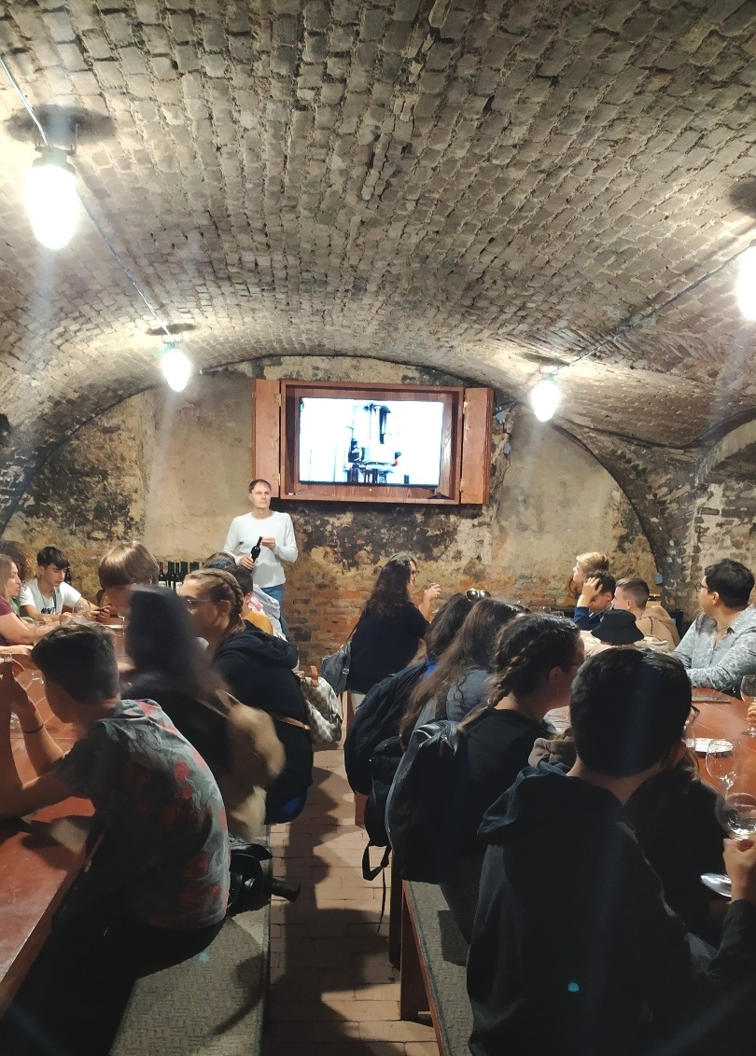

Slide 18
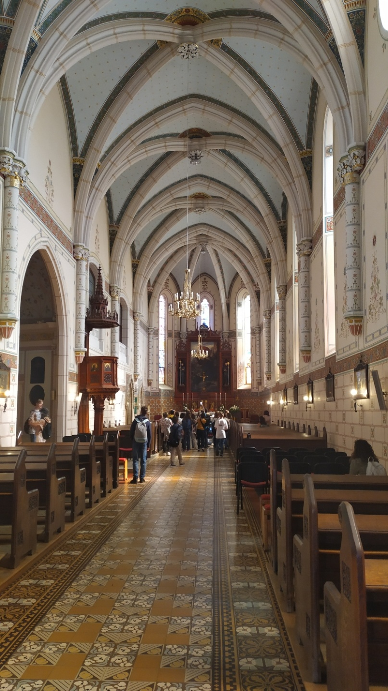
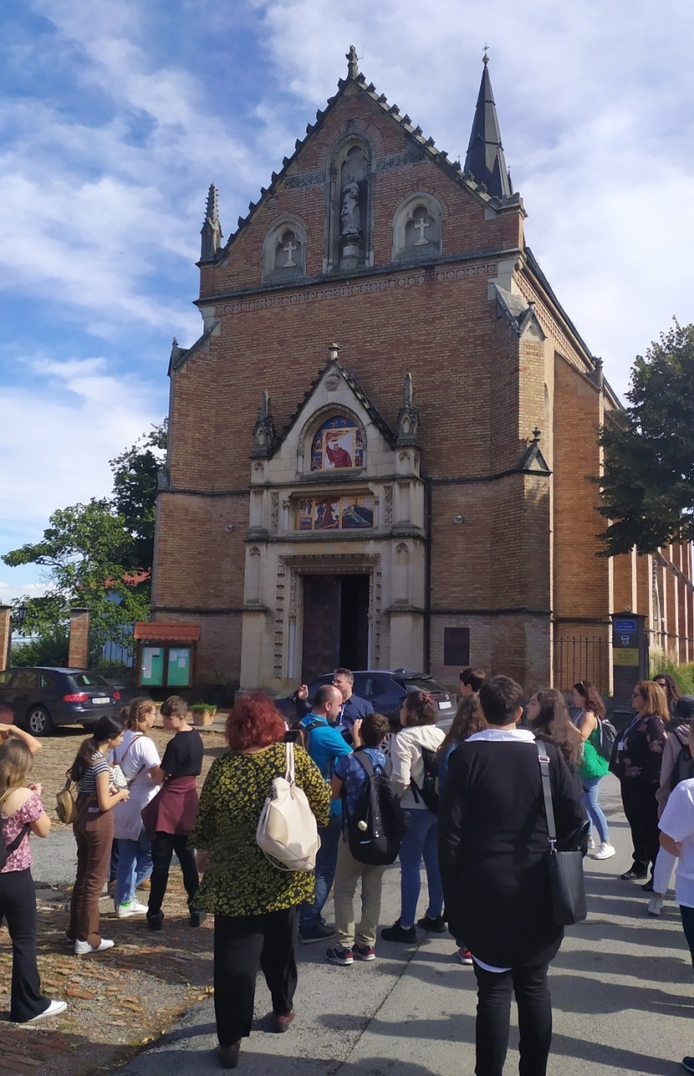
Trip to Ilok

Slide 19
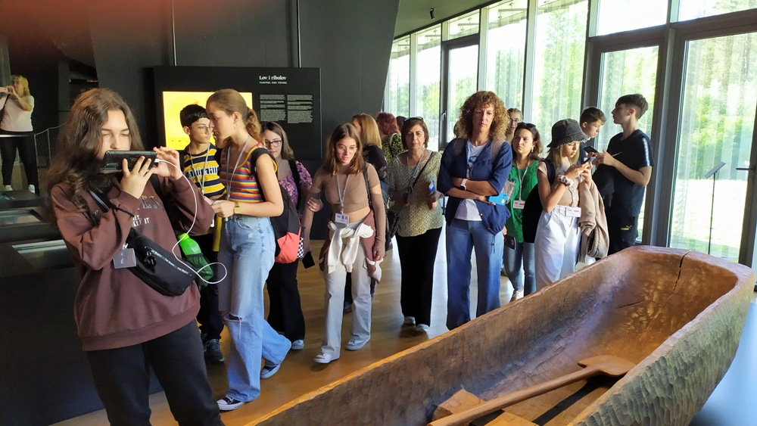
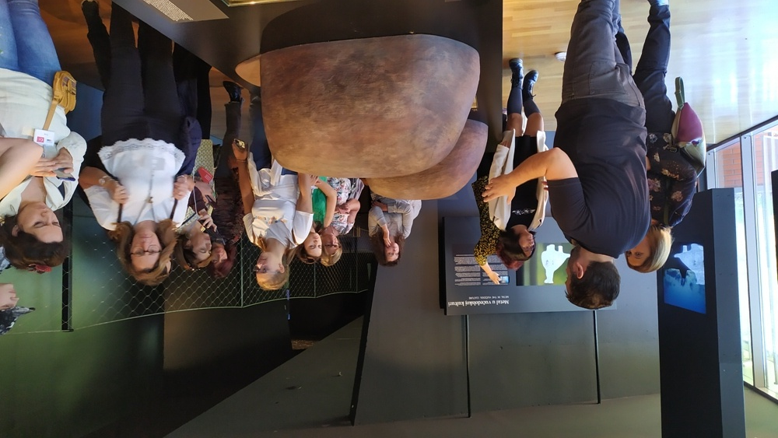
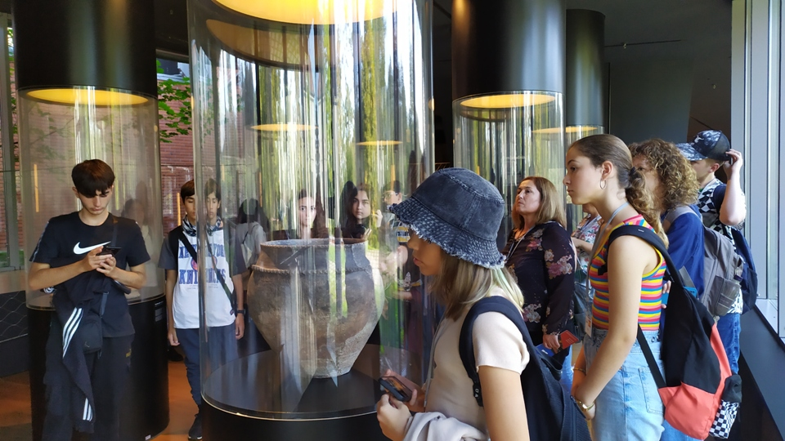
Museum of Vučedol culture

Slide 20
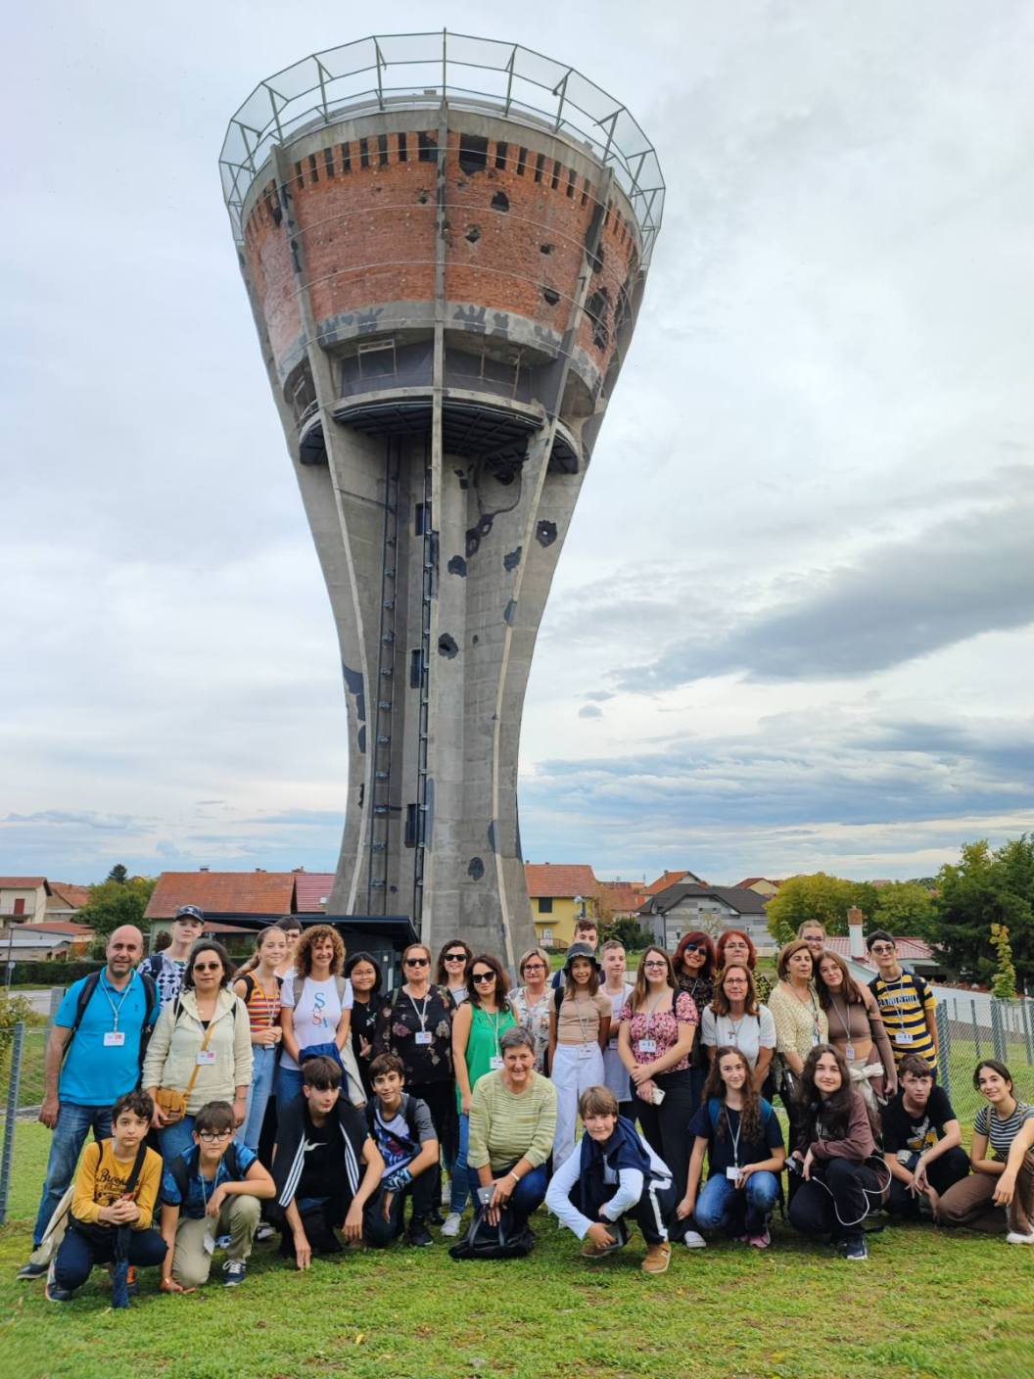
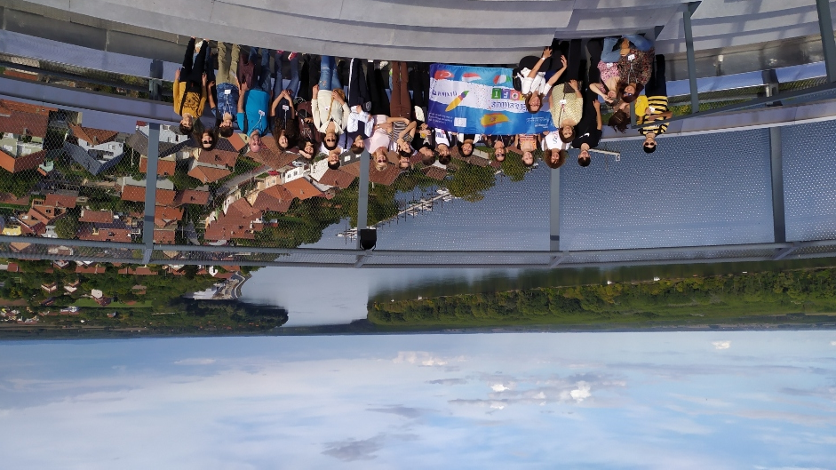
Vukovar Water tower

Slide 21
The next meeting will be in November in Italy. We will continue developing our skills and making friends.

