Slide 1
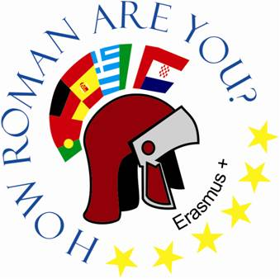
Osnovna škola Bartola Kašića Vinkovci Erasmus+ project 2020-2022 How Roman are you? 2020-1-DE03-KA229-077527_5
ANCIENT ROMAN SPORTS AND GAMES

Slide 2
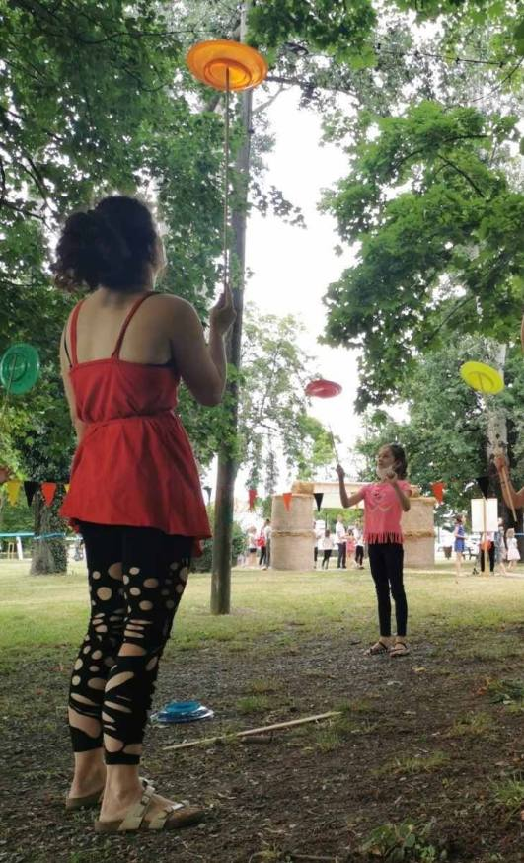
In ancient Rome people enjoyed lots of sports activities. They did them to keep fit and helathy. Lots of different sports and games were popular, but there were also activities organised to keep the people of Rome content and to prevent uprisings (rulers offered people panem et circenses).

Slide 3
Boys would start playing sports at a very young age. They would engage in ball games, wrestling, fishing and hunting, and horseback riding. Romans believed that in order to stay fit and strong, they had to play sports.
Swimming: Swimming was one of the favorite activities of Roman boys, and it was widely practiced in the Tiber River. There are also some accounts of women who knew how to swim in ancient times.
Horseback Riding: horseback riding was a preferred activity of lots of Roman boys from a young age.
Wrestling and Boxing: Wrestling and boxing were popular sports that were usually practiced in the palaestra (a central field) of Roman baths. Both activities helped to improve fitness and build strength and stamina, and they were popular among Romans. Because there were no such things as boxing gloves, athletes tightly wrapped their hands in layers of cloth.

Slide 4
Running: Running was another favorite activity in ancient Rome. Boys competed in footraces with one another.
Hunting and Fishing: Hunting was one of the oldest and most popular sports among the Roman elite, and boys often accompanied their fathers on hunting expeditions. In the country, fishing was among the favorite pastimes.
Ball Games: During their exercises, Romans also took part in a variety of sporting activities involving balls, including handball, soccer, field hockey, catch games, and perhaps even dodge ball. These usually took place in the palaestra or sphaerista (ball-courts). There are some accounts of females participating in ball games.

Slide 5
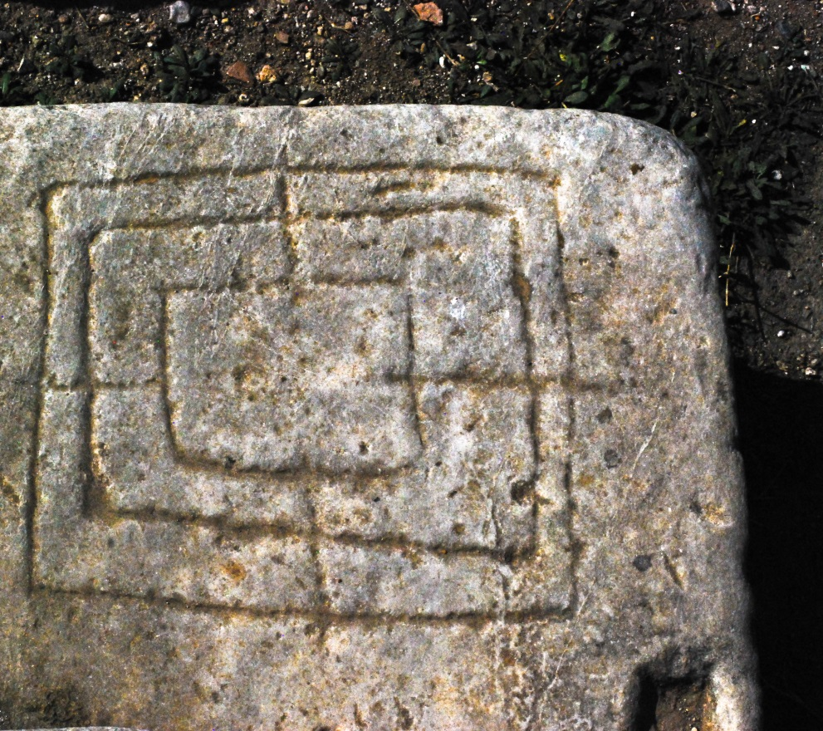
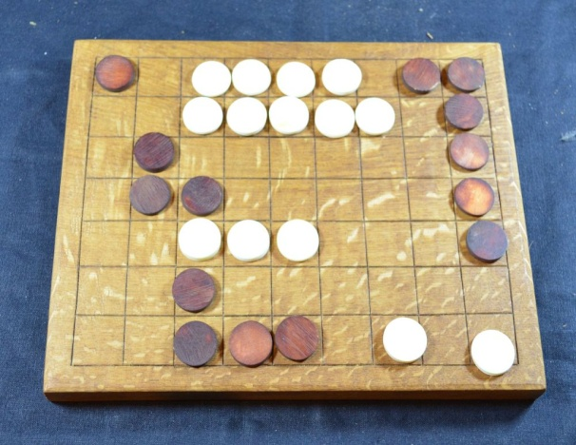
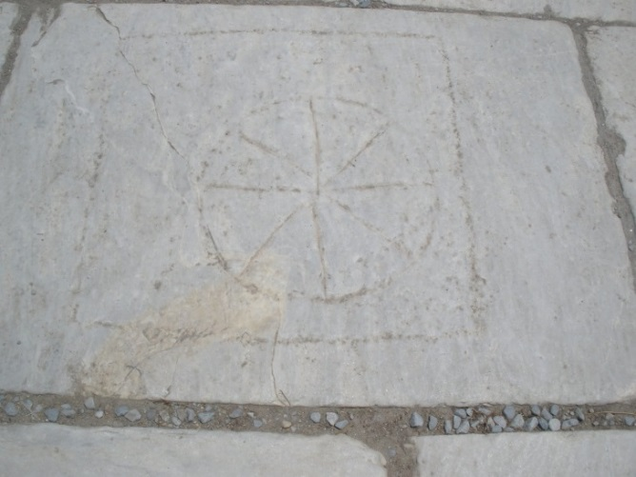
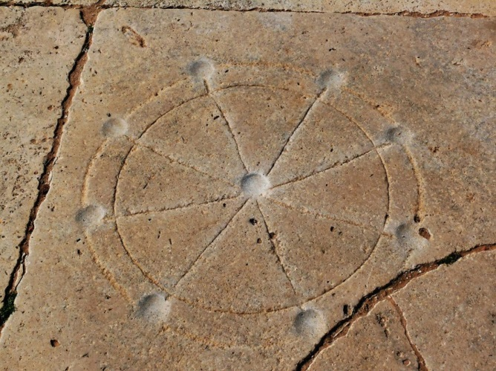
Board Games: Ancient Romans played a wide variety of board games:
merellus
Ludus latrunculorum
Terni lapilli (also known as Rota)

Slide 6
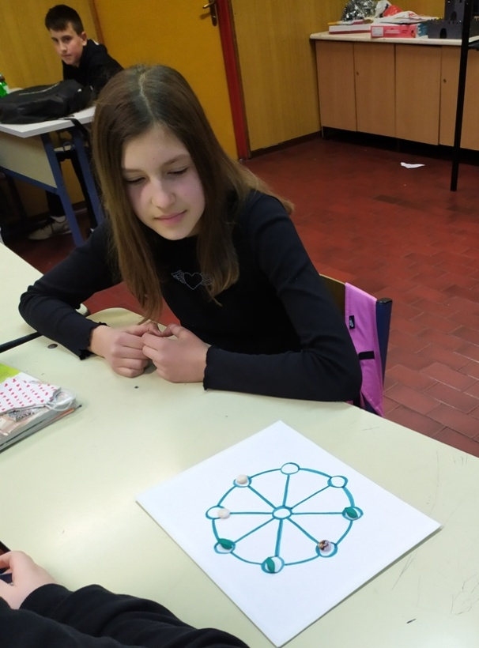
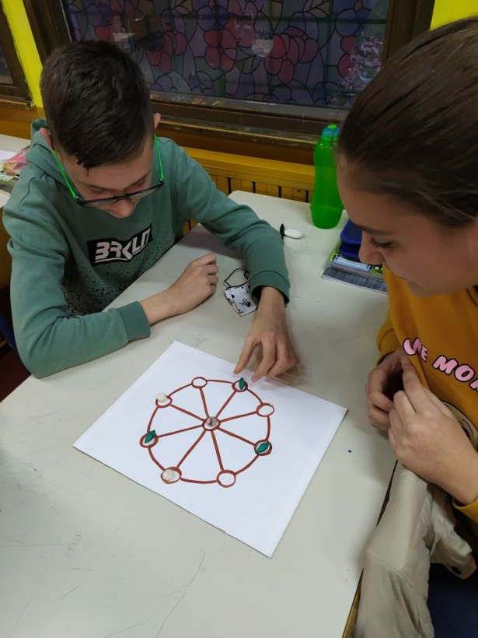
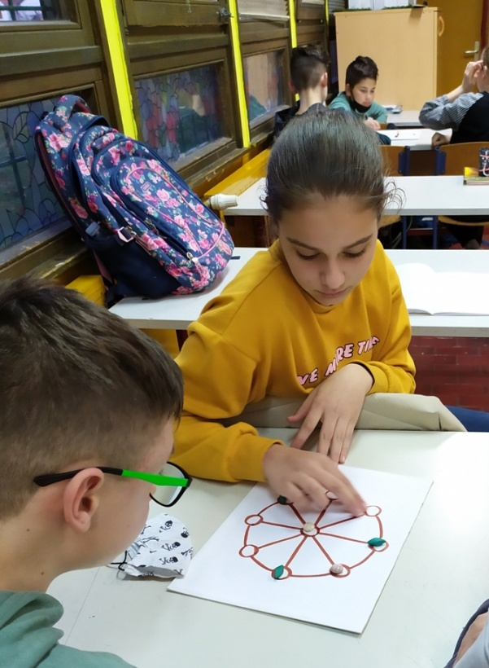
We played two interesting ancient board games:
The Rules for the Game of ROTA/TERNI LAPILLI:
- Each player gets THREE pieces.
-Each turn, players can put one piece on the board in any open spot.
-After all three pieces are on the board, a player must move one piece each turn.
-A piece may move along any line or curving edge of the circle to the next empty spot.
-A piece may not jump other pieces nor move more than one spot.
-The first person to get three in a row wins.

Slide 7
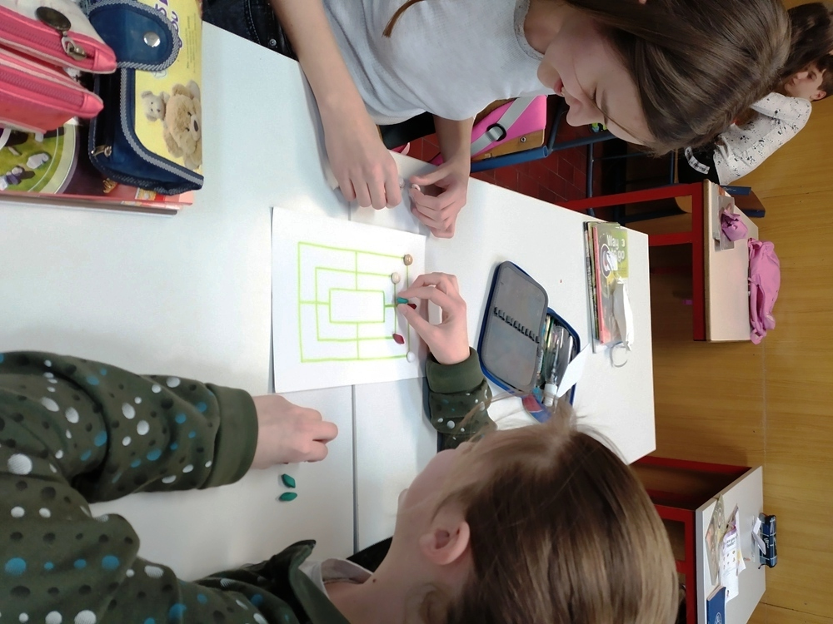
The mill game (Nine men’s morris, merellus) It is estimated that it was palyed as early as 1400 BC. It was popular in ancient Rome and it is still popular. This game and other games were found carved into stones on many Roman roads and buildings around the Roman Empire.

Slide 8
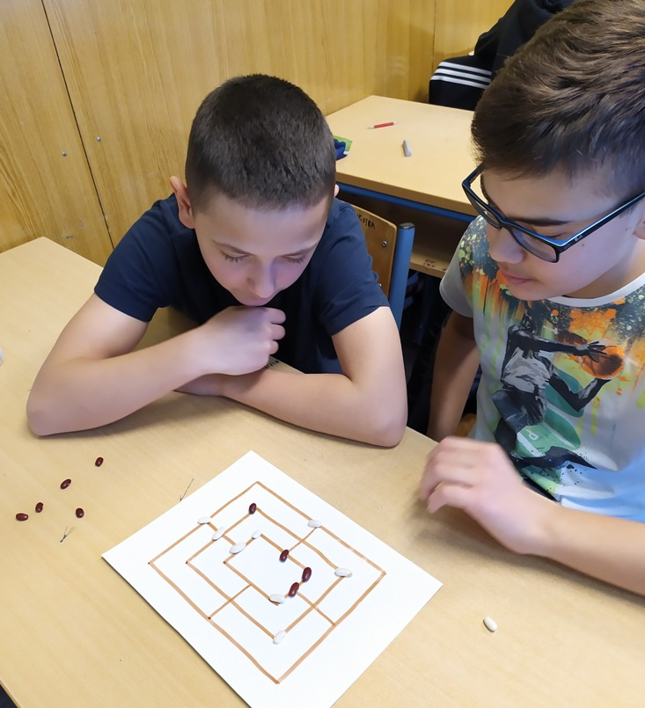
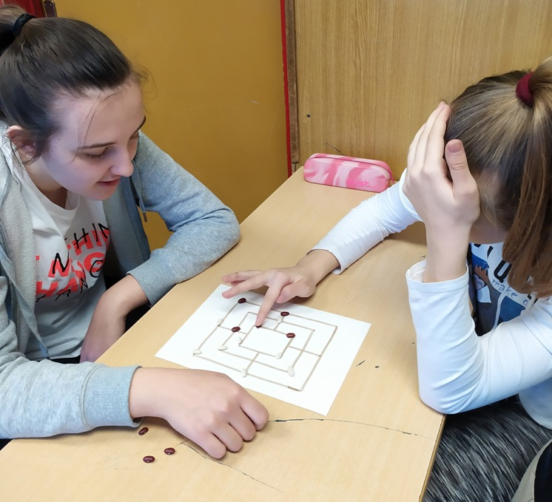
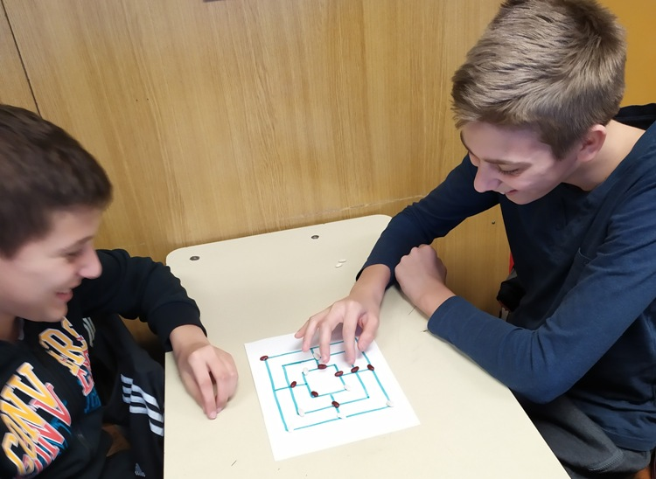

Slide 9
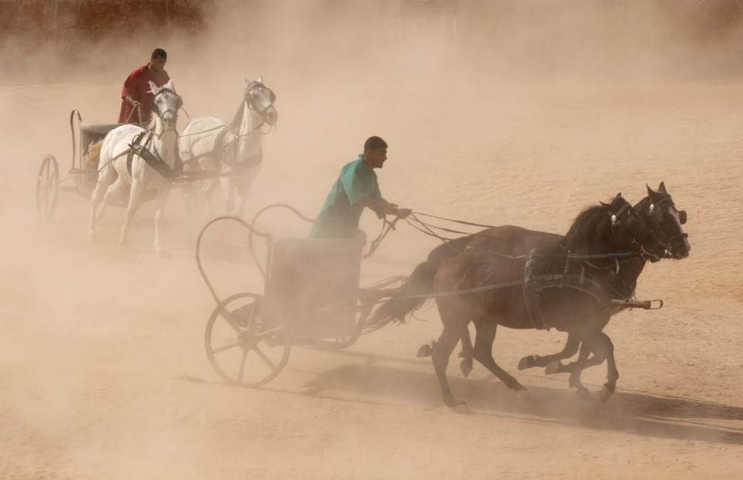
Chariot racing Chariot racing is one of the most popular among the ancient Roman sports. This sport was also played in Greece which was probably the inspiration for Roman chariot racing.
The Romans had a great interest in this game. It even resulted in conflicts between the fans of different teams and caused political clashes.

Slide 10
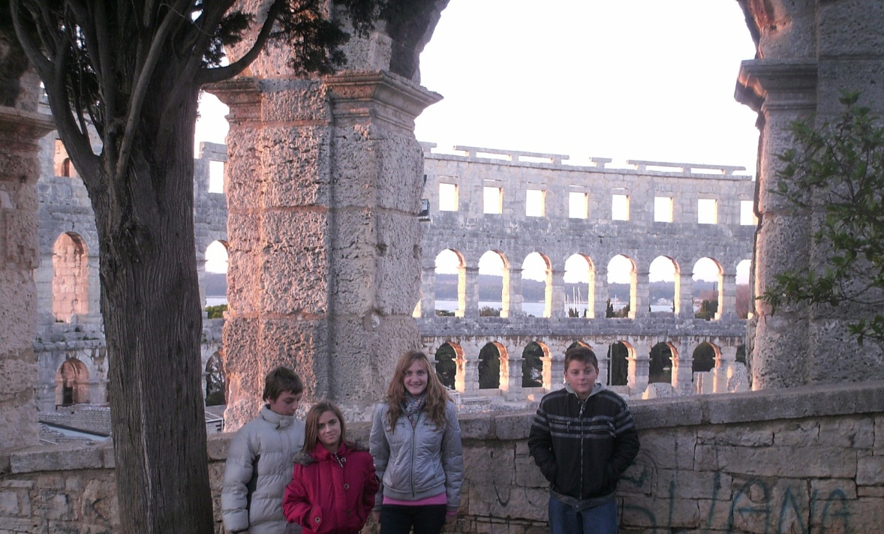
The remains of more than 200 Roman amphitheatres have been found thorughout the Roman Empire. The Colosseum is the largest of all.
Inside the arenas, people would gather to watch and play sports, but the arena would also be a place for animal games.
The biggest sport that happened in the arena was between the gladiators. Gladiators trained and learned to fight. Even the slaves trained and learned how to fight.
Remains of Roman amphitheatre in Pula, Croatia

Slide 11
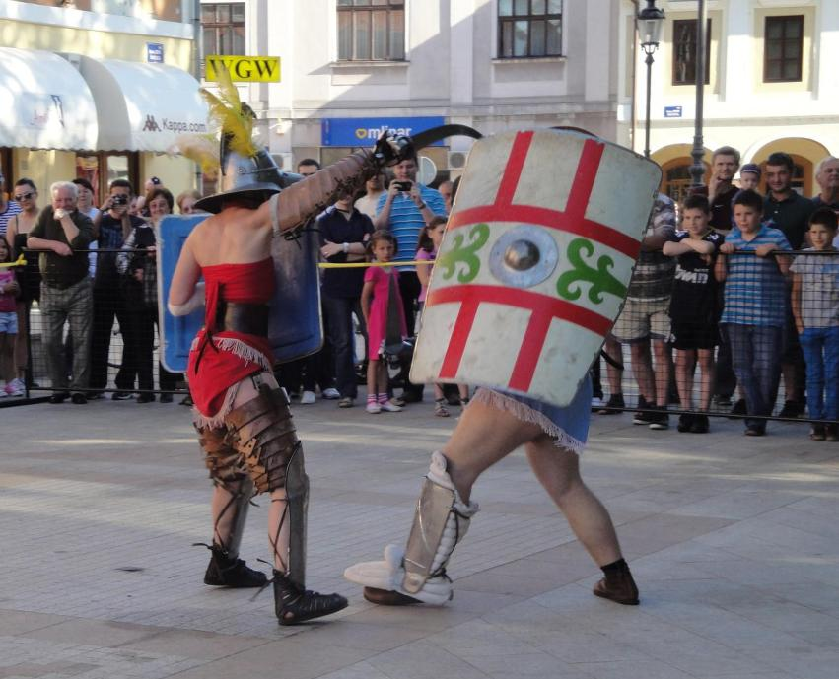
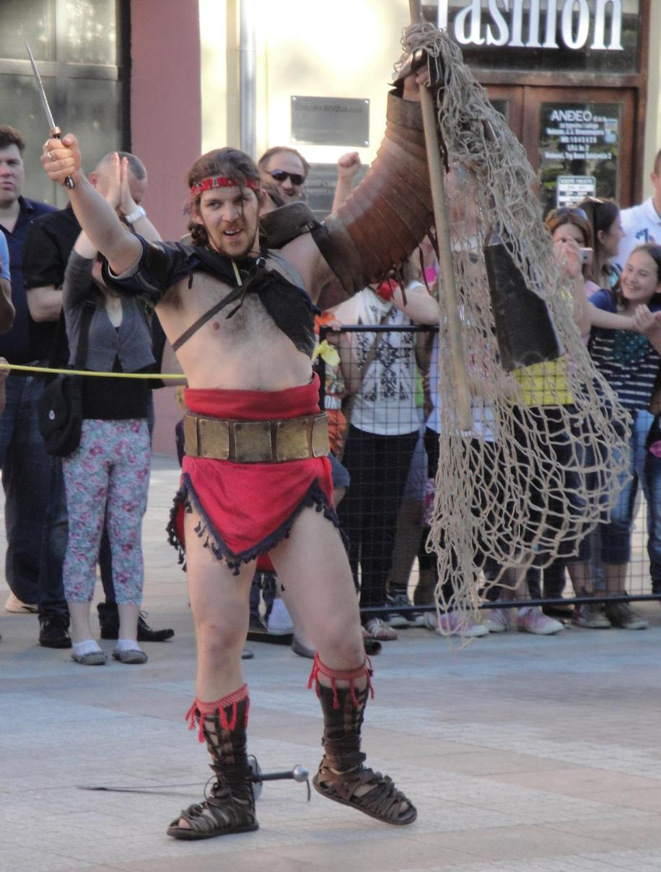
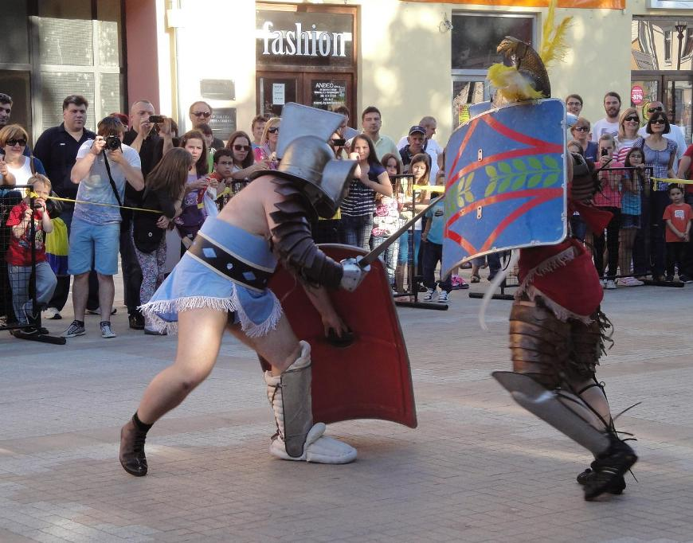
Gladiators used different weapons

Slide 12
Sources:
https://www.ancient.eu/article/98/athletics-leisure-and-entertainment-in-ancient-rom/
https://mentalitch.com/learn-about-these-ancient-roman-sports/
http://factsanddetails.com/world/cat56/sub399/entry-6336.html
https://museumbrochurep6.weebly.com/roman-sports.html
https://coriniummuseum.org/event/roman-games-2/
https://exarc.net/events/my-roman-board-games
https://www.romanbaths.co.uk/roman-games
https://www.praetorian.com/challenges/rota/
https://www.ancientgames.org/nine-mens-morris/
https://www.historyforkids.net/ancient-rome/daily-life/roman-sports.html/
http://persweb.wabash.edu/facstaff/royaltyr/AncientCities/web/bradleyj/Project%201/Games.html
https://www.ancient.eu/article/98/athletics-leisure-and-entertainment-in-ancient-rom/

