Slide 1
Osnovna škola Bartola Kašića Vinkovci Erasmus+ project 2020-2022 How Roman are you? 2020-01-DE03-KA229-077527_5
Aquae Iasae
July 2021

Slide 2
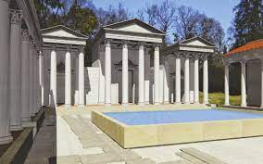
We visited Aquae Iasae, which was a Roman settlement and Roman bath in the area of present city Varaždinske Toplice. The thermal sulfur water that springs in the area of ​​today's archeological park is extremely healing, with a temperature of 58°C, and the findings indicate the use of the same source for more than 2000 years. Archeological park is one of the best preserved Roman remains in Croatia.

Slide 3
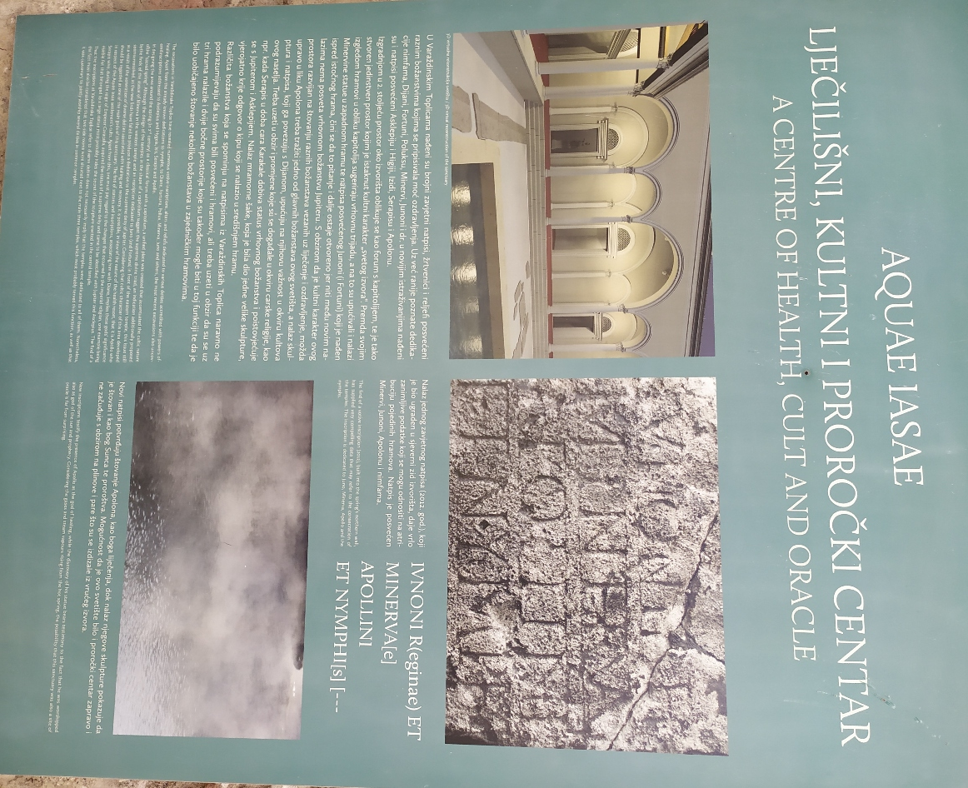
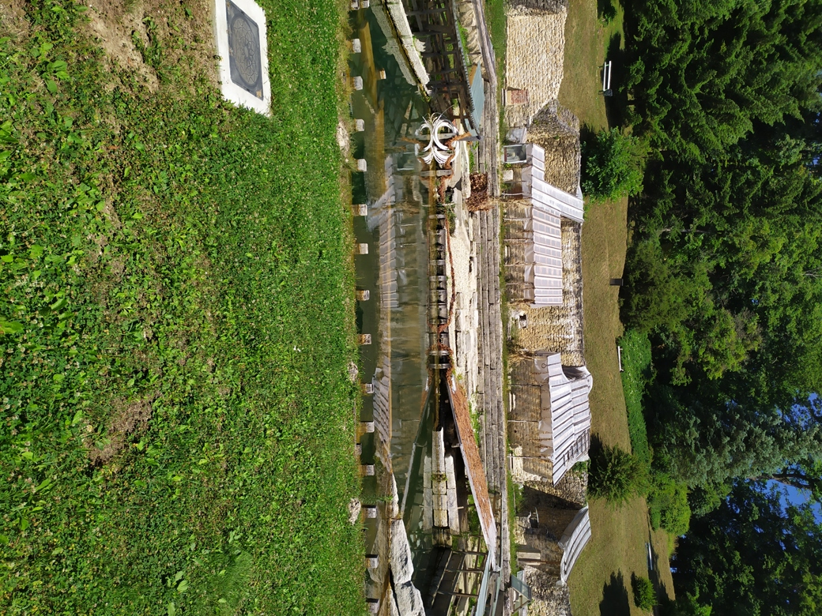
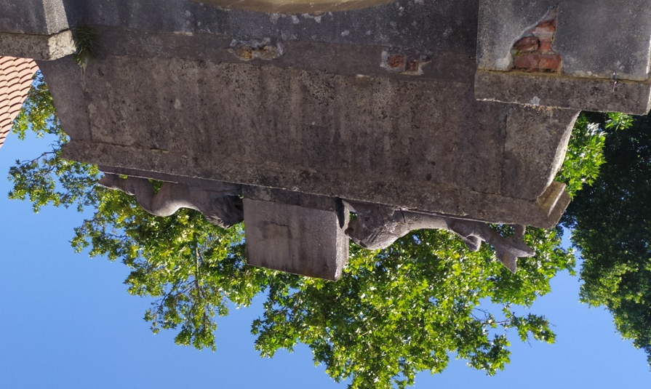

Slide 4
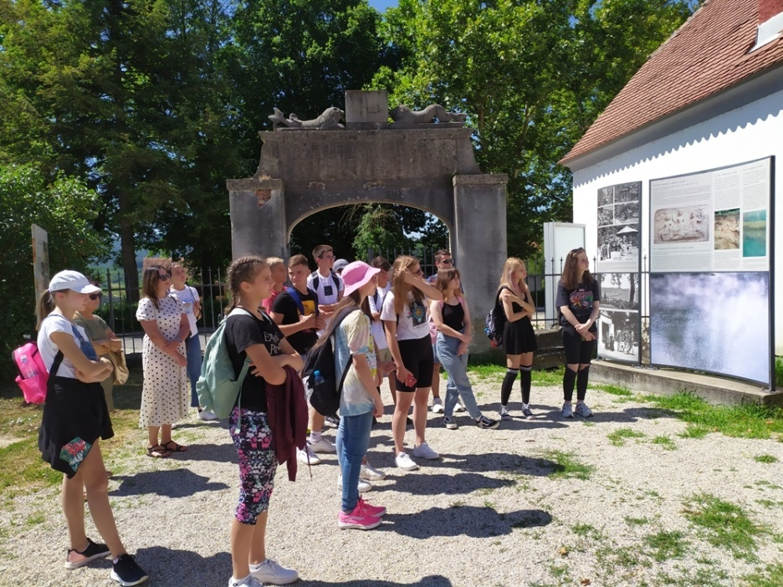
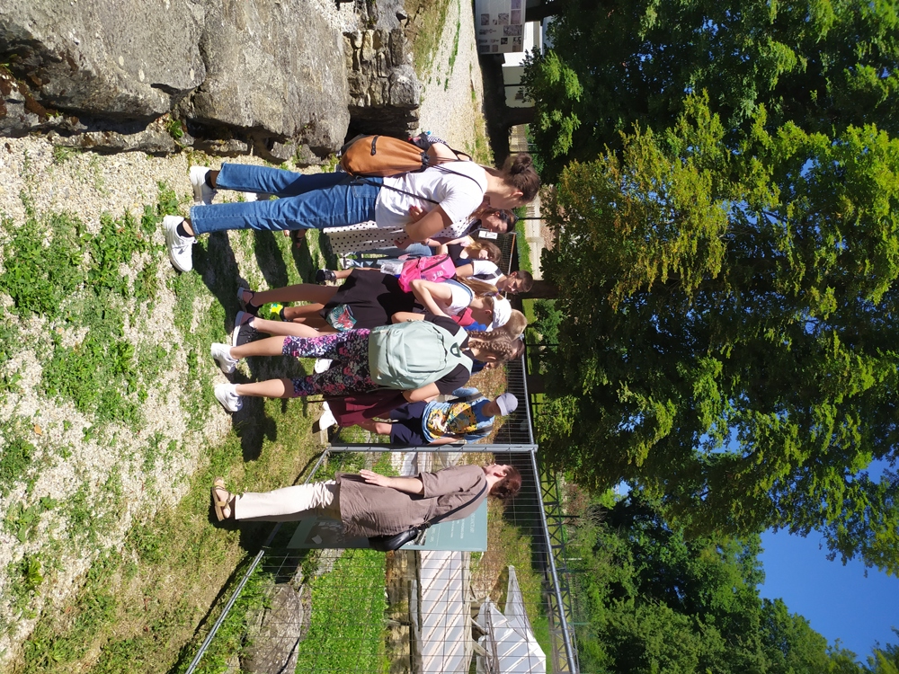
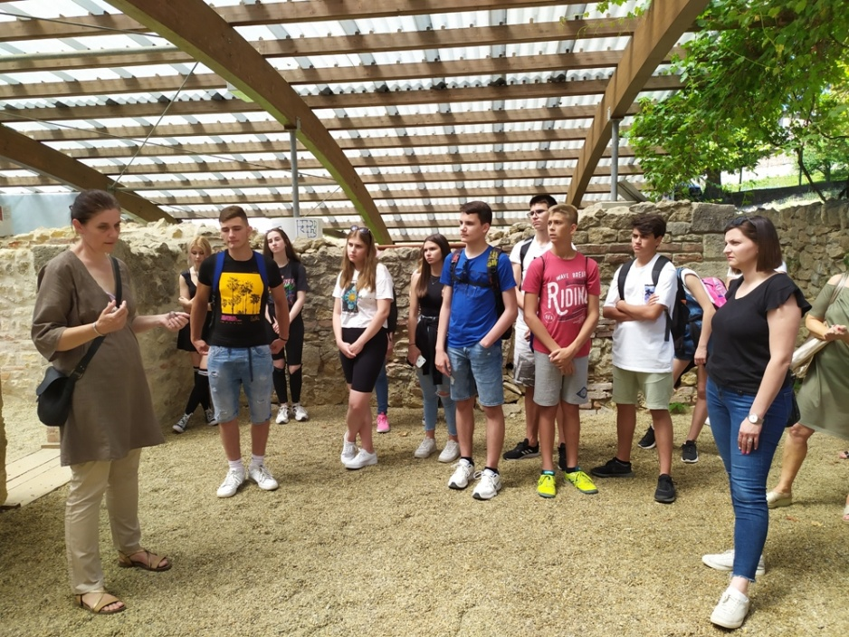

Slide 5
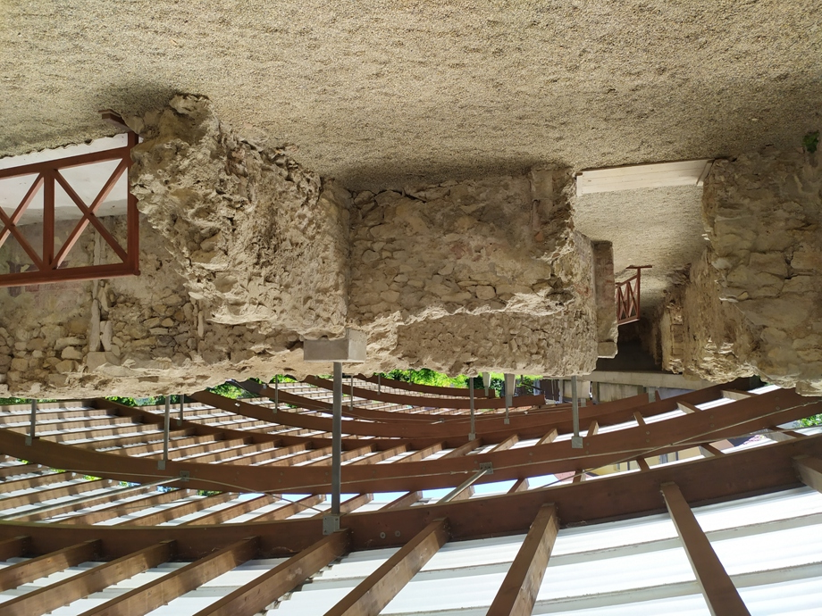

Slide 6
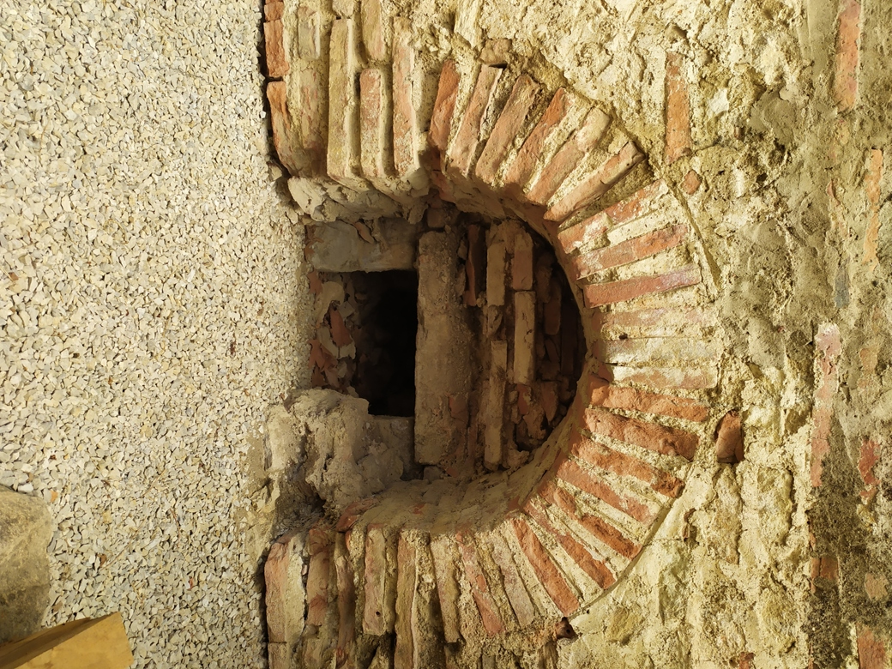
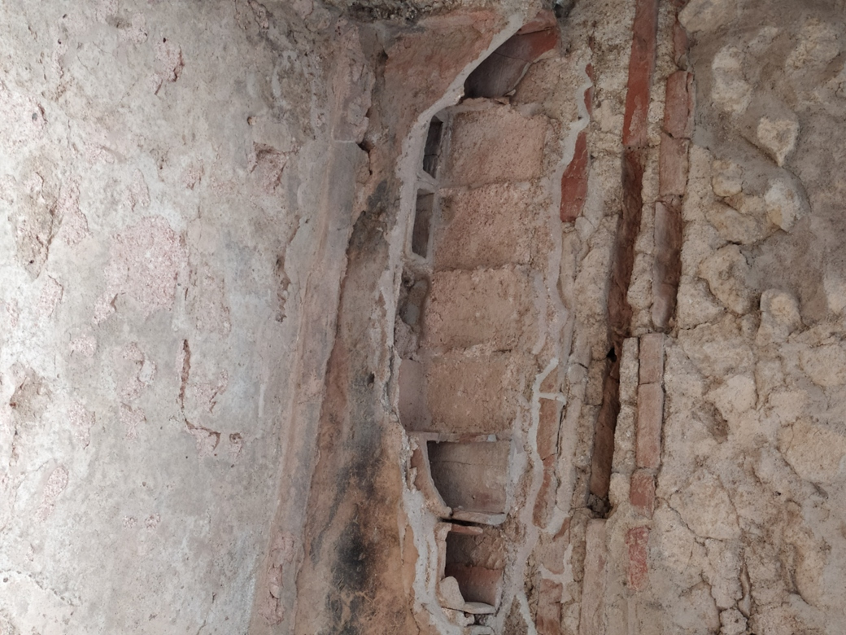
Fire was lit and hot air circulated through hollow bricks.

Slide 7
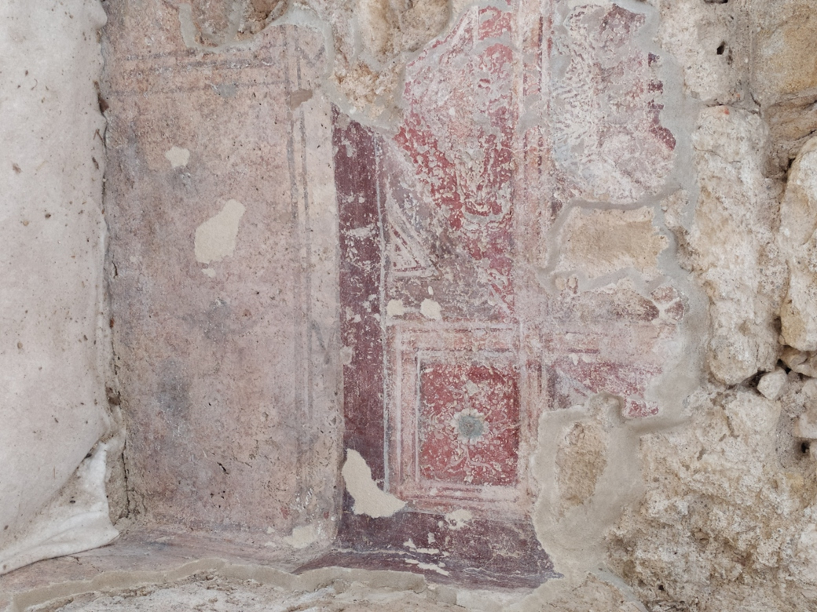
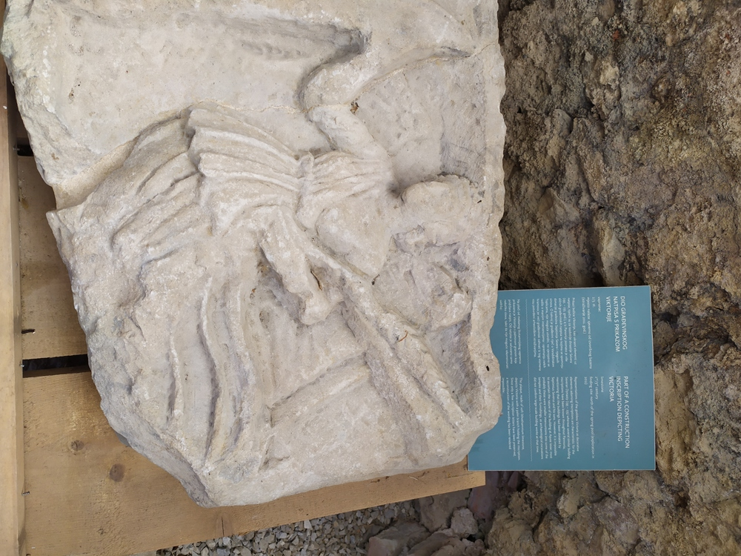

Slide 8
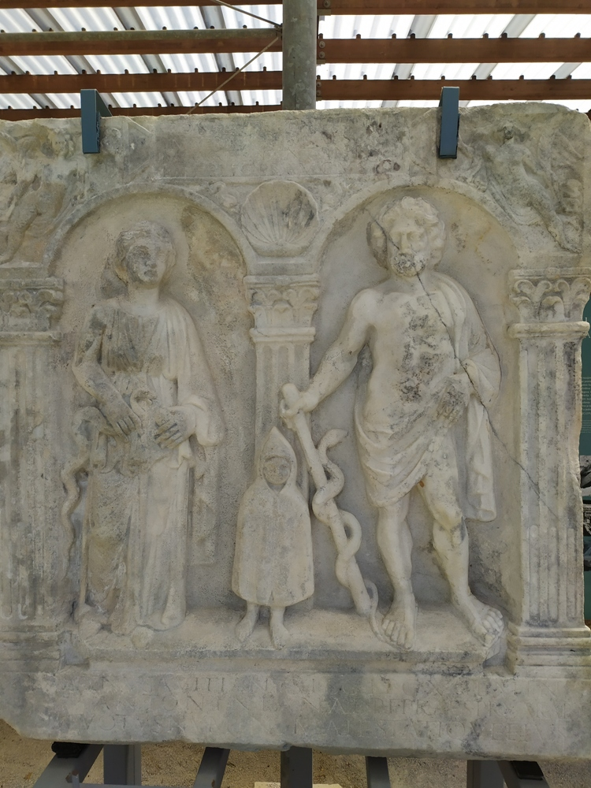
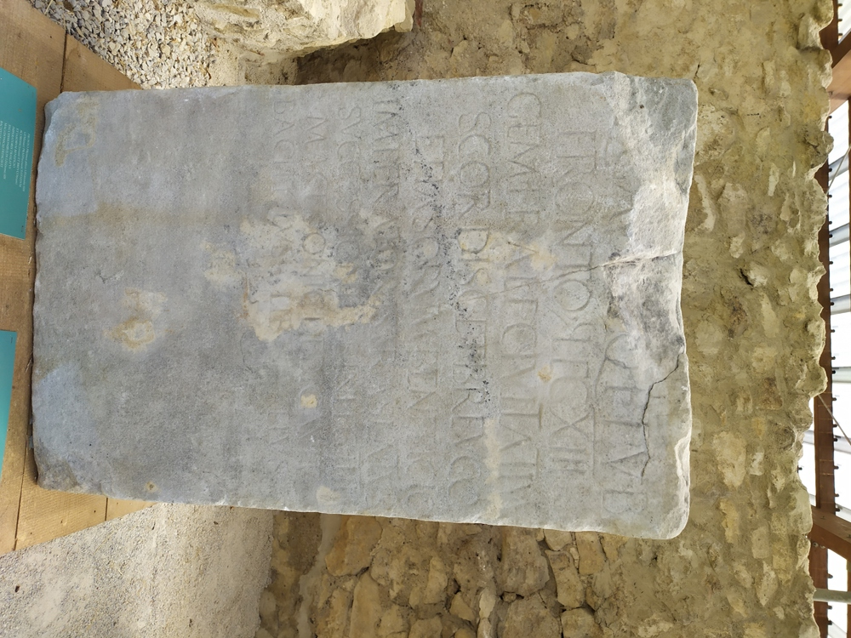

Slide 9
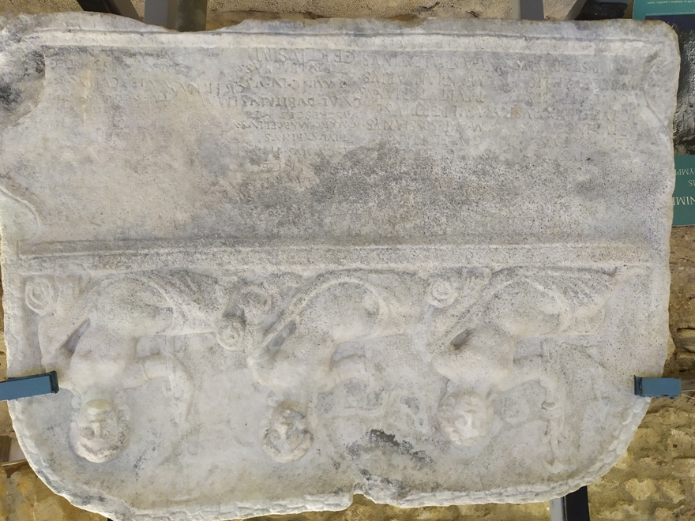

Slide 10
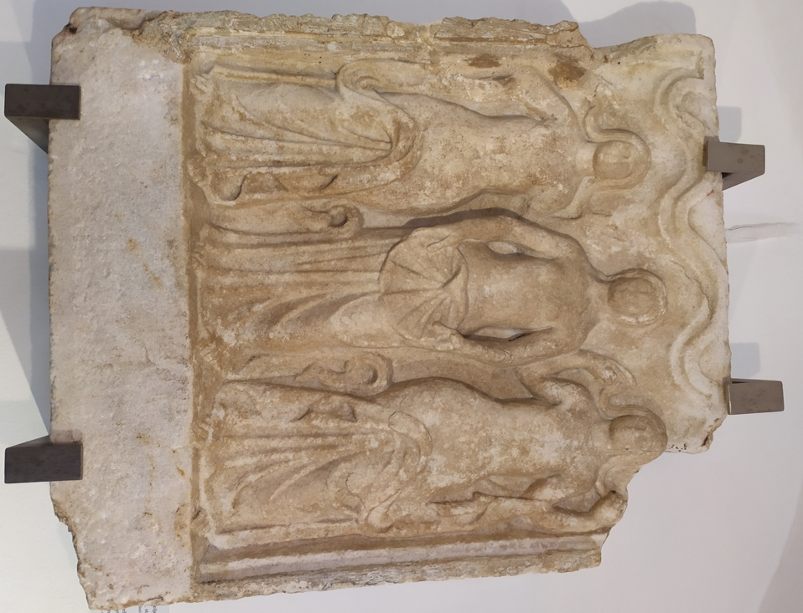
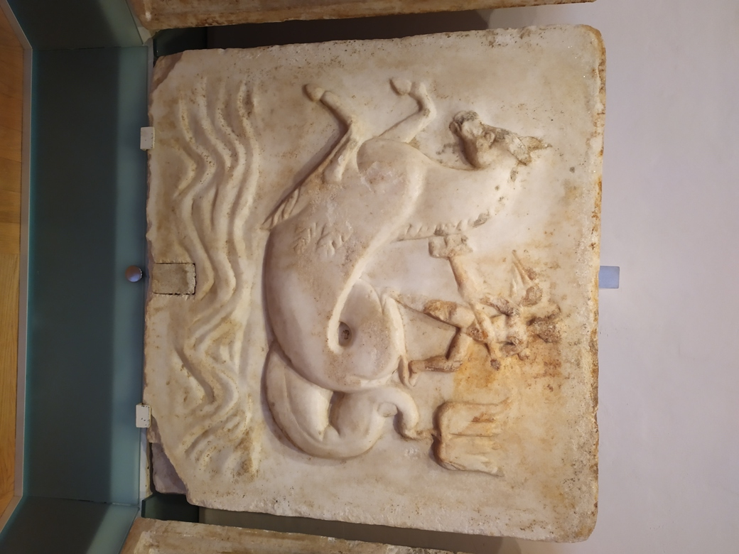

Slide 11
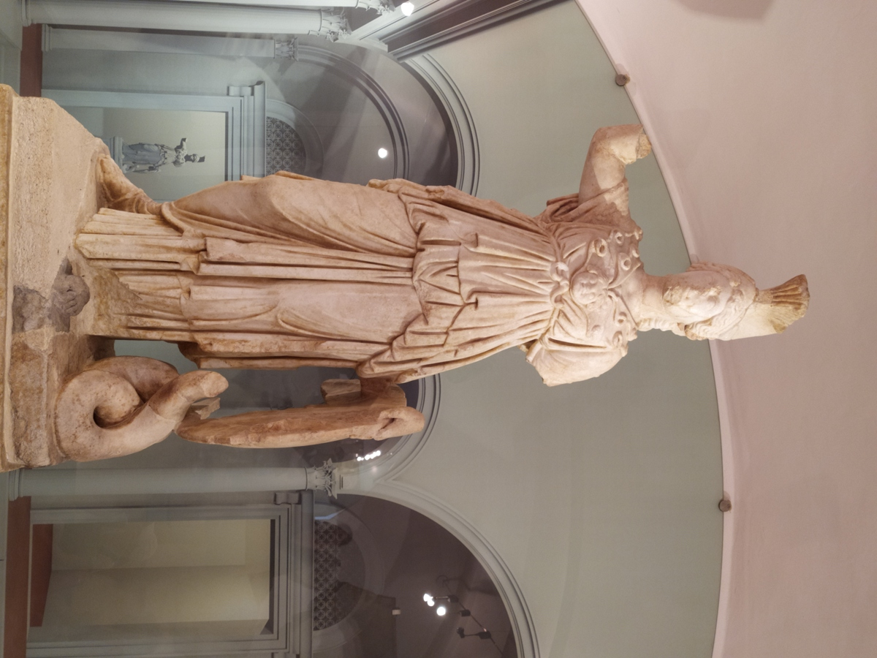
The most valuable finding is the statue of the goddess Minerva with a pedestal, found at the entrance to the temple. Minerva wears a legionary helmet, wields a copper spear and shield, and instead of hair has snakes

