Slide 1
Osnovna škola Bartola Kašića Vinkovci Erasmus+ project 2020-2022 How Roman are you? 2020-1-DE03-KA229-077527_5
ANCIENT ROMAN ARCHITECTURE

Slide 2
As the Roman Empire expanded to the Mediterranean region and also large areas of Europe, Roman architects wanted to achieve two aims: - to demonstrate the greatness and power of Rome, - to improve the life of Roman citizens To achieve this, they mastered a number of important architectural techniques, including the arch, the dome, the vault and the use of concrete. Roman engineers designed and built some of the greatest public buildings: temples, basilicas, amphitheatres, triumphal arches, monuments, and public baths. Roman architects designed aqueducts, drainage systems, and bridges, a network of roads. Planners developed a series of urban blueprints, based on army camps, to help create new towns .

Slide 3
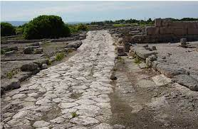
The development of concrete was very important. Concrete is lighter than other building materials. It can take on many different shapes and doesn’t require as much support as stone does. The Romans perfected brick-making, they used fired clay bricks, which repalced earlier sun-dried mud-brick. Romans used different knids of stone.
Roman architecture used the arch: an arch transfers all of its weight to its supporting columns, so there doesn’t need to be any wall between the columns. Roads began to be built in 500 BC to make transportation and expansion much easier.

Slide 4
Roman architects deisgned and built lots of great buildings: Basilicas: used as administrative centers
Aqueducts: used to carry water for many miles to overcrowded cities. The first was built in the 4th century BCE
Amphitheaters: were created to provide entertainment. The most famous is the Colloseum in Rome
Temples: created to worship and honor the gods.
Triumphal arches and columns: which were used to tell the stories of great battles.
Bathhouses: served as meeting places as well as a place to get clean in warm water.

Slide 5
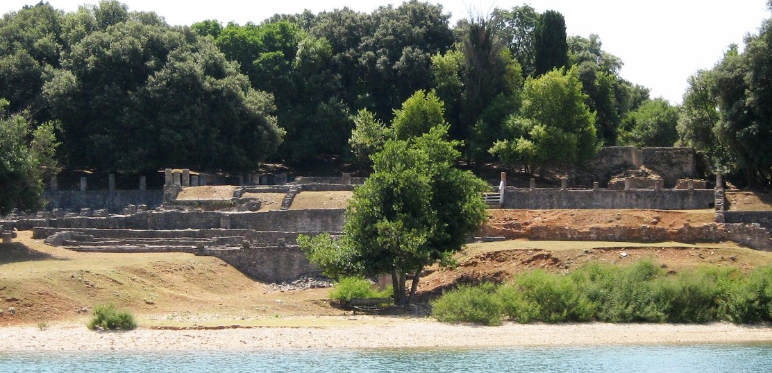
The Verige Roman Villa – remains of a villa rustica located in the bay of Verige off the coast of Istria, within Brijuni National Park, Croatia. The construction of the villa began in the 1st century BC. Some parts of the villa were used until the 6th century.

Slide 6
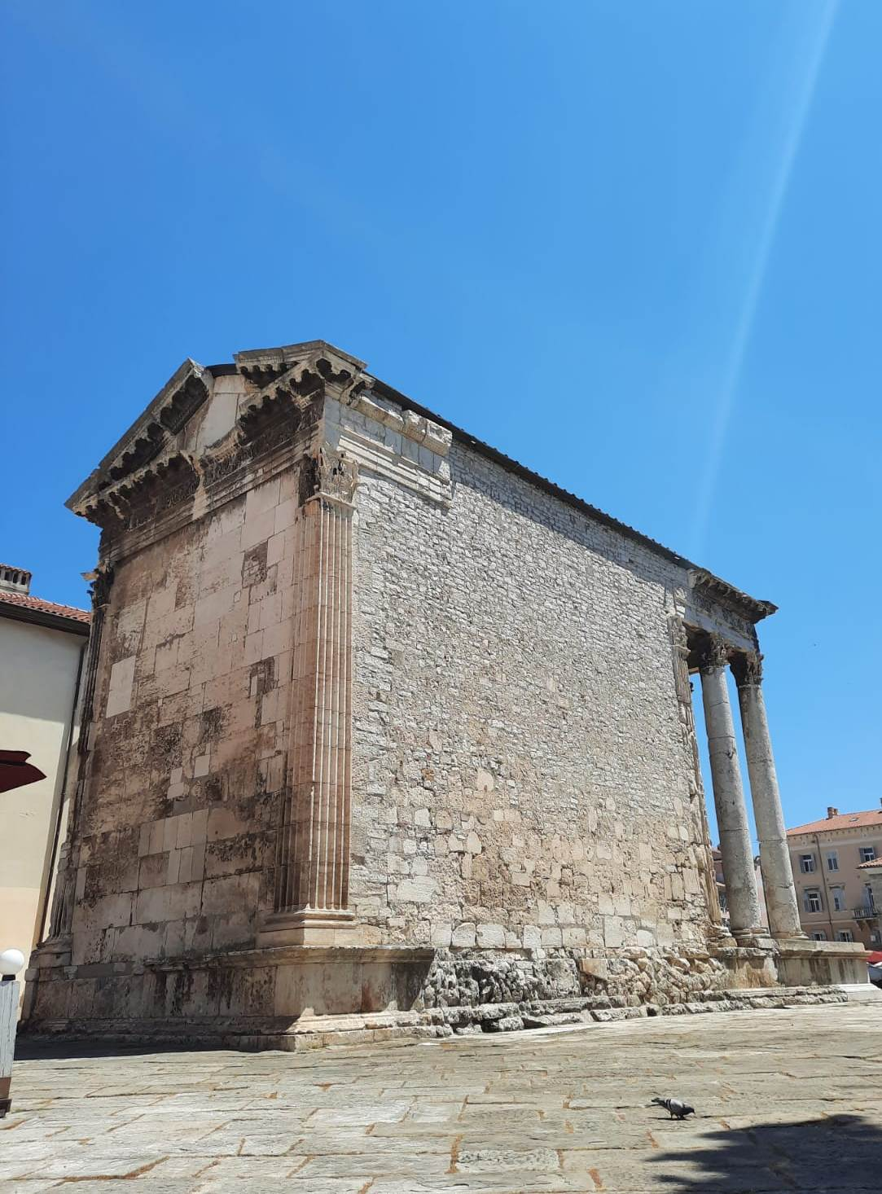
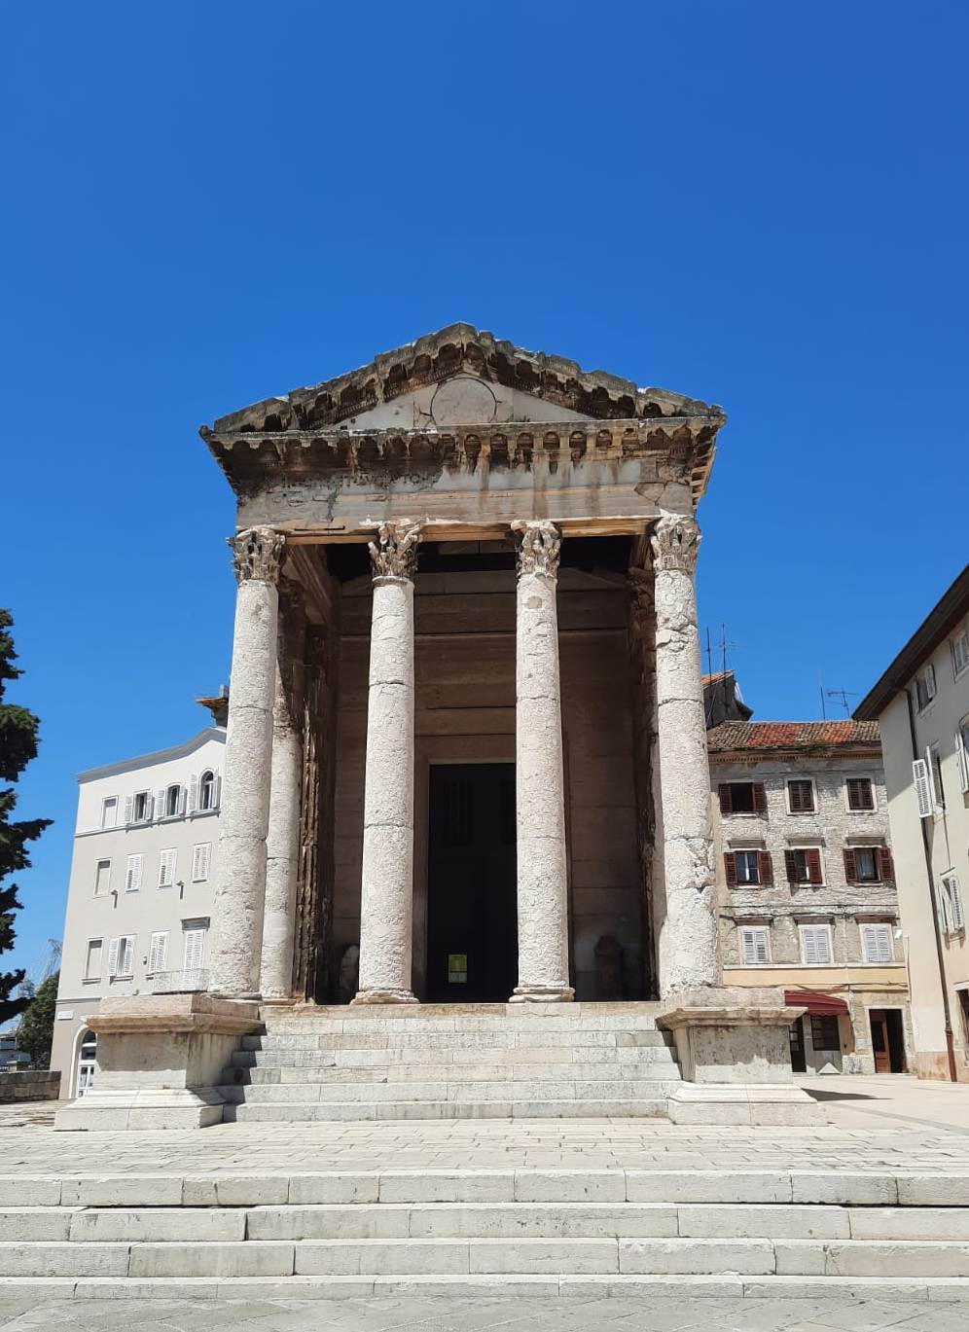
Temple of Augustus in Pula, Roman temple dedicated to emperor Augustus, probably built between 2 BC and 14 AD.

Slide 7
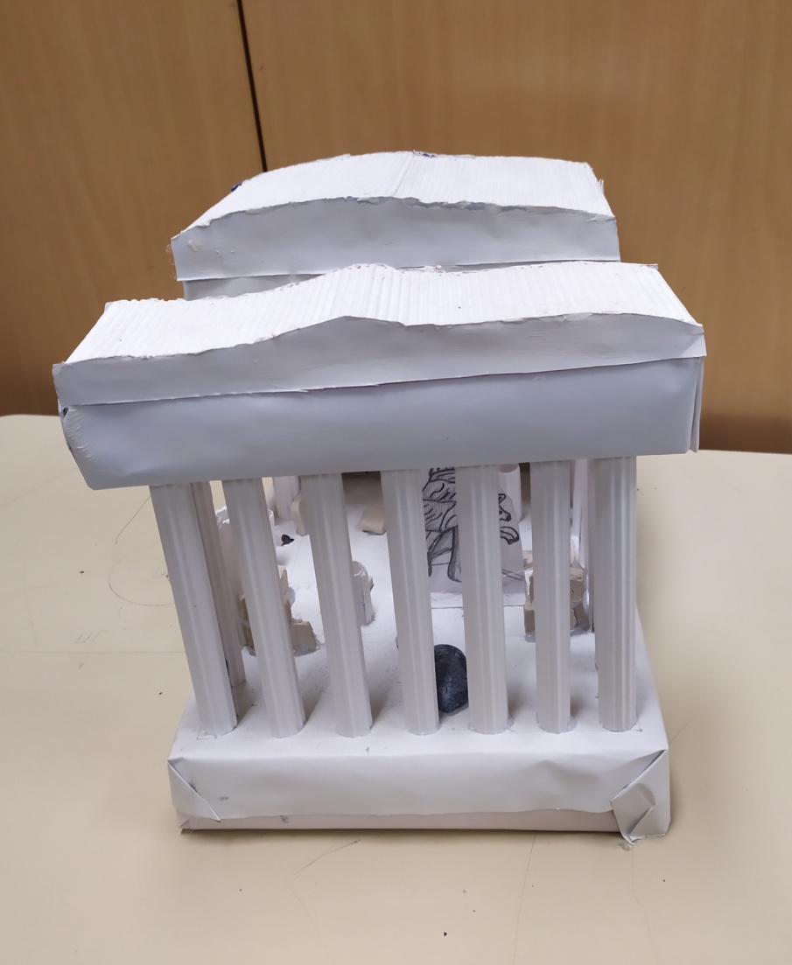
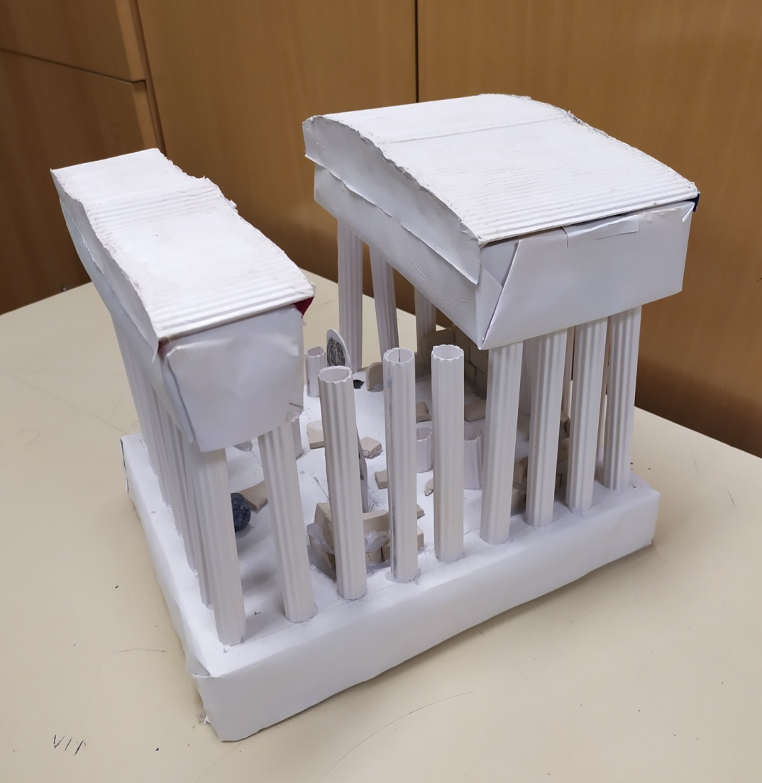

Slide 8
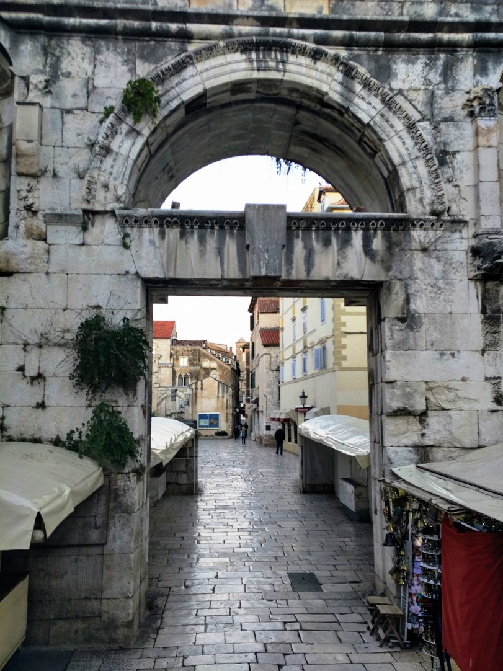
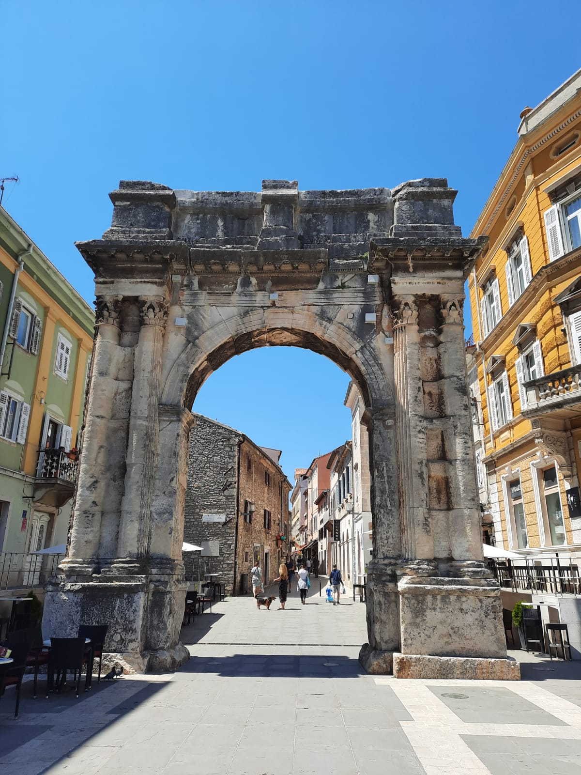
The Silver Gate /Porta argentea , or "the Eastern gate" is one of the four Roman gates into the Diocletian’s palace in Split.
Arch of the Sergii, Roman triumphal arch, called Golden gate, in Pula, constructed 29-27 BC.

Slide 9
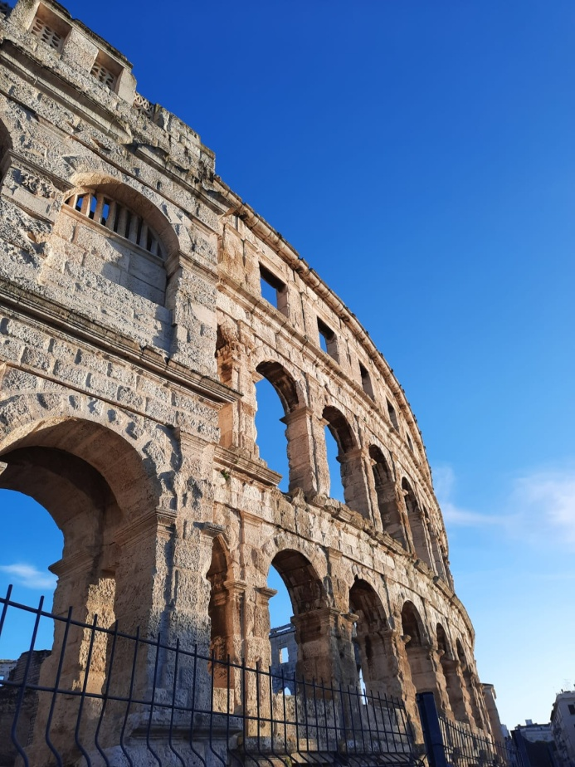
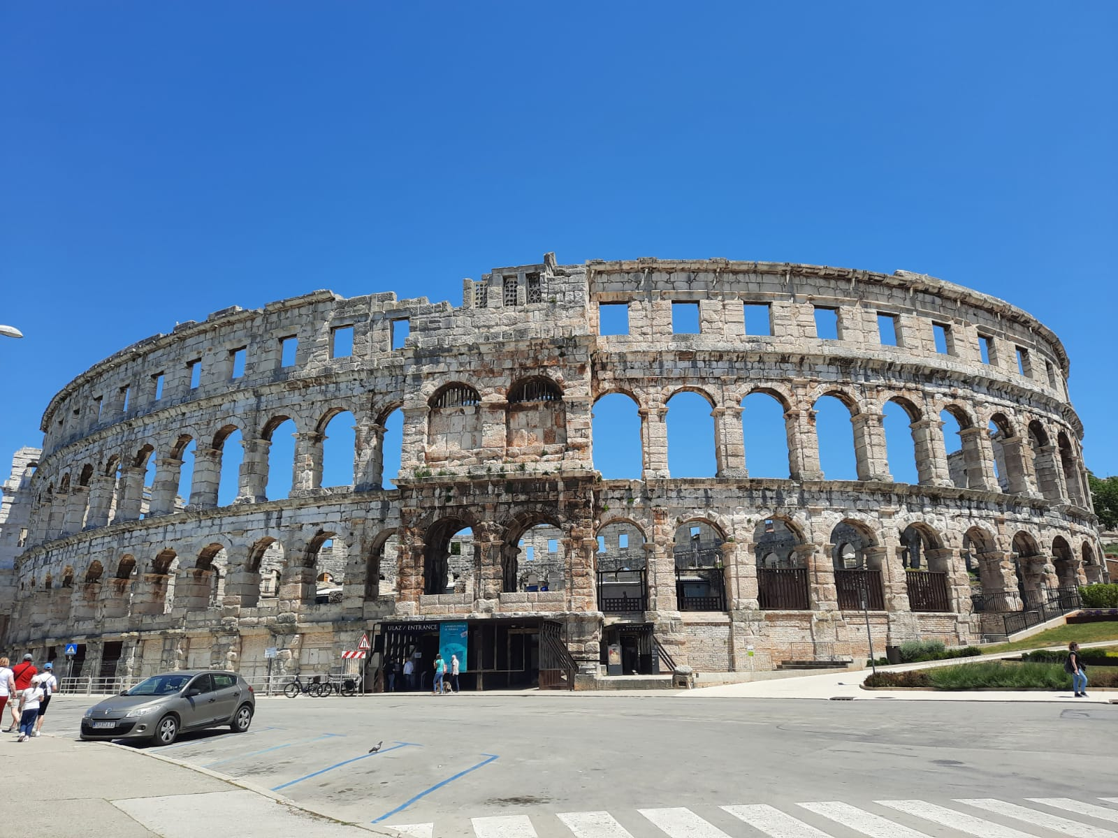
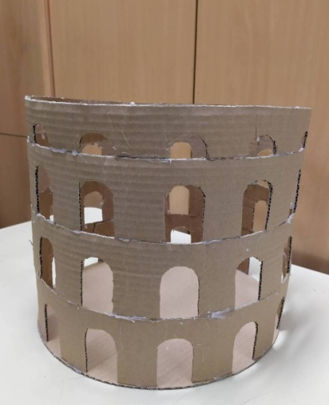
The Pula Arena is a Roman amphitheatre located in Pula. It is the only remaining Roman amphitheatre with four side towers entirely preserved. It was constructed between 27 BC and AD 68, and is among the world's six largest surviving Roman arenas.

Slide 10
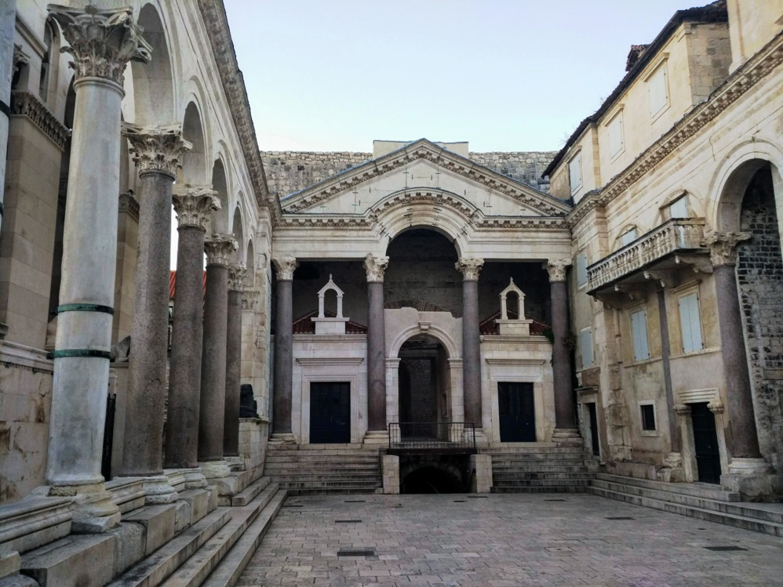
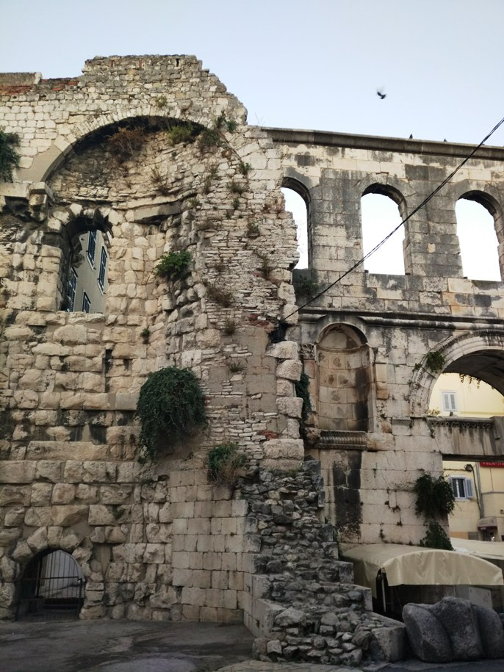
Diocletian's Palace in Split, an ancient palace built for the Roman emperor Diocletian. The construction began in 295 AD. It was used as the retirement residence of Diocletian.

Slide 11
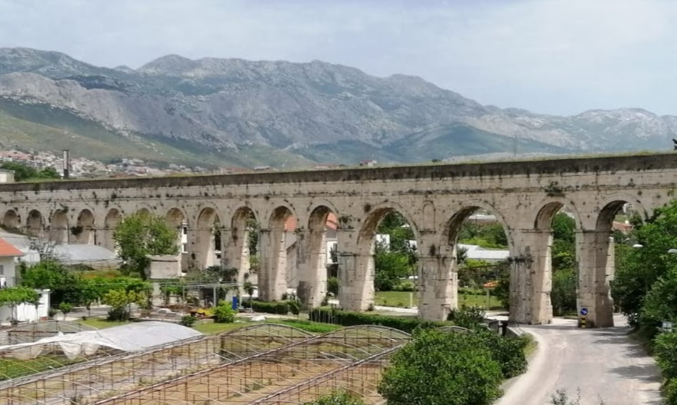
Roman aqueduct that is 1700 years old, built to bring water from the Jadro river to Diocletian’s Palace. It was constructed between the end of 3rd and beginning of the 4th century AD. It is 9 kilometres long.

Slide 12
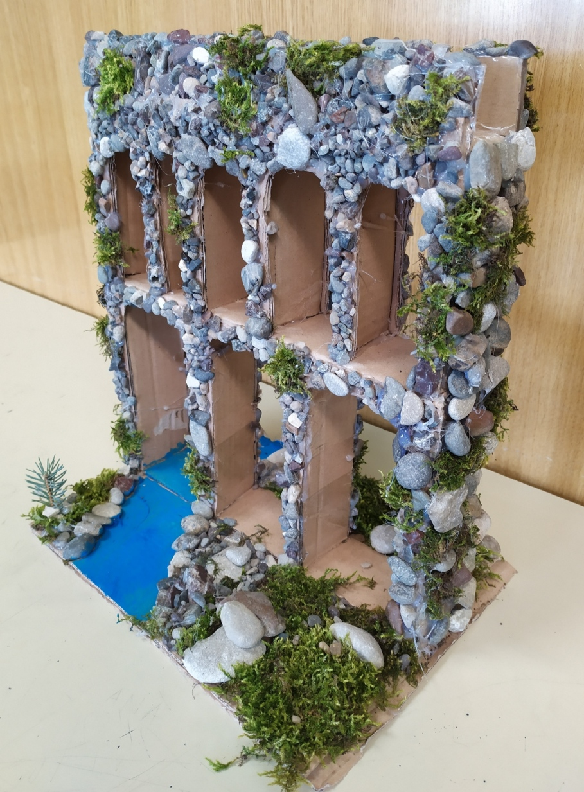
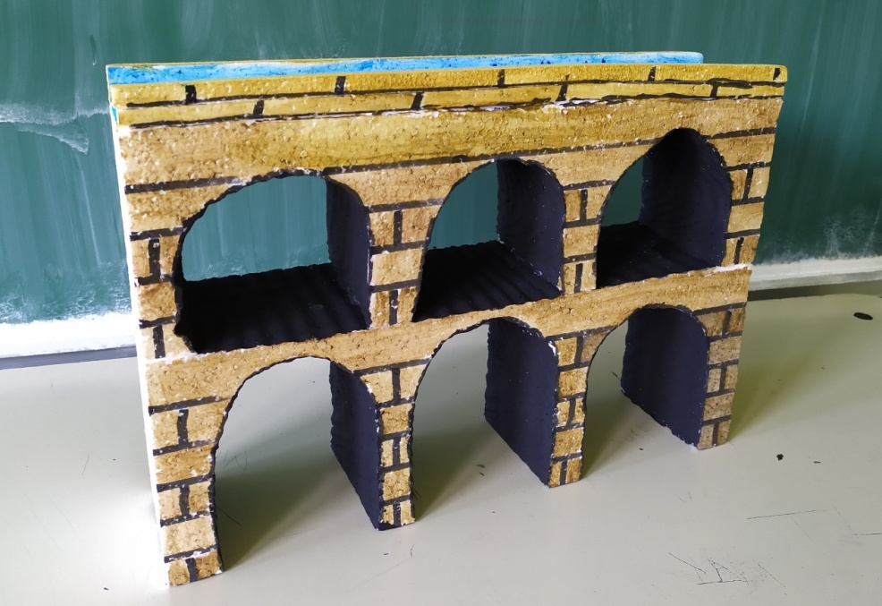
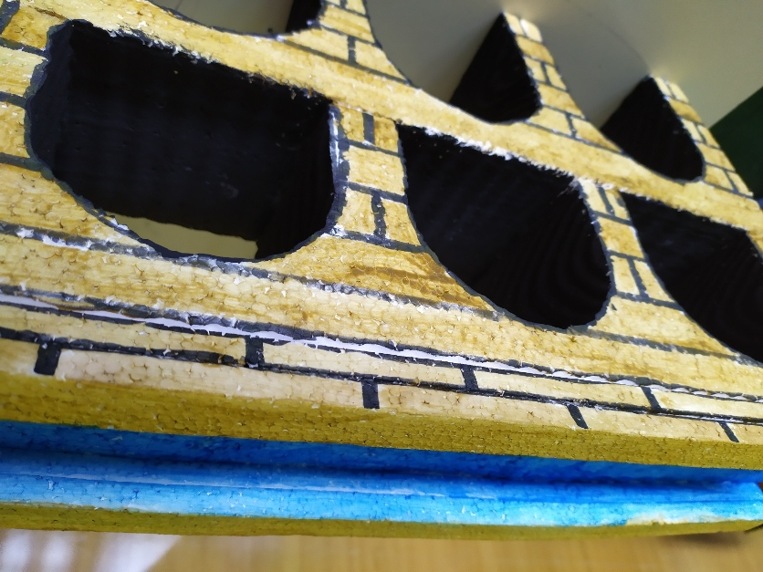

Slide 13
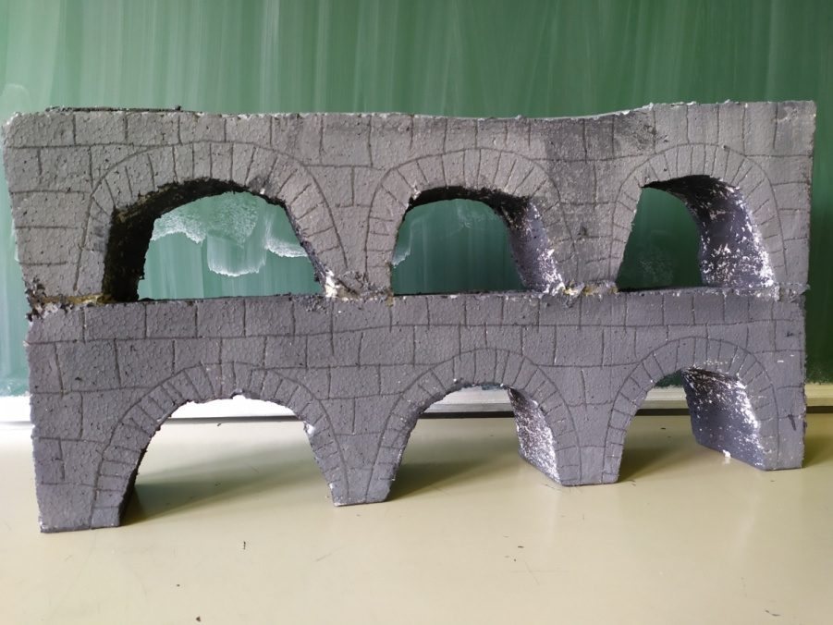
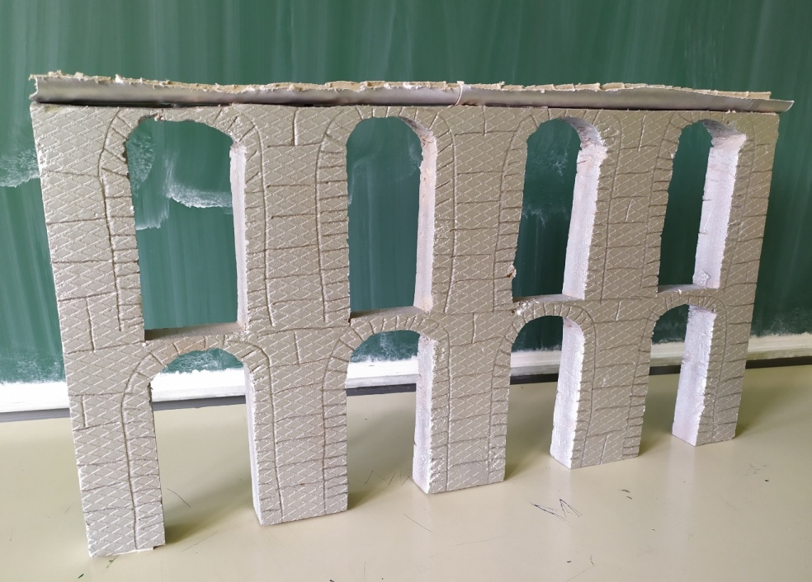
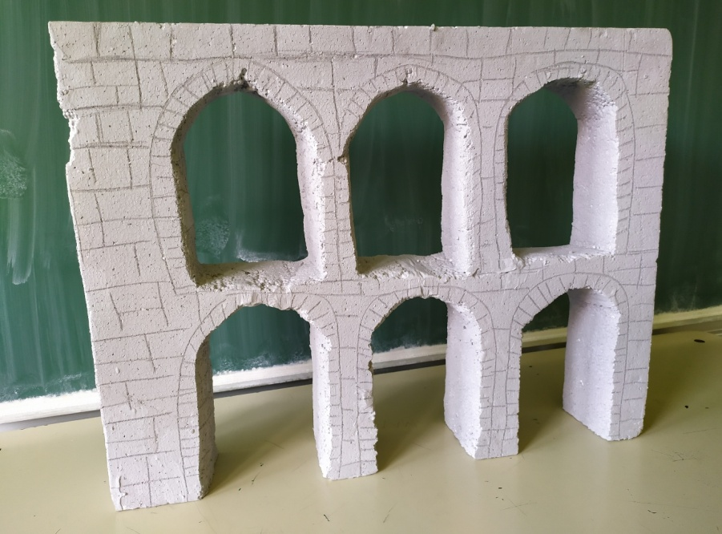

Slide 14
Sources:
http://www.visual-arts-cork.com/architecture/roman.htm#architecture
https://www.hisour.com/types-of-ancient-roman-architecture-27607/
https://www.re-thinkingthefuture.com/fresh-perspectives/a1191-elements-of-ancient-roman-architecture/
https://www.smithsonianmag.com/history/the-secrets-of-ancient-romes-buildings-234992/
https://ascholarlyskater.com/2017/12/19/guide-classical-roman-architecture/
https://www.historyforkids.net/roman-architecture.html
https://www.unrv.com/architecture.php
http://employees.oneonta.edu/farberas/arth/arth200/politics/roman_architecture.html
https://www.pinterest.com/amronimri/roman-architecture/

