Slide 1
Osnovna škola Bartola Kašića Erasmus+ project 2020-2023 “How Roman are you?” 2020-1-DE03-KA229-077527_5
ROMAN DAYS 2023
June 2023

Slide 2
The festival Roman Days was held from June 16 to June 18 2023. It is called Decenalija. Decennalia (or Decennia, from Latin decennium - "tenth anniversary"; decem, "ten" + annus, "year") were Ancient Roman festivals celebrated with games every ten years Roman emperors.

Slide 3
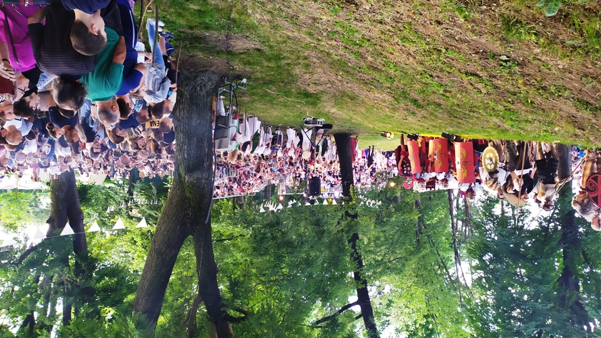
The event attracted thousands of visitors

Slide 4
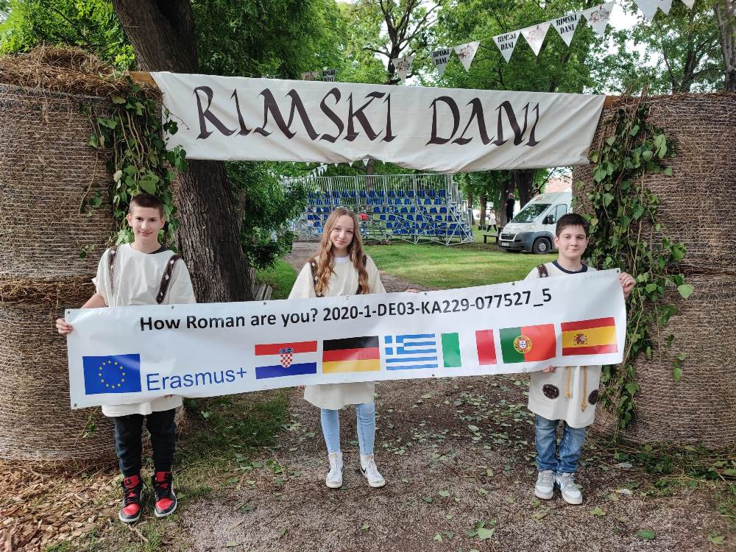
Osnovna škola Bartola Kašića actively participated. We had an exhibition and sales stand where we informed the visitors about the project and sold products made by our pupils. Both pupils and teachers took turns at the stand for three days.

Slide 5
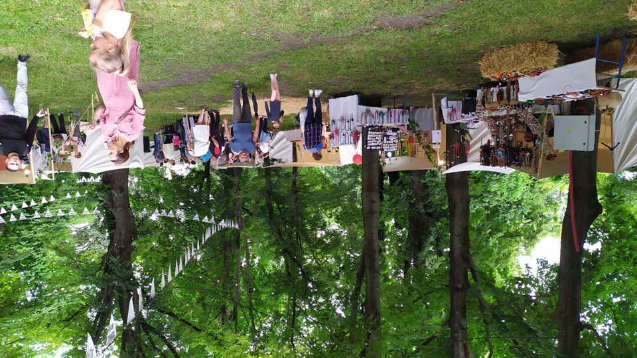
During the festival, Vinkovci changed its name and became Rimkovci.

Slide 6
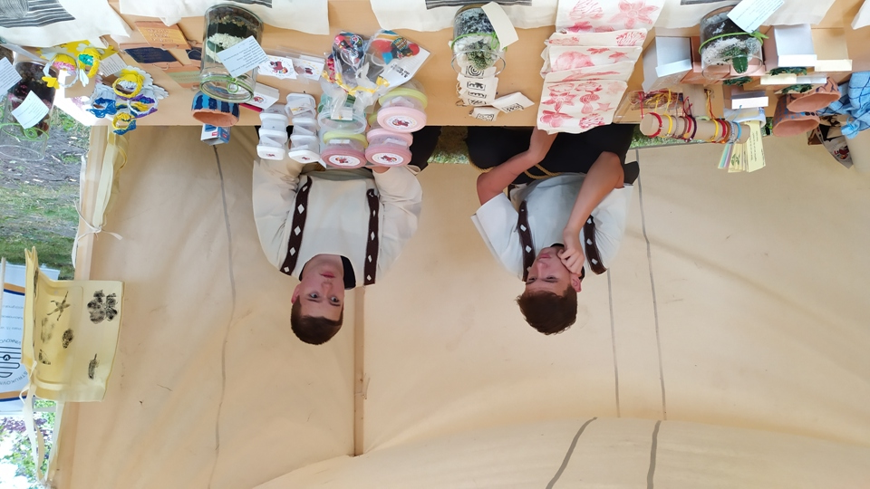
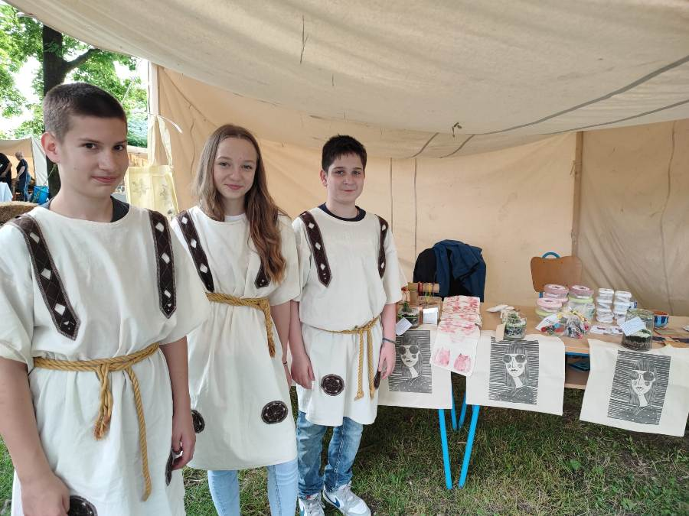
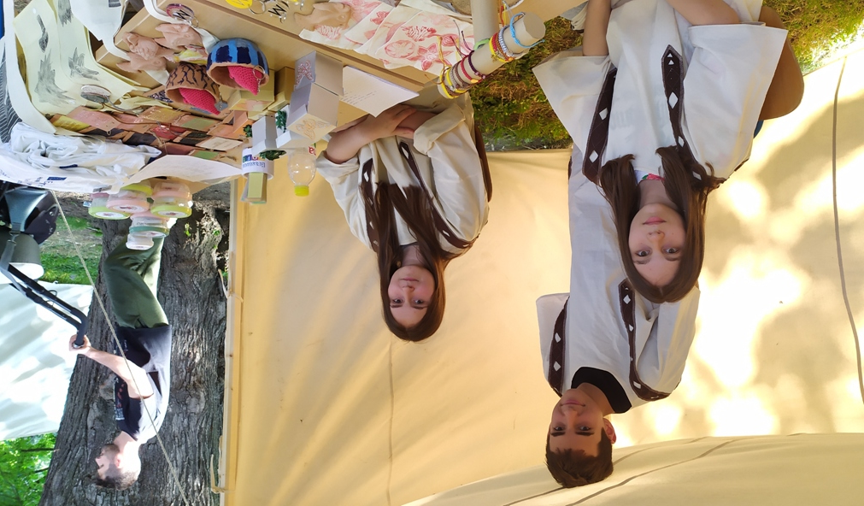
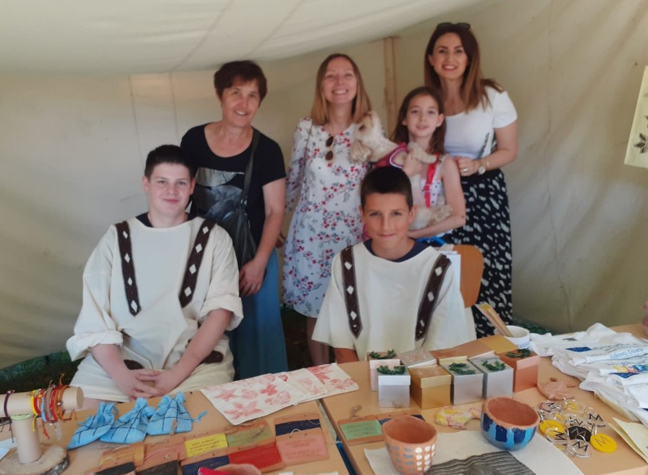

Slide 7
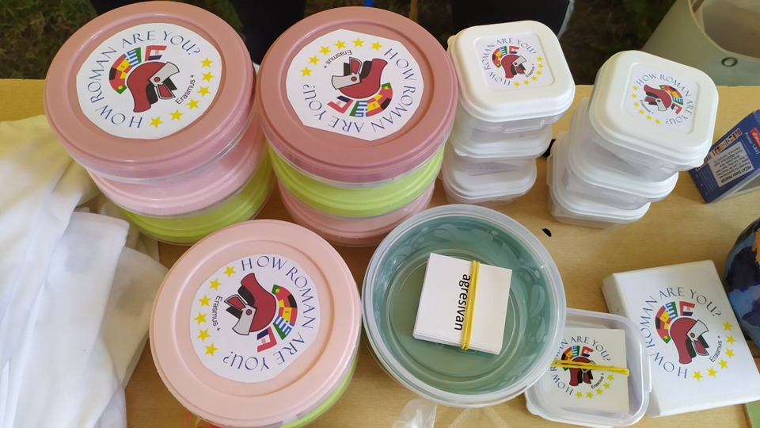
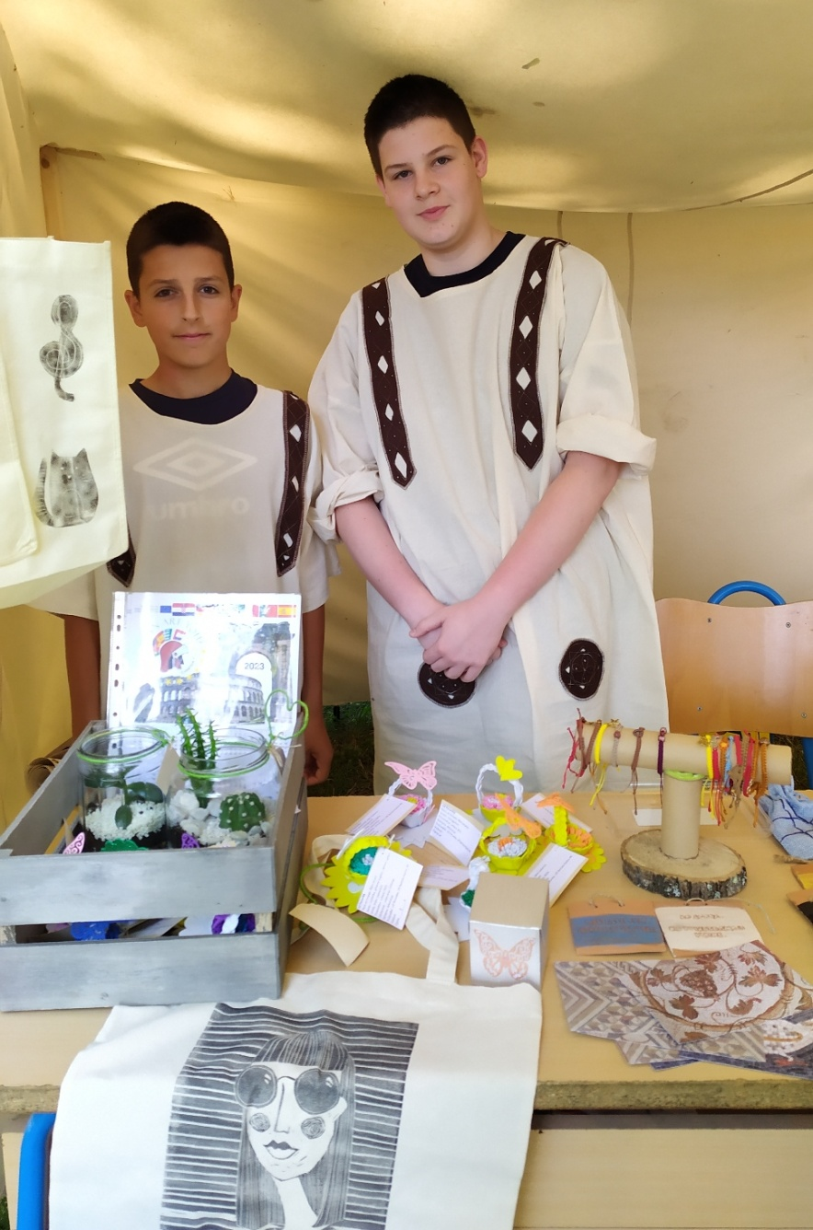
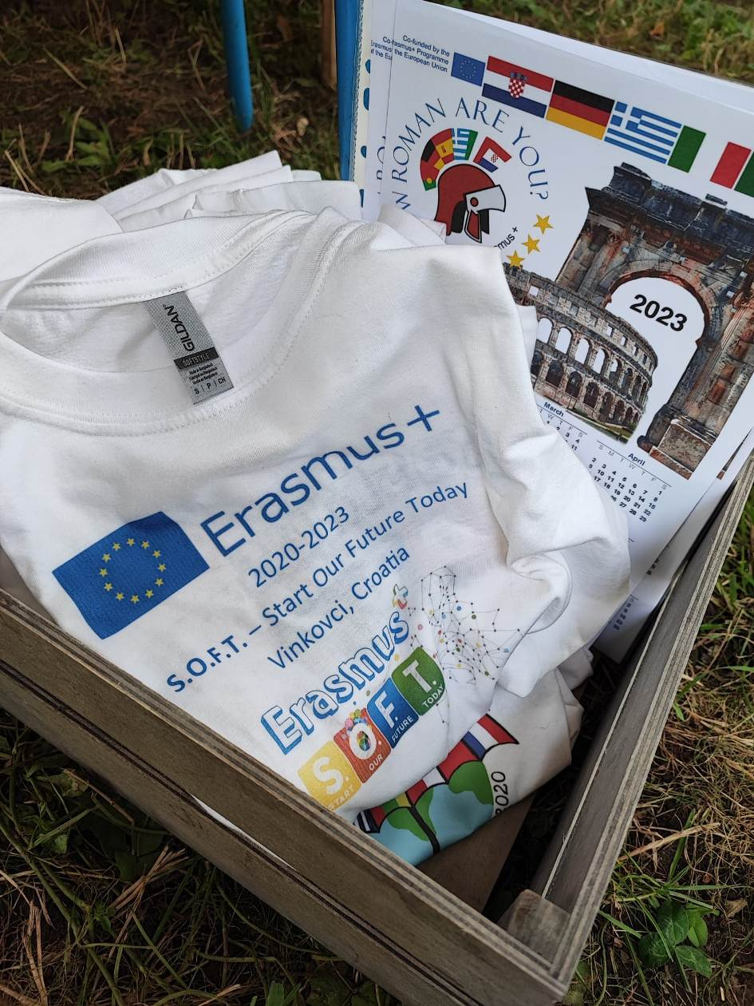
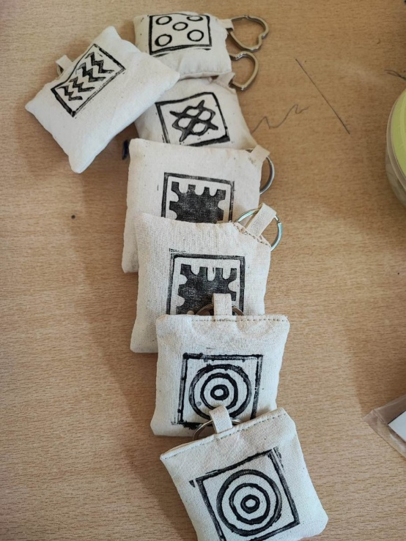

Slide 8
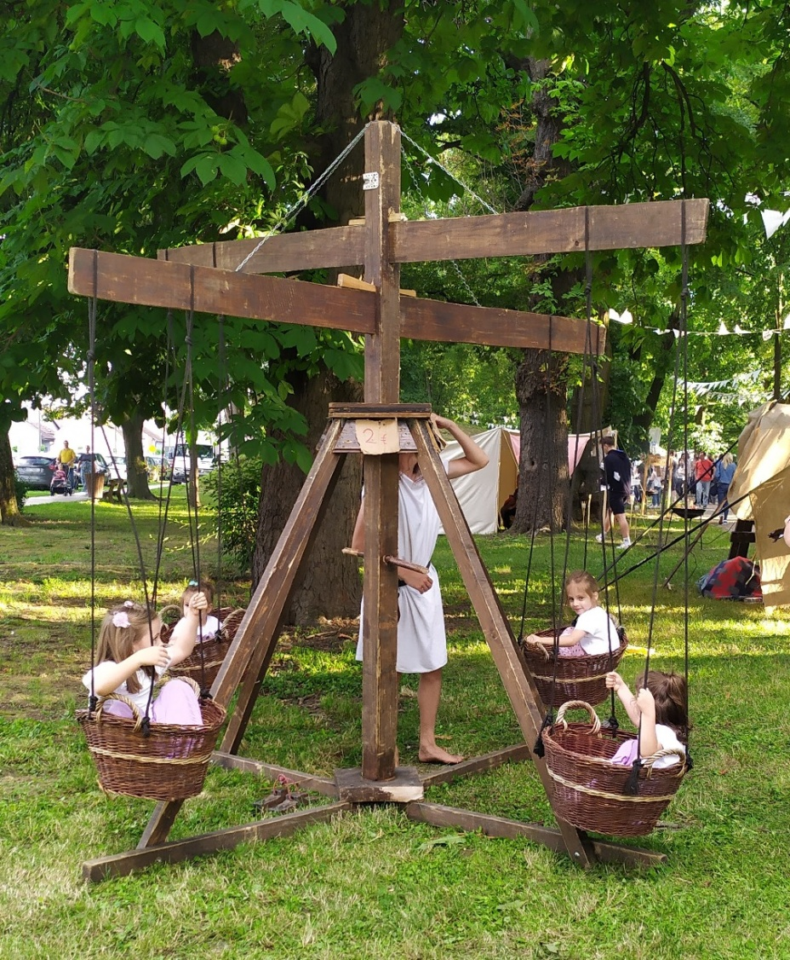
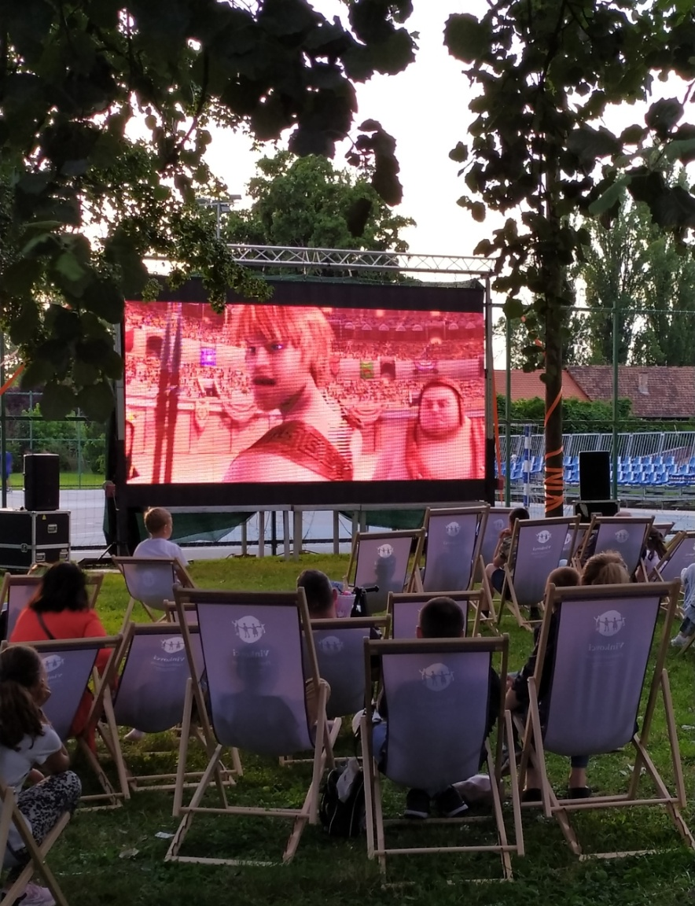
There were lots of interesting things to see and do for children and adults.

Slide 9
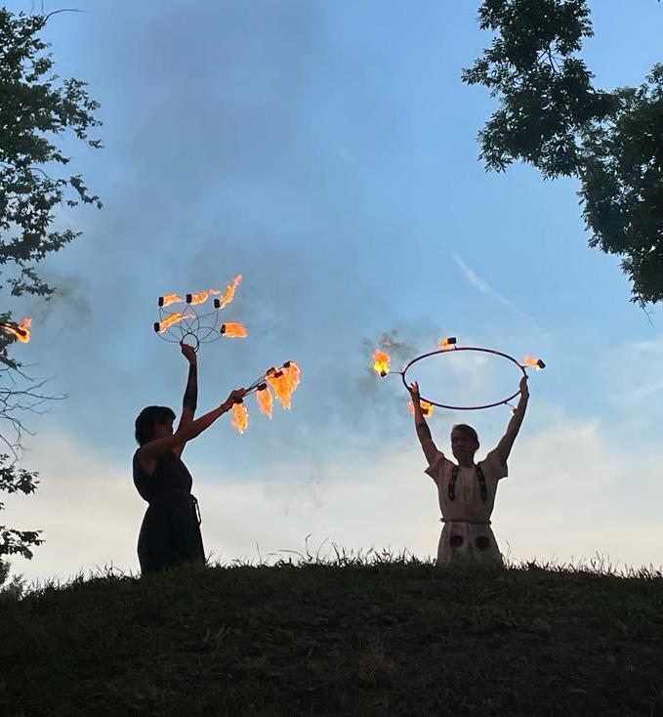
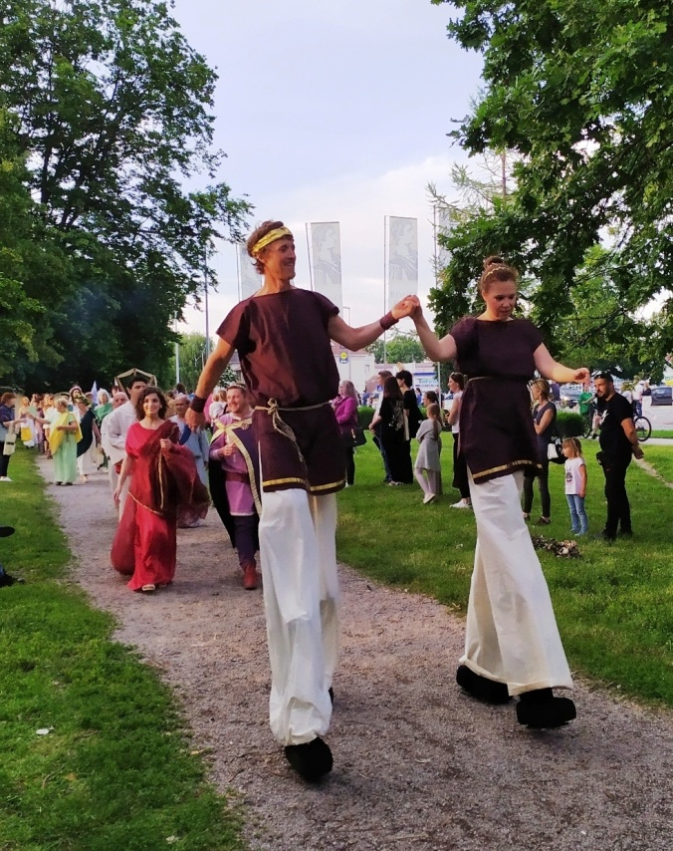
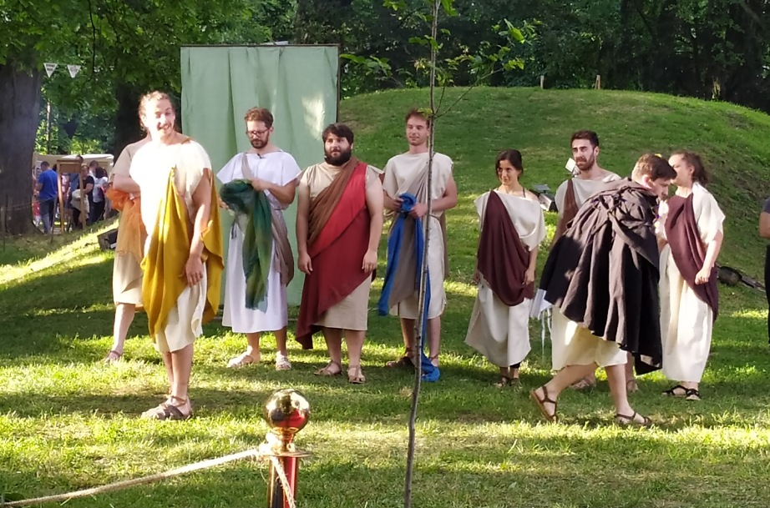
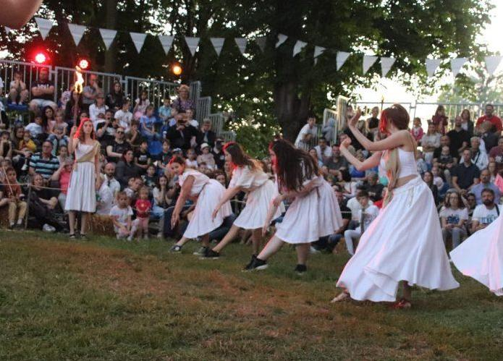

Slide 10
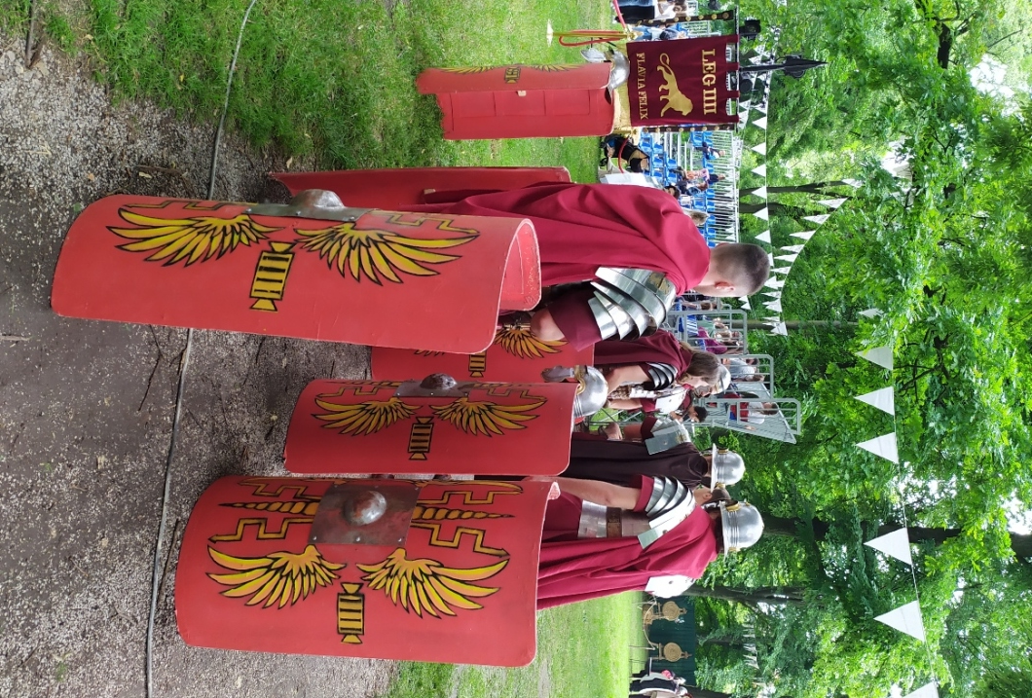
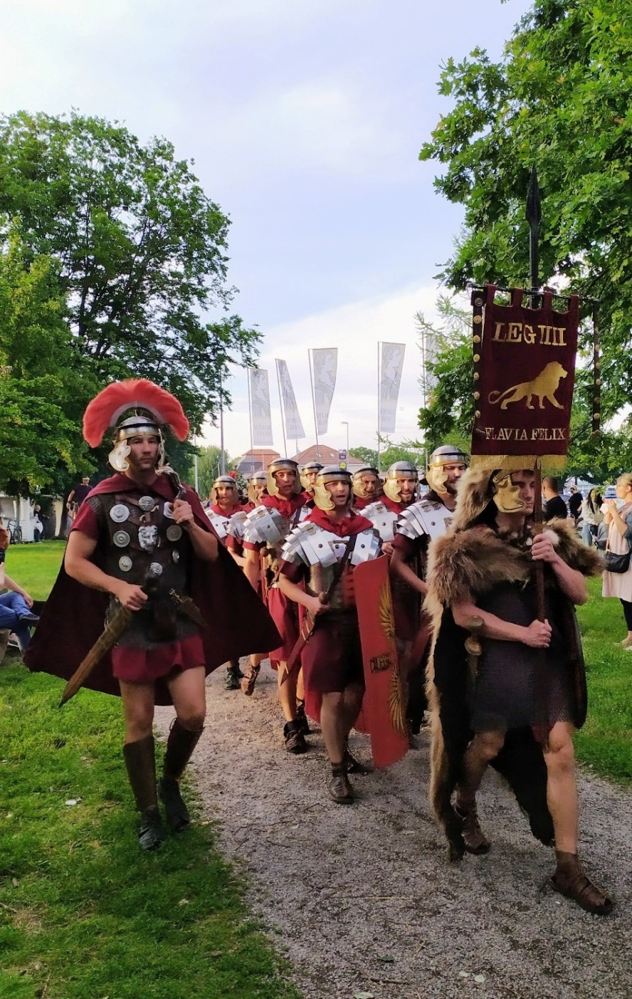

Slide 11
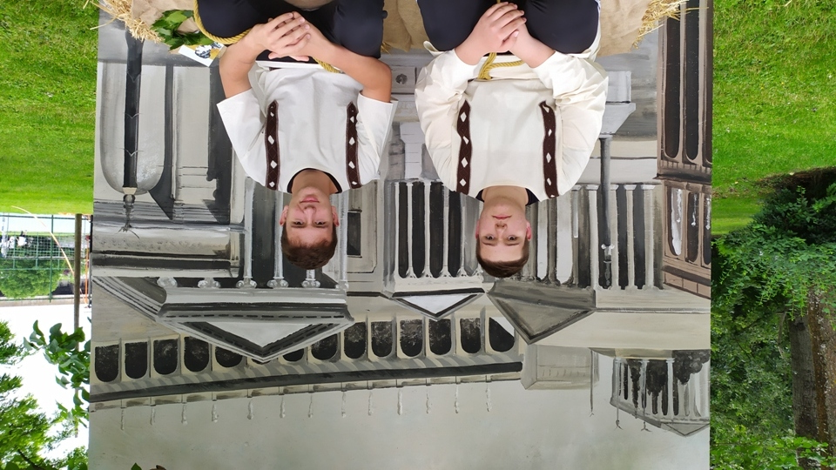
For a moment we fellt like we were in ancient Roman Empire.

