Slide 1
Osnovna škola Bartola Kašića Vinkovci Erasmus+ project 2020-2022 How Roman are you? 2020-01-DE03-KA229-077527_5
ROMAN DAYS 2021
June 2021

Slide 2
Pupils and teachers of Osnovna škola Bartola Kašića took part in the ninth Roman Days, which were held in Vinkovci on June 25 and June 26 2021. This event is dedicated to the history and the influence of Rome on the city of Vinkovci. This year the motto was “Diem natalem felicem tibi, auguste noster Valentiniane” (Happy birthday, Valentinian, our emperor) because Roman emperor Valentinian was born in 321 A.D. in Vinkovci (Colonia Aurelia Cibalae). During two days, pupils presented our project and sold products of our cooperative at the stand: ceramics (bowls, tiles with Latin sayings and medallions with the image of Emperor Valens), canvas bags and different decorations.

Slide 3
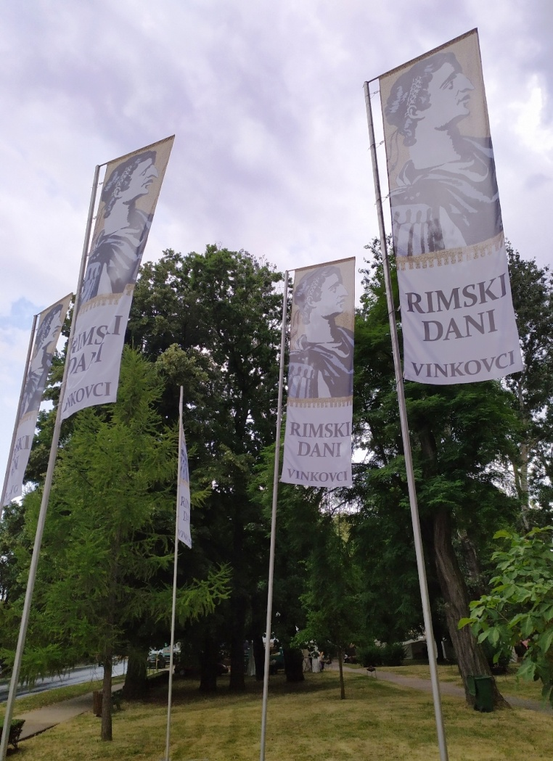
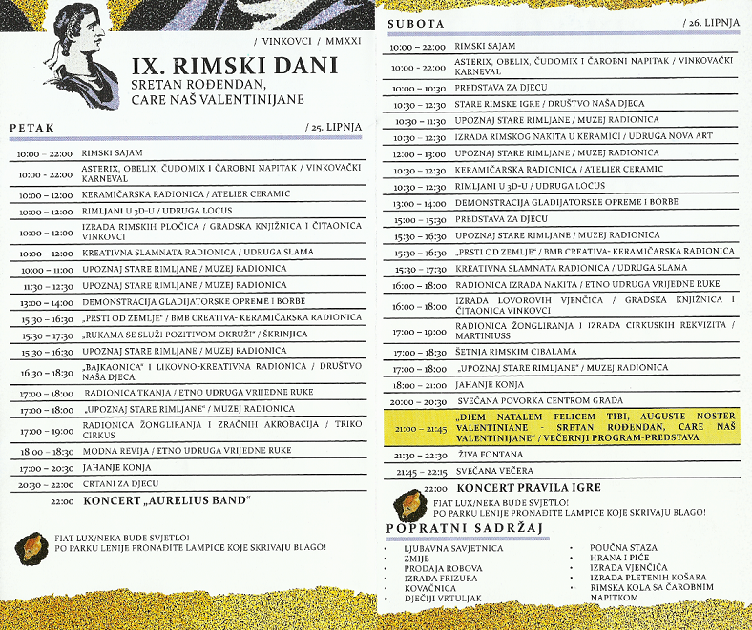

Slide 4
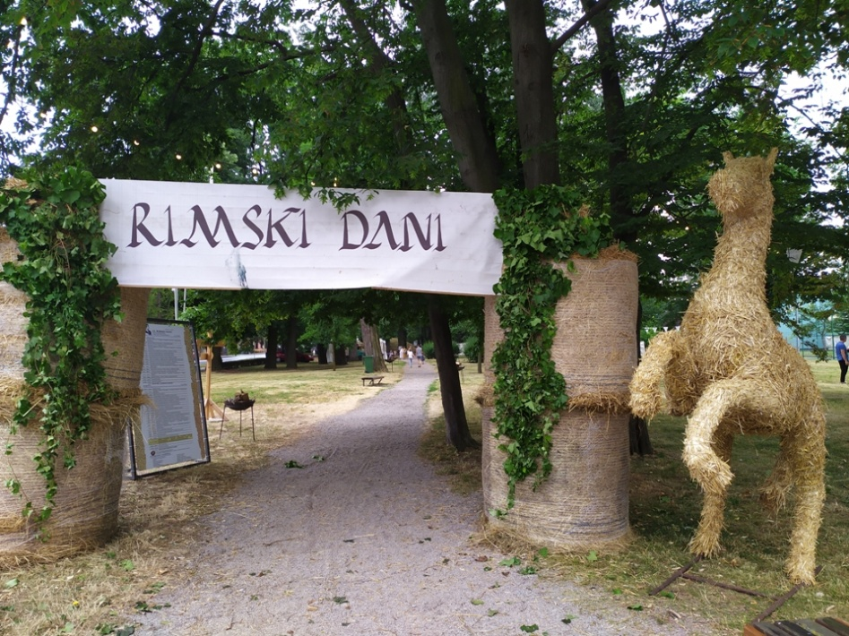
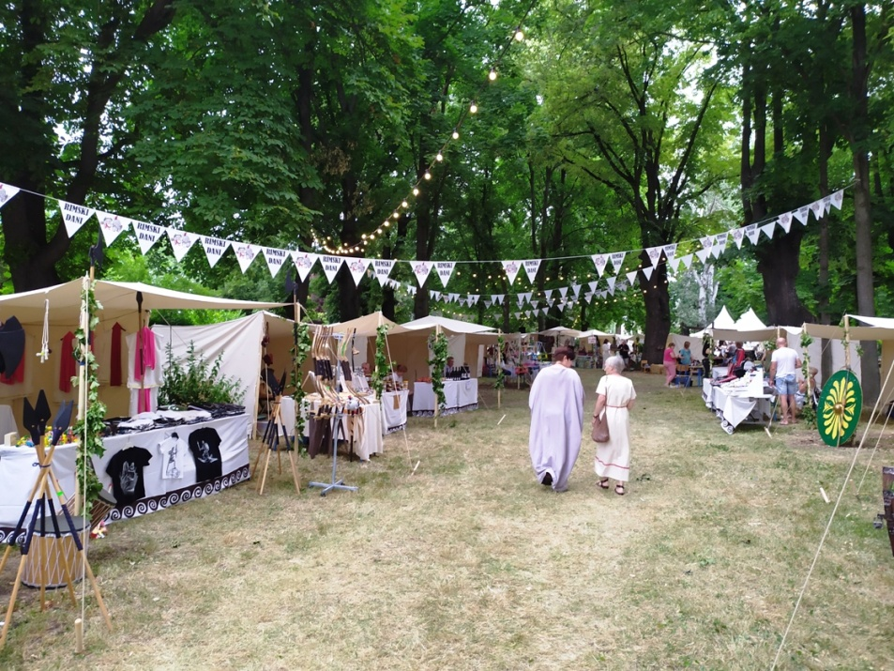
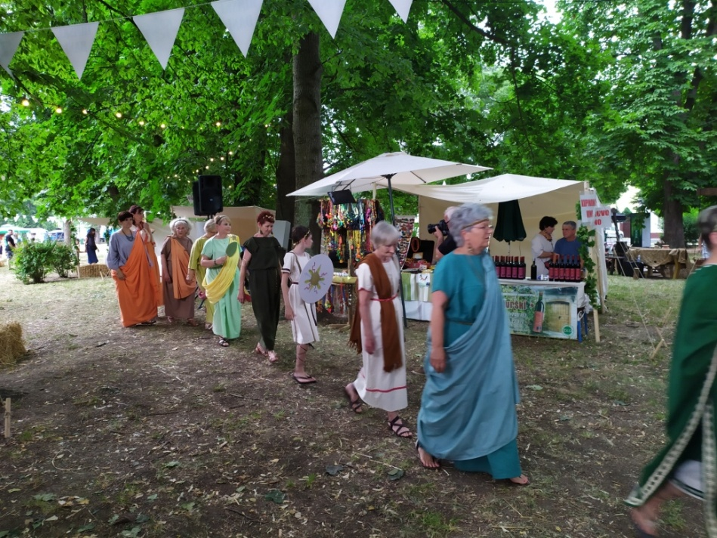
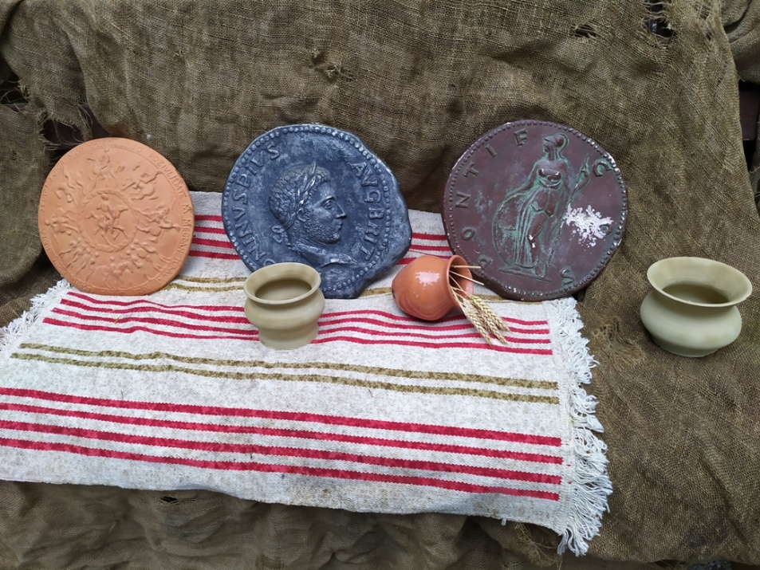

Slide 5
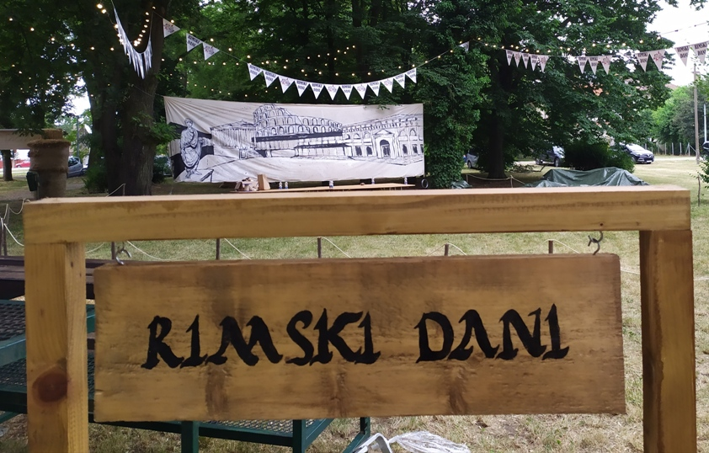
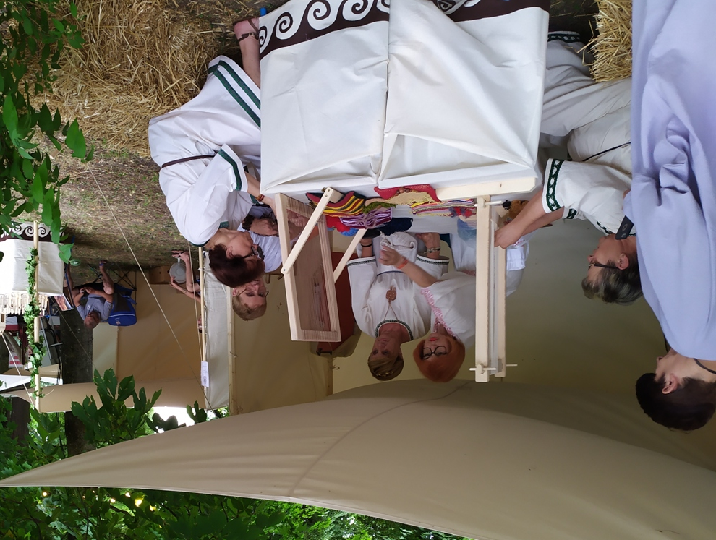

Slide 6
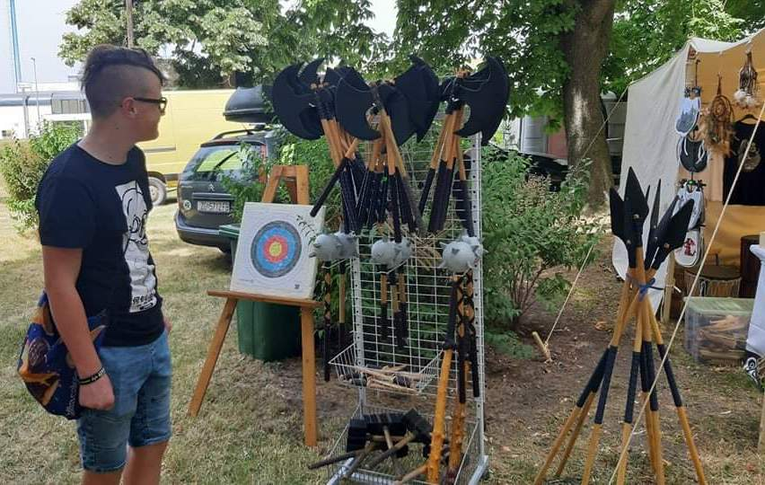
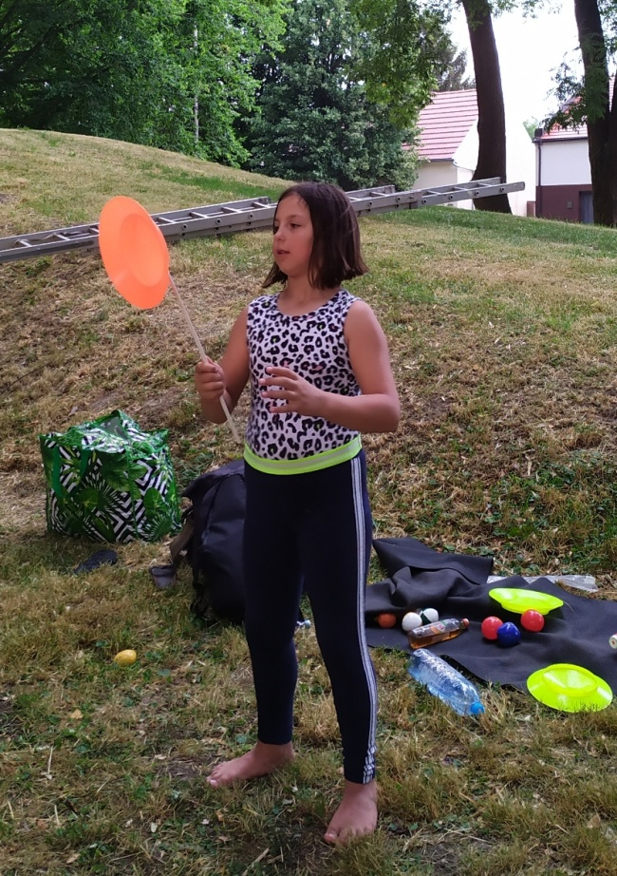
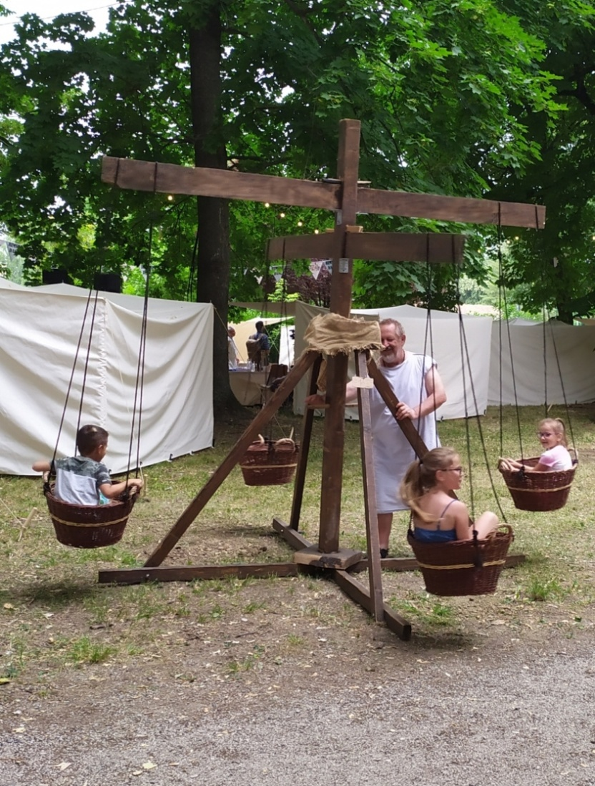
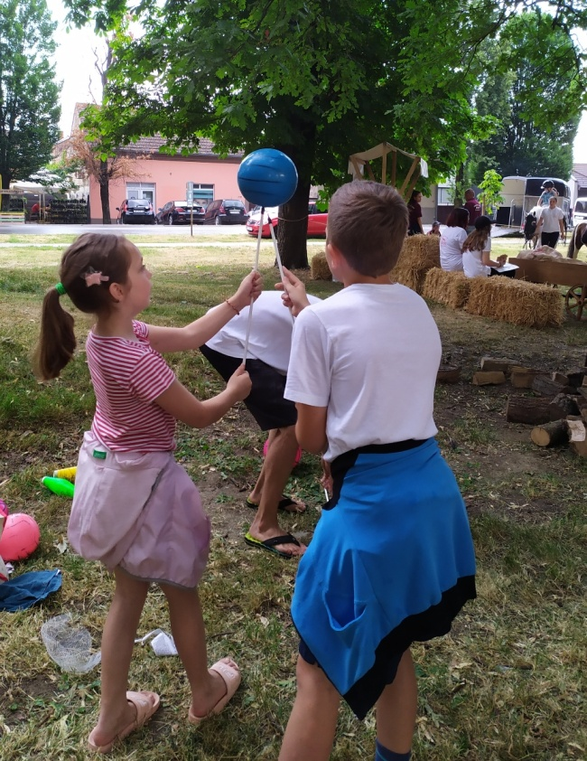

Slide 7
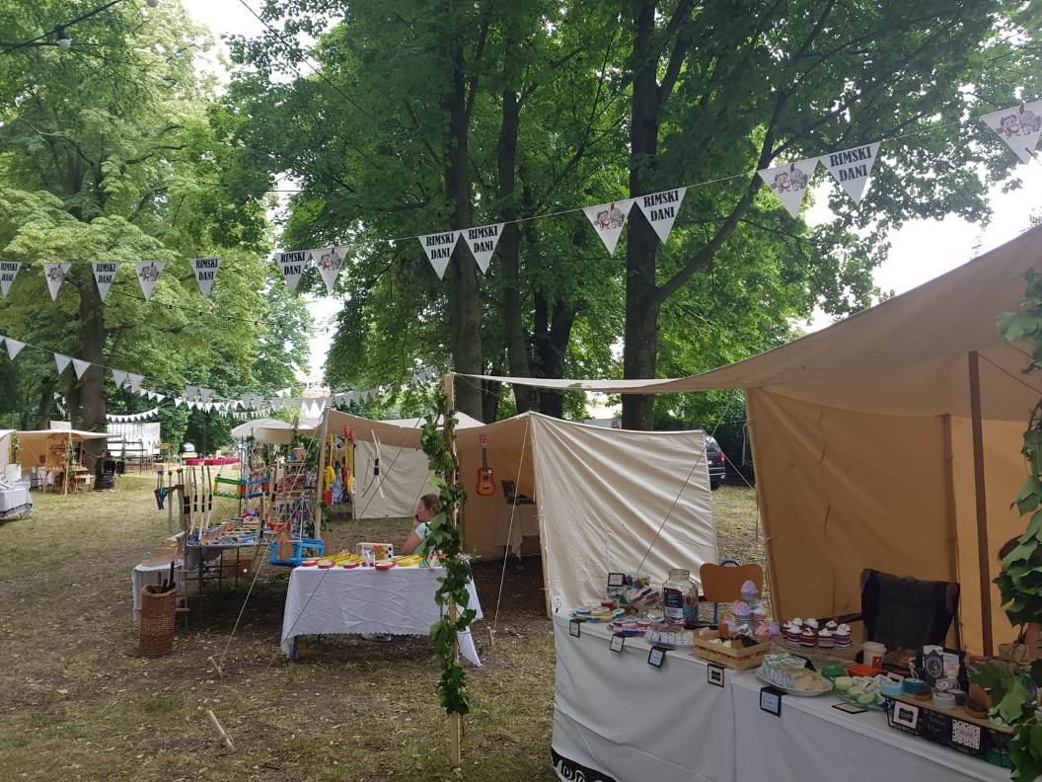
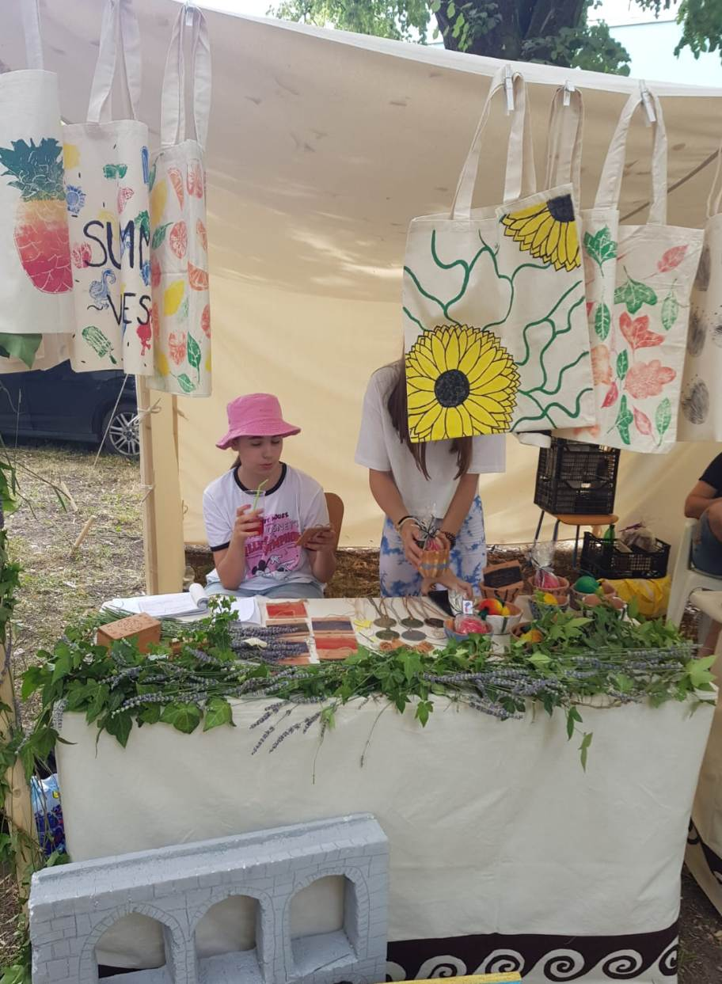
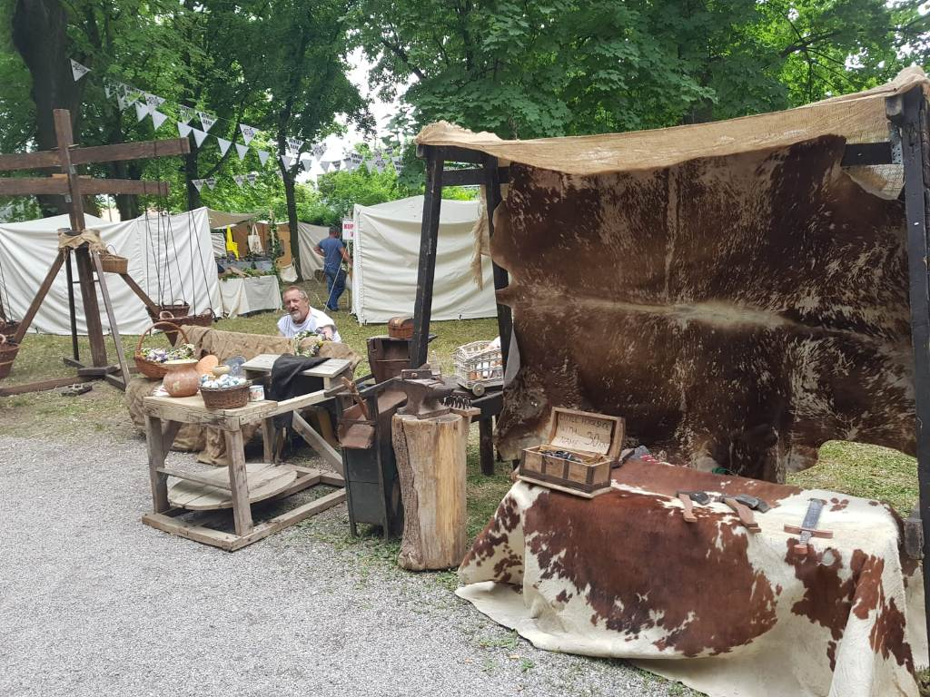

Slide 8
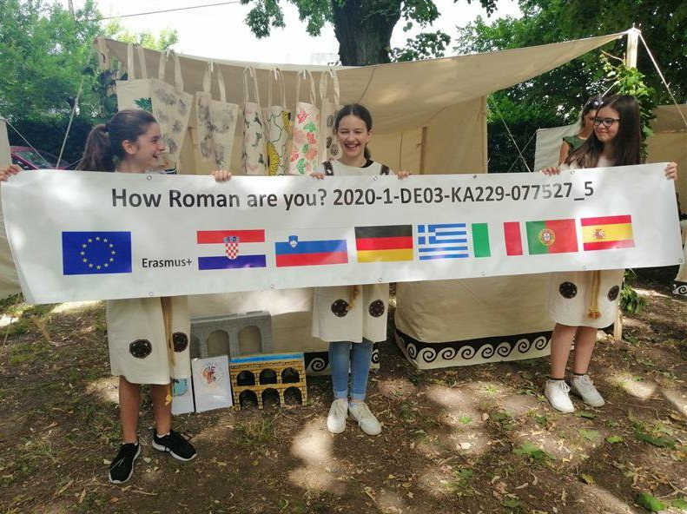
On Friday morning we started setting up the stand

Slide 9
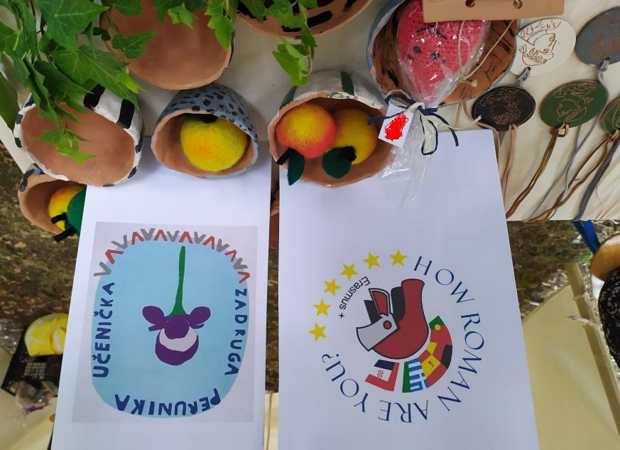
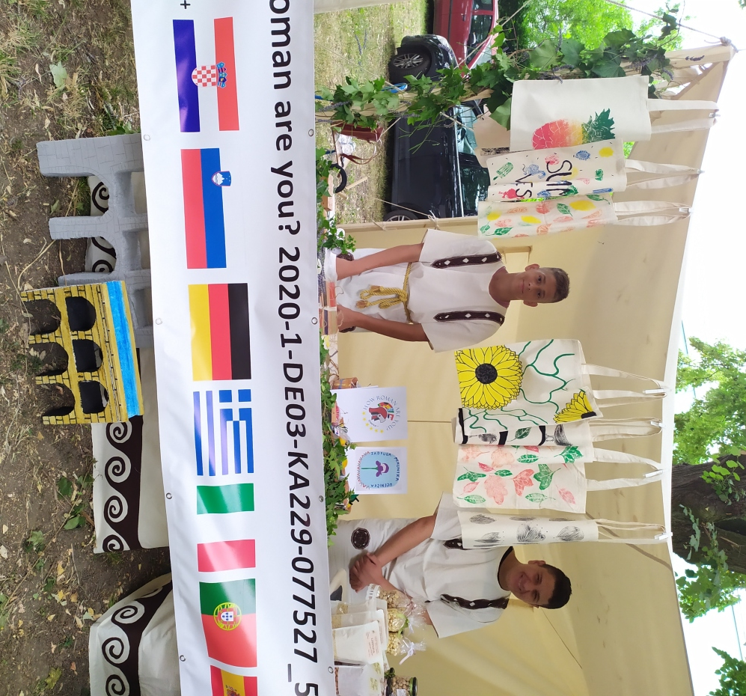
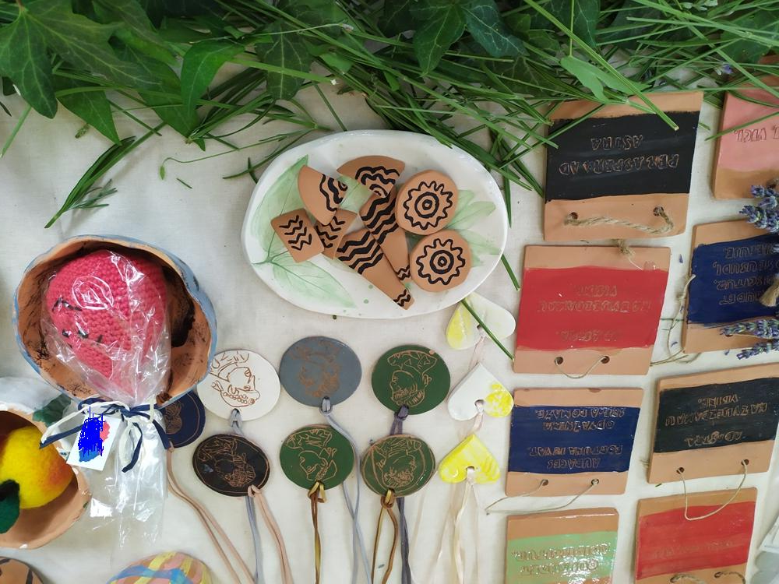

Slide 10
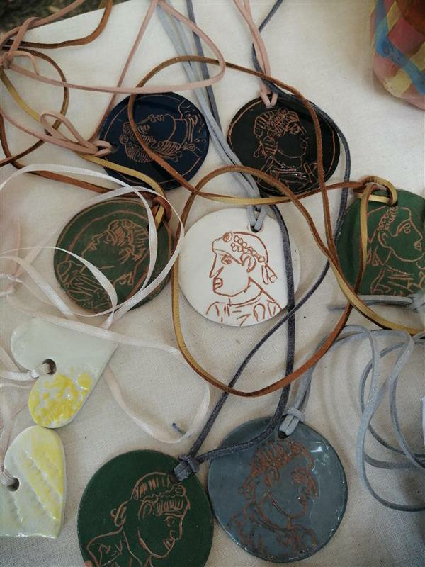
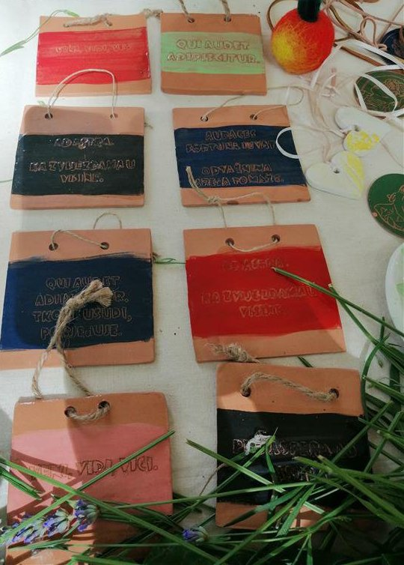

Slide 11
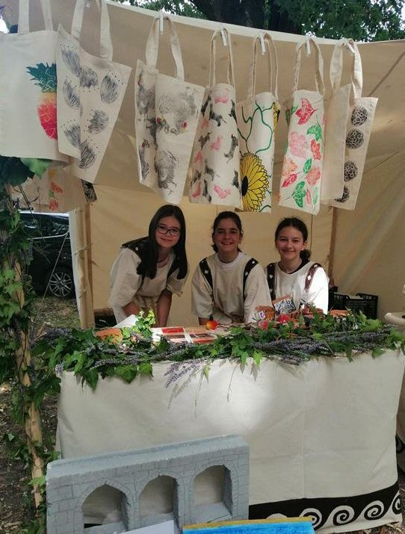
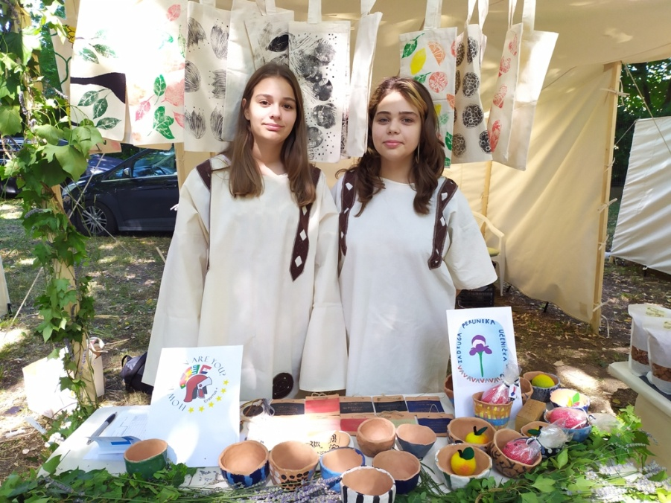
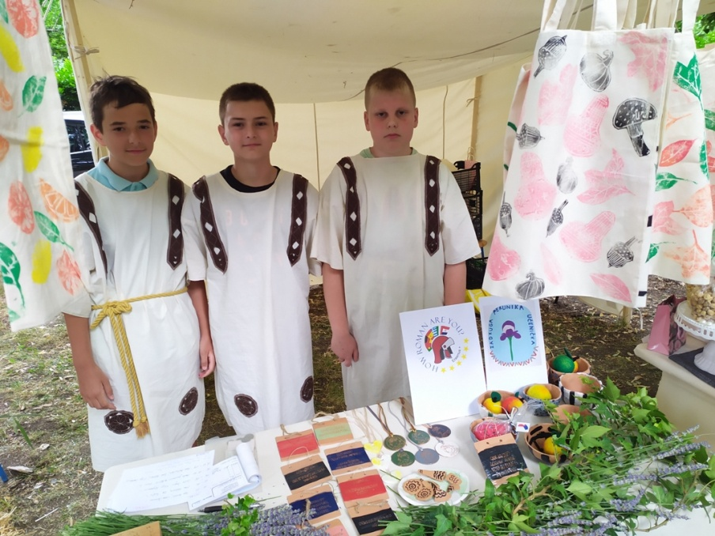

Slide 12
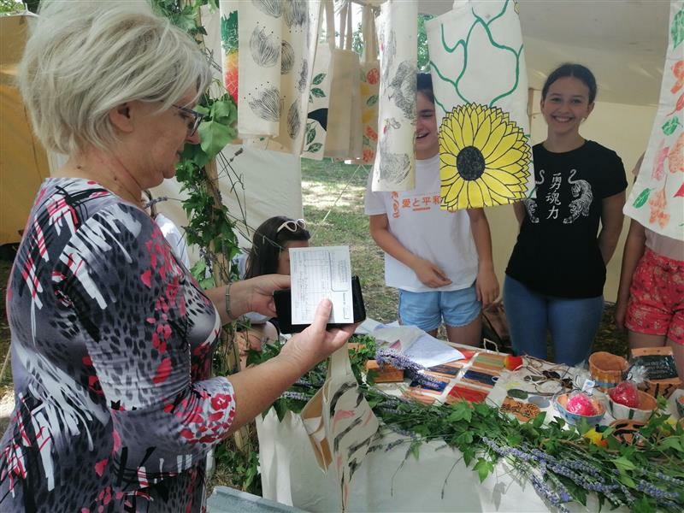
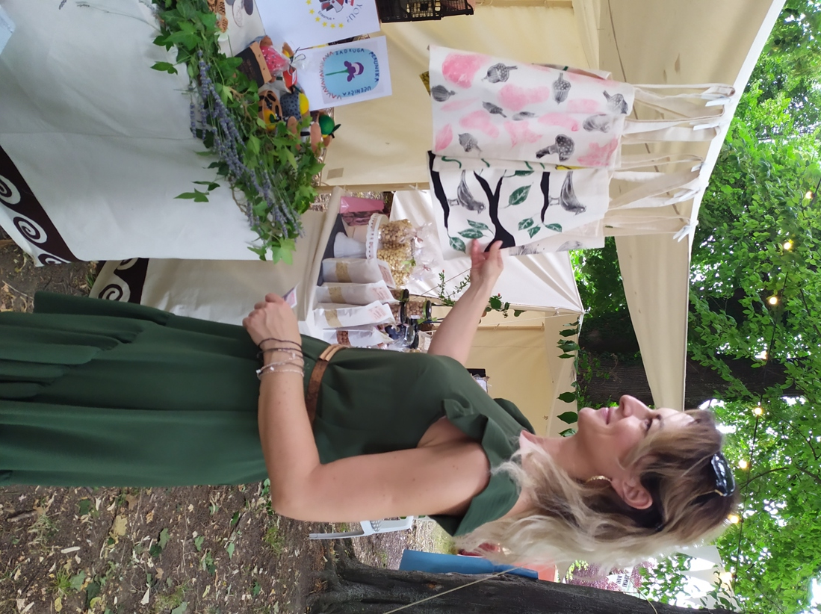

Slide 13
