Slide 1
OŠ Bartola Kašića Vinkovci Erasmus+ project 2020-2022 How Roman are you? 2020-1-DE03-KA229-077527_5
The relation of our region to the Romans

Slide 2
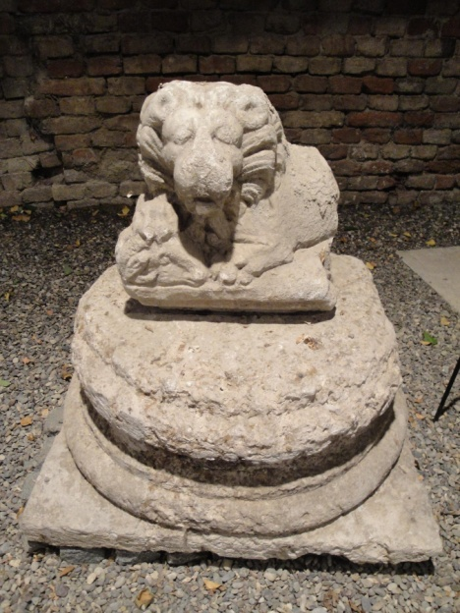
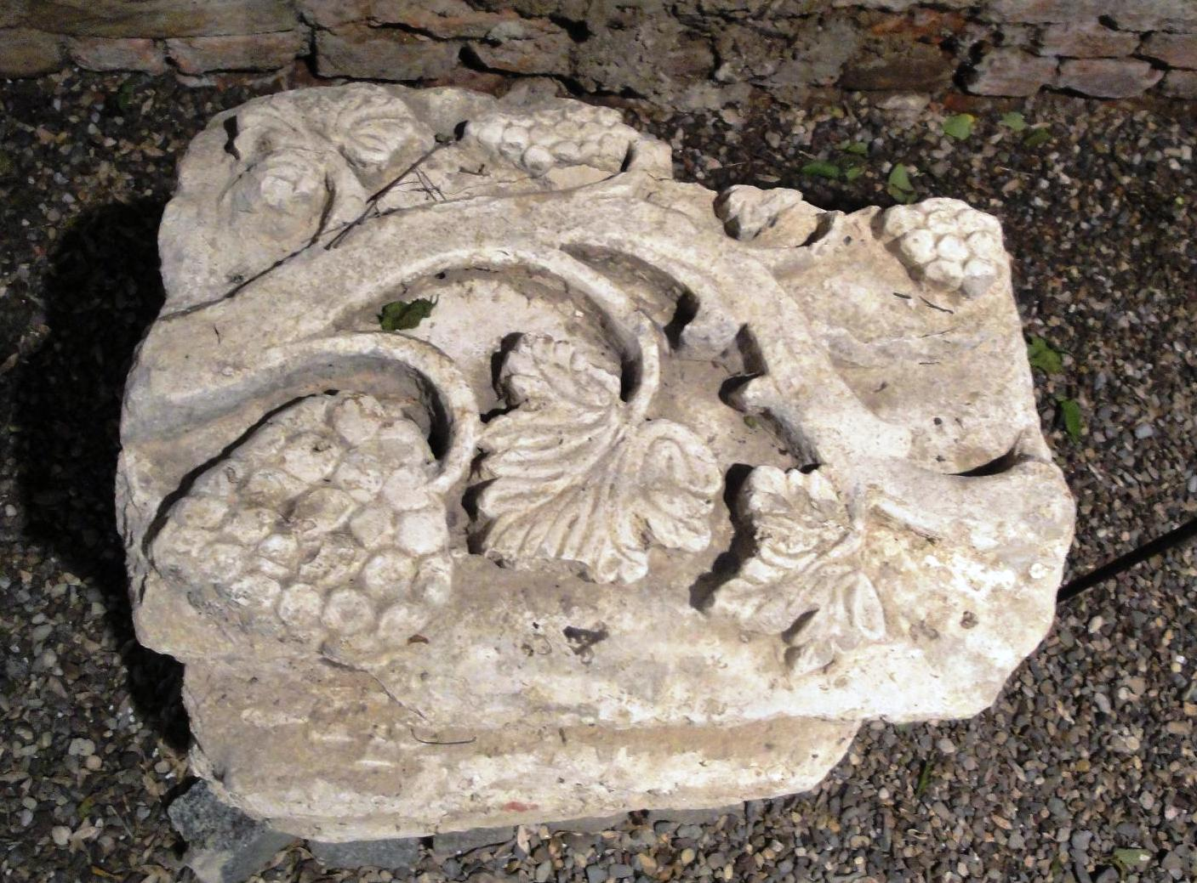
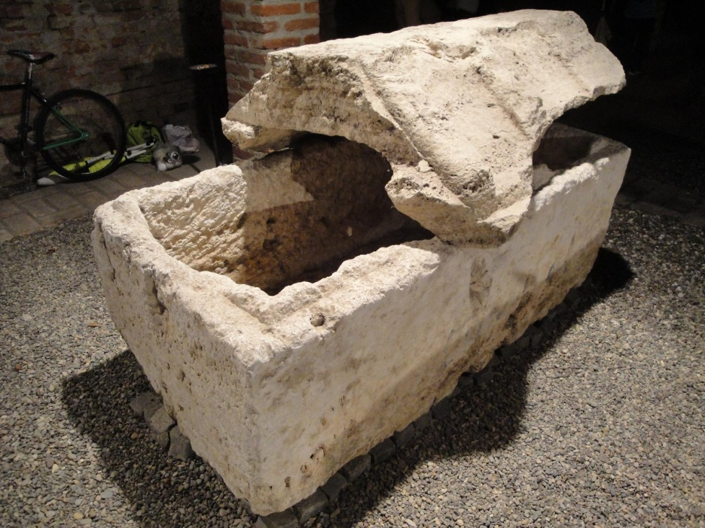
Our region has been inhabited for 8000 years and it was important during the Roman empire, but there are not many remains of buildings because building material was not stone. Archeologists have found lots of everyday objects: coins, pottery, etc. Roman heritage has an important role in our lives and lots of things remind us of that time everywhere.

Slide 3
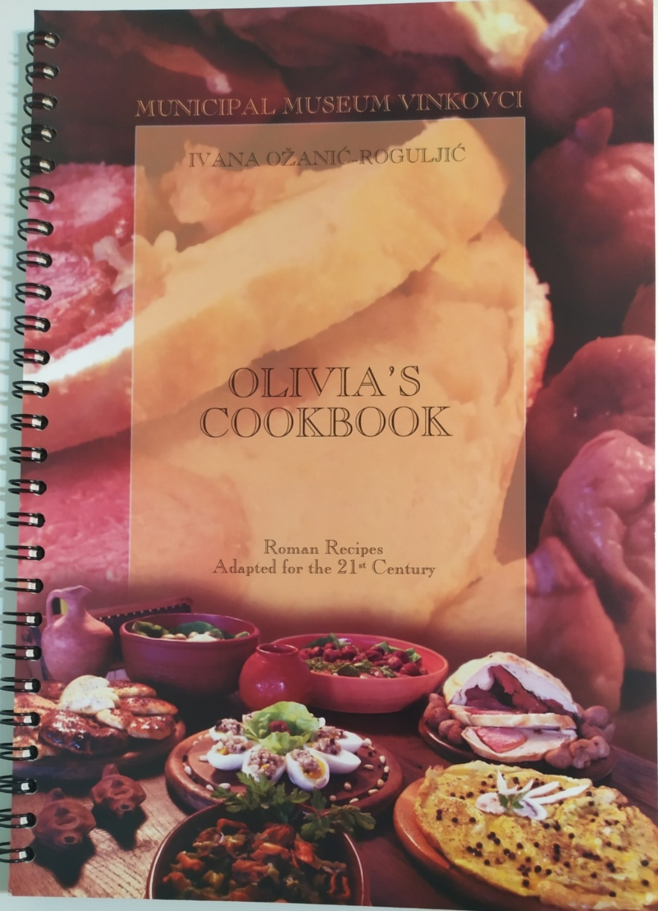
Food and feasts were important for Romans. Our region is known for good food. Municipal museum Vinkovci published a book of Roman reciipes Olivia’s Cookbook. Recipes are written in English, Croatian and Latin. The book has already had several editions.

Slide 4
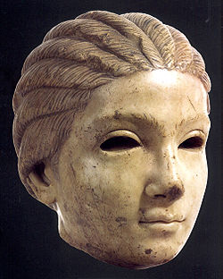
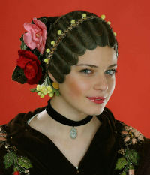
The art of making traditional women’s hairstyles in the areas of Slavonia, Baranja and Srijem has a long history. Research has shown that similar hairstyles in this area were made in time of
the late Roman Empire. They can be seen on Roman portraits from that time.

Slide 5
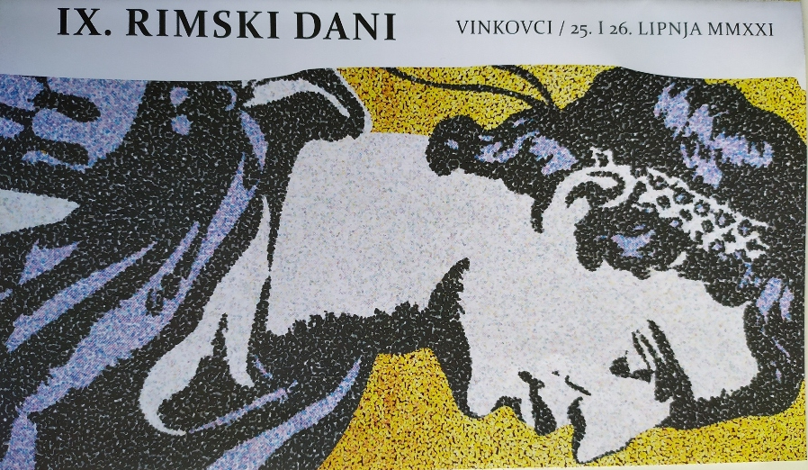
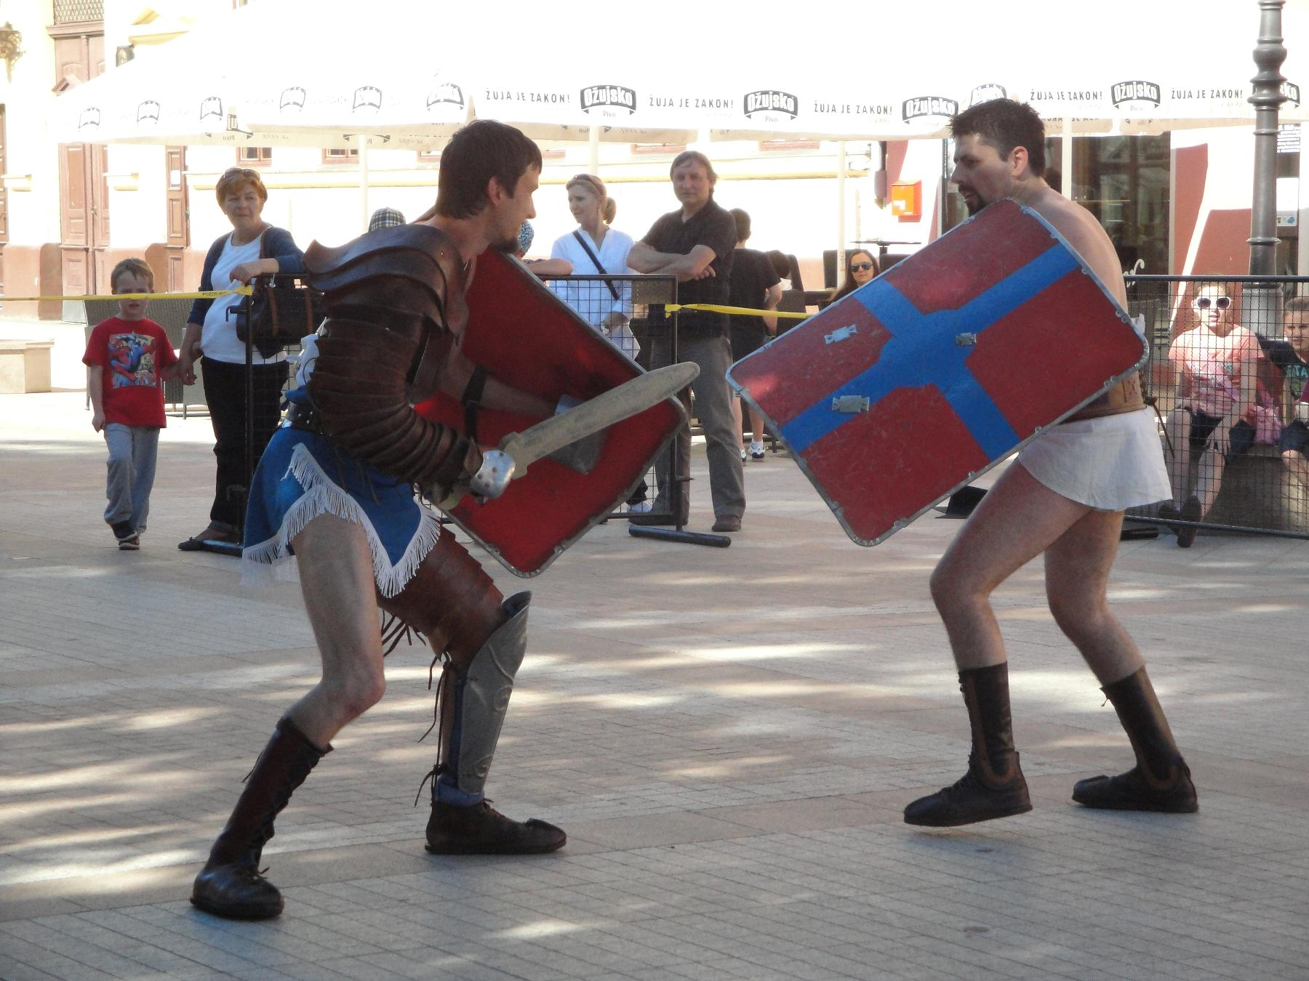
Every spring Vinkovci has a festival called Roman Days. Citizens can learn children’s games, attend workshops, children take part in quizes and we can see gladiators’ fights.

Slide 6
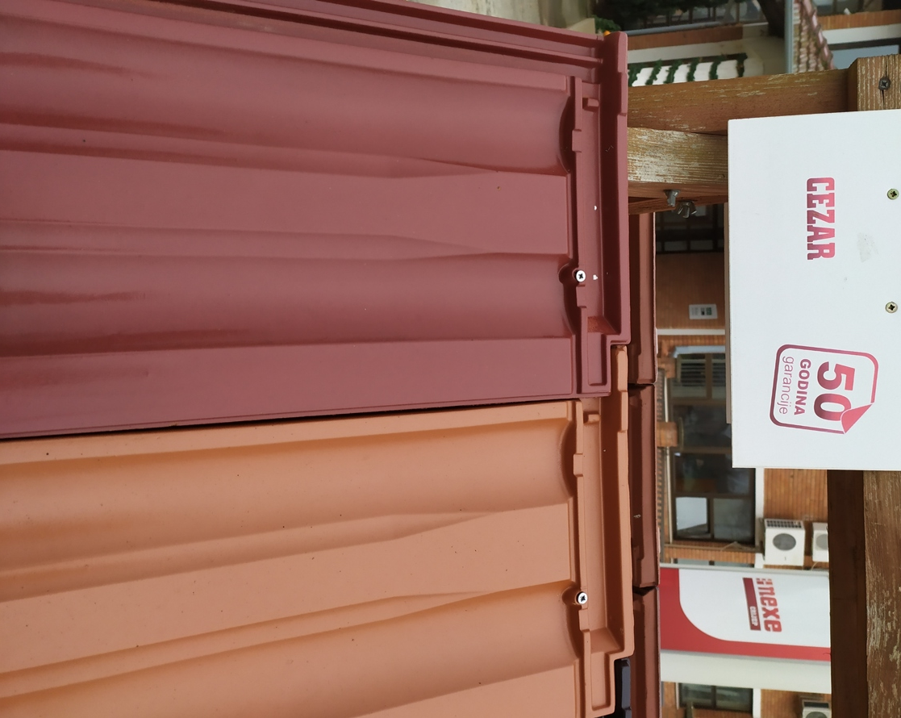
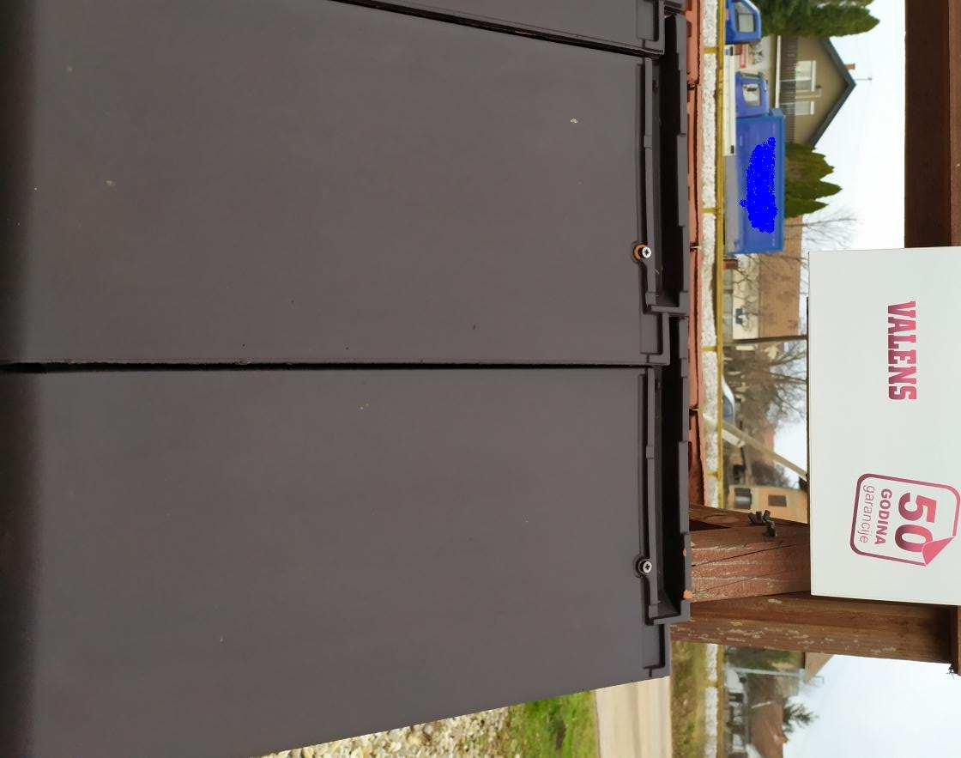
Dilj, factory that produces and exports roof tiles to several countries, named the products after Roman emperors.
CAESAR

Slide 7
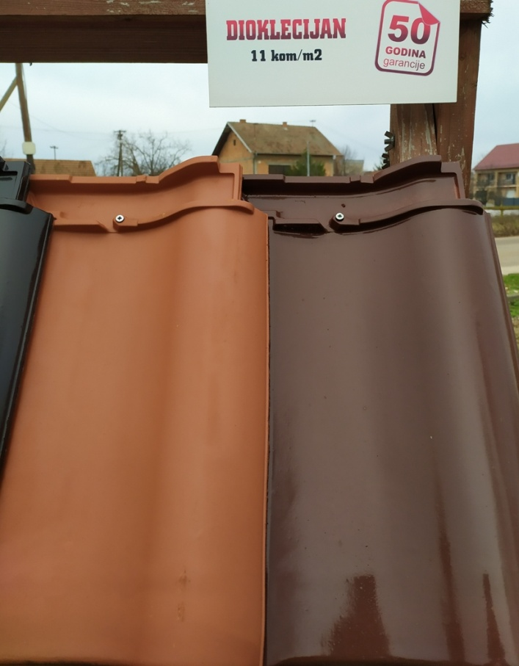
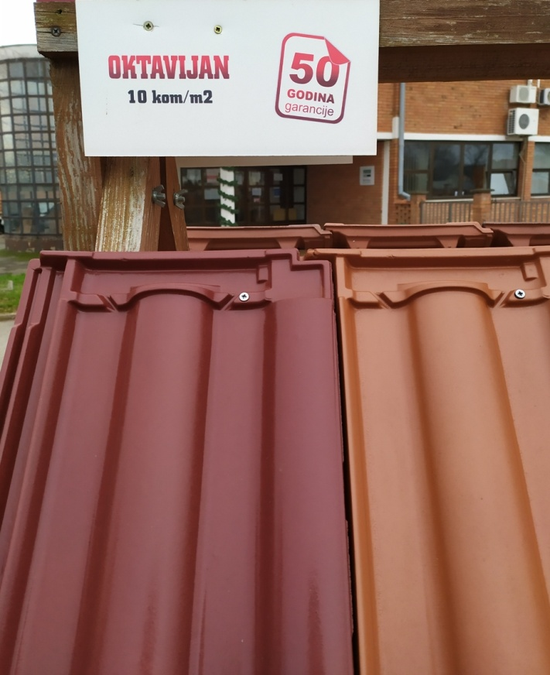
OKTAVIJAN, DIOKLECIJAN (Octavian, Diocletian,) roof tiles

Slide 8
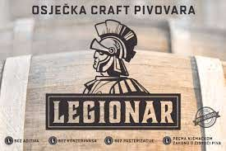
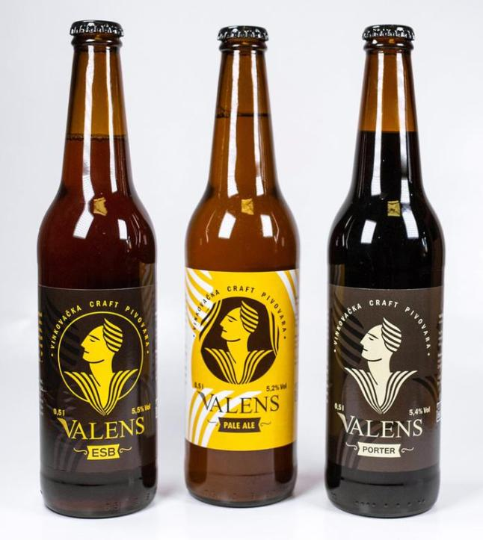
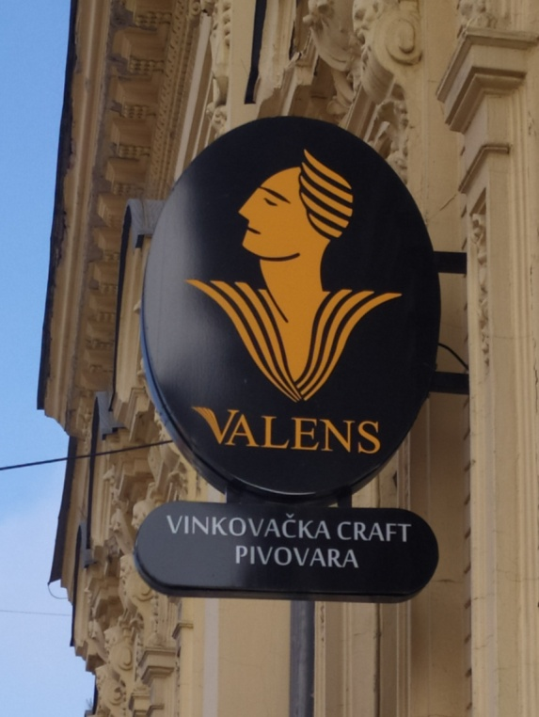
VALENS (Roman emperor) – Valens beer LEGIONAR (legionary) - beer
MMA club Valens, Vinkovci

Slide 9
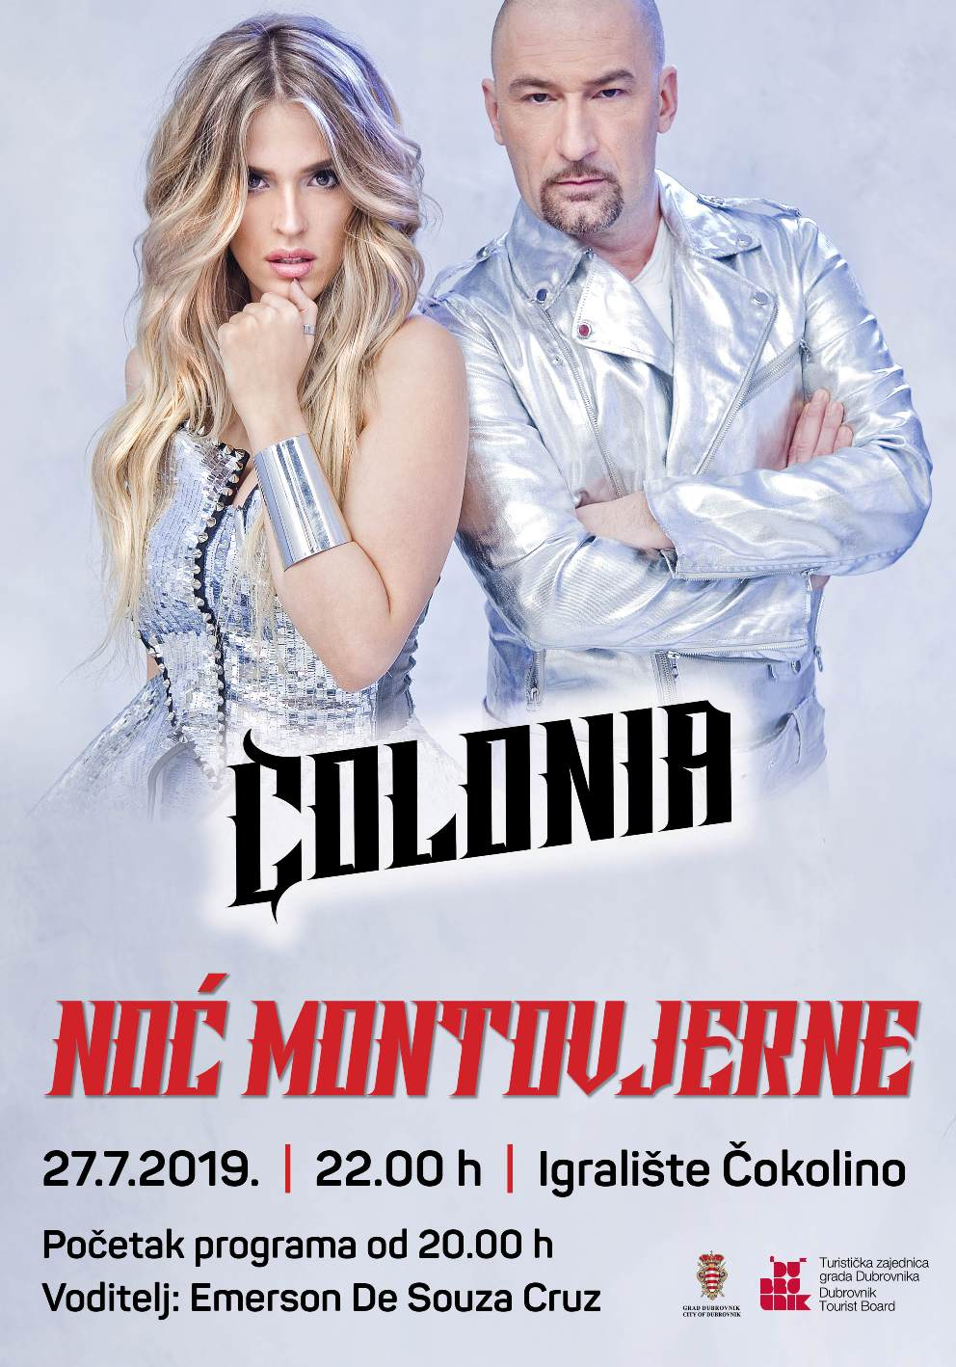
COLONIA AURELIA CIBALAE – Vinkovci

Slide 10
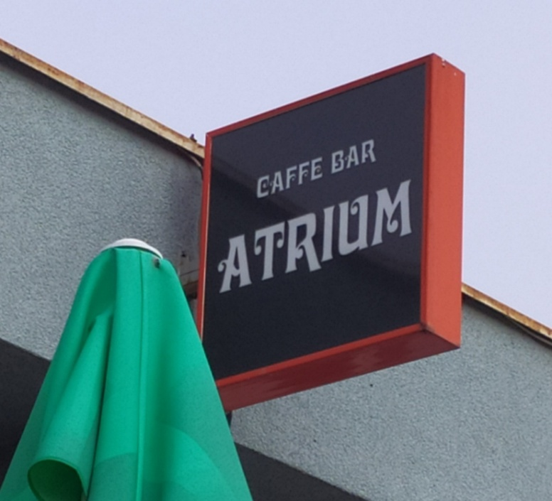
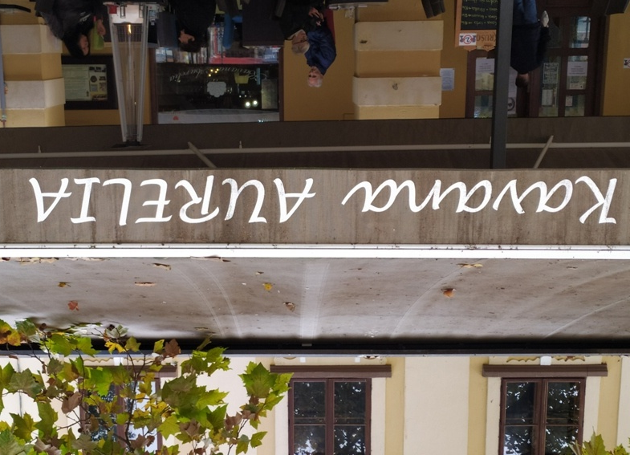
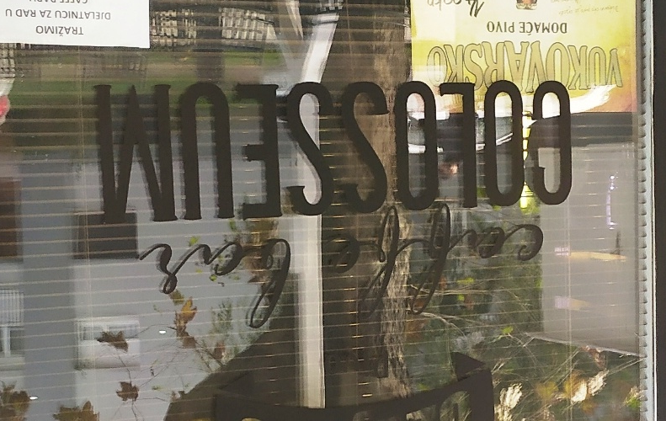
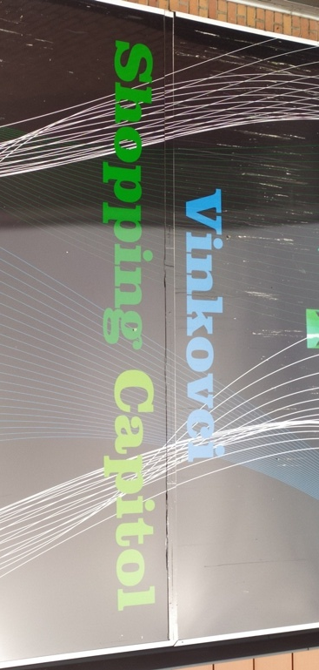
Shops and cafes in Vinkovci:

Slide 11
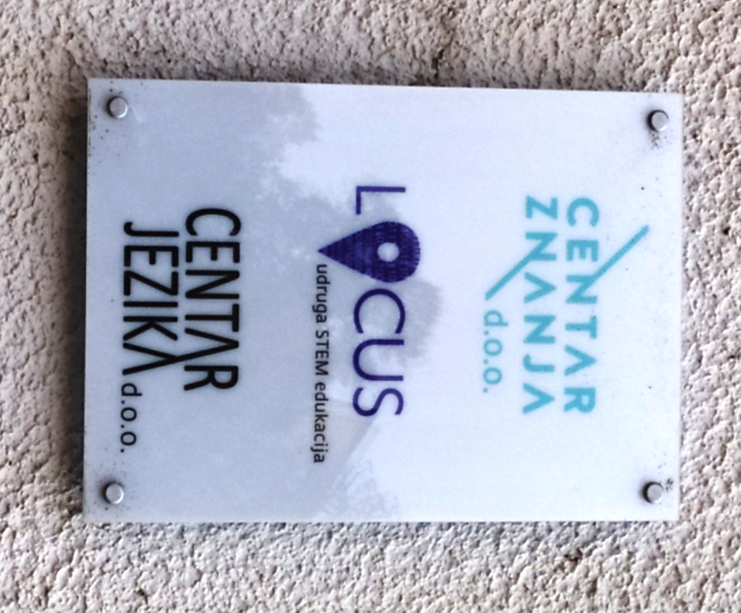
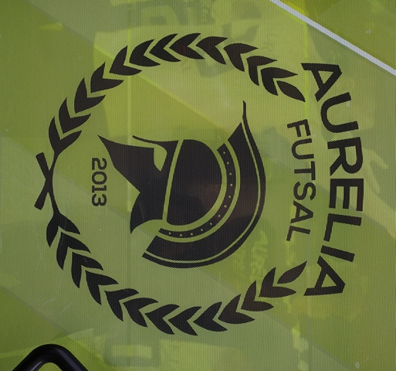

Slide 12
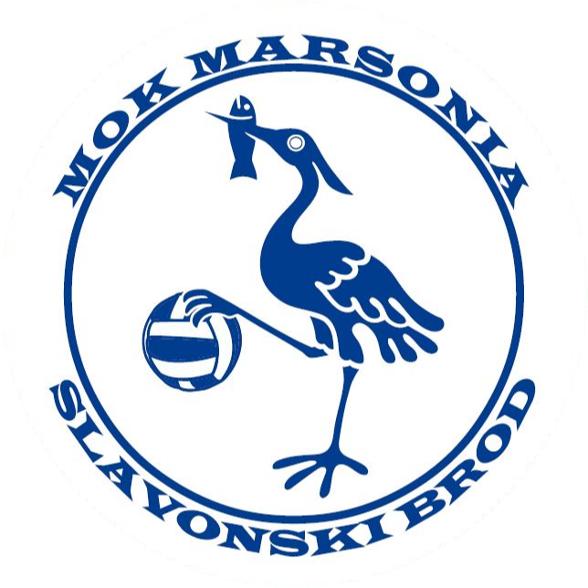
Sports clubs have the old Roman names of their cities
MARSONIA - Slavonski Brod MURSA - Osijek

