Slide 1
Osnovna škola Bartola Kašića Vinkovci Erasmus + project 2020-2022 S.O.F.T. – Start our future today
PROVERBS AND QUOTES

Slide 2
The most popular book among businessmen, has been “The Art of War” written by Sun Tzu (Sunzi) more than 2500 years ago, in the 6th century BC, but in the book there is still much we can learn about managing conflicts and difficult situations wisely, efficiently and victoriously.

Slide 3
Here are some quotes in Croatian and English:
“Rat je pitanje o kojem valja pomno promisliti. “It (war/ business) is a matter of life and death, a road either to safety or to ruin. Hence it is a subject of inquiry which can on no account be neglected. ”
“Brižno odmjeri situaciju prije no što povučeš potez.”
“Calculate the situation, and then move.” “Ponder and deliberate before you make a move.”
We decided to look for wise advice that can be inspiration and motivation for healthy life, good human relationships, working together, making and saving money in proverbs.

Slide 4
A proverb is a simple and concrete saying, popularly known and repeated, that expresses a truth based on common sense or the practical experience of humanity. Proverbs play many roles in society. The most common role that a proverb plays is to educate. They are most often tossed around as expert advice in conversation, their role is to educate people on what might happen if they do something.
A proverb as a little bit of wisdom that just about everyone – no matter where they are from – can offer. There is a proverb for just about every circumstance, and proverbs can be applied to any situation. Self-help literature has become very popular , but proverbs offer useful adivce on how to solve a problem in just a few words.

Slide 5
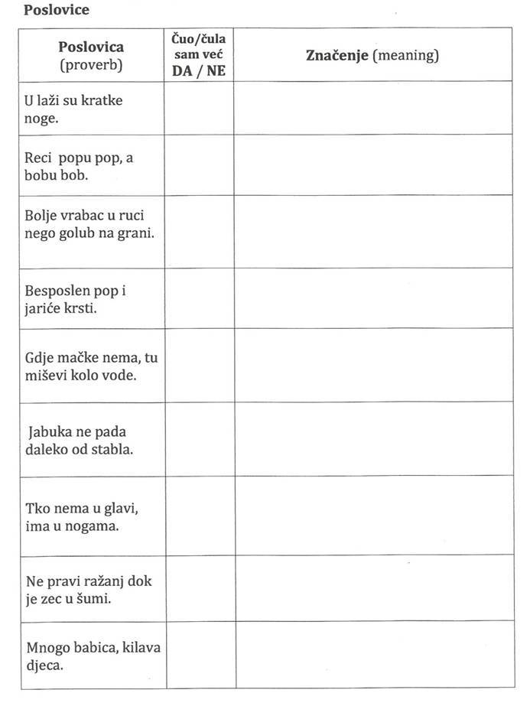
We want younger generations to save proverbs from oblivion. First we conducted a survey to see if students are familiar with proverbs’ meaning.
Students were given 9 proverbs, they were asked to indicate whether they had heard them or not. They also had to write what they think the meaning of the proverbs is.

Slide 6
Survey showed that students don’t understand most of the proverbs. Most students understood the meaning of “U laži su kratke noge.” (Lies walk on short legs.) and “Gdje mačke nema, tu miševi kolo vode.” (When the cat’s away, the mice will play.) Most students didn’t understand the meaning of other proverbs. Less than 10% of students understood the meaning of “Mnogo babica, kilava djeca”. (Too many cooks spoil the broth.) “Reci popu pop, a bobu bob.” (Call a spade a spade.) “Ne pravi ražanj dok je zec u šumi.” (Don’t count your chickens before they are hatched.)

Slide 7
All students were asked to talk with their elders at home, especially grandparents, and to bring to school as many proverbs as they can. They brought lots of different proverbs. The next step was to find corresponding proverbs in English and German, foreign languages taught at our school. The aim was to show that all nations have proverbs, some even use the same words. If diferent words are used, the meaning is still the same. Students made posters containing proverbs in three languages and illustrations. Posters were hung in some classrooms.

Slide 8
Erasmus+ project S.O.F.T. – Start our future today is about developing soft skills, leading a healthy life, preparing pupils for the labour market, starting and running a school mini company ,so we concentrated on proverbs about healthy life, working together and saving money:
Složna braća kuću grade. Union is strength. Ein Bruder hilft dem anderen.
Dobar je početak pola posla. A good beginning is half the work. Guter Anfang ist halbe Arbeit.
Štednja valja koliko i radnja. Saving must equal having. Sparen ist verdienen.
Bez zdravlja nema bogatstva. Health is better than wealth. Gesundheit ist der gröβte Reichtum.

Slide 9
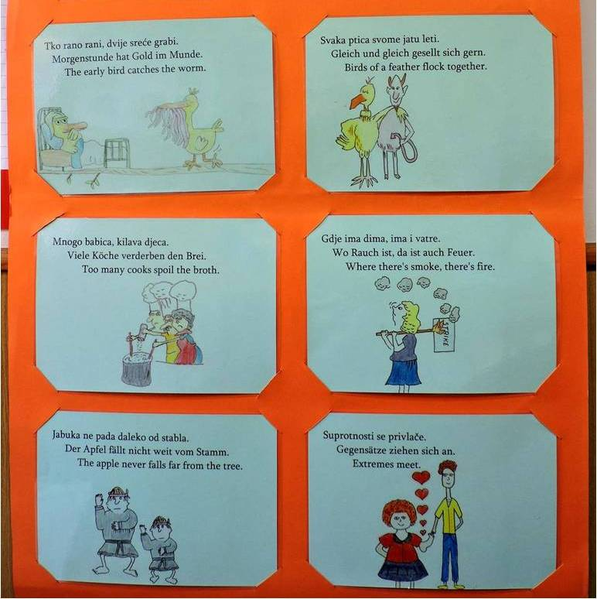
Students learned the meaning of proverbs and had to think of how to illustrate them.

Slide 10
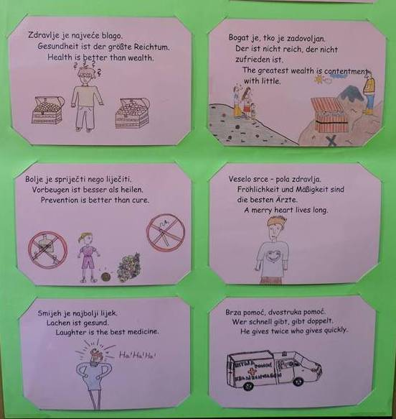
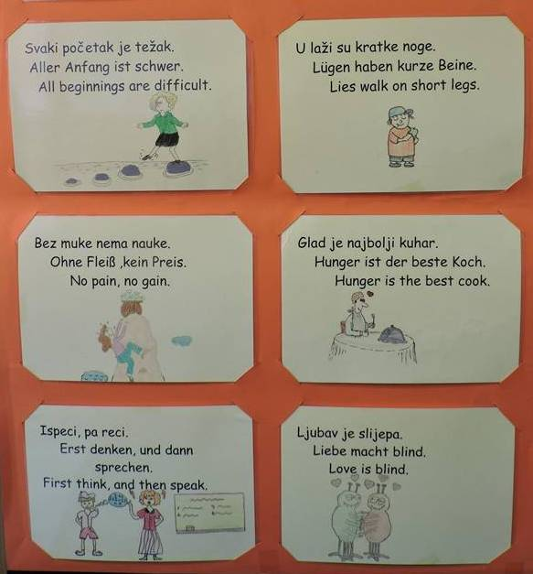

Slide 11
HRVATSKI JEZIK
Poveži dijelove poslovica:
Daleko od očiju,
Svaki početak
Bolje ikad,
Nije zlato
Suprotnosti
Glad je
Svatko je
Griješiti je
Ljubav
U laži su
Bolje znanje
Ispeci,
Bolje vrabac u ruci
Govoriti je srebro,
Bez muke
Prijatelj se
Tko rano rani,
Bolje spriječiti
Čist račun,
Tko nema u glavi,
najbolji kuhar.
kovač svoje sreće.
kratke noge.
daleko od srca.
je težak.
nego imanje.
sve što sija.
nego nikad.
se privlače.
je ljudski.
je slijepa.
nema nauke.
nego liječiti.
duga ljubav.
ima u nogama.
nego golub na grani.
pa reci.
šutjeti je zlato.
dvije sreće grabi
We organized a workshop for students. They were given three lists with parts of proverbs that should be connected (in Croatian, English and German). After that the task was to fill in the table by writing corresponding sentences. The same workshop will be one of Business Day (Open Doors Day) activities.

Slide 12
ENGLESKI JEZIK
Poveži dijelove poslovica:
Out of sight,
All beginnings
Better late
All that glitters
Extremes
Hunger is
To err
You make
Love is
Lies walk
Better wit
First think,
A bird in the hand
Speech is silver,
No pain,
A friend in need
The early bird
Prevention is
Even reckoning
A forgetful head
NJEMAČKI JEZIK
Poveži dijelove poslovica:
Aus den Augen,
Aller Anfang
Besser spät
Es ist nicht alles Gold
Gegensätze
Hunger ist
Irren ist
Jeder ist seines Glückes
Liebe
Lügen haben
Besser viel wissen,
Erst denken,
Besser ein Spatz in der Hand,
Reden ist Silber,
Ohne Fleiß
Freunde erkennt man
Morgenstunde hat
Vorbeugen ist besser
Kurze Rechnung,
Was man nicht im Kopf hat,
ist schwer.
macht blind.
der beste Koch.
kurze Beine.
als viel haben.
menschlich.
ziehen sich an.
aus dem Sinn.
was glänzt.
als nie.
Schmied.
in der Not.
dann sprechen.
lange Freundschaft.
Gold im Munde.
als heilen.
Schweigen ist Gold.
muss man in den Beinen haben.
als eine Taube auf dem Dach.
kein Preis.
the best cook.
your own fortune.
on short legs.
are difficult.
out of mind.
is human.
than never.
is not gold.
meet.
blind.
silence is golden.
than wealth.
better than cure.
catches the worm.
and then speak.
is worth two in the bush.
makes friends.
is a friend indeed.
makes a weary pair of heels.
no gain.

Slide 13
HRVATSKI JEZIK, Croatian | NJEMAČKI JEZIK, German | ENGLESKI JEZIK, English
Daleko od očiju, daleko od srca. | Aus den Augen, aus dem Sinn. | Out of sight, out of mind.
Svaki početak je težak. | Aller Anfang ist schwer.
 |  | Better late than never.
 |  | All that glitters is not gold.
Suprotnosti se privlače.
 | Hunger ist der beste Koch.
U laži su kratke noge. |  | Lies walk on short legs.
 |  | Speech is silver, silence is golden.
Čist račun, duga ljubav. | Kurze Rechnung, lange Freundschaft.
Bolje vrabac u ruci nego golub na grani. |  | Better a bird in the hand than two in the bush.
Tko rano rani, dvije sreće grabi. | Morgenstunde hat Gold im Munde.
 |  | No pain, no gain.
Svatko je kovač svoje sreće.
 | Irren ist menschlich. | To err is human.
 |  | Better wit than wealth.
Prijatelj se u nevolji poznaje.
Ispeci pa reci. | Erst denken, dann sprechen.
 |  | Prevention is better than cure.
Tko nema u glavi, ima u nogama.
Ljubav je slijepa. | Liebe macht blind.

Slide 14
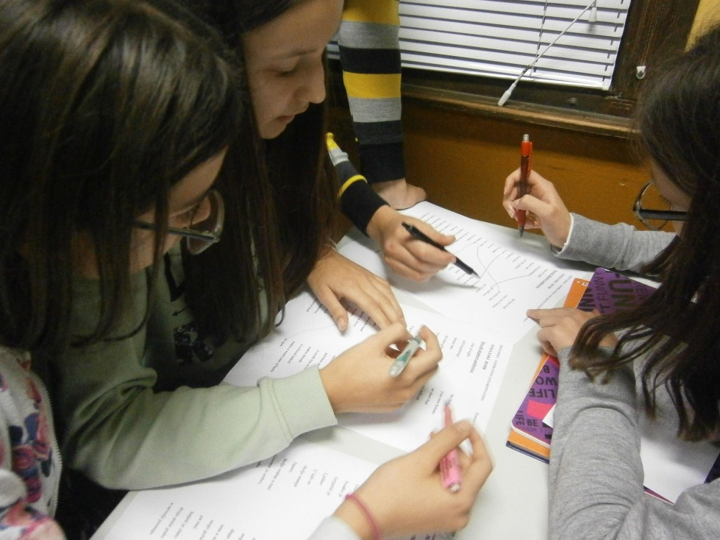
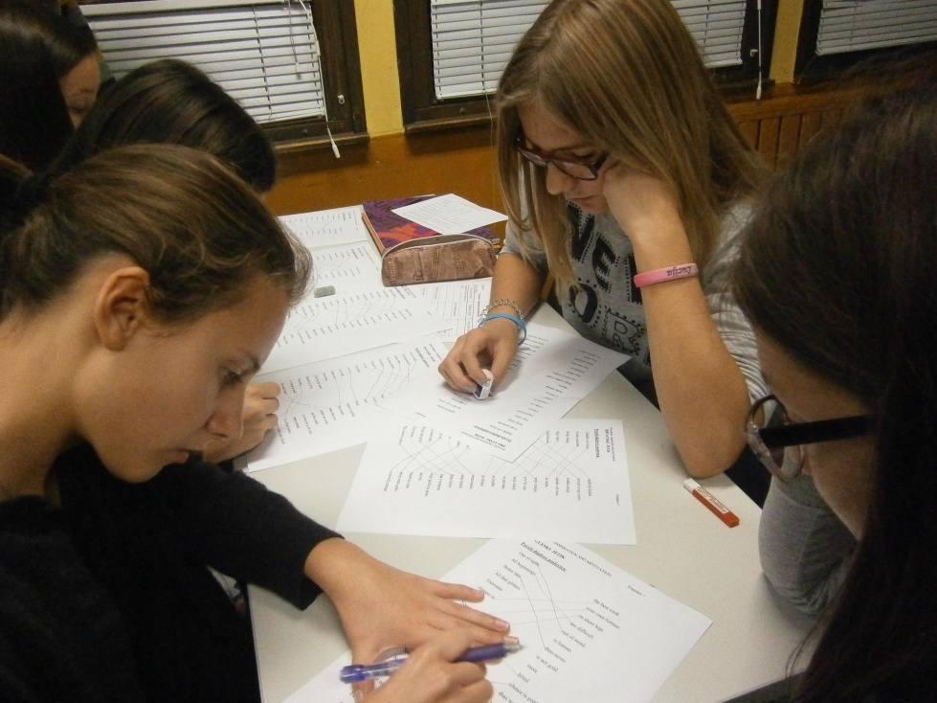
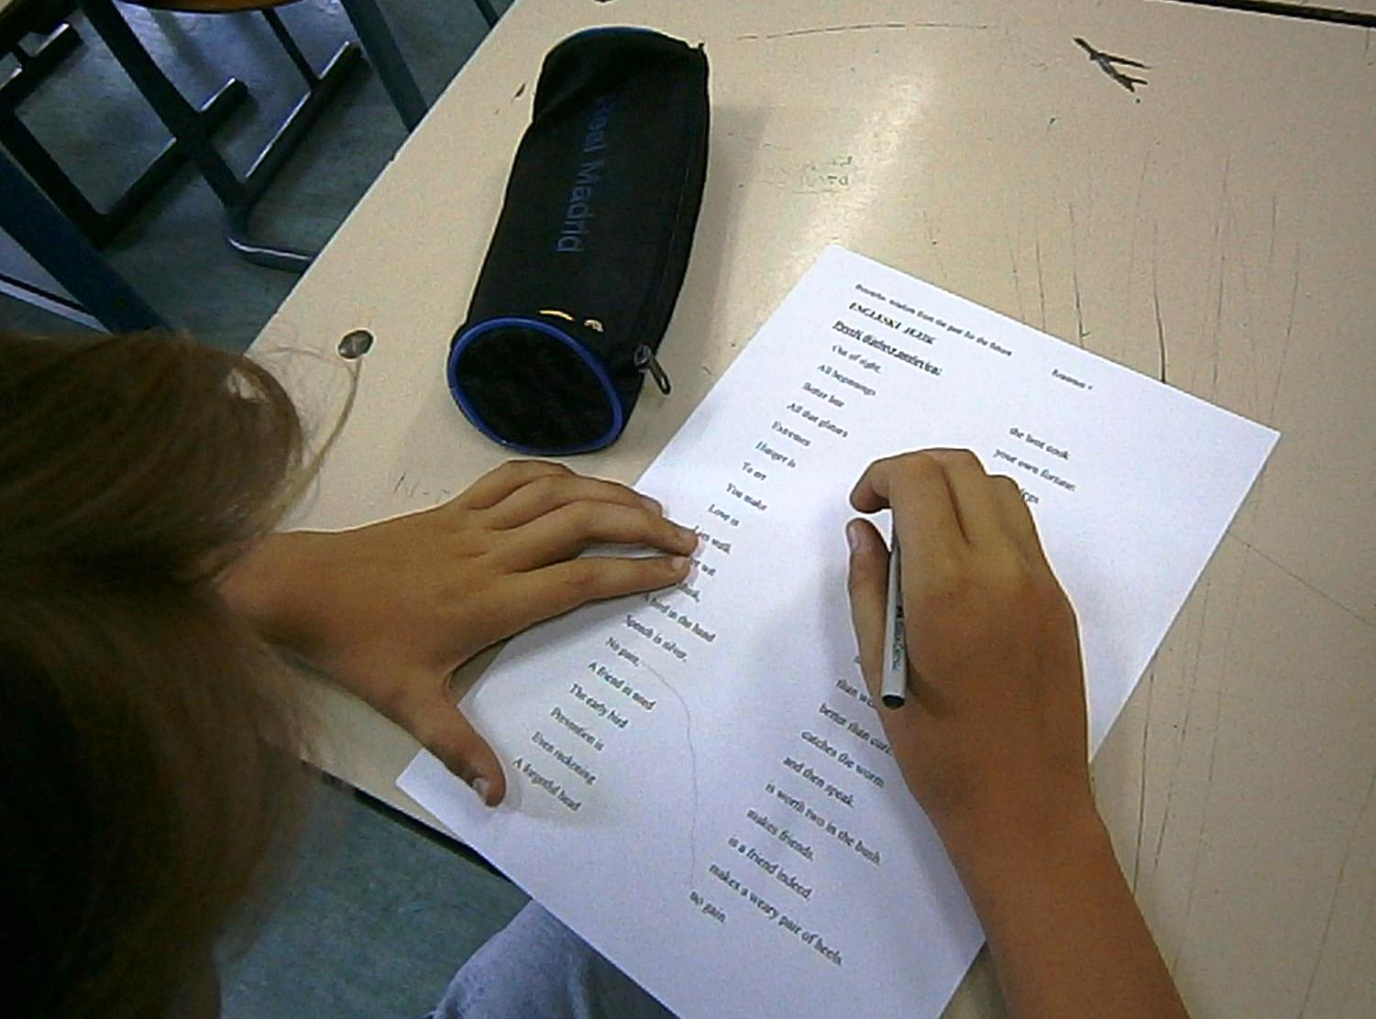
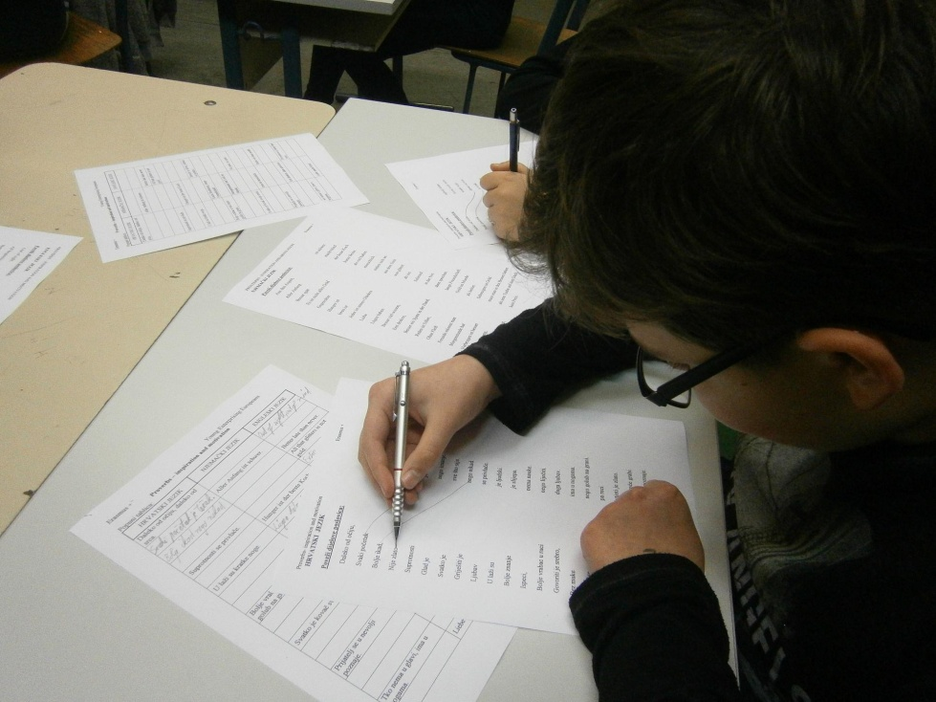

Slide 15
We found lots of quotes that can motivate and inspire us:
“With an enthusiastic team you can achieve almost anything.” Tahir Shah
“A plan is what, a schedule is when. It takes both a plan and a schedule to get things done.”
Peter Turla
“Alone we can do so little, together we can do so much.” Helen Keller
„I have not failed. I’ve just found 10,000ways that won’t work.
Thomas A. Edison
“Teamwork is the ability to work together toward a common vision.” Andrew Carnegie
“ If everyone is moving forward together, then success takes care of itself.” Henry Ford

Slide 16
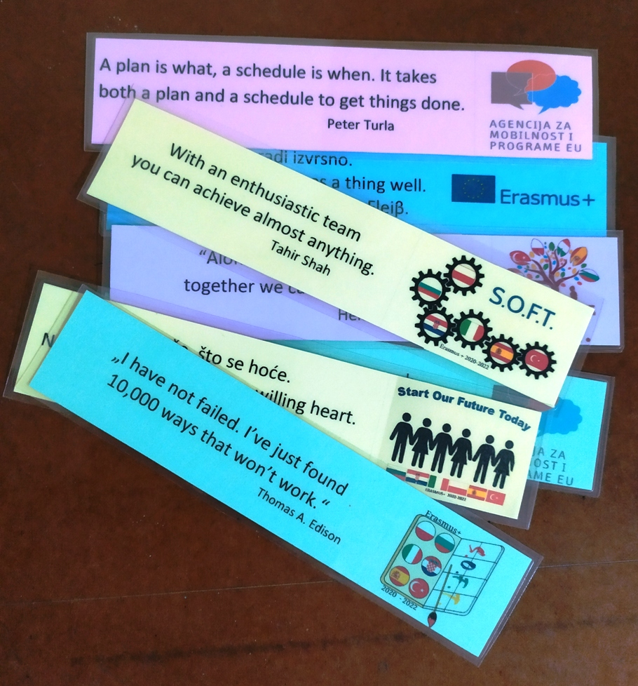
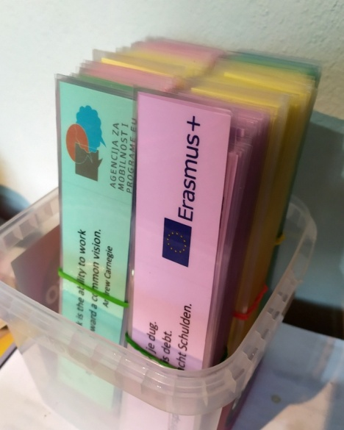
Laminated proverbs will be handed out to visitors of Vinkovci Health Fair in April, at our school’s Open Doors Day in June and on other occasions.
They can be used as bookmarks.

Slide 17
Every student chose one proverb, explained to his/her classmates how he/she understands it and decided to use it as often as possible in conversations, so that other people have the chance to learn new proverbs. Students learned that “He that will thrive, must rise at five” is not just about getting up early and that “The early bird catches the worm” is not only about birds and worms and why “Lies walk on short legs.”

Slide 18
Resources:
Pavao Mikić, Danica Škara: Kontrastivni rječnik poslovica, August Cesarec, Školska knjiga, Zagreb, 1992. Christa Frey,Annelies Herzog, Arthur Michel, Ruth Schütze: Deutsche Sprichwörter für Ausländer, VEB Verlag Enzyklopädie, Leipzig, 1981. Sun Tzu: Umijeće ratovanja, Mozaik knjiga, Zagreb, 2009. https://www.linkedin.com/pulse/5-powerful-strategy-business- lessons-from-art-war-sun-d-suryawanshi http://www.businessinsider.com/the-art-of-war-sun-tzu-2011-5 http://www.phrasemix.com/collections/the-50-most-important-english-proverbs https://www.moneymanagement.org/Community/Blogs/Blogging-for-Change/2013/May/Financial-proverbs-that-are-still-true-today.aspx

