Slide 1
Erasmus+ project S.O.F.T. – Start Our future Today 2020-1-PL01-KA229-081533
PROJECT BASED LEARNING Gordana Maršić Osnovna škola Bartola Kašića, Vinkovci
PBL
Meeting in Poland, November 2021

Slide 2
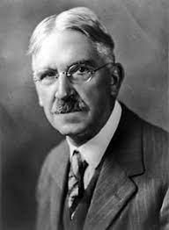
John Dewey was an American philosopher, psychologist and educational reformer. Because of his methods of teaching, which were based the principles “learning by doing”, he is regarded as the founder of project-based learning. Dewey's theories on learning advocated a life-long learning approach where learning happens when students interact during real life tasks.
1859-1952

Slide 3
Project based learning, PBL - teaching method, the main goal is learning by solving problems - it is closely linked to the curriculum - traditional ways of teaching and learning from textbooks are not considered to be appropriate fot the development of the key competences necessary for the living and working in the 21st century - it often connects mulltiple school subjects - research has shown that pupils that had project based learning at schools achieve far better results in final exams

Slide 4
21st century skills
The 4 Cs Learning and innovation | Digital literacy | Career and life
Critical thinking and problem solving Creativity and innovation Communication Collaboration | Information literacy Media literacy ICT literacy | Flexibility and adaptability Initiative Social and cross-cultural interaction Leadership Responsibility

Slide 5
The differences between projects and project based learning
Projects | Project-based learning
Can be done at home without teacher guidance or team collaboration. | Require teacher guidance and team collaboration.
The teacher work occurs mainly after the project is complete. | The teacher work occurs mainly before the project starts.
The pupils do not have many opportunities to make choices at any point of the project. | The pupils make most of the choices during the project within the pre-approved guidelines.
Are closed: every project has the same goal. | Is open: pupils make choices that determine the outcome and path of research.
Cannot be used in the real world to solve real problems. | Could provide solutions in the real world to real problems even though they may not be implemented.
Are not particulary relevant to pupils’ lives | Is relevant to pupils’ lives or their future lives.

Slide 6
Projects | Project-based learning
Do not resemble work done in the real world. | Is just like or closely resembles work done in the real world.
Happen after the “real” learning has already occured. | Is how pupils do the real learning.
Are turned in. | Is presented to a public audience (at least exhibition in the school hall).
Are all the same. | Is different.
Example: Make a model of the school,... | Example: Design a fortification that would take your community through a bio or other non-traditional attack and amke a reccomendation th the city counci8l for the future planning.

Slide 7
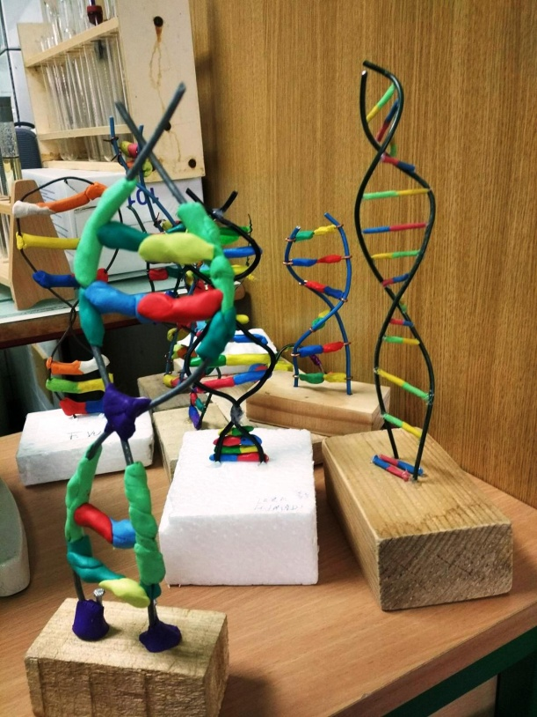
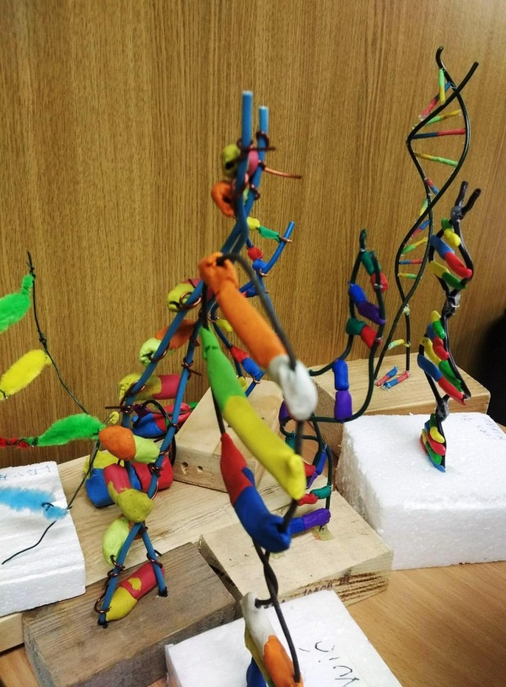
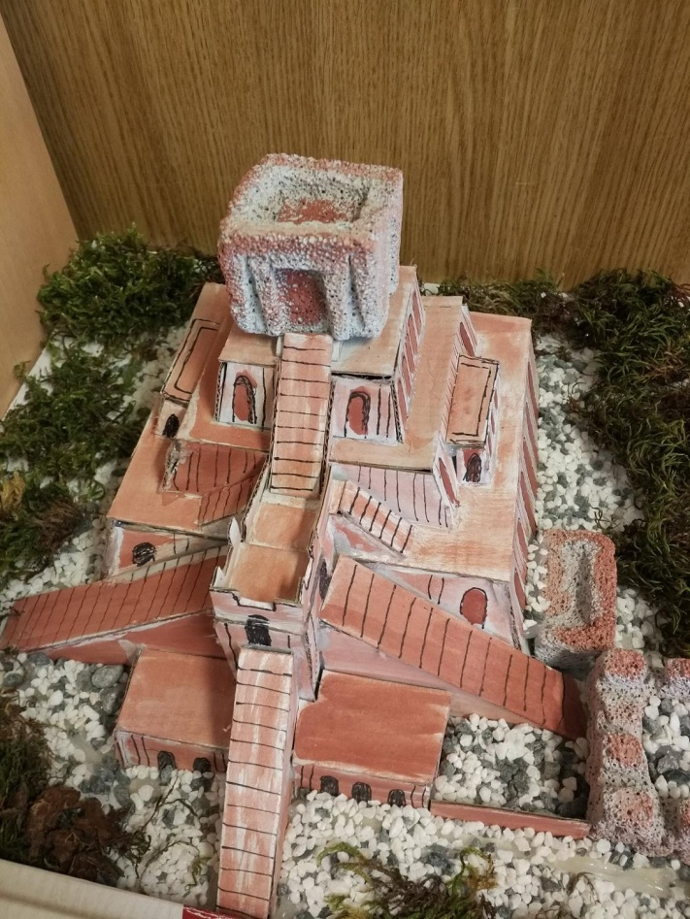
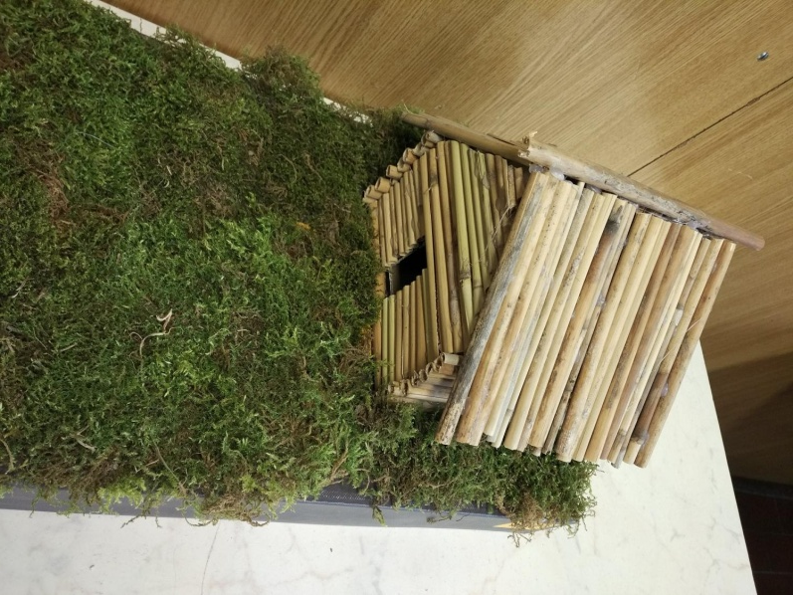
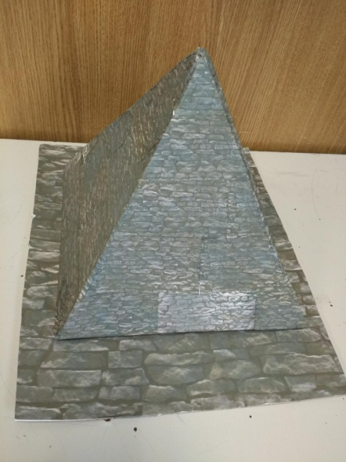

Slide 8
Project-based learning components:
- the topic of the project is determined by the teacher according to the existing curriculum
- pupils develop key 21st century skills
- driving question
- the pupil’s need to solve problems and acquire knowledge
- respecting pupils’ preferences and desires - allowing pupils to make decisions
- getting to know the problems, making assumptions for solving them
- execution of the project, work on the topic according to the plan and with the teacher's help and supervision
- presenting solutions outside the classroom
- the teacher and pupils together assess the applicability of the solution

Slide 9
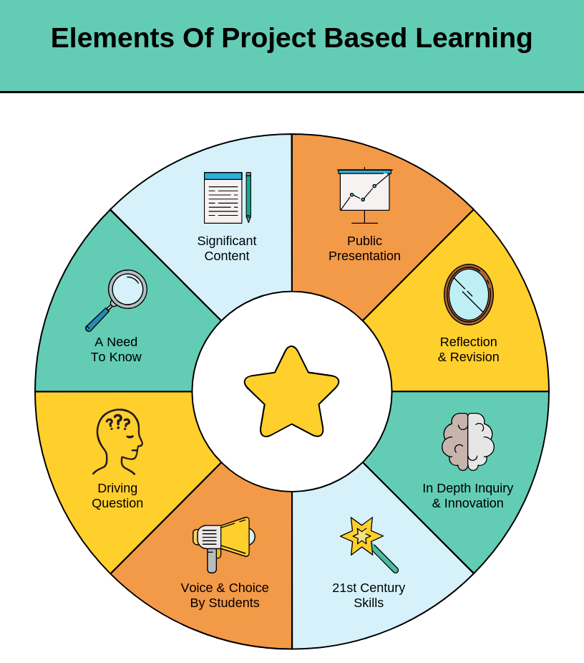

Slide 10
Projects can result in:
- learned teaching material
- educating / informing others
- inviting groups of people to action
- creating something useful for pupils/ community
- event planning
- collecting money for a purpose
- inspiring others
- devising a better way to do something

Slide 11
Driving question – checklist: - the question is appealing to pupils - the question is concise - the question has no easy answer - the question taps into pupils interests - the question leads to more questions - there is more than one answer to the question - the topic is personal or local - pupils can relate to the question in their daily lives - pupils have choices for end product - the wqestion requires serious investigation - there is an authentic audience for the project - pupils will learn important skills and content - the project will somehow make a difference in the world

Slide 12
Driving question
Bad | Good
How did the anciant Greeks contribute to the development of modern civilization? | How Greek are we?
Is China powerful because of its history, geographical location or political and economic system? | Why is China a powerful country?
What is an epic poem? | How can I write an epic poem about an important event from my life?
Which food is healthy? | Does it matter what food we eat?
Which advertising techniques are most effective? | How can we create a website where we recommend books to the youth of our city?

Slide 13
Bad | Good
What is global warming? | How will global warming affect our community?
what caused the Great Depression? | Can the Great Depression happen again?
How many / What senses do we have? | How do we use our senses to discover the world around us?
Bad: pupils can easily find the answer on the Internet, the answer is too obvious, the question does not leave an open end | Good: it takes planning, discussing, it’s harder to come up with an answer

Slide 14
Driving question: Do we need heroes? Can theft ever be justified? How can we reduce energy consumption in school? Who is the real leader? What if Rosa Parks had given up her seat on the bus? How does science affect sport? How safe is our community? How do our decisions affect our health? Is exercise enough for success? How do animals communicate? Can society function without government? Why do we use money? Is technology changing our lives for the better?

Slide 15
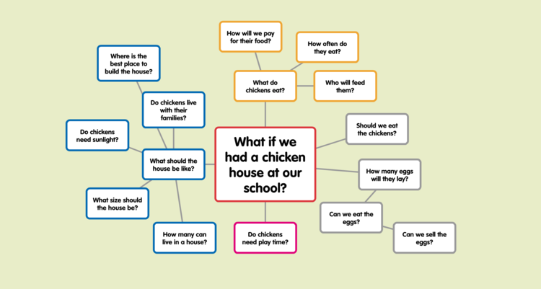
Branching questions

Slide 16
What should be the area and depth?
Which spot in the park is the most suitable?
How can we make a pond in the school park?
How can we prevent loosing the water?
Which plants can we plant?
Can we have fish? Which ones?
Can we use water from our public water supply system?
How do we solve the problem of water overheating in the summer?
Price?

Slide 17
Project workflow: - the teacher chooses what the pupils have to learn - driving question – pupils present what they already know about it - pupils suggest the final product and plan - research (in pairs or groups) - bring the first draft to the teacher, discuss the good parts and shortcomings - making the final product - presentation of research results - evaluation

Slide 18
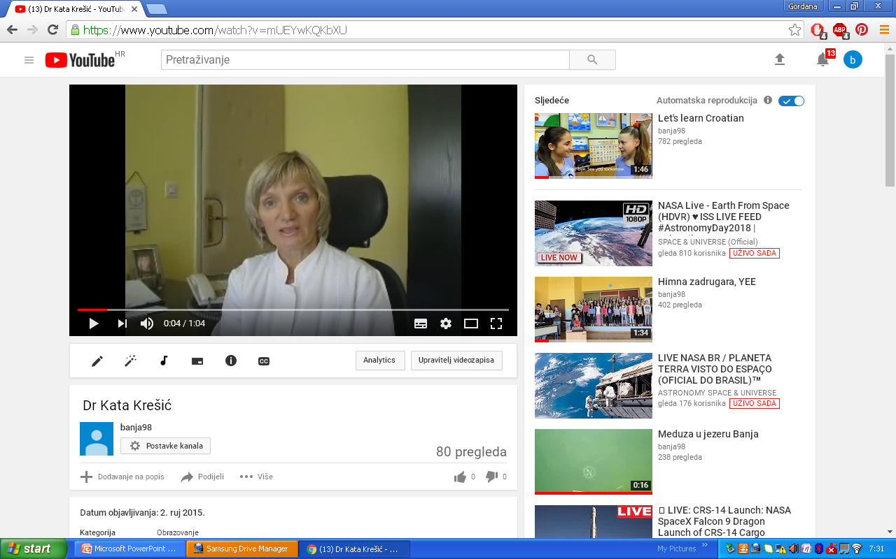
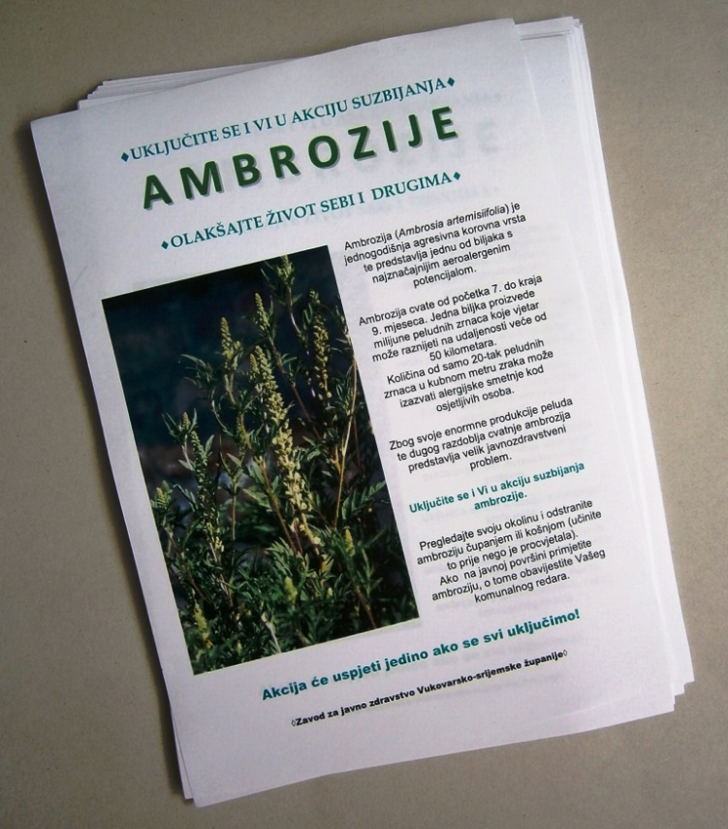
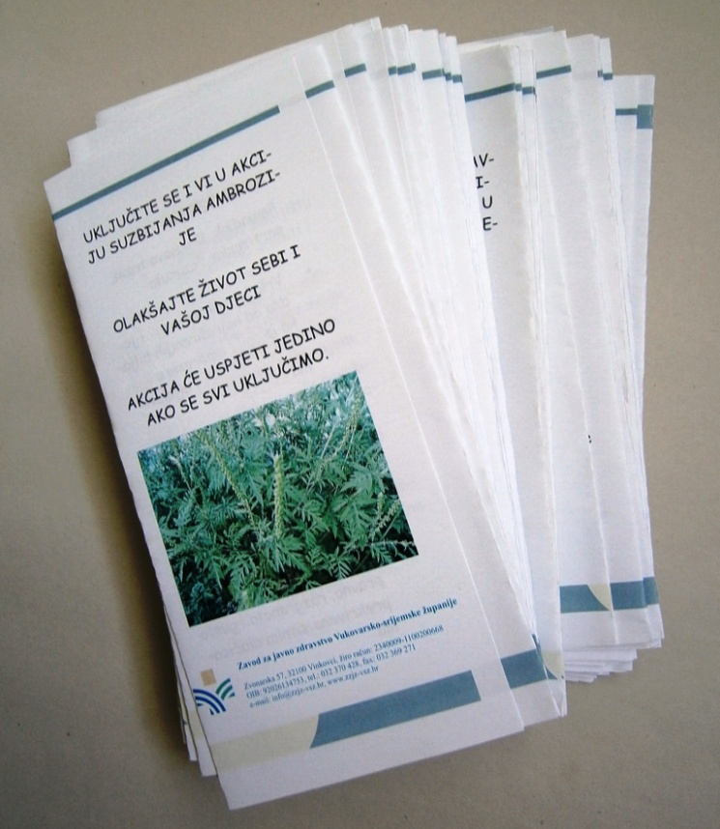

Slide 19
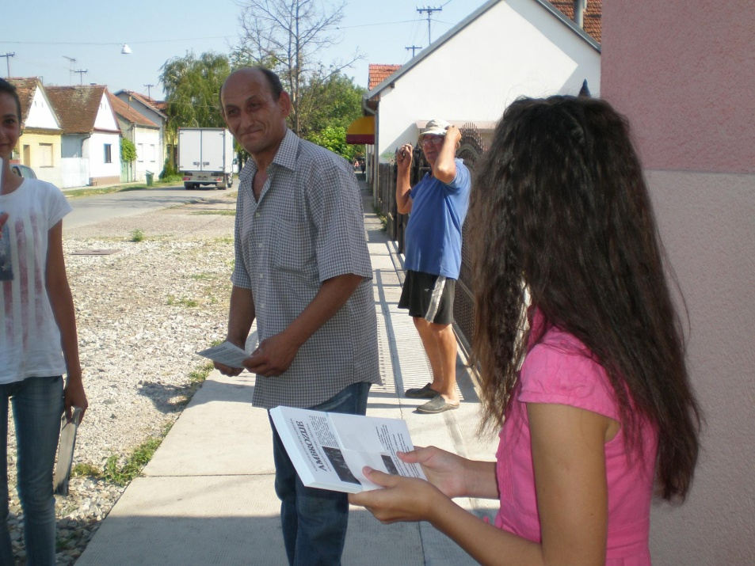
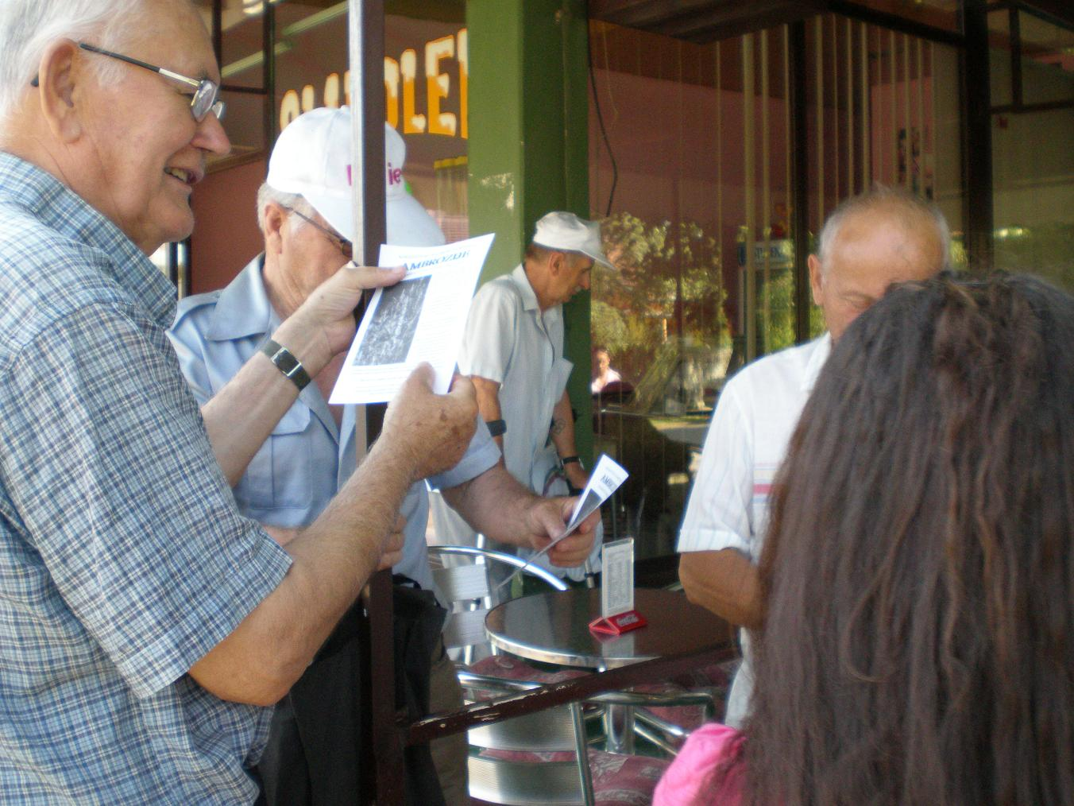
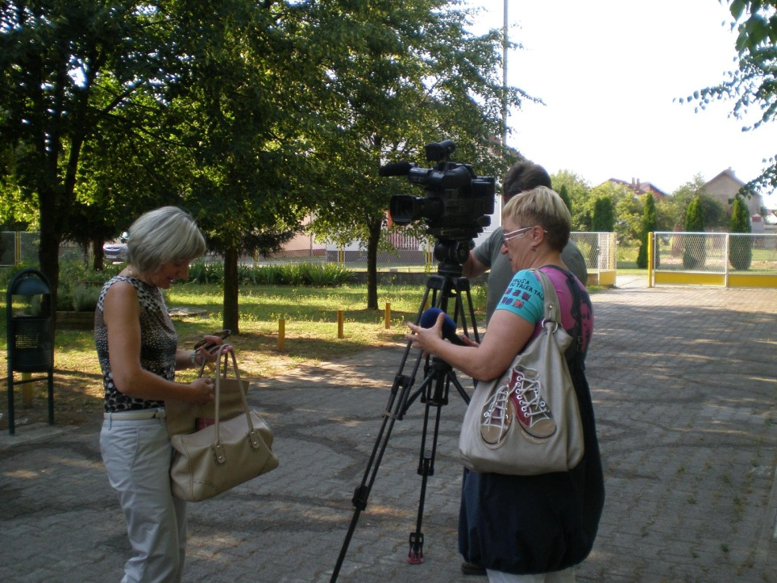

Slide 20
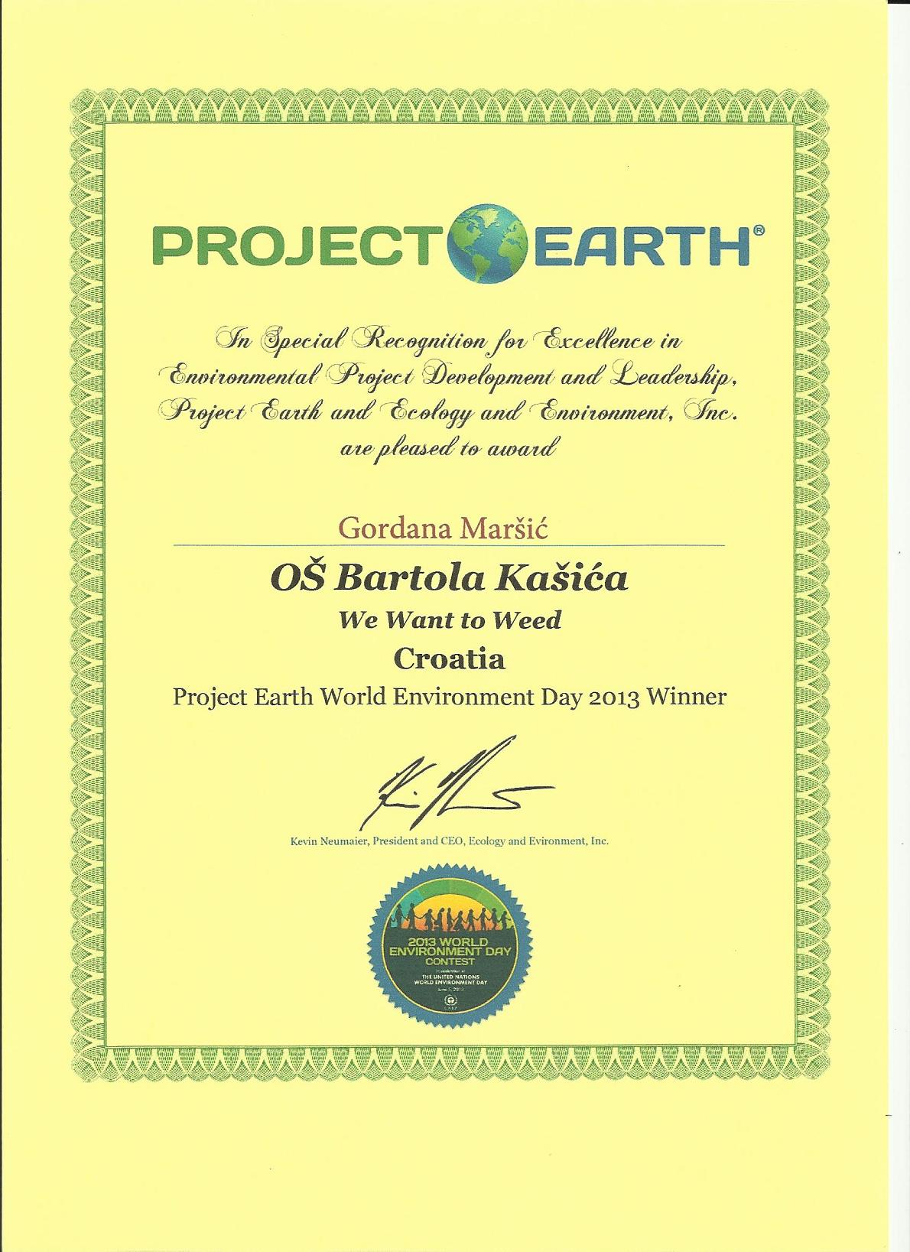
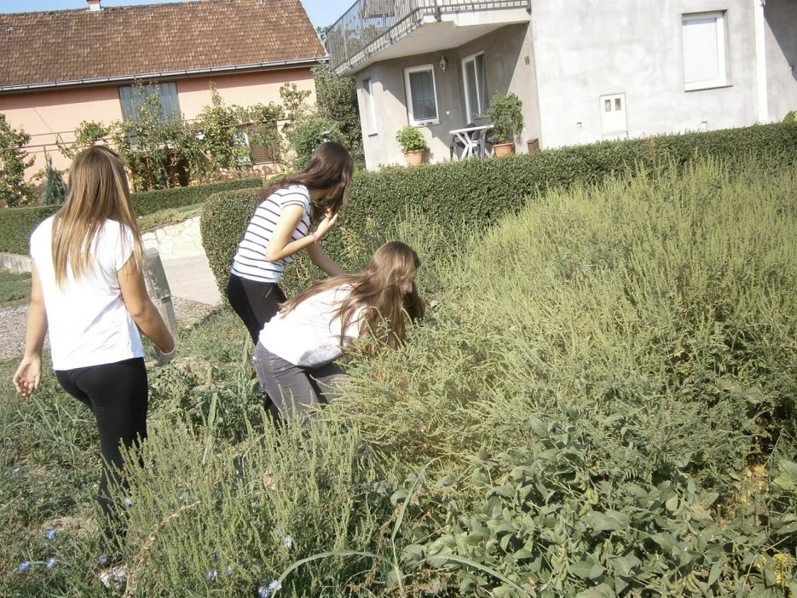

Slide 21
Advantages of project-based learning:
- a good question motivates almost all pupils to work and research
- better understanding of the material – pupils develop communication skills, cooperation with others - pupils develop creativity
- pupils develop critical thinking - pupils make decisions, they can choose the way they work according to their preferences - the process is important, not just the result

Slide 22
Disadvantages, possible problems: - PBL requires much more time than classical teaching - fear that some students will not work (can be avoided by carefully forming groups) - teachers sometimes find it difficult to find the right driving question (pupils quickly identify false challenges, set problems) - teachers accustomed to the status of “know-it-all“ person find it difficult to cope know the solution to the problem faced by students - the teacher must research and help students to obtain sources for research - student assessment requires precise criteria - acceptance of failure

Slide 23
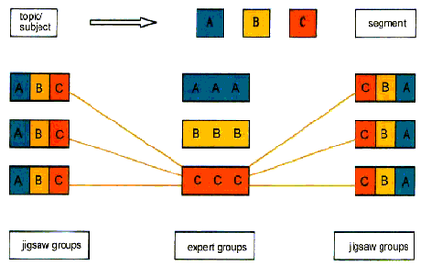

Slide 24
Accepting effective failure - the potential for failure is not a drawback of this method of learning - pupils must see problem solving as an opportunity to link theoretical school knowledge with real problems - pupils will not be able to create clear solutions to every problem they face - failure is a great opportunity to show students how their actions have consequences in real life and that success is not guaranteed - problem solving is not an exam and perfection is not the goal - failure does not affect the grade

Slide 25
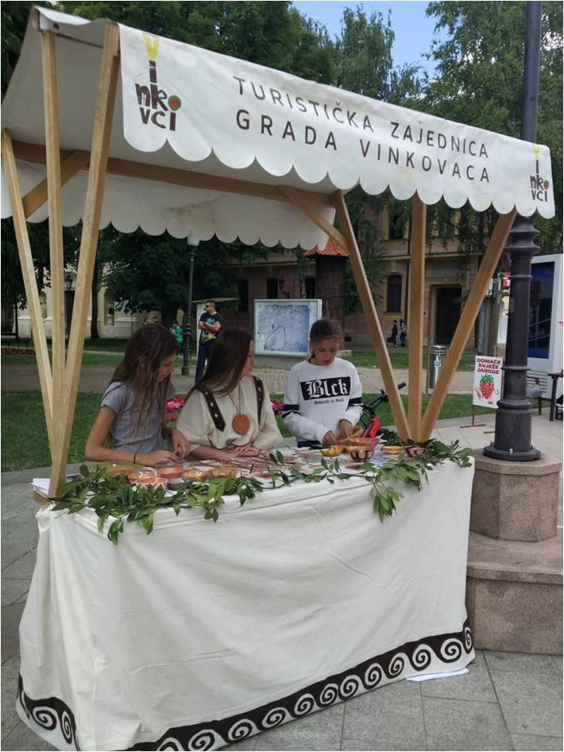
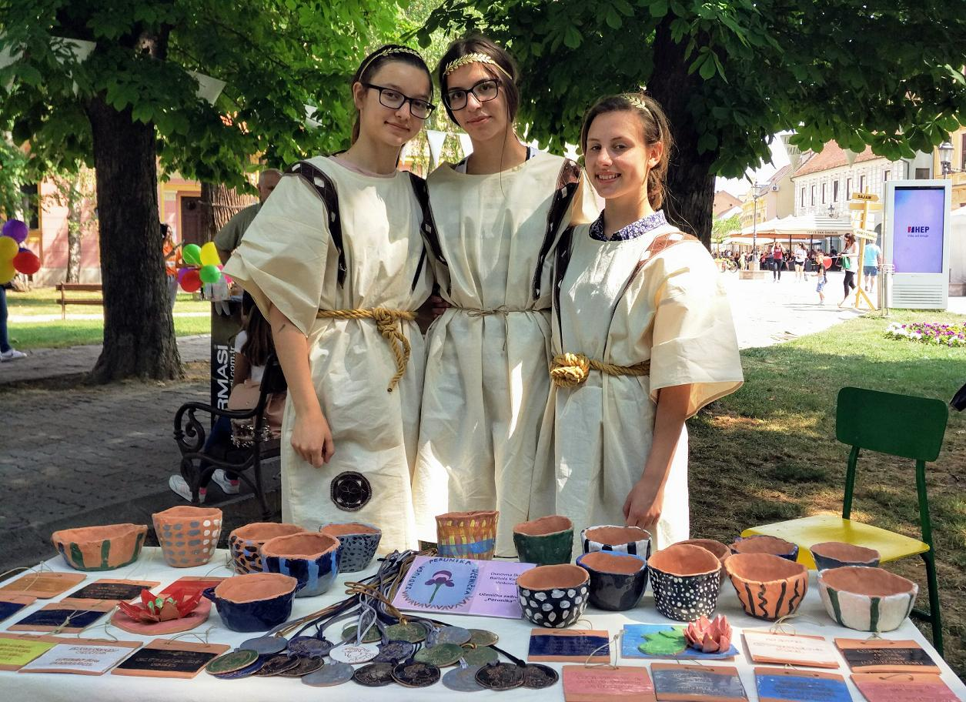
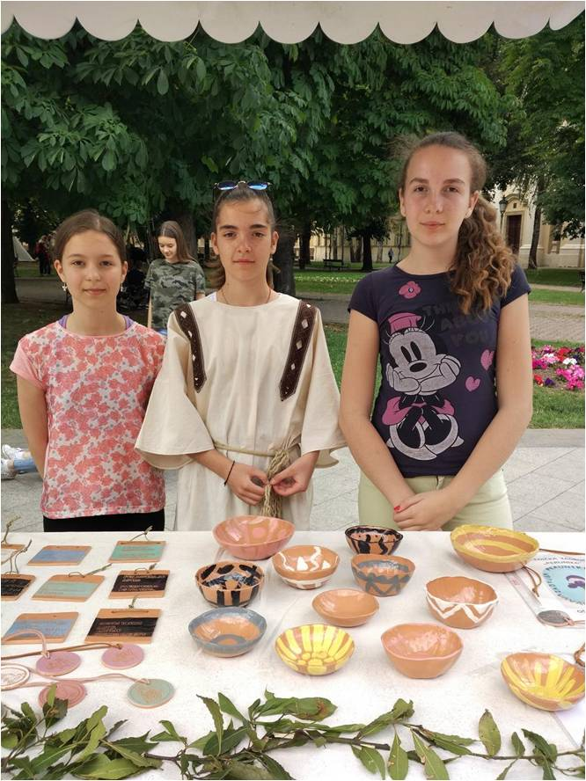
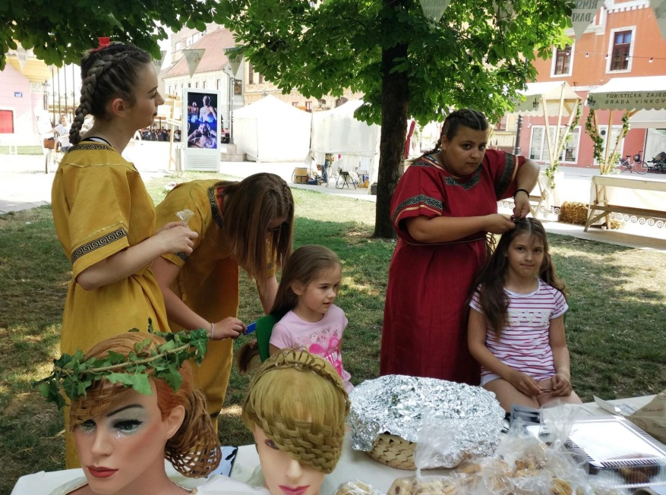
Roman Days: 2017 and 2018

Slide 26
What can we do to help the Boar Špiro and the citizens Split?

Slide 27
Sources:
https://www.edutopia.org/project-based-learning-history
https://www.pblworks.org/what-is-pbl
https://www.powerschool.com/resources/blog/project-based-learning-benefits-examples-and-resources/
https://www.teachthought.com/project-based-learning/smart-ideas-for-project-based-learning/
https://www.prodigygame.com/main-en/blog/project-based-learning/
https://www.southwestern.edu/about-southwestern/university-leadership/past-presidents/edward-burger/effective-failure/
http://bonnieblan.pbworks.com/w/page/83263720/Project%20Based%20Learning
https://www.pblworks.org/blog/gold-standard-pbl-public-product
https://www.edutopia.org/blog/pbl-failure-planning-successful-pbl-katie-spear

Slide 28
Thank you for your attention!

