Slide 1
Osnovna škola Bartola Kašića Vinkovci Erasmus+ project 2020-2023 S.O.F.T. – Start our future today 2020-1-PL01-KA229-081533_4
MY FUTURE PROFESSION
May 2022

Slide 2
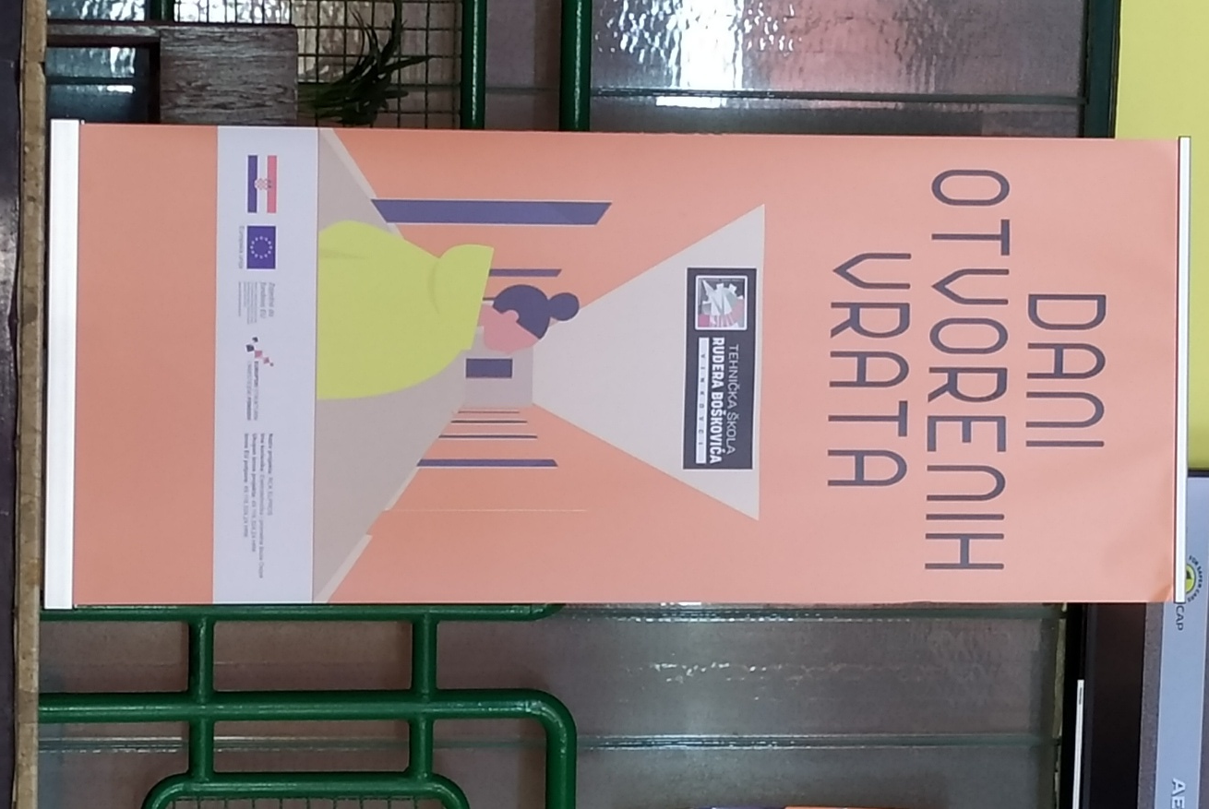
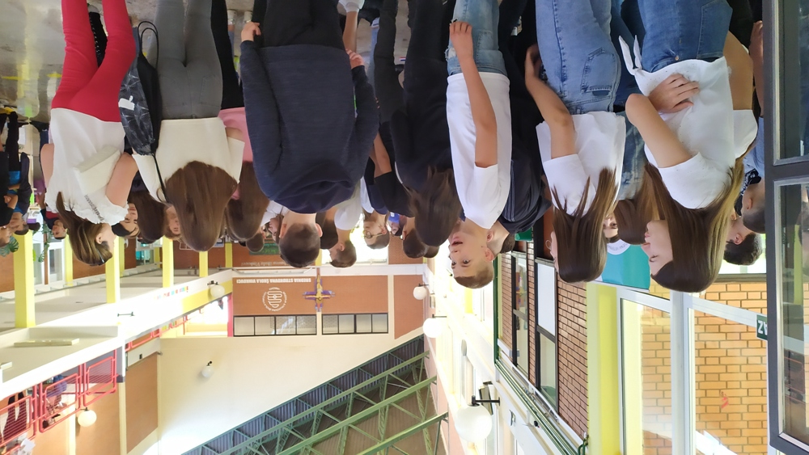
Four secondary schools in Vinkovci schools organized an Open Doors Day on 13 May to show eighth graders from primary schools what opportunities they have for further education and choosing their future profession.

Slide 3
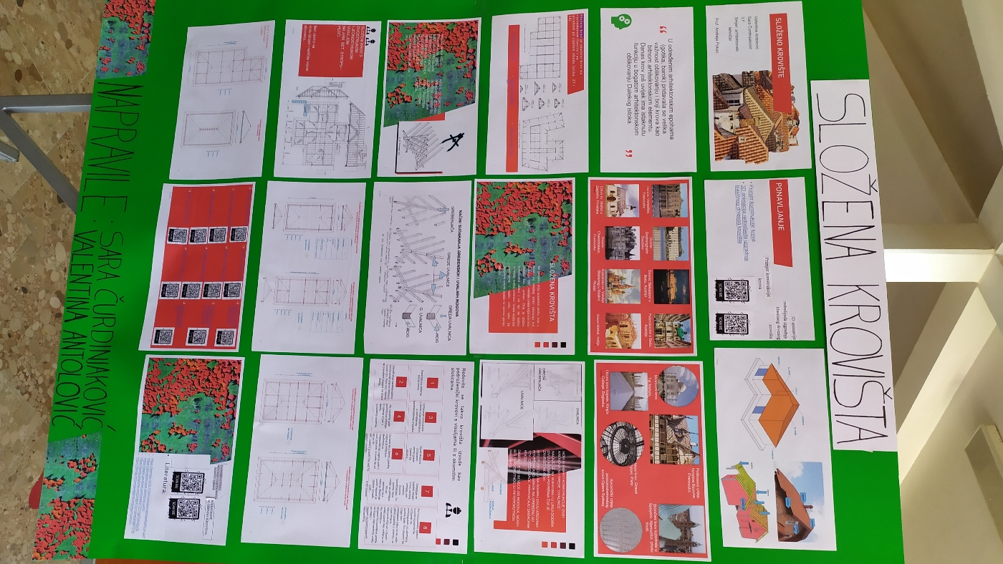
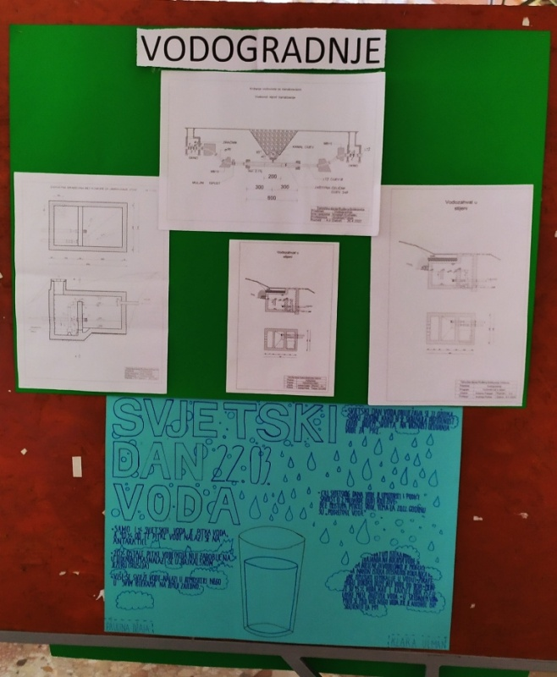
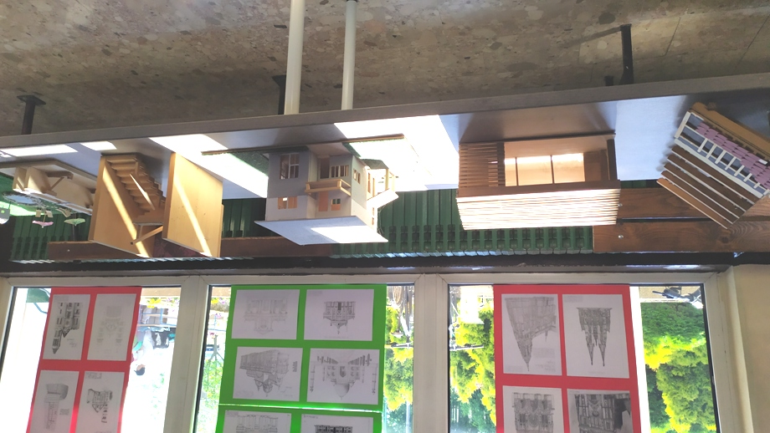
There was an exhibition in the hall

Slide 4
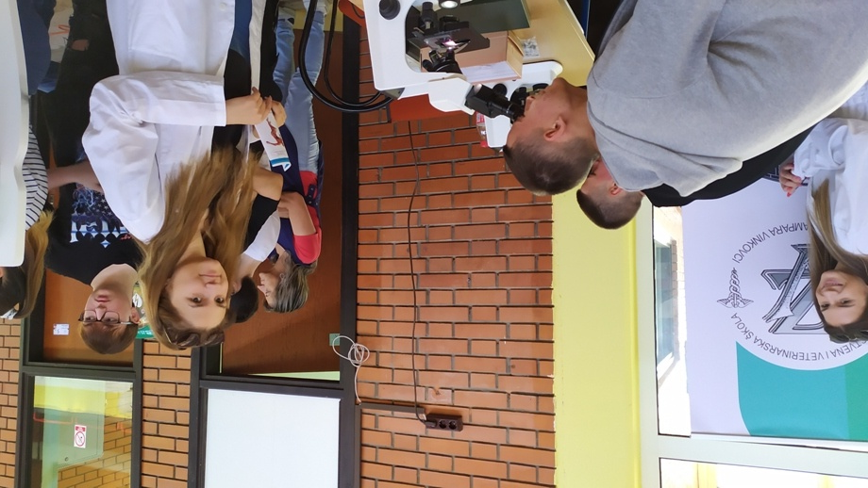
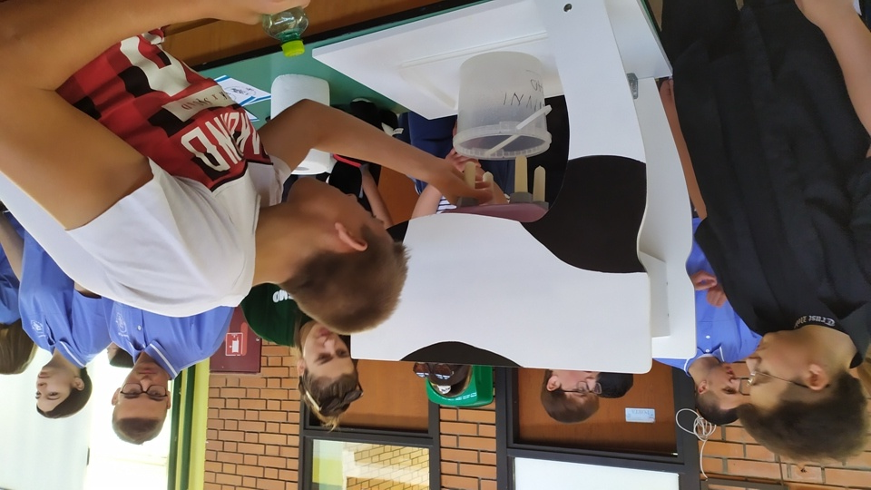
Medical and veterinary school

Slide 5
Blood pressure measurement

Slide 6
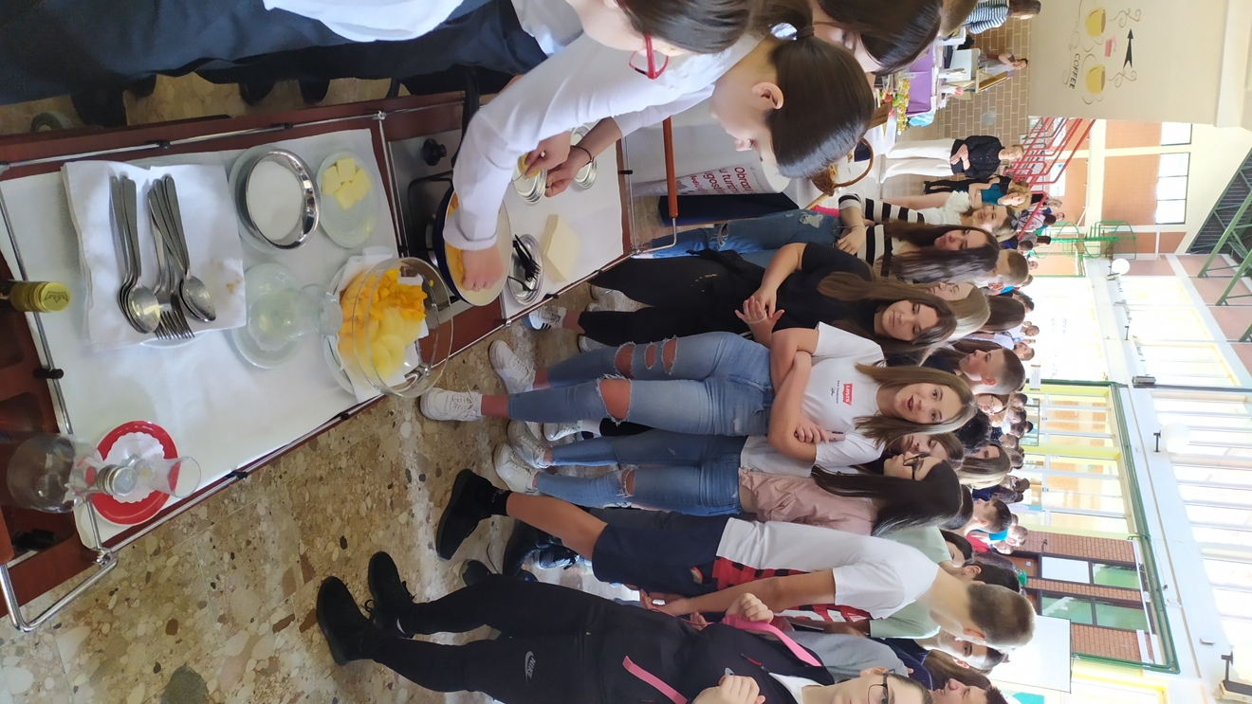
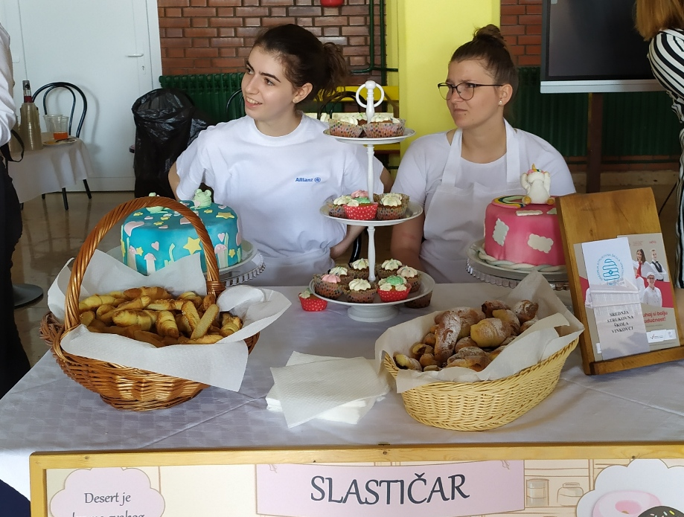
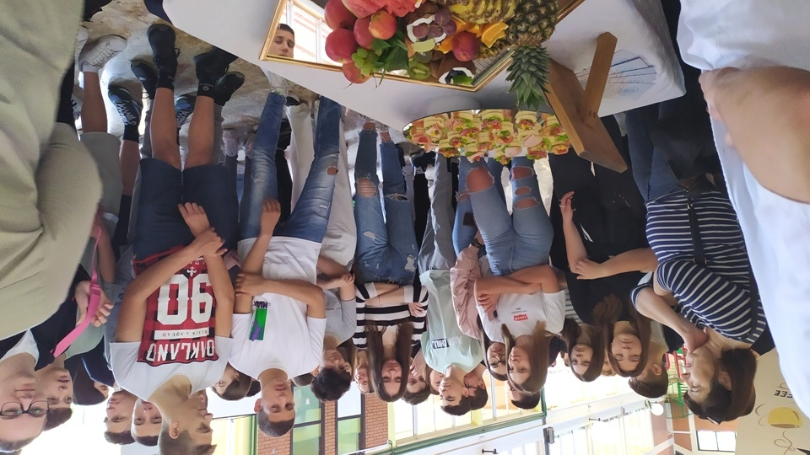
Vocational school: Future chefs and confectioners

Slide 7
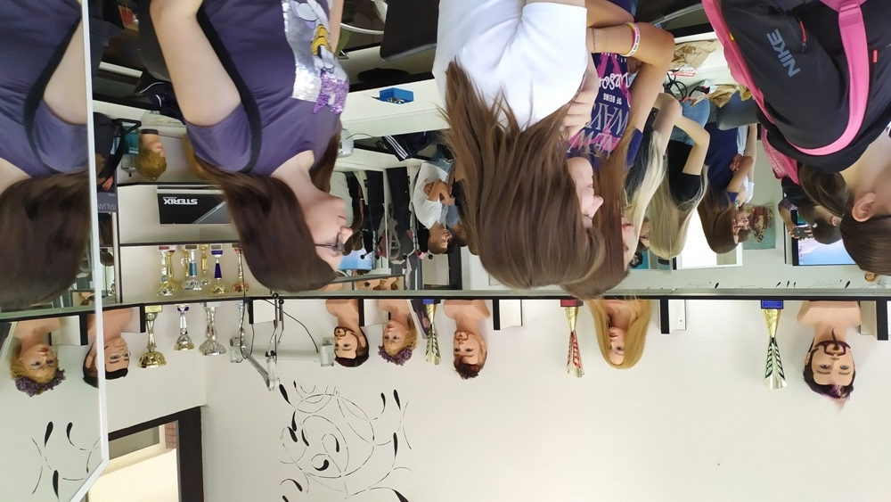
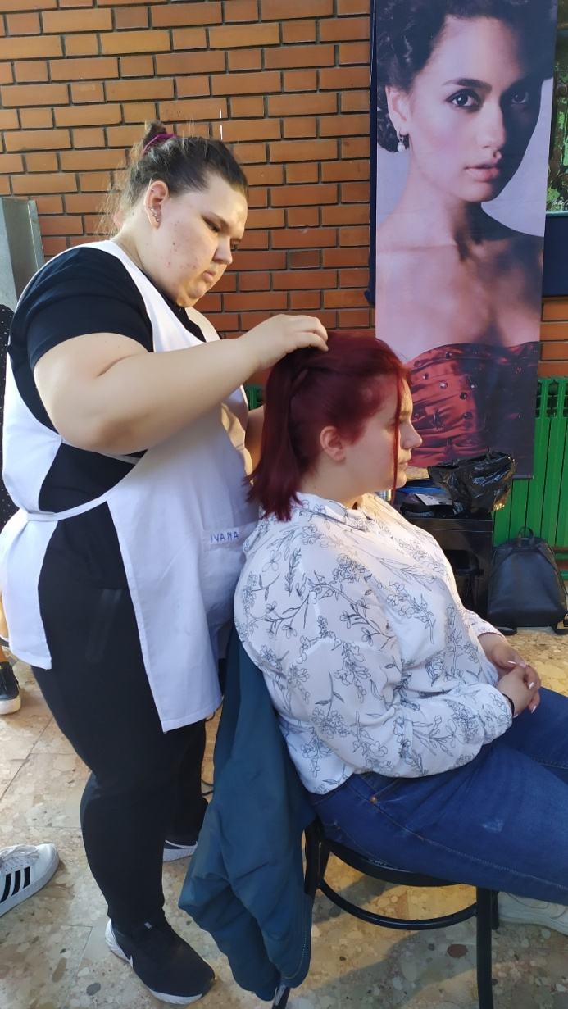
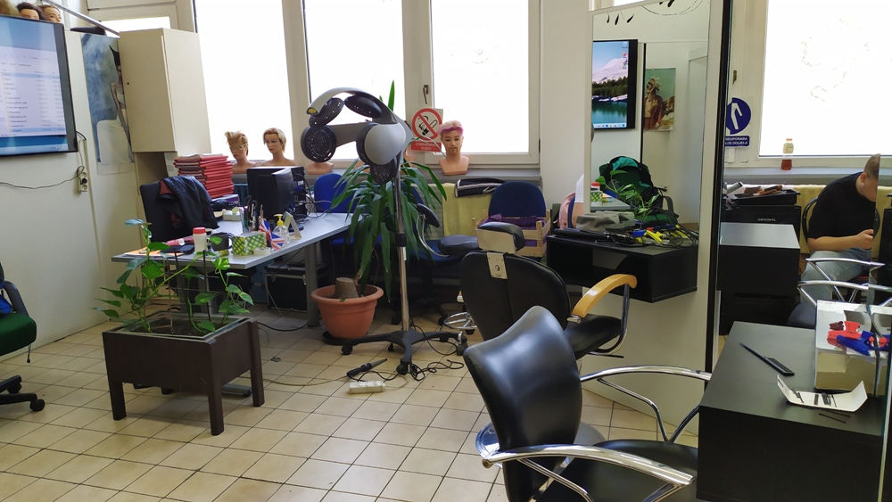
Hairdressers

Slide 8
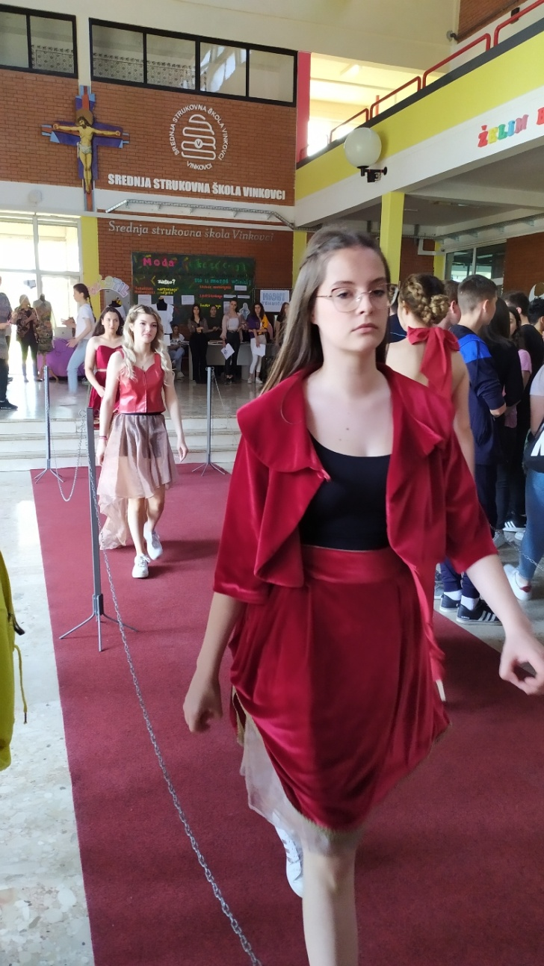
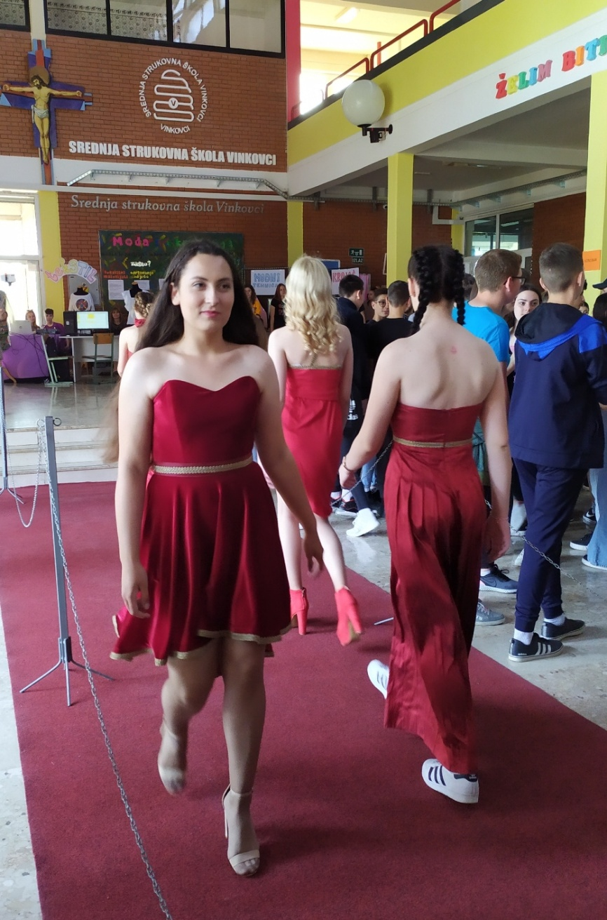
Fashion designers and tailors prepared a fashion show

Slide 9
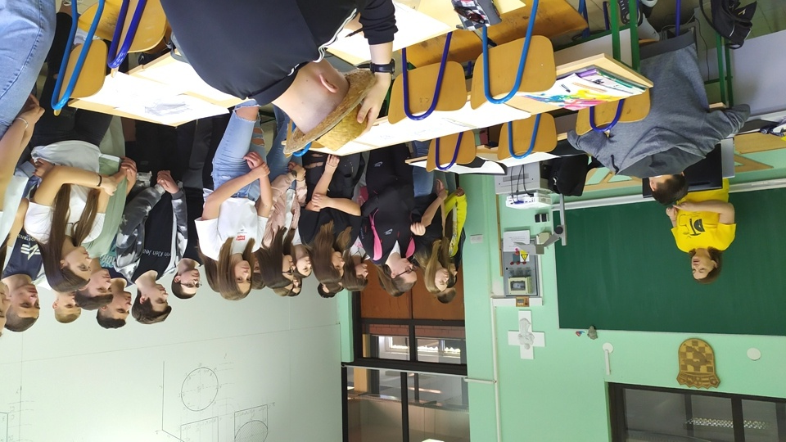
Carpentry technicians must be able to draw well

Slide 10
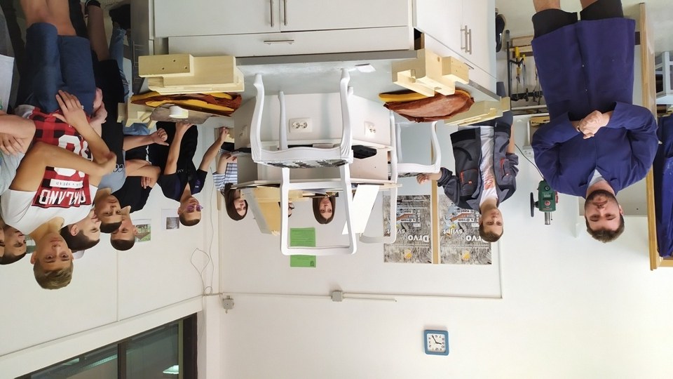
Restoration of old furniture

Slide 11
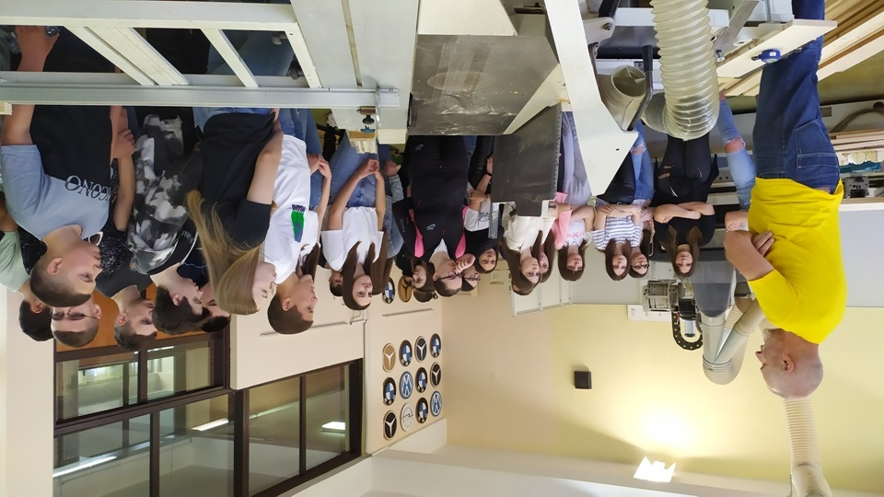
Woodworking workshops equipped with modern machines

Slide 12
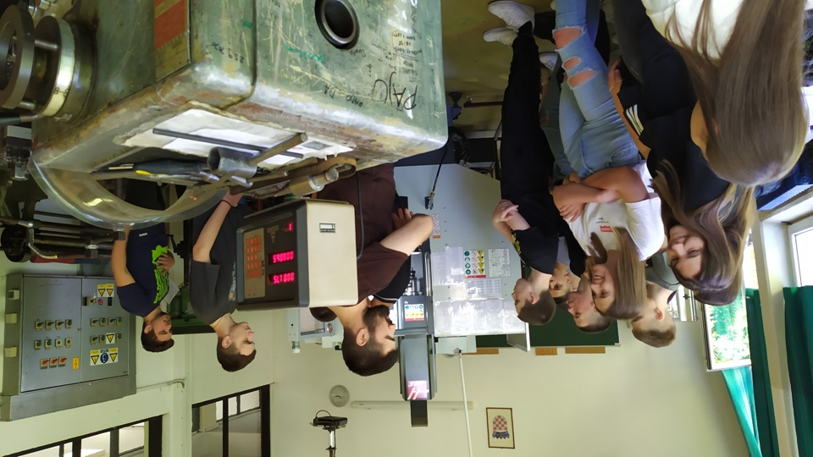
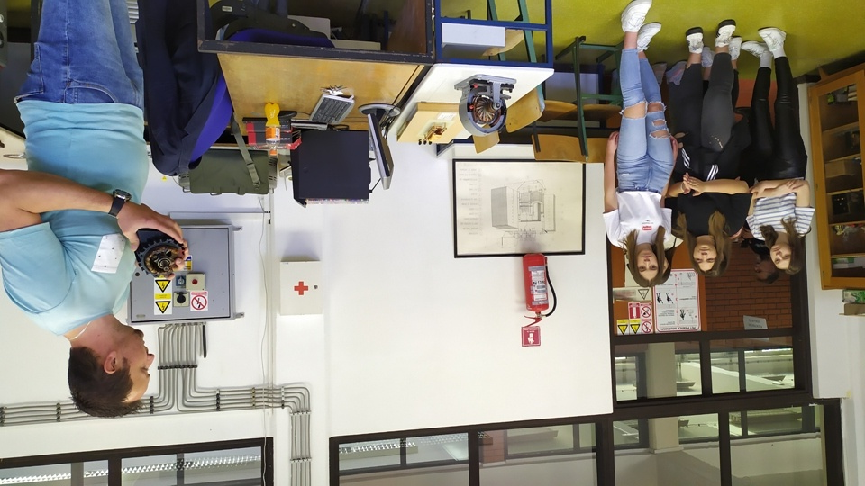

Slide 13
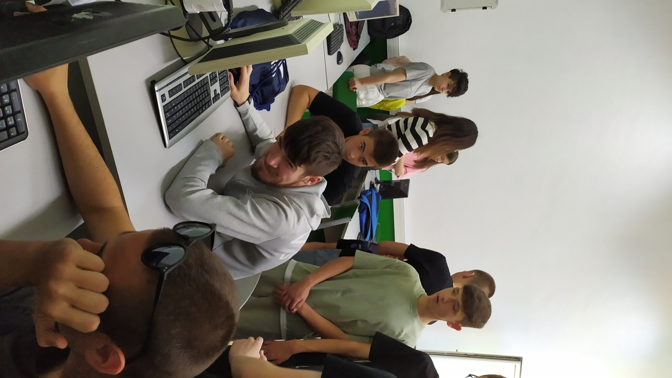
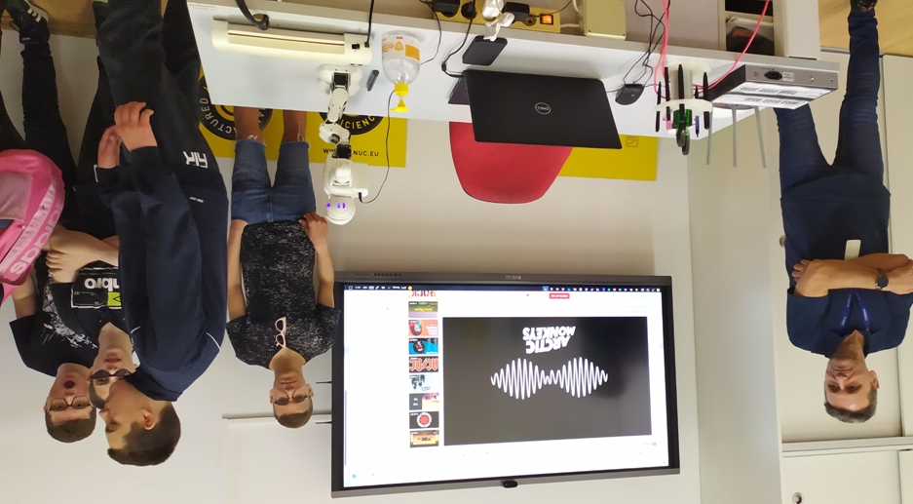
Technical school also has lots of computers for mechatronics students

Slide 14
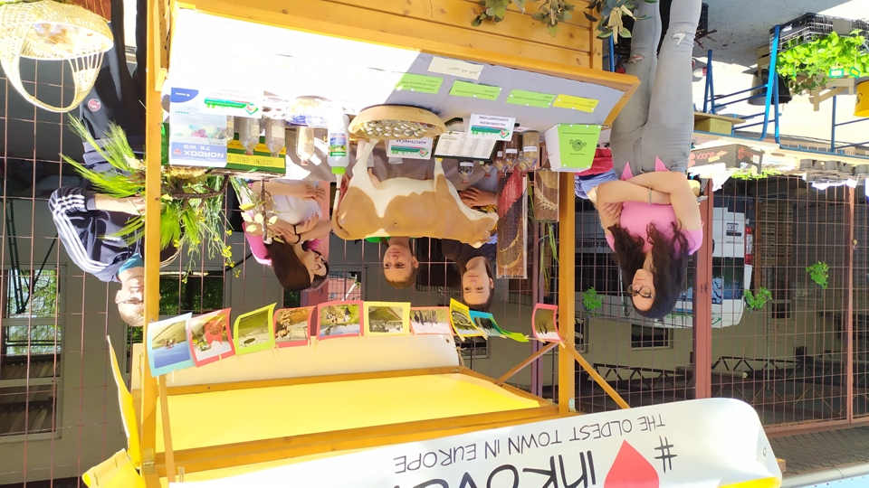
Agricultural and forestry school

Slide 15
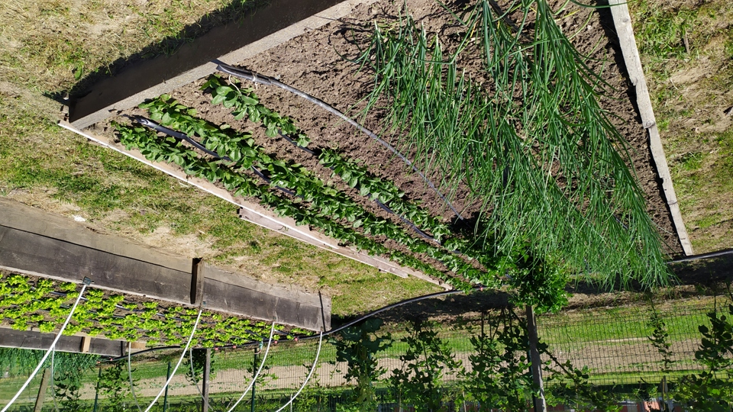
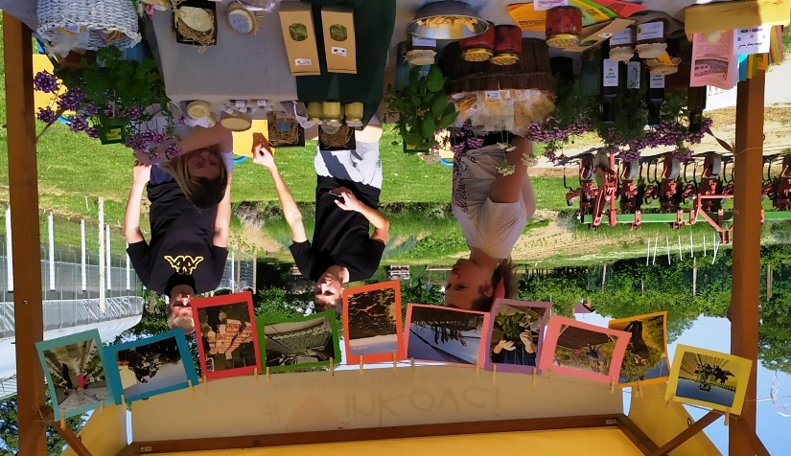
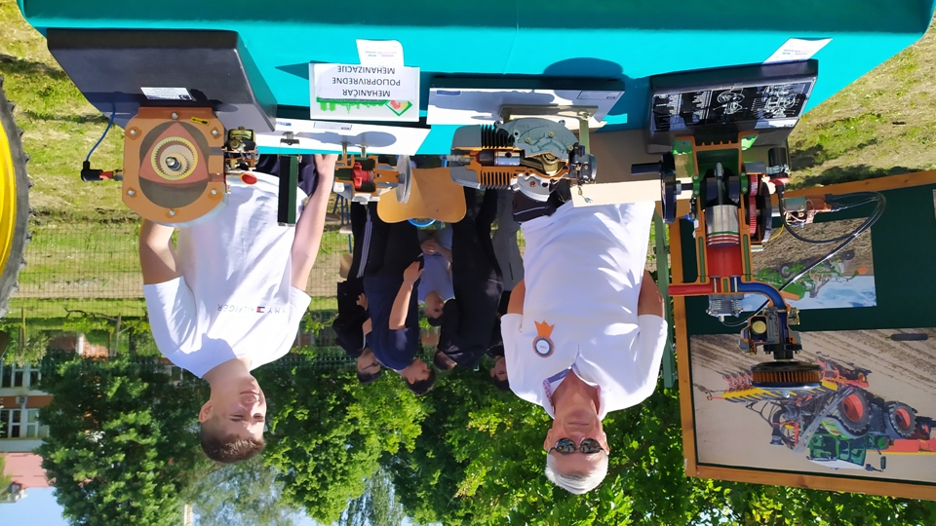
Students grow vegetables, flowers, fruits, make jams, apple chips, etc. and learn about agricultural machinery

