Slide 1
Osnovna škola Bartola Kašića Vinkovci, Croatia Erasmus+ project 2020-2023 How Roman are you? 2020-1-DE03-KA229-077527
Meeting in Vinkovci
May 2022

Slide 2
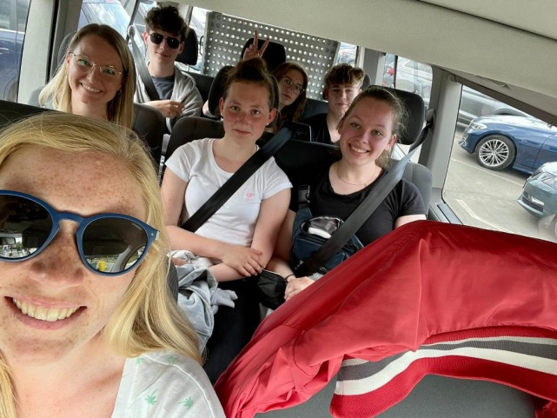
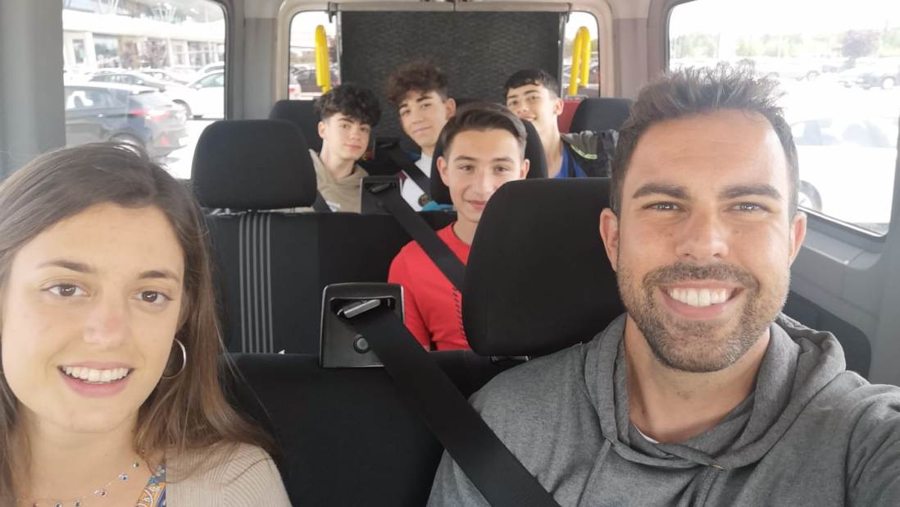
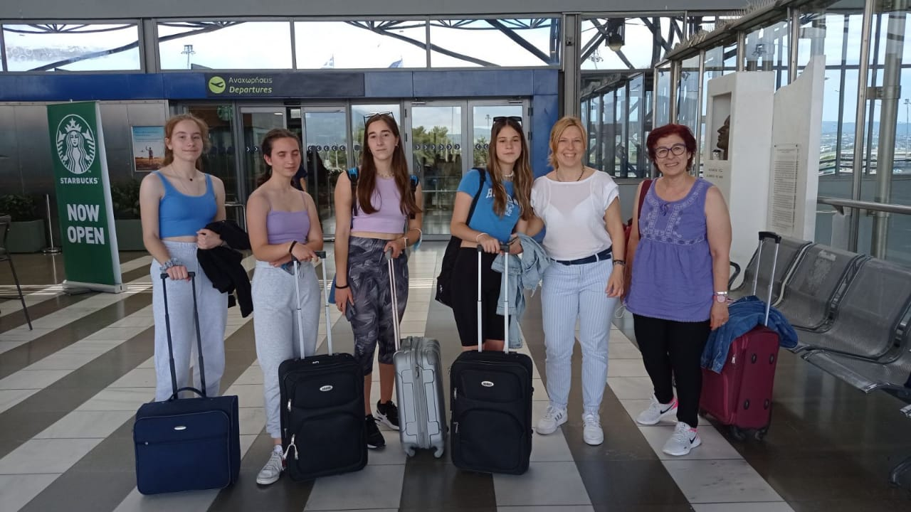
Osnovna škola Bartola Kašića was the host of the short-term exchange of groups of pupils from 22 May till 28 May 2022. We hosted 31 participants from five partner countries in the Erasmus + project How Roman are you? Our guests came from Germany, Greece, Italy, Protugal and Spain.

Slide 3
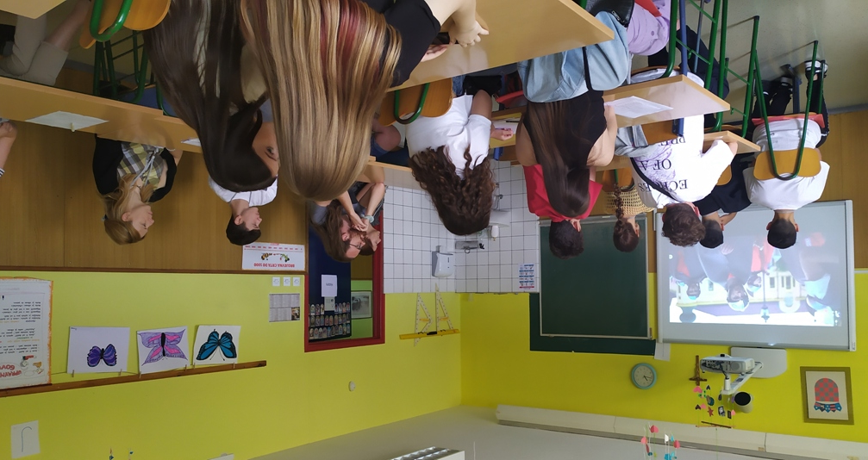
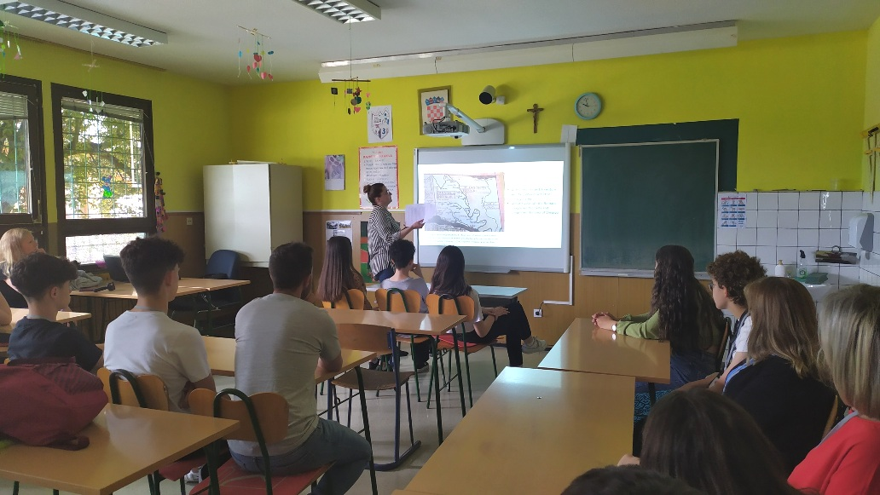
Activities at school: lessons about the history of Vinkovci

Slide 4
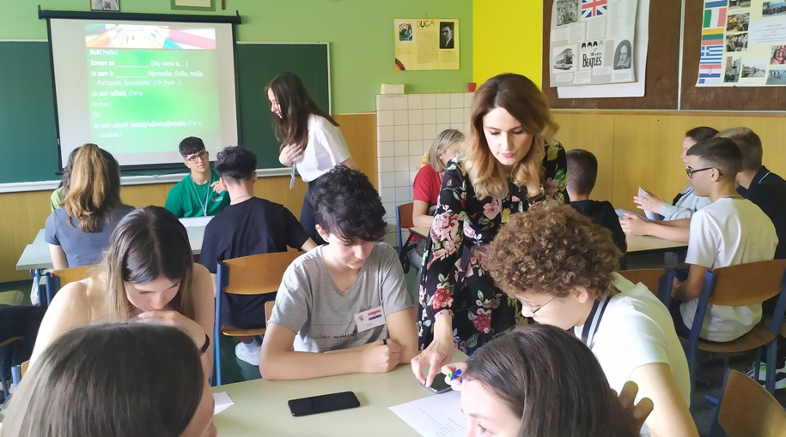
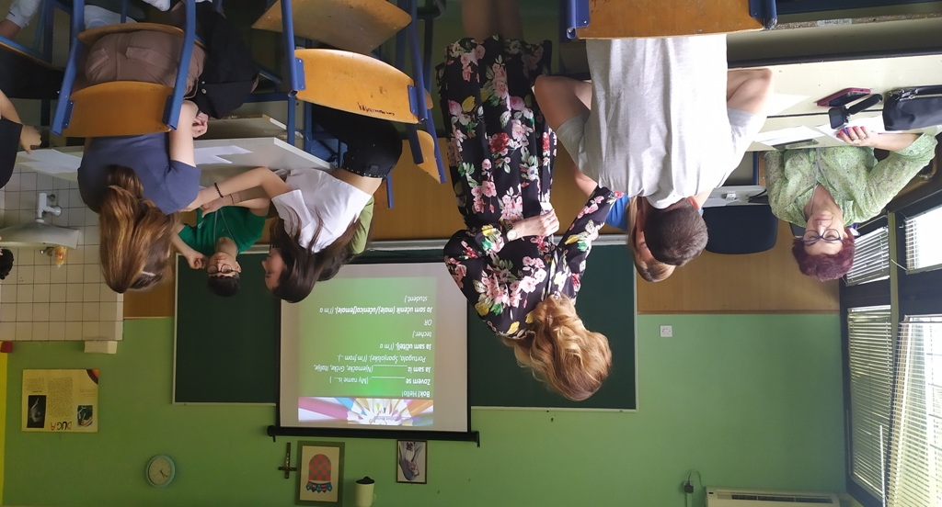
Croatian language:
basic phrases for beginners

Slide 5
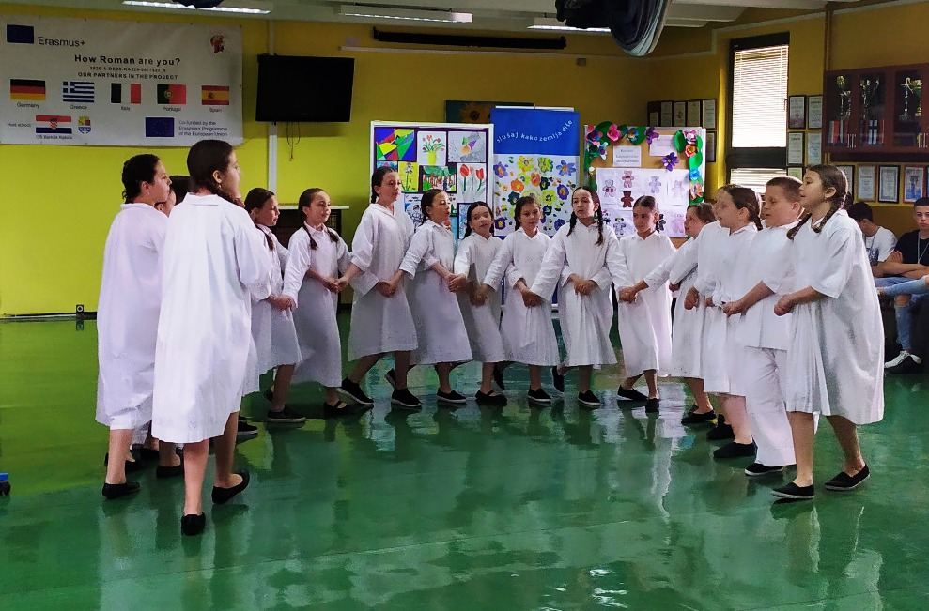
Welcoming ceremony our special guests were the members of cultural club Šumari, who performed traditional songs and dances.

Slide 6
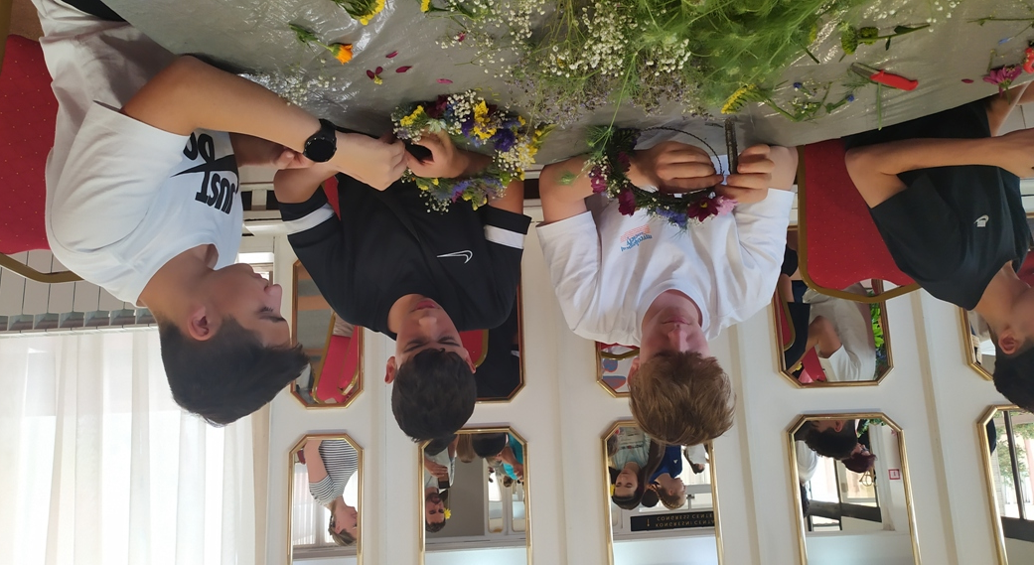
Workshops Blaženka Omrčanin from Flower shop Frezija and Blaženka Čondić from Secondary agricultural school showed pupils how to make flower decorations

Slide 7
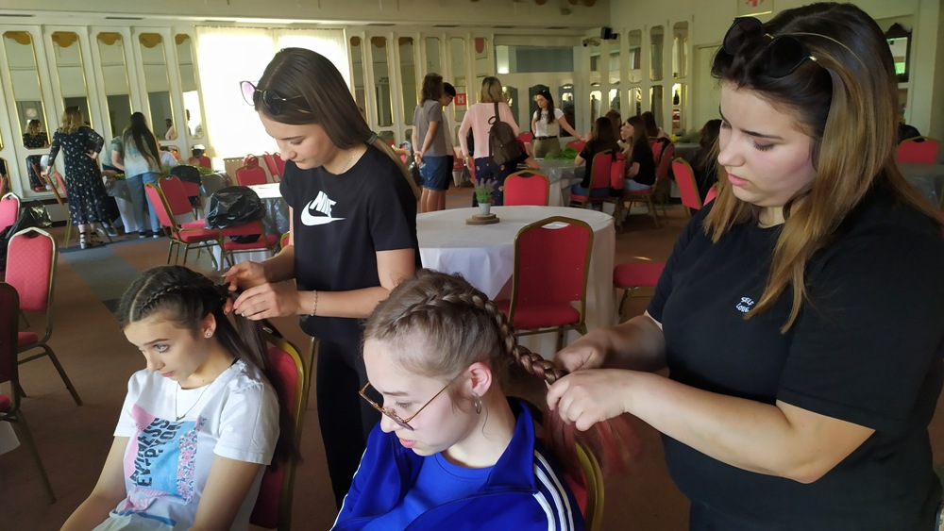
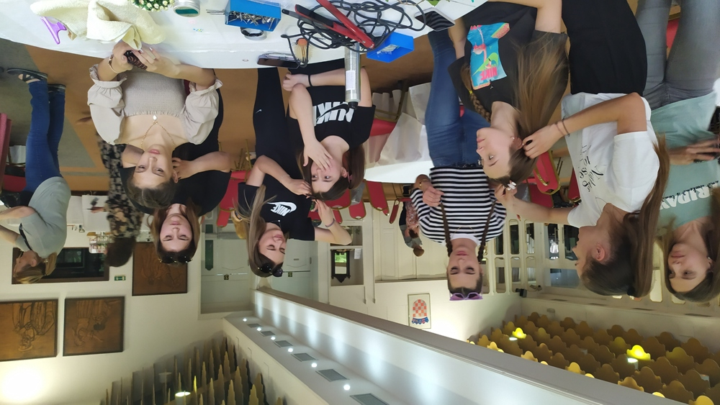
Pupils from Vocational secondary school Vinkovci and their teacher Josipa Bobovec showed traditional hairstyles of this region that were inspired by Roman hairstyles

Slide 8
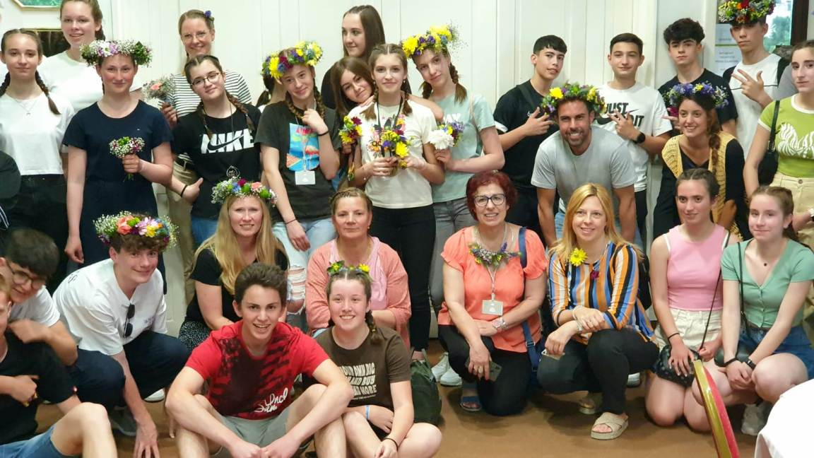
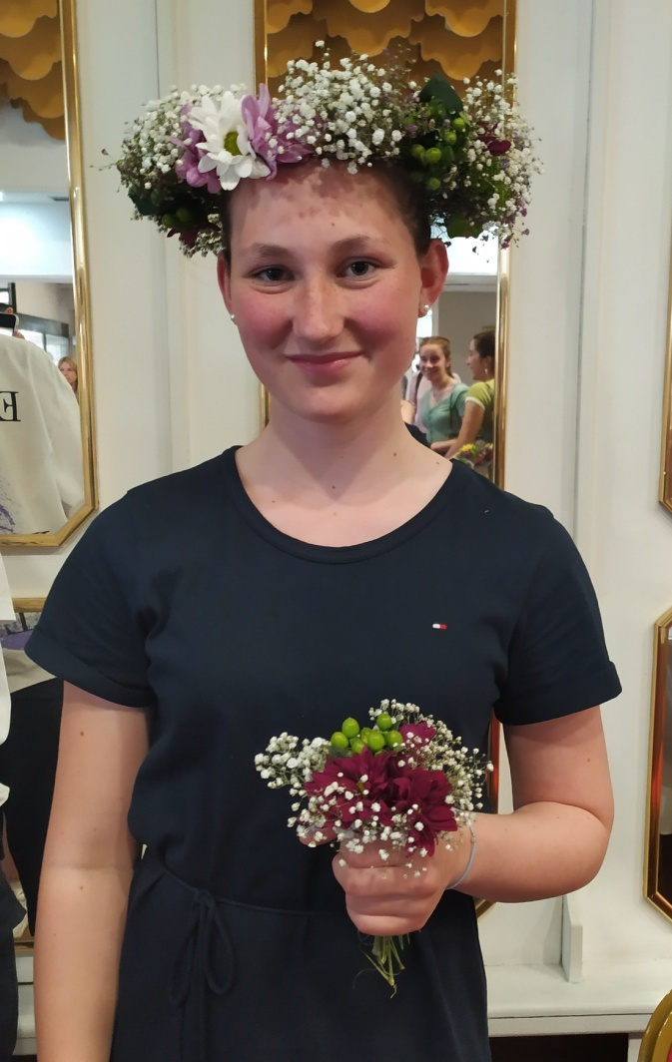
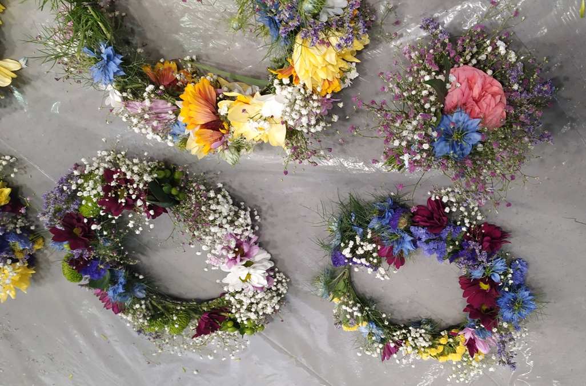

Slide 9
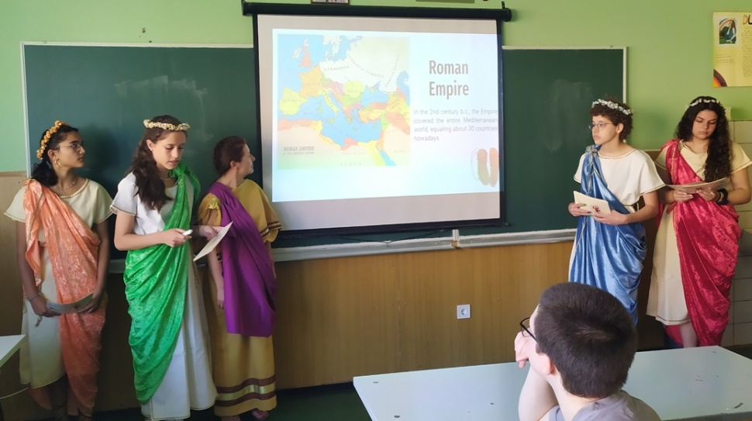
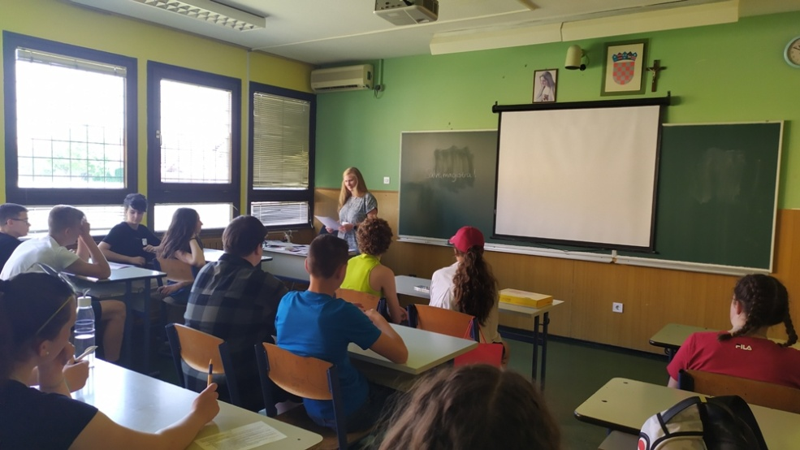
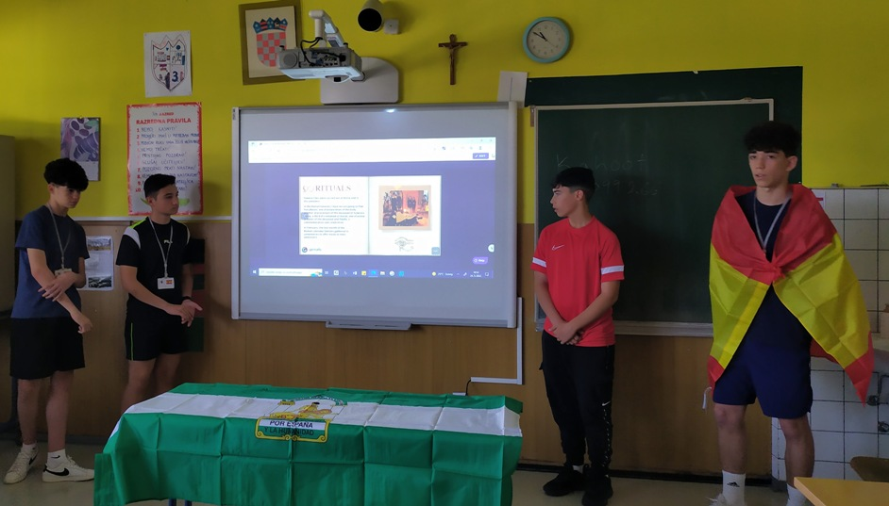
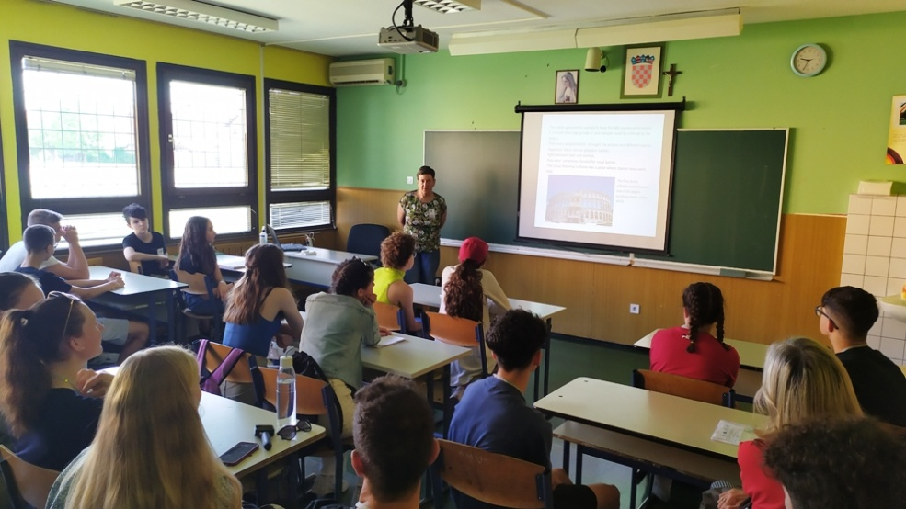
Lessons and workshops conducted by pupils and teachers from all six partner schools

Slide 10
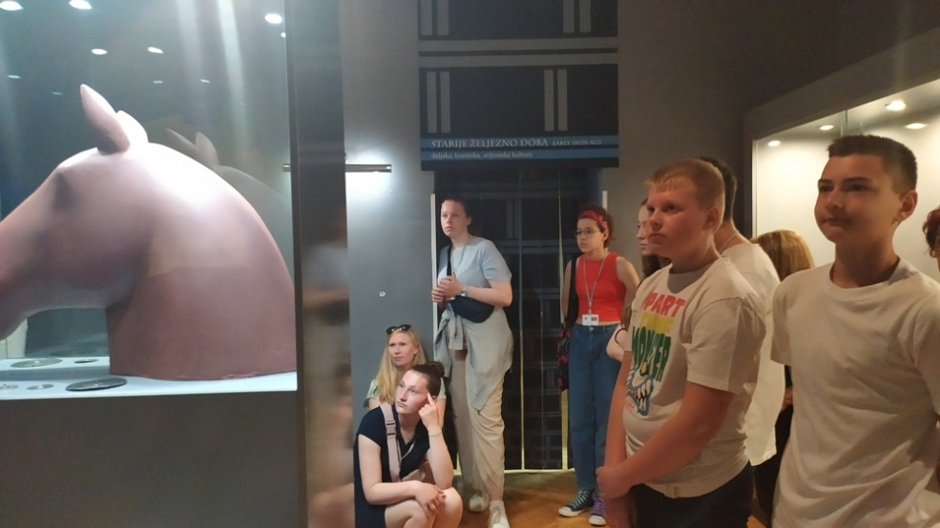
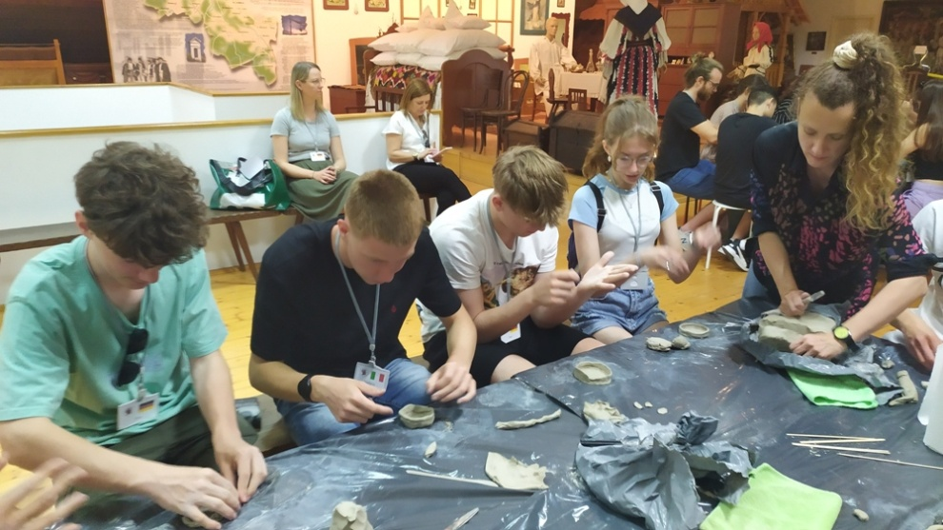
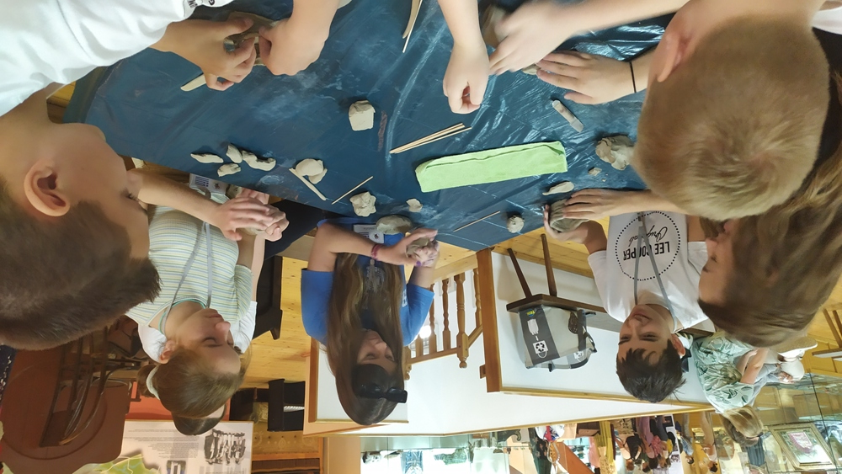
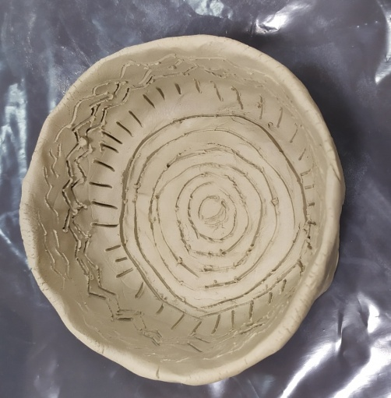
Activities at the museum: learning about the history of Vinkovci and ceramics workshop

Slide 11
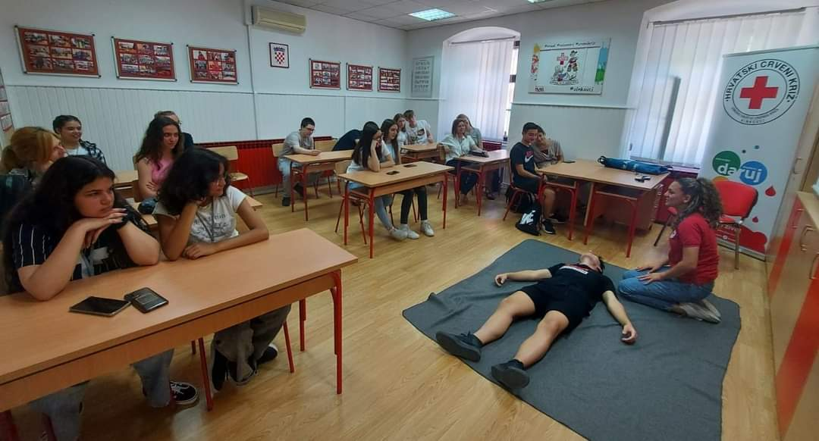
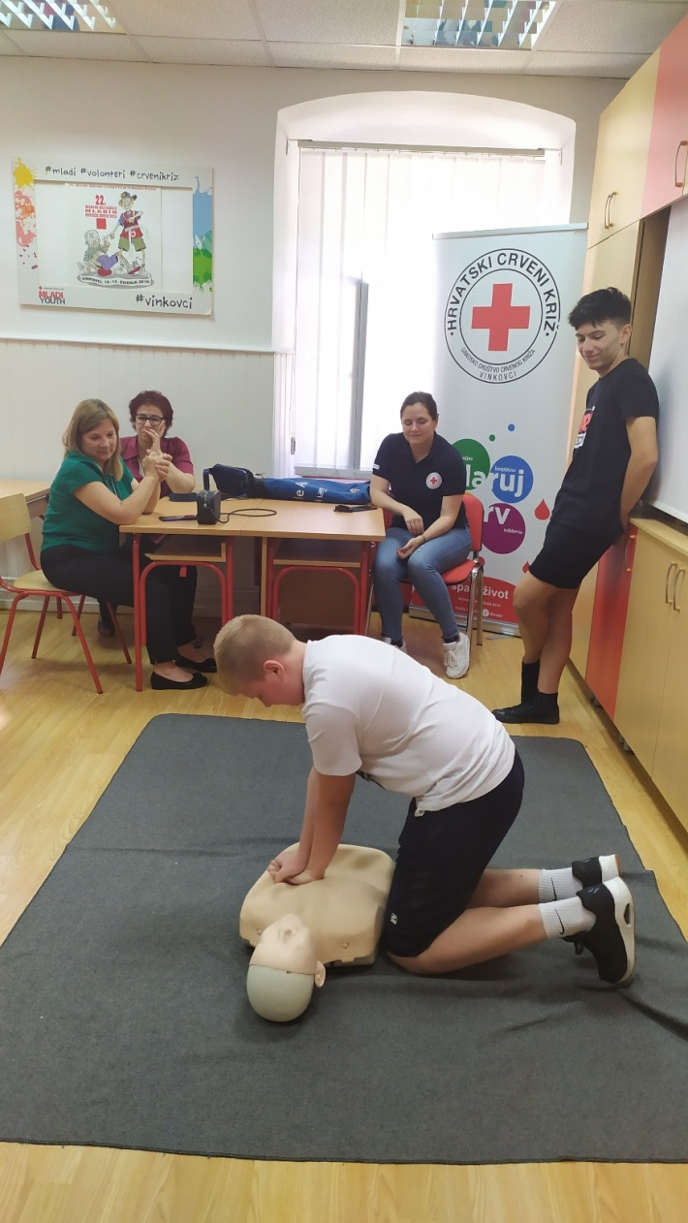
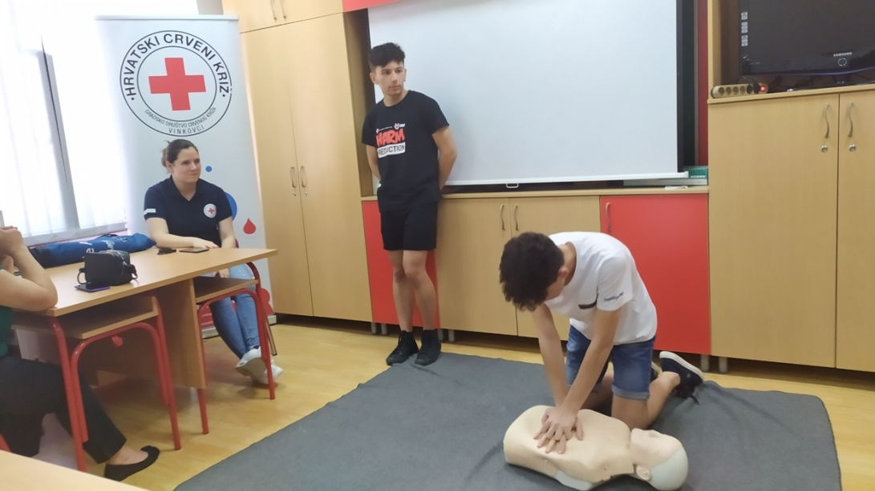
Activities at the Red Cross

Slide 12
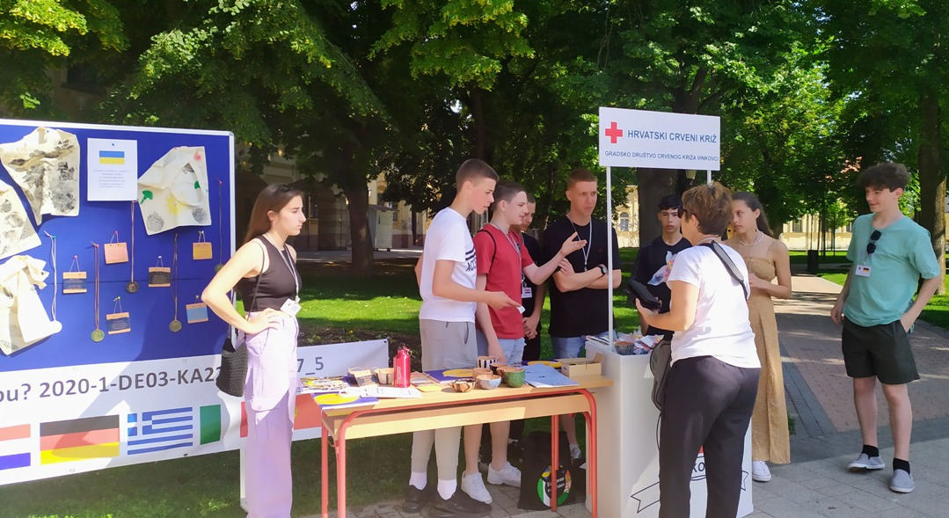
Project dissemination in the city centre and raising money for the refugees from Ukraine

Slide 13
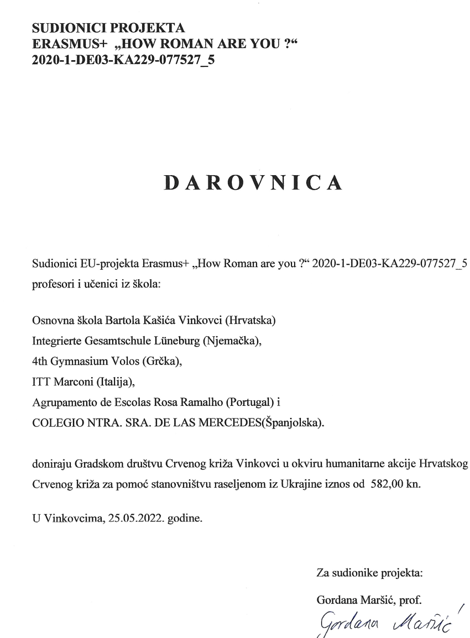
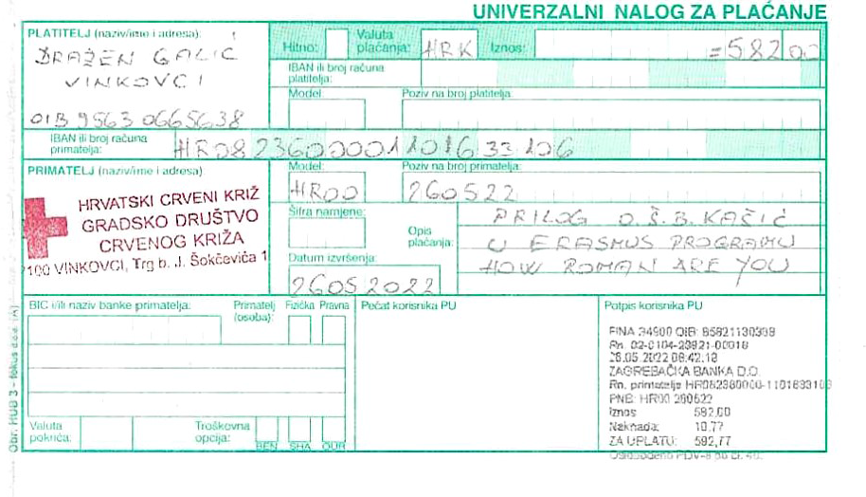
We donated the money to the Red Cross

Slide 14
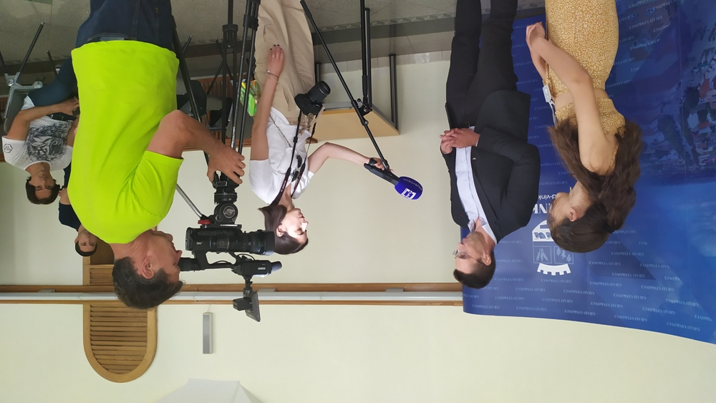
Reception at the mayor’s office and interviews for local television

Slide 15
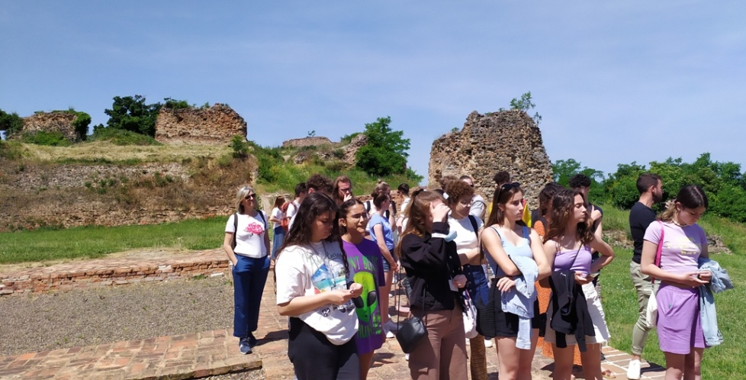
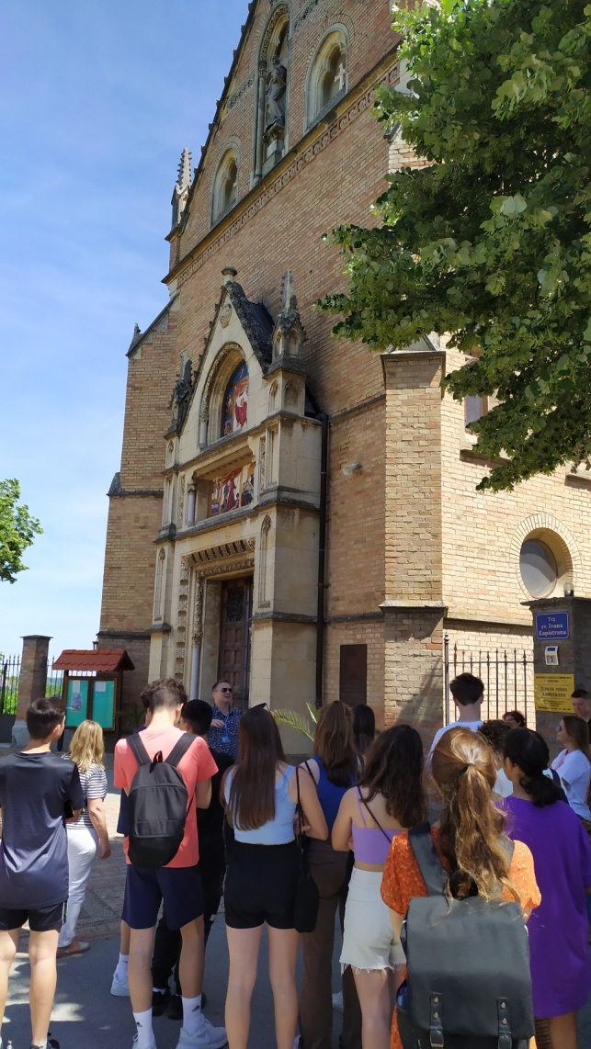
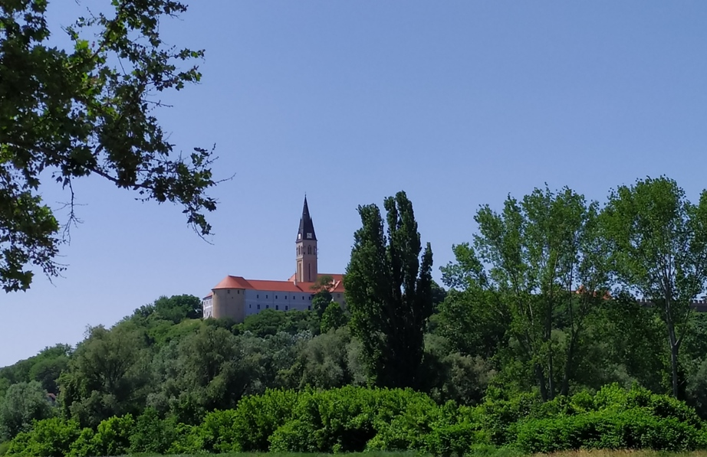
Trip to Ilok and Vukovar: learning about ancient history and about the recent Croatian Homeland War

Slide 16
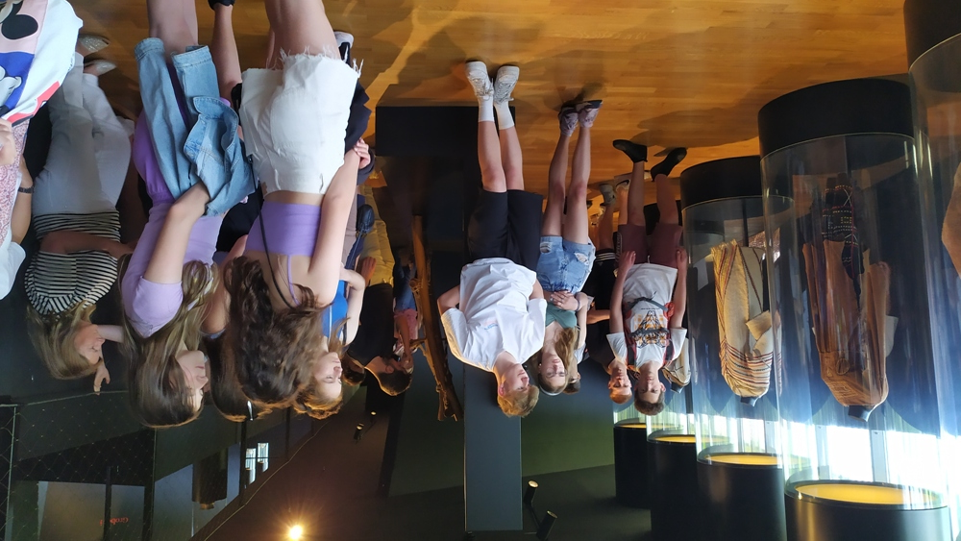
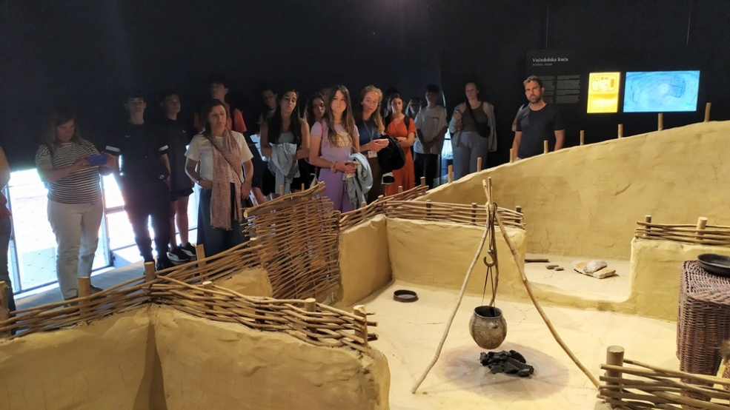
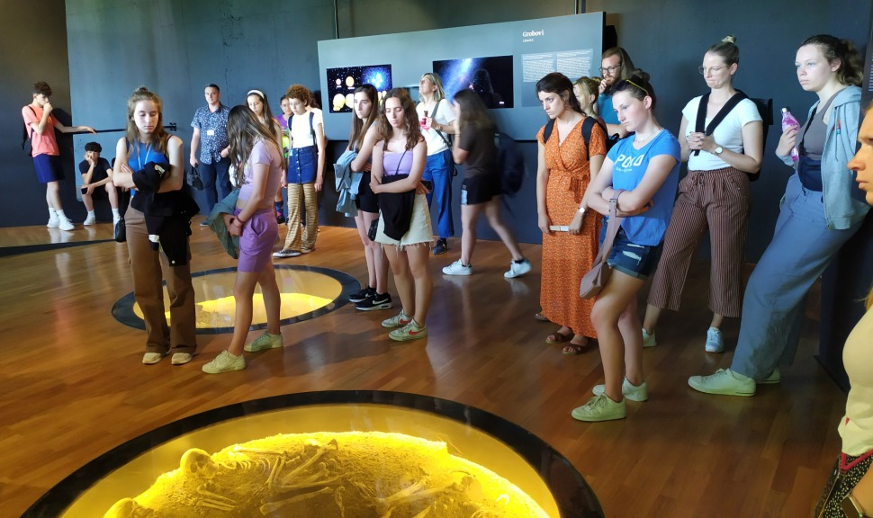
Museum of Vučedol culture

Slide 17
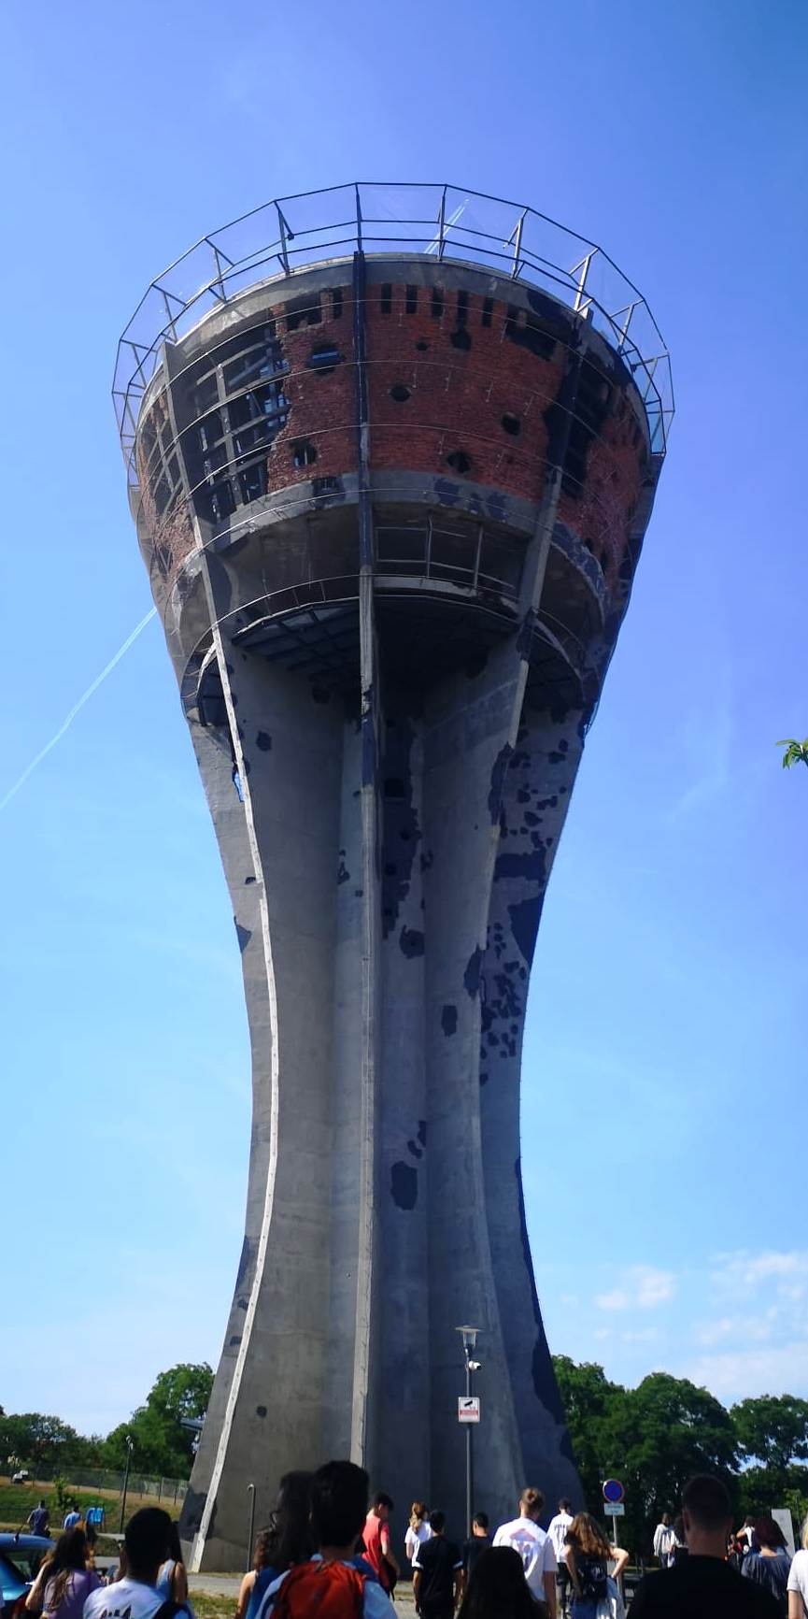
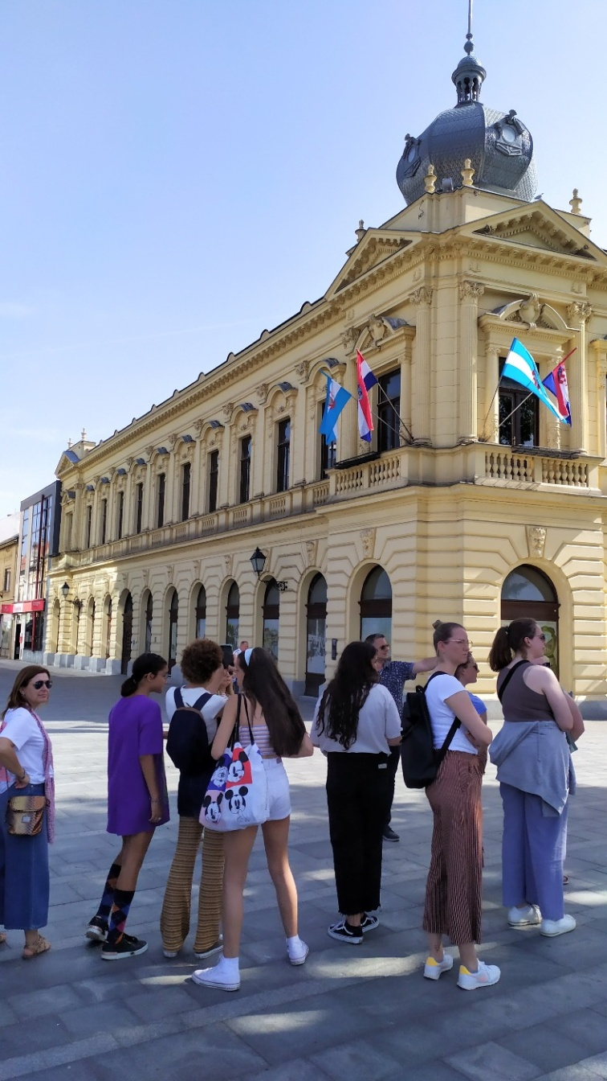
Vukovar

Slide 18
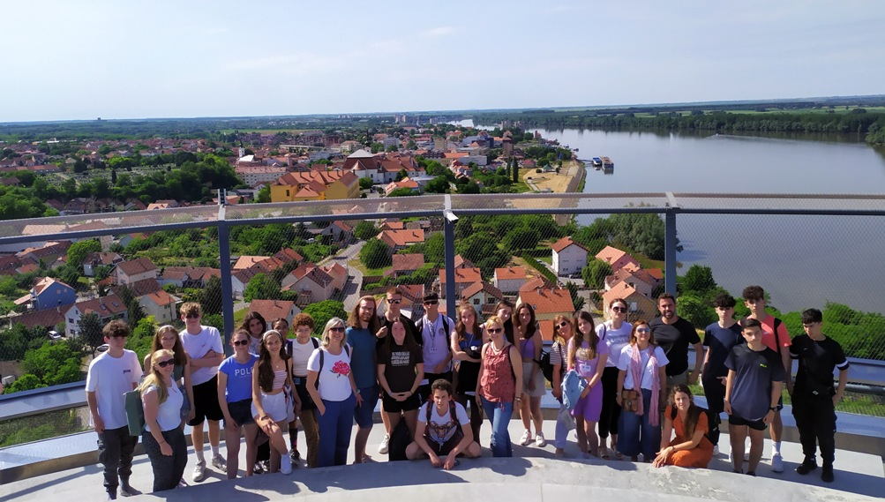
On the top of Vukovar water tower

Slide 19
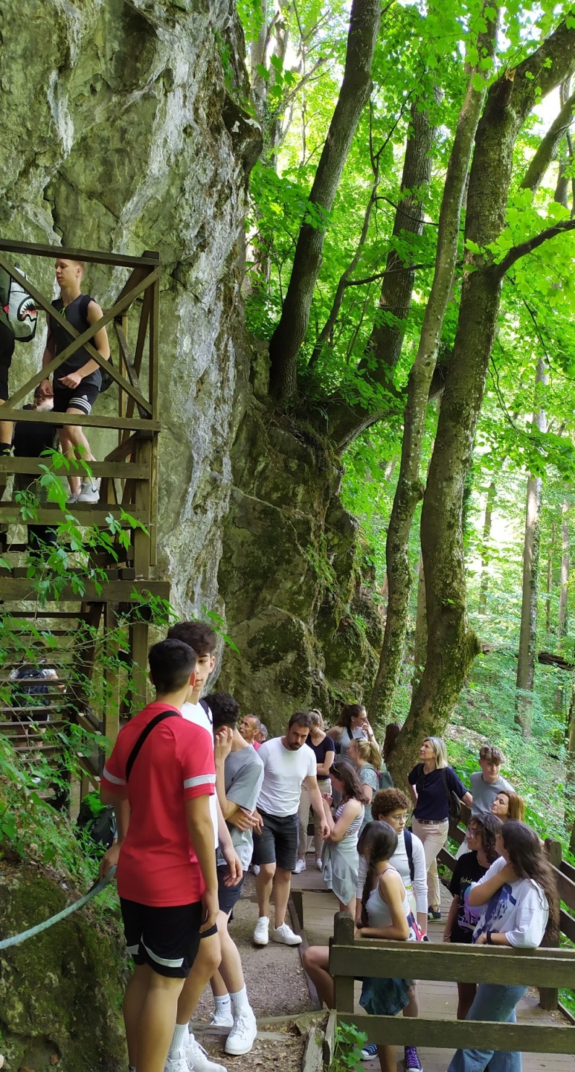
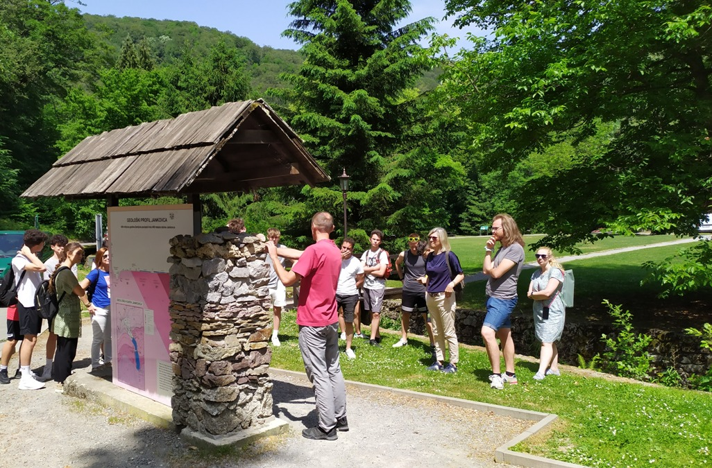
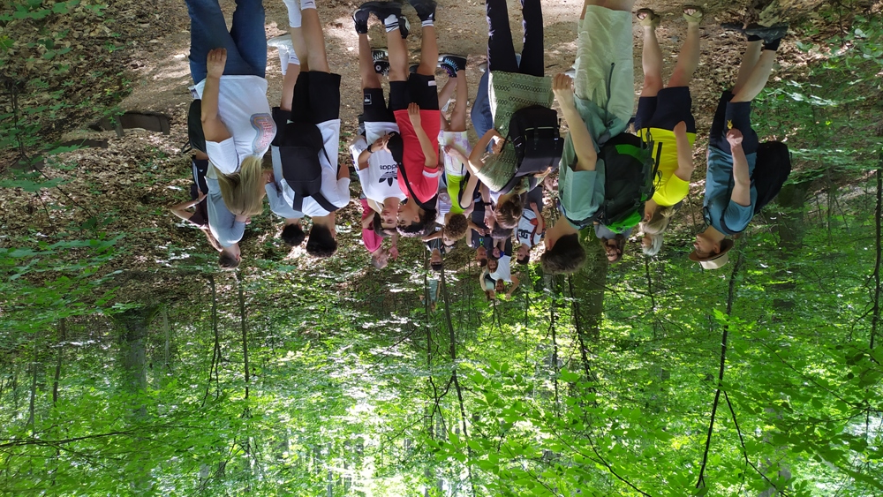
Trip to Nature park Jankovac

Slide 20
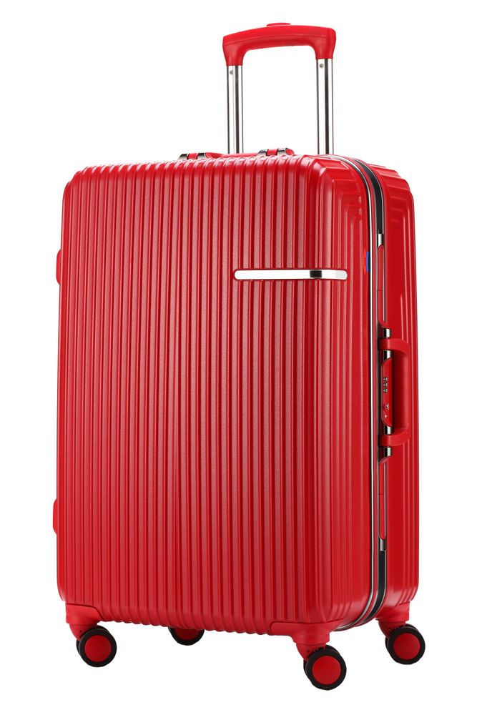
The groups departed on Saturday, 28 May, after a very successful meeting. The next short-term exchange of groups of pupils will be held in Spain, in October.
Pack your suitcases in time. We can’t wait to meet all of you again!

