Slide 1
Osnovna škola Bartola Kašića Vinkovci Erasmus+ project 2020-2023 S.O.F.T. – Start Our Future Today 2020-1-PL01-KA229-081533_4
MEETING IN POLAND
November 2021

Slide 2
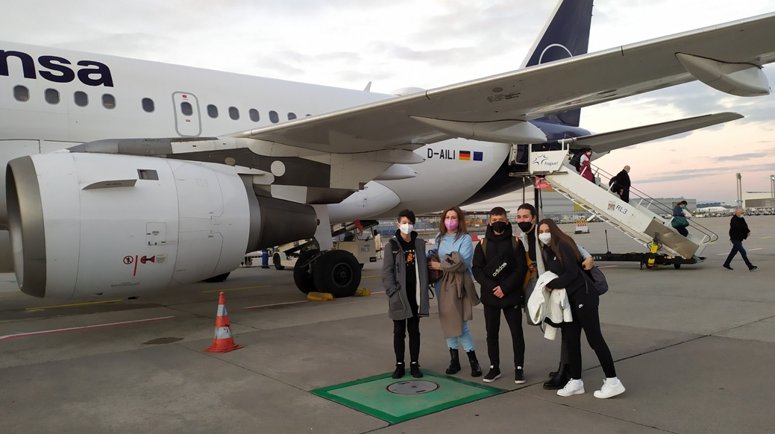
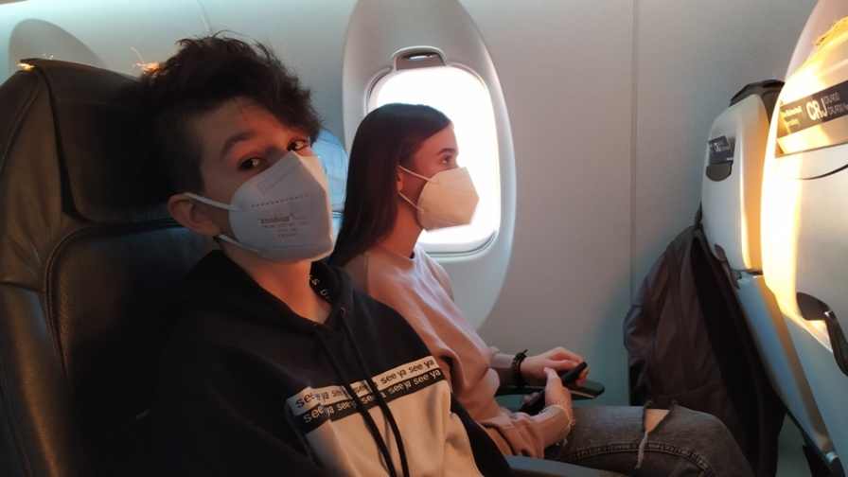
The first short-term exchange of groups of pupils took place in Poland from 14 November till 20 November 2021. The host school was Zespol Szkolono-Przedszkolny w Szemudie, Szemud. Our school was represented by three pupils: Ema Kalaica, Tina Rosandić and Filip Stjepanović. They were accompanied by three teachers. We flew to Poland.

Slide 3
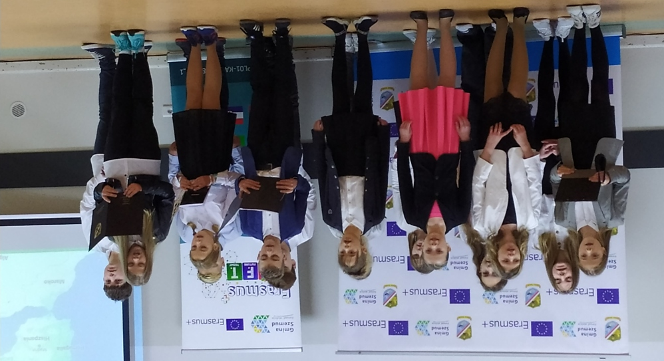
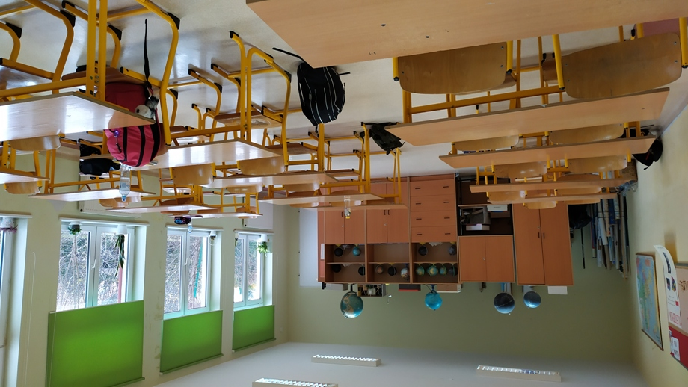
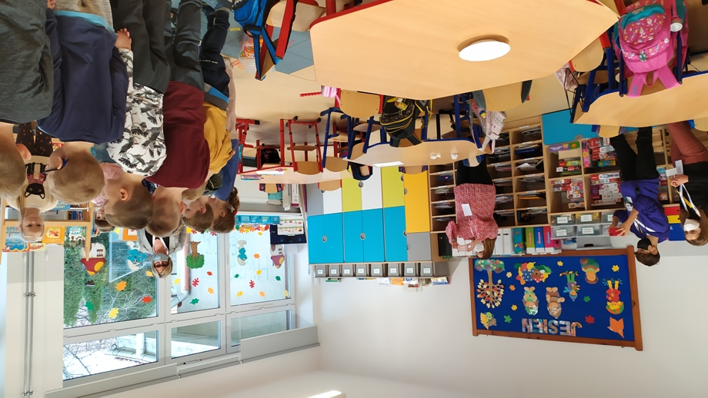
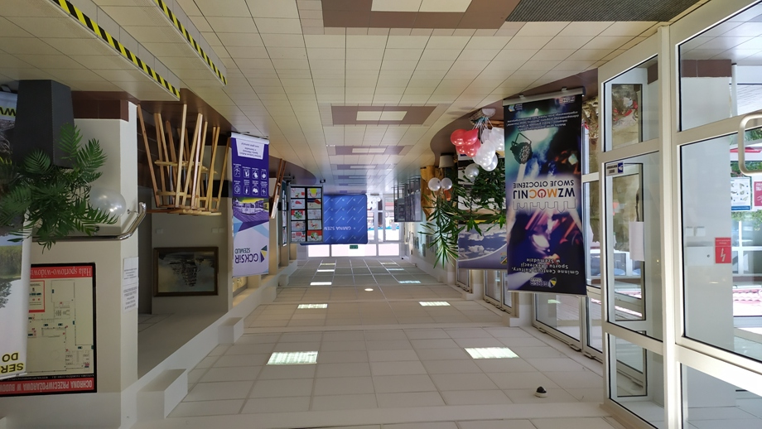
Host school and welcoming ceremony

Slide 4
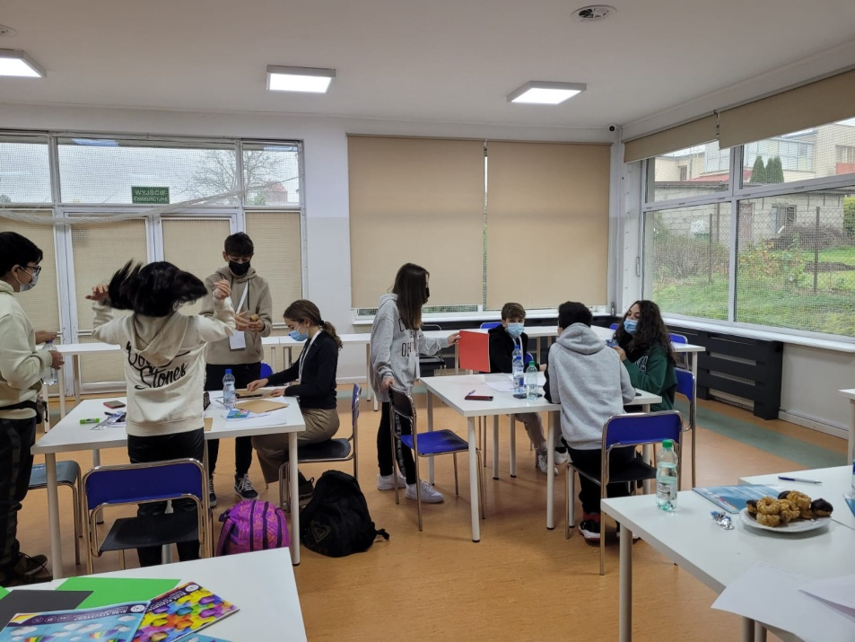
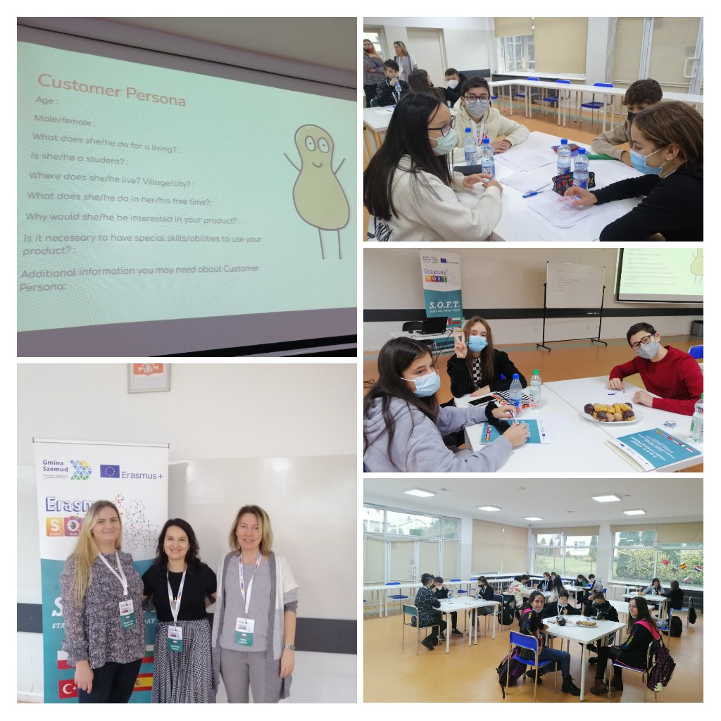
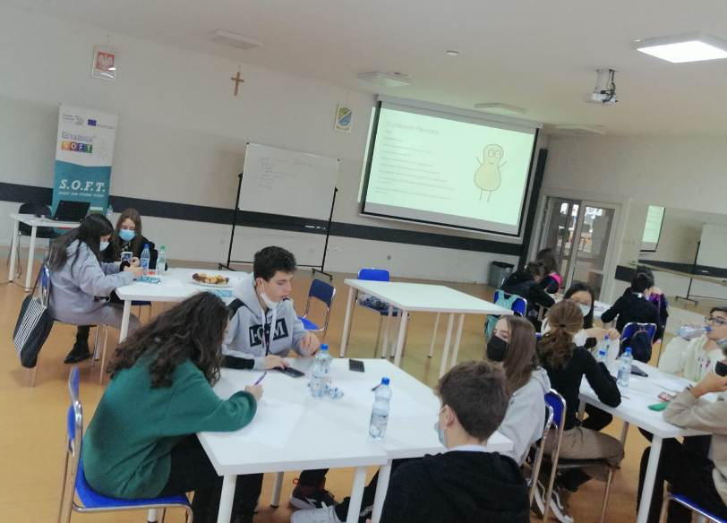
Activities at school, workshops

Slide 5
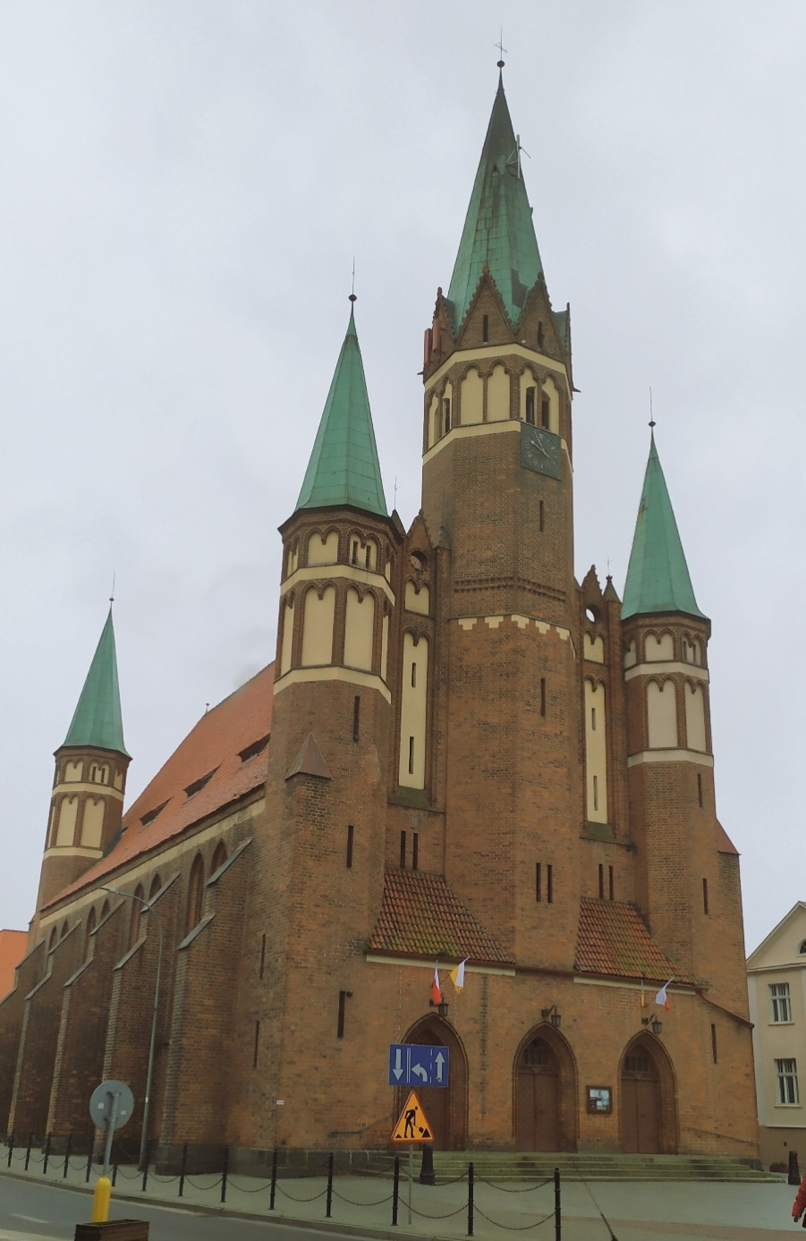
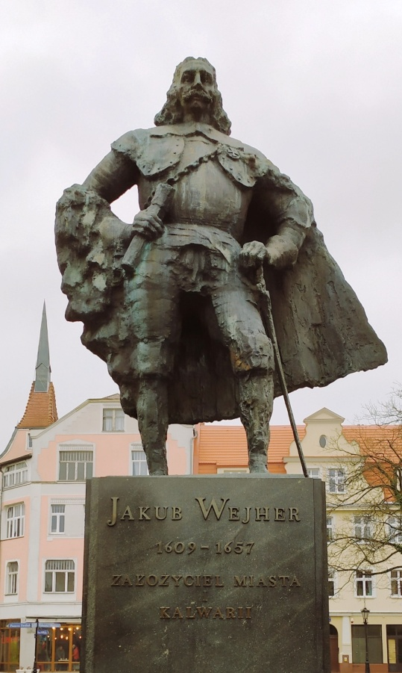
Wejherowo is a town founded in the 17th century by Jakub Wejher. We visited interesting sights and learned a lot about Kashubian history, culture and language.

Slide 6
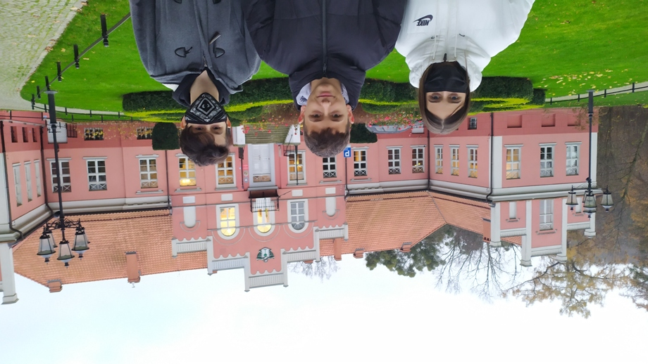
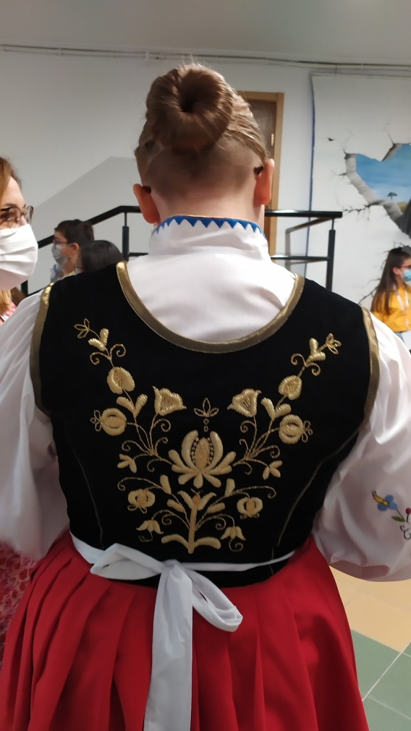
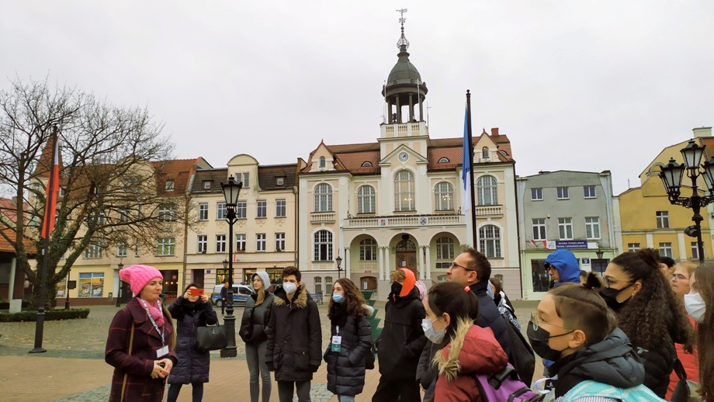

Slide 7
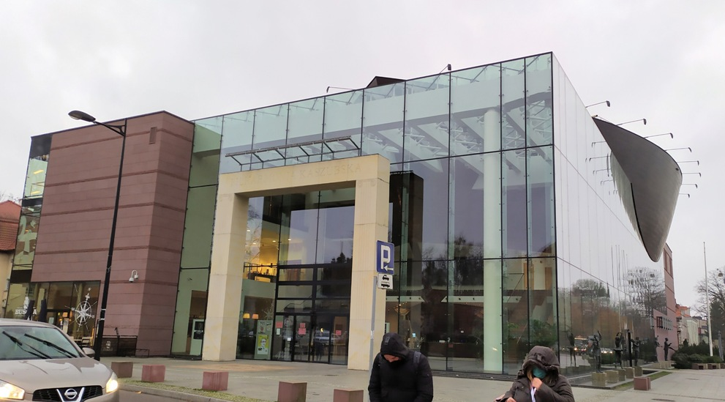
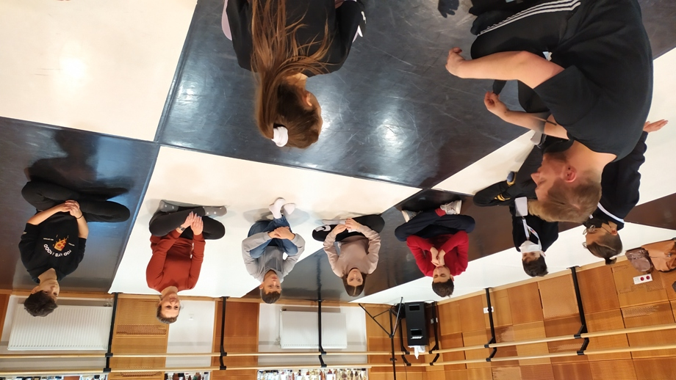
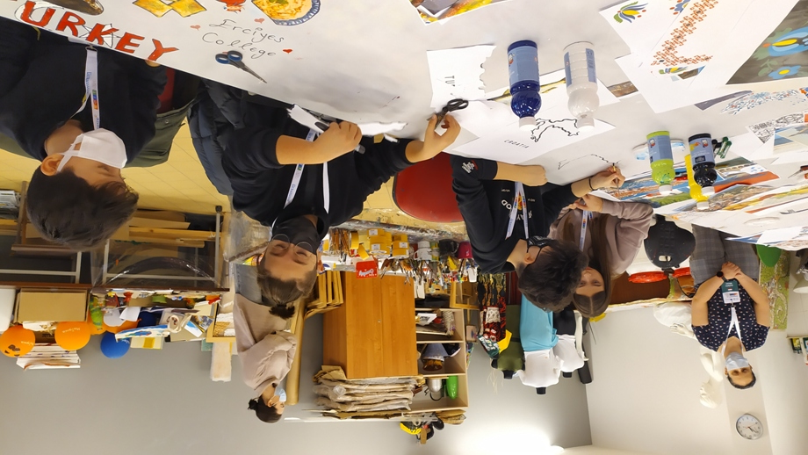
Kashubian Philharmonic is a cultural centre where you can learn how to make films, paint, take pottery course, learn to play an instrument, dance and many other things.

Slide 8
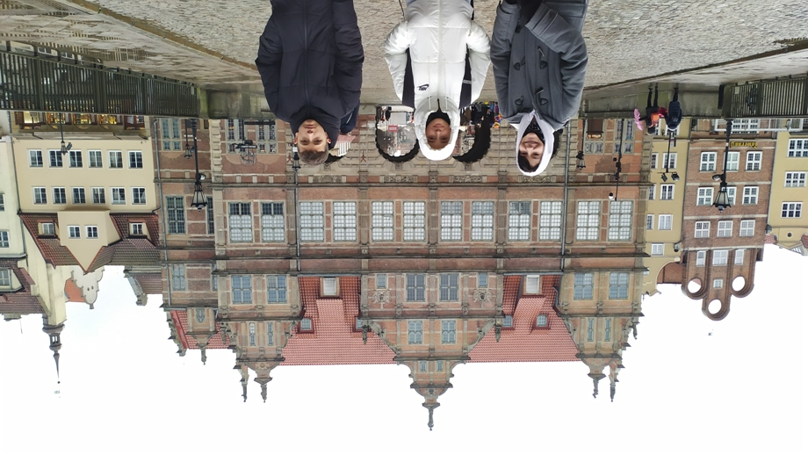
We visited Gdańsk, the capital and largest city of the Pomeranian Voivodeship.

Slide 9
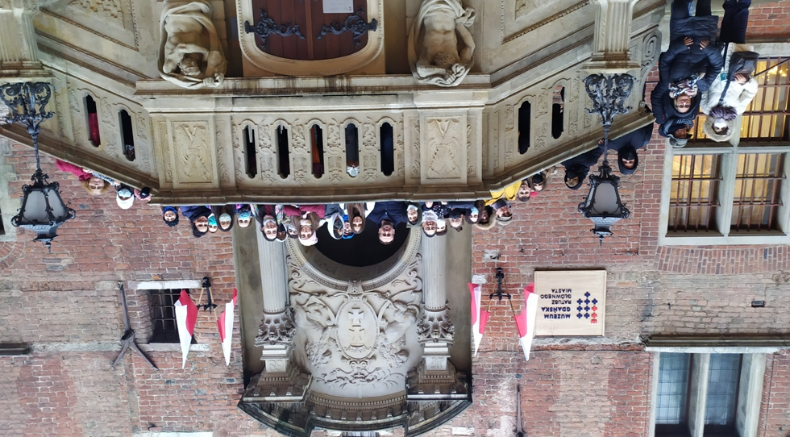
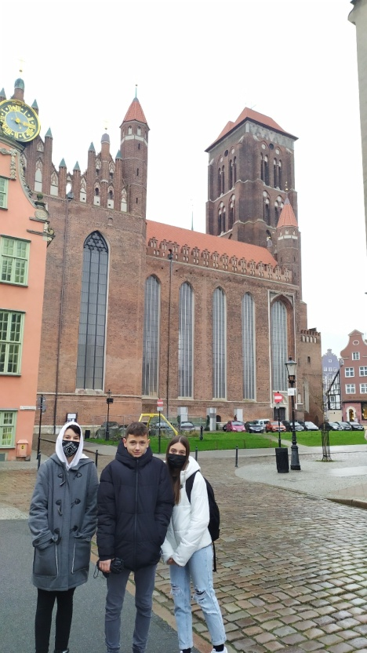
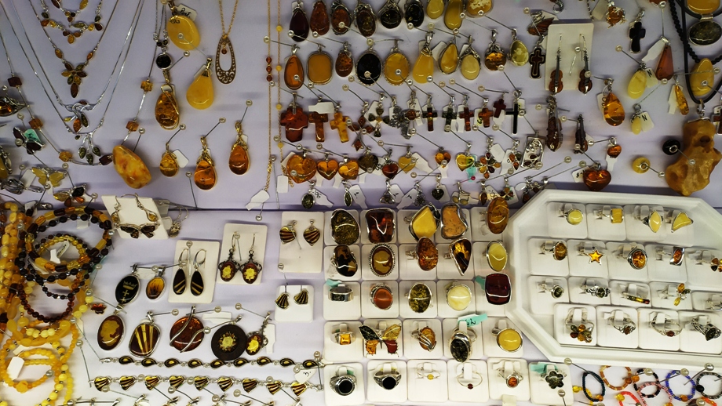
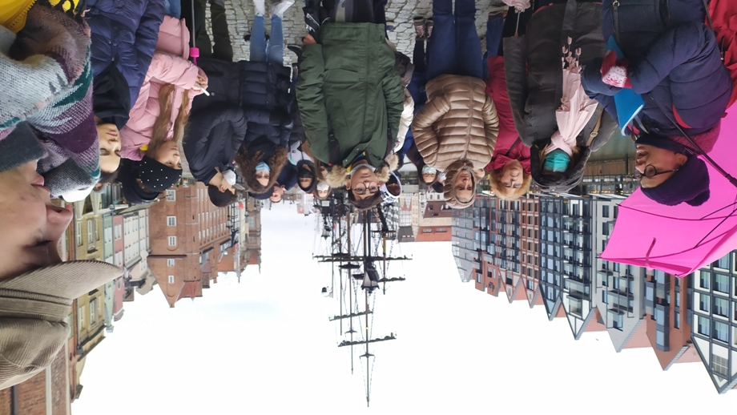

Slide 10
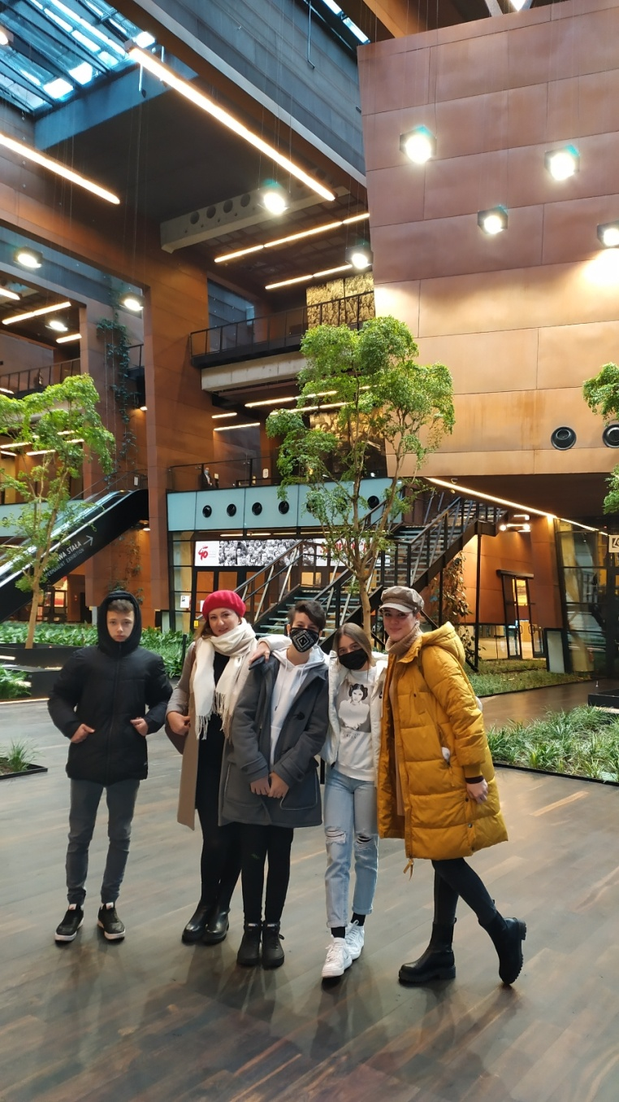
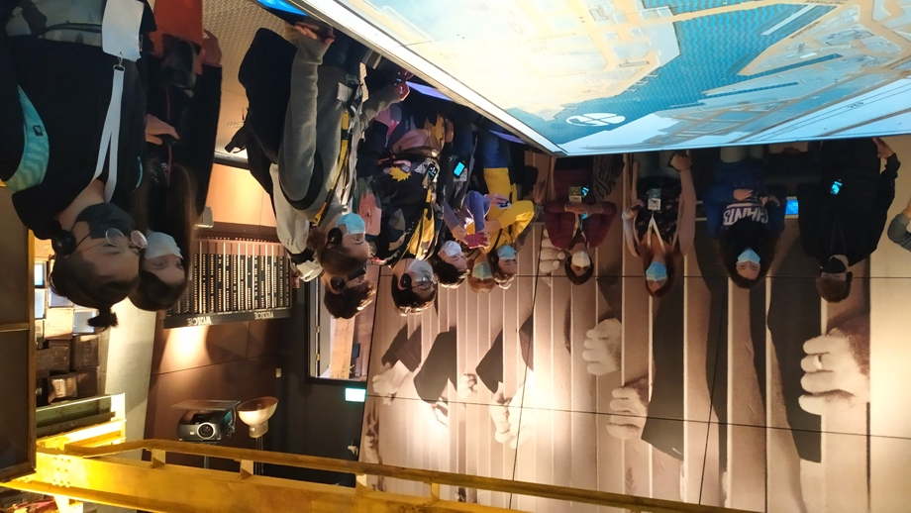
The European Solidarity Centre is a museum and library, devoted to the history of Solidarity, the Polish trade union and civil resistance movement, and other opposition movements of Communist Eastern Europe.

Slide 11
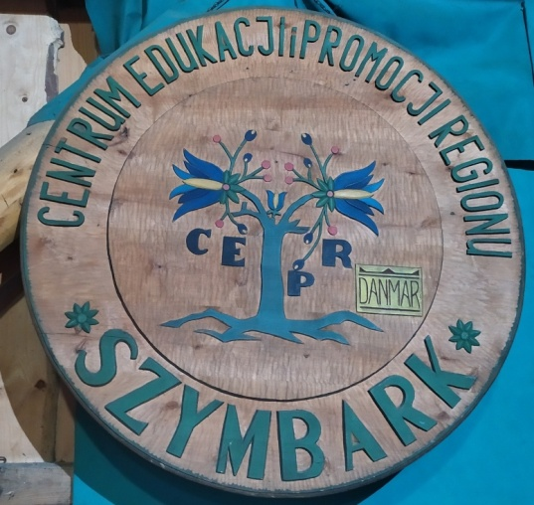
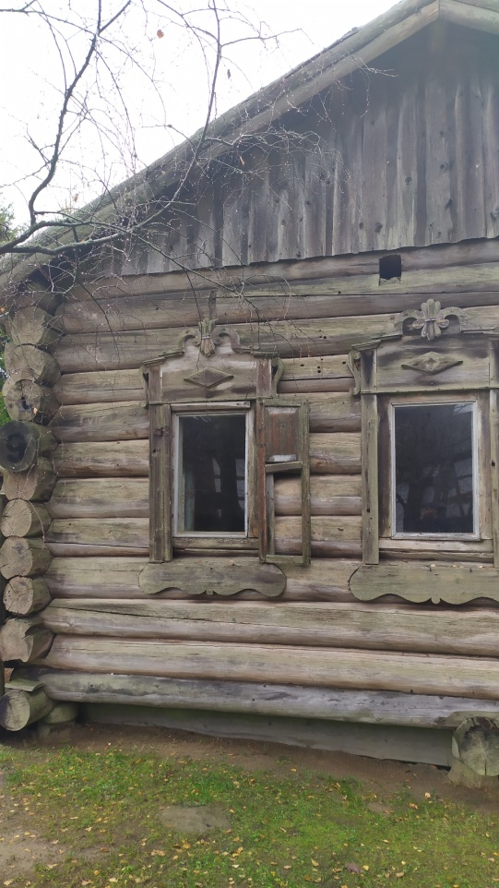
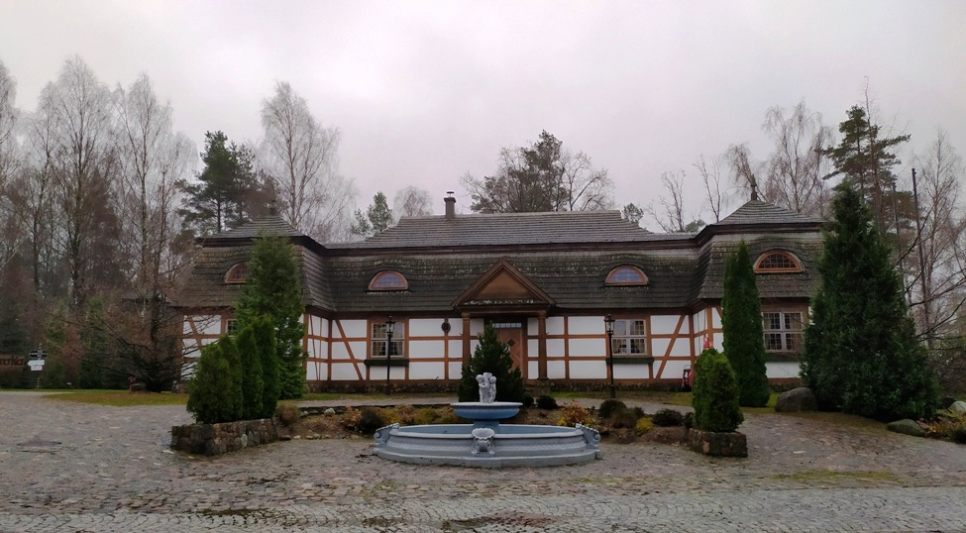
Szymbark is a village which has an open-air museum featuring traditional Kashubian wooden houses, an upside-down house, and the longest wooden plank in the world (38.83 meters long).

Slide 12
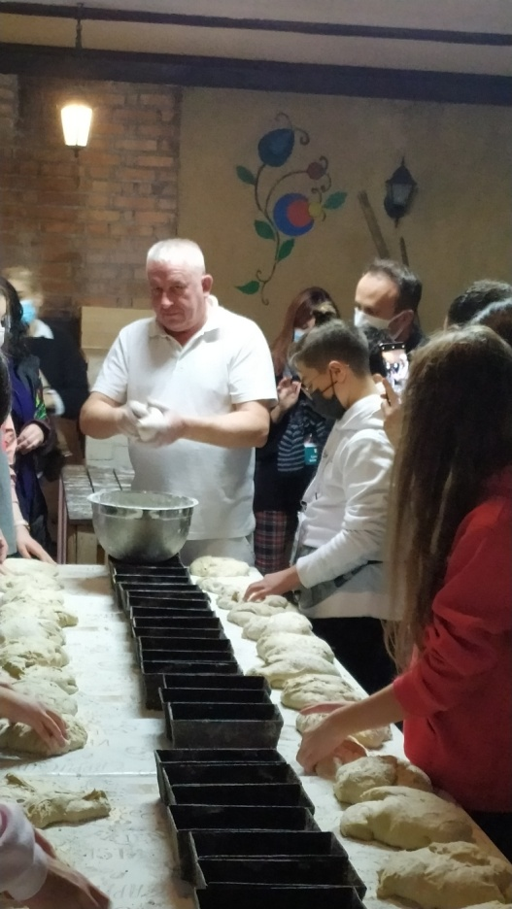
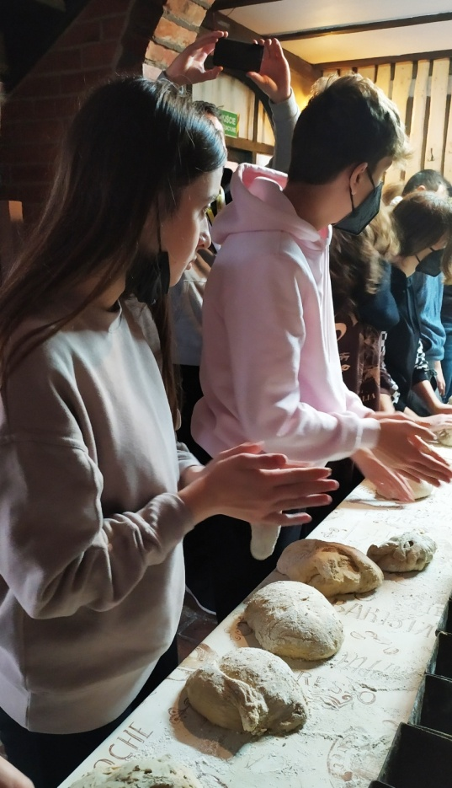
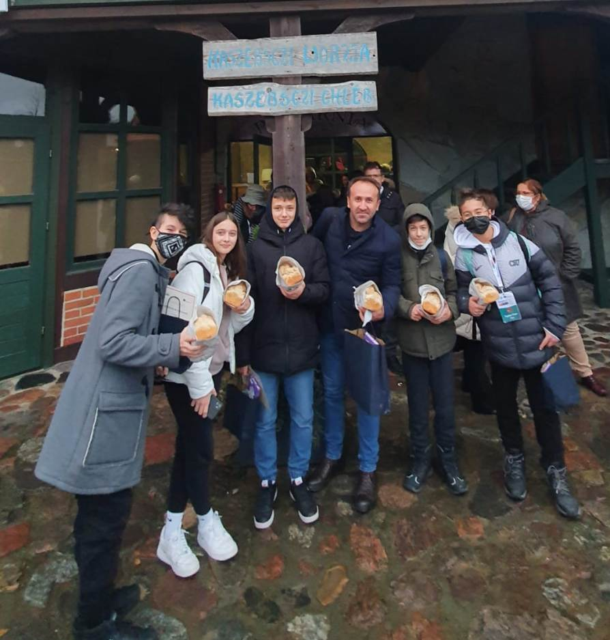
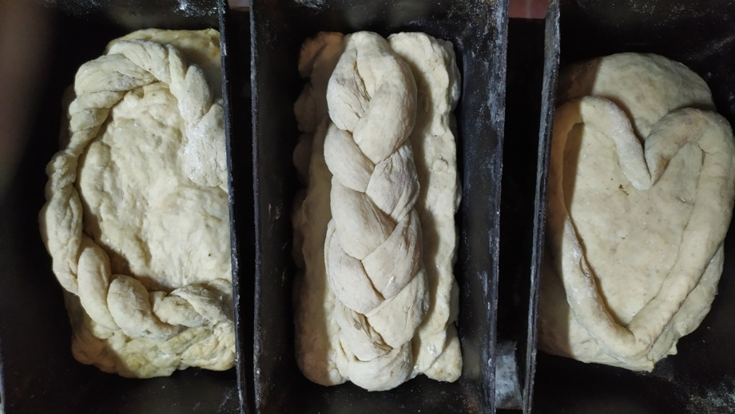
Pupils baked bread

Slide 13
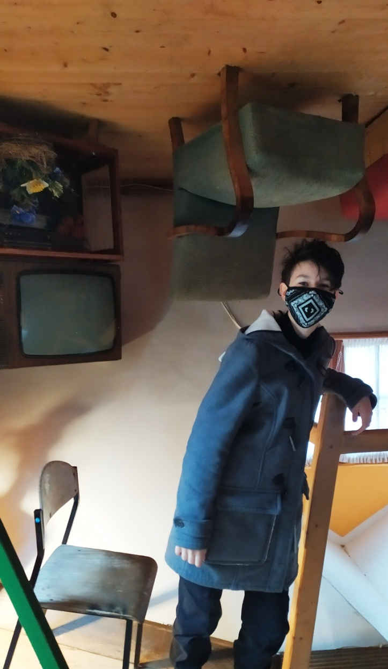
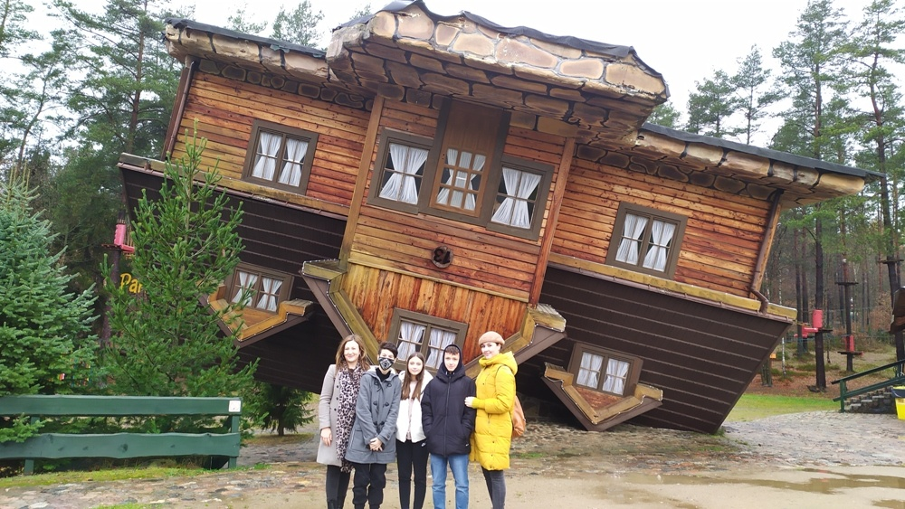
An upside-down house

Slide 14
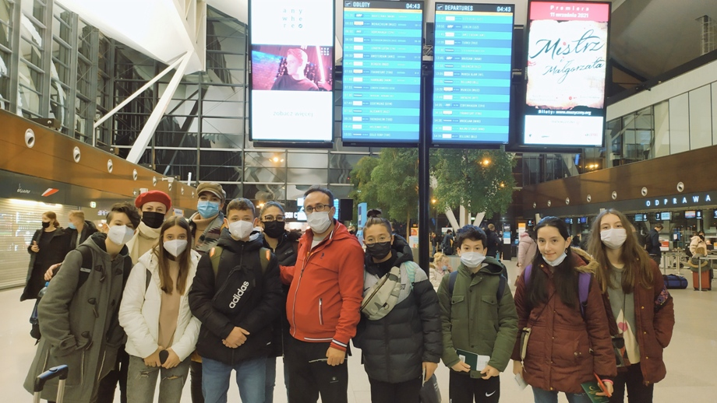
We said goodbye at the airport and wished a safe journey home.

Slide 15
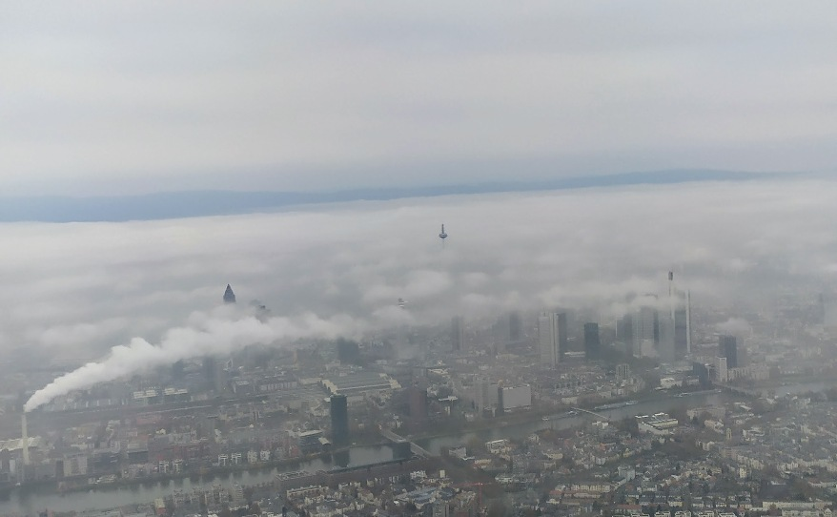
We enjoyed the view and have already started planning future project activities and meetings. See you in spring 2022!

