Slide 1
OŠ Bartola Kašića Erasmus+ project 2020-2023 S.O.F.T. – Start our Future Today 2020-1-PL01-KA229-081533_4
MEETING IN ITALY
November 2022

Slide 2
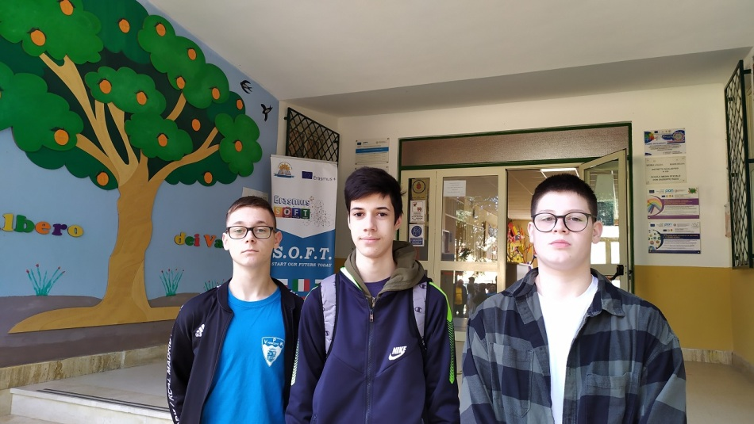
The fifth short-term exchange of groups of pupils of Erasmus+ project “S.O.F.T. – Start our Future Today” took place in Italy from 6 November untill 12 November 2022. The title of the meeting was “Get to know each other and be aware of your potential to start a business idea” Host school was Istituto coprensivo statale di Ciminna, guests were pupils and teachers from Poland, Bulgaria, Croatia, Spain and Turkey. Osnovna škola Bartola Kašića was represented by three pupils: Lovro Gabud, Filip Ivandić, Filip Japundžić.

Slide 3
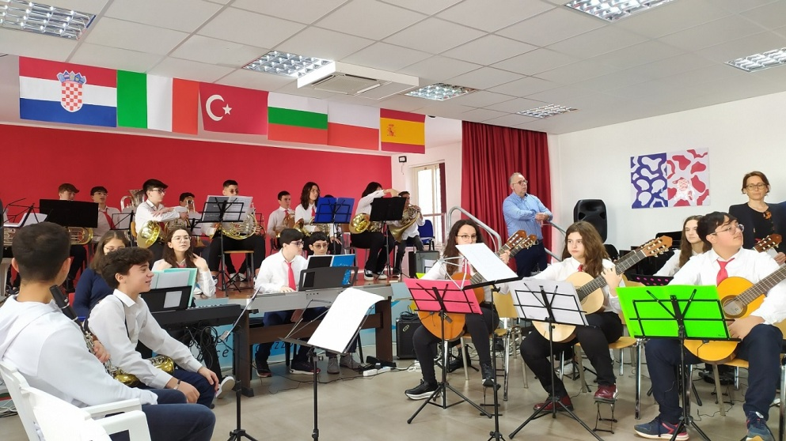
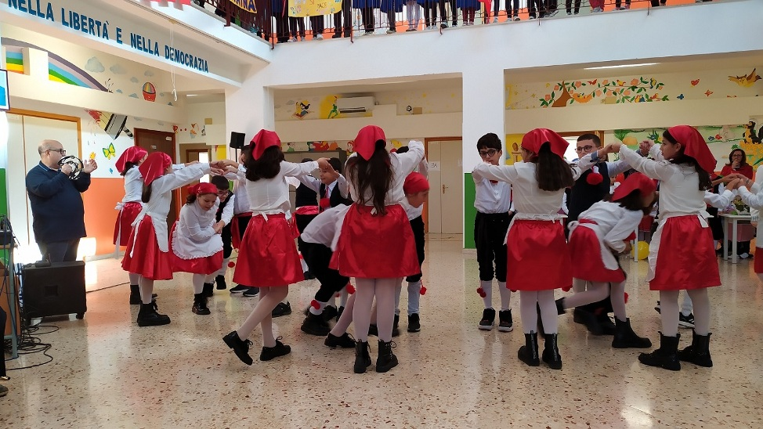
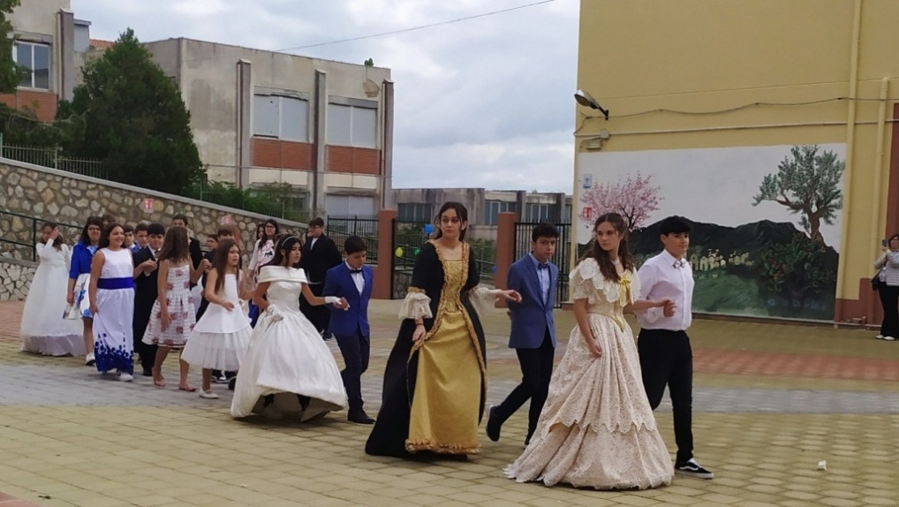
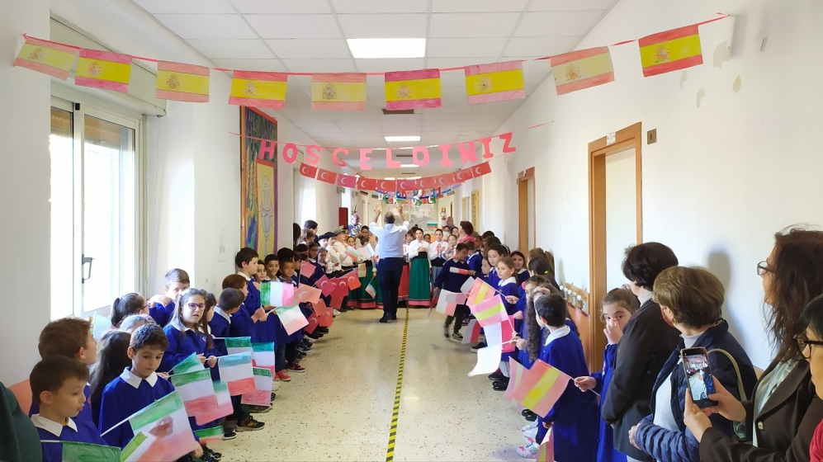
Host school has branches in three towns, we were warmly welcomed everywhere.

Slide 4
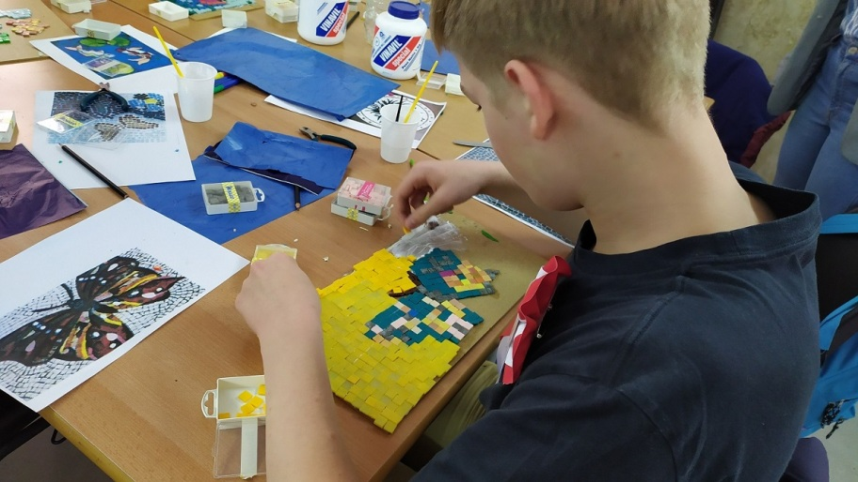
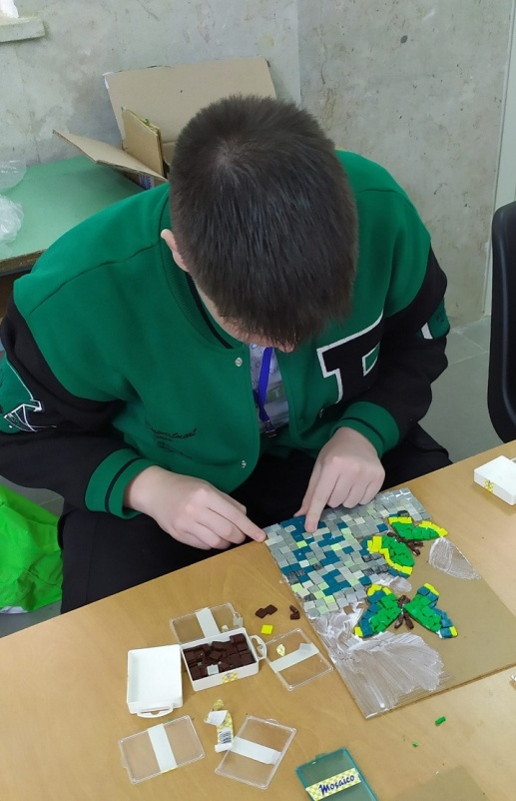
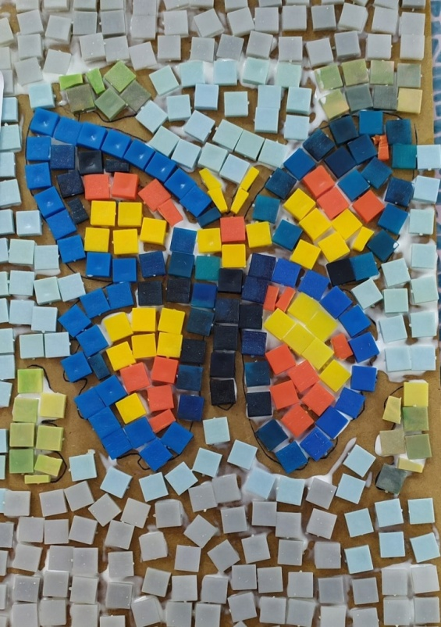
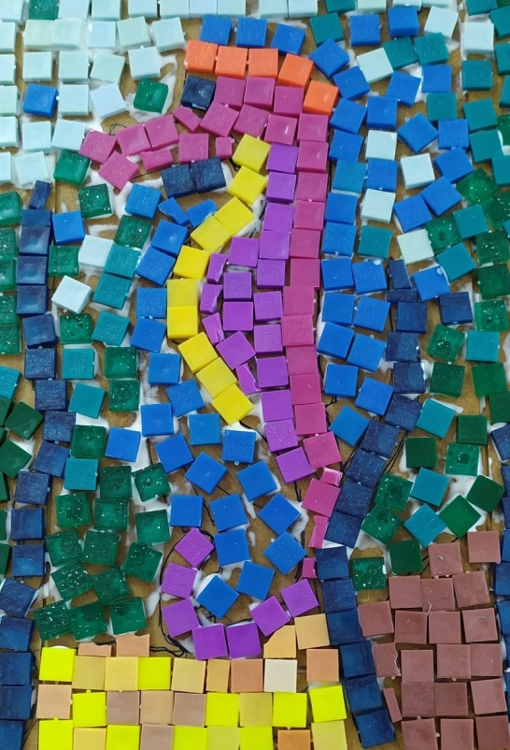
Project participants had interesting workshops:
making mosaics after visiting Monreale and its cathedral famous for mosaics

Slide 5
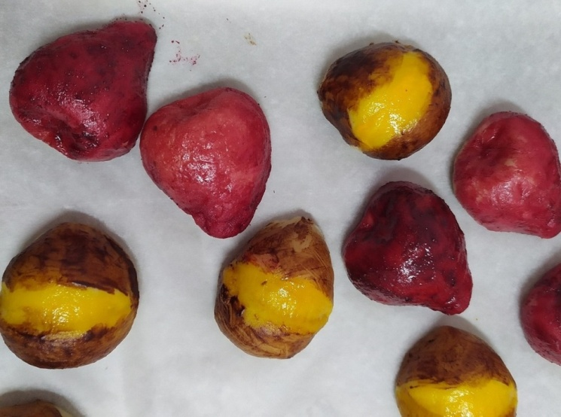
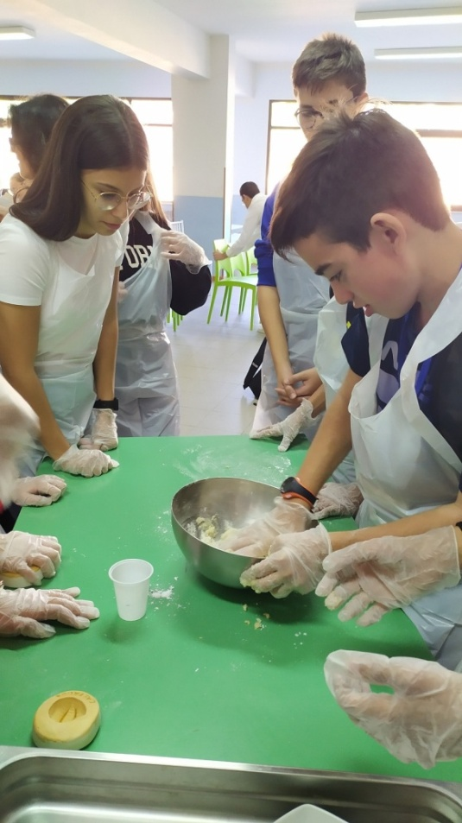
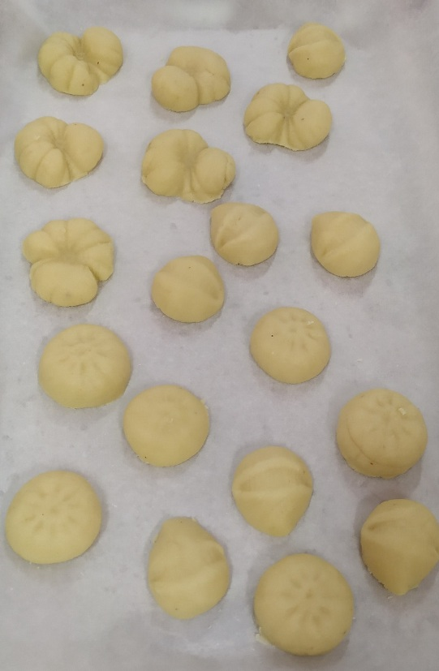
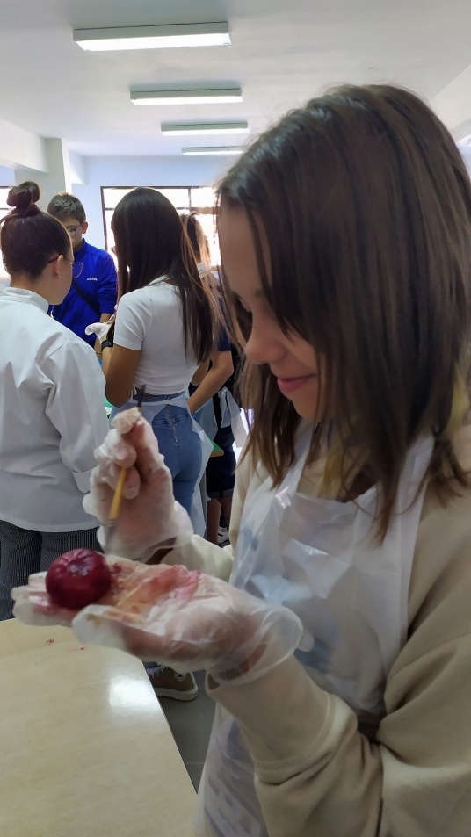
Making Fruta Martorana – marzipan fruit, the tradition started in a monastery in Palermo in the 16th century. The nuns made marzipan fruit for a very distinguished guest.

Slide 6
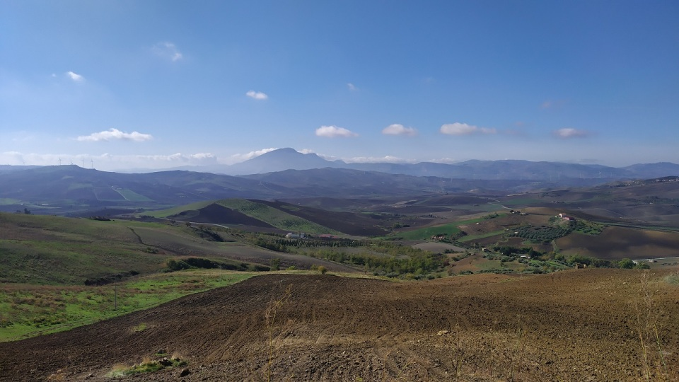
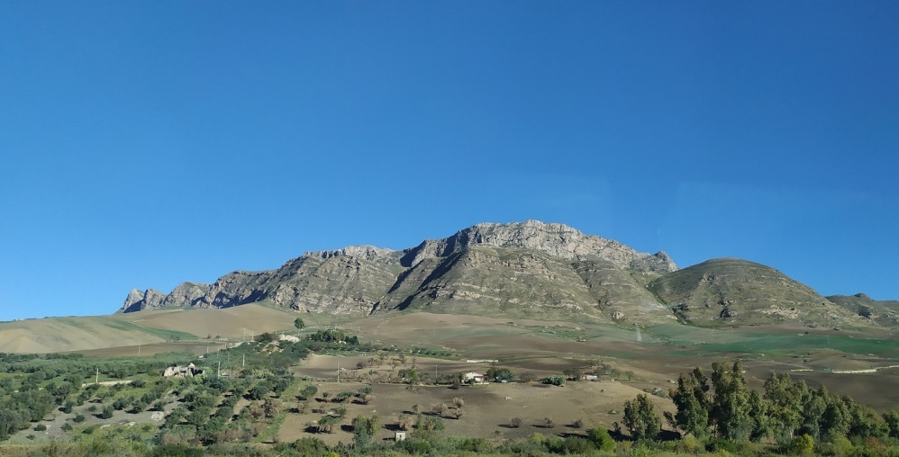
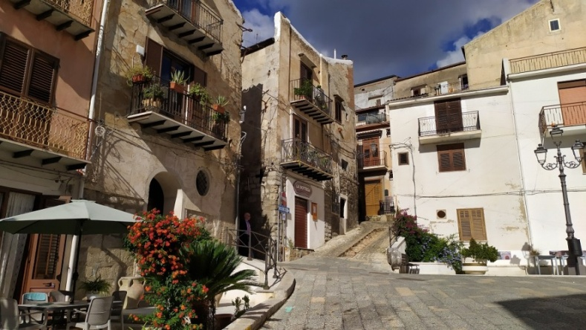
We visited 6 Sicilian Towns: Monreale, Ciminna, Baucina, Alia, Ventimiglia di Sicilia and Mezzojuso. The hosts showed us their most interesting and valuable sights.

Slide 7
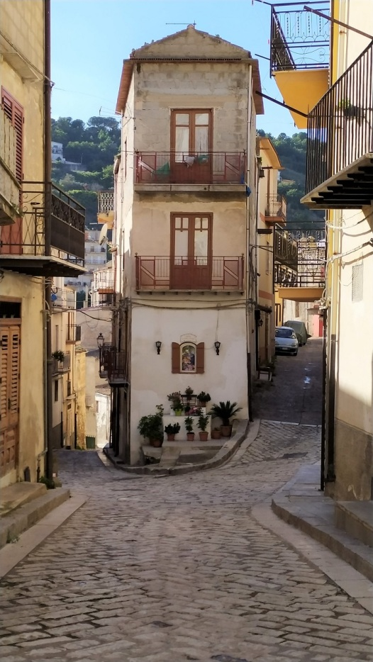
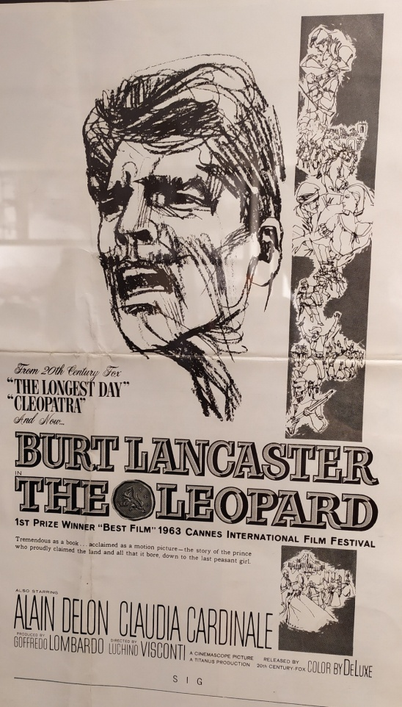
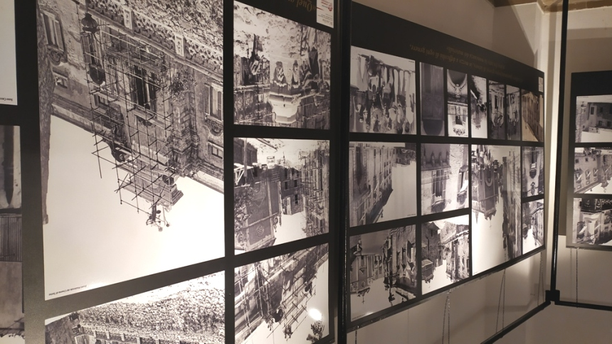
Ciminna: The historical drama Il Gattopardo (The leopard) was filmed in Ciminna and there is a museum with thousands of photos documenting shooting of the film.

Slide 8
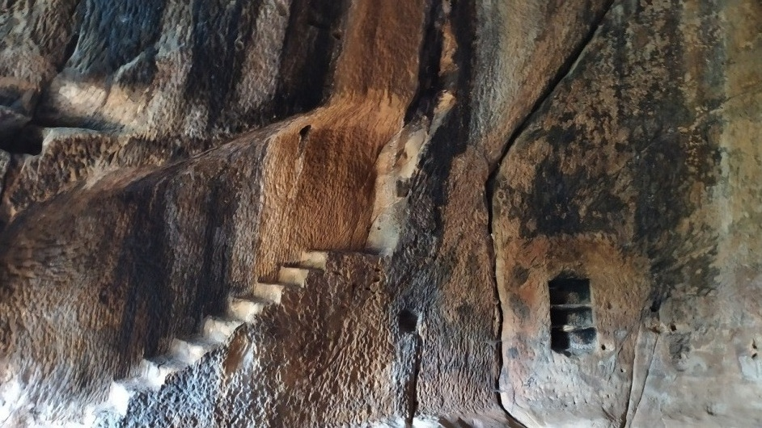
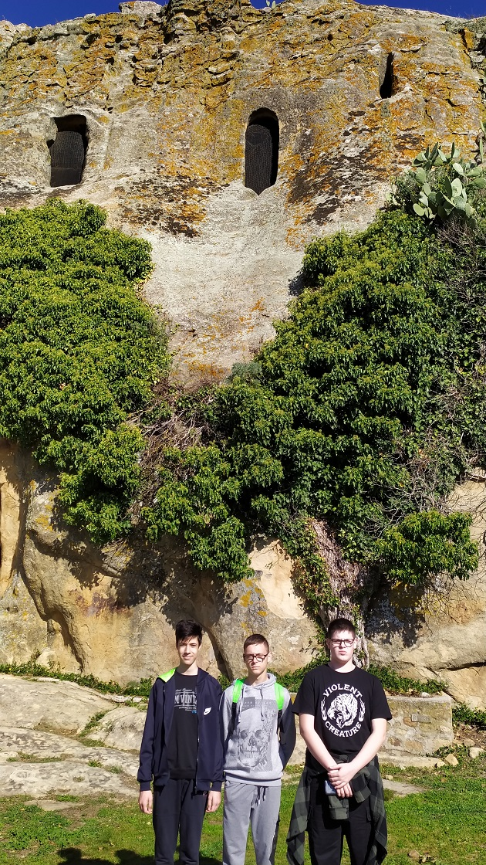
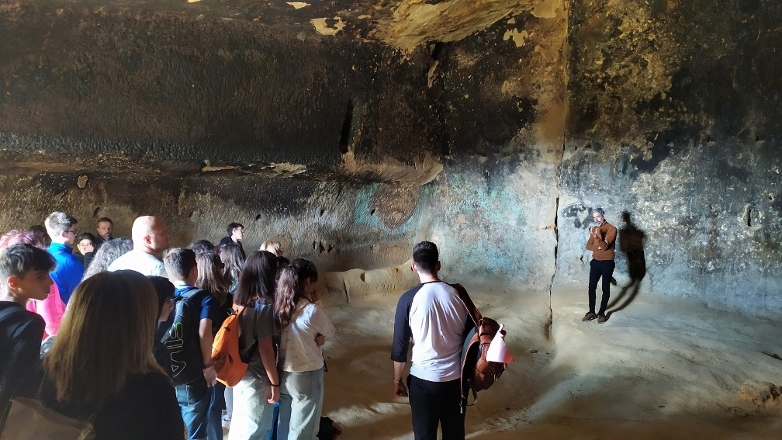
Alia: Gurfa caves – man made caves dated to 2500BC – 1600BC. They are made up of 6 rooms, dug into a red sandstone cliff, organized on 2 levels.

Slide 9
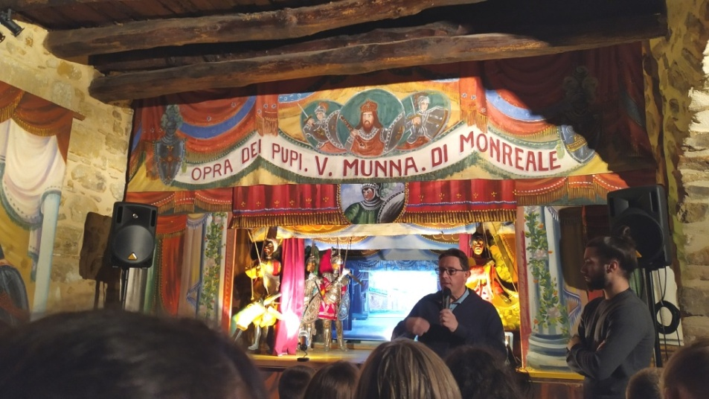
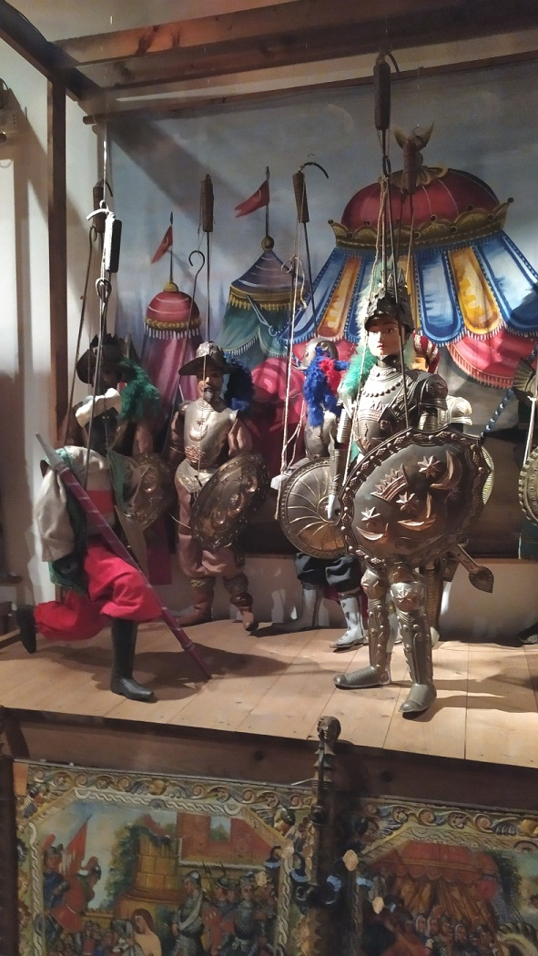
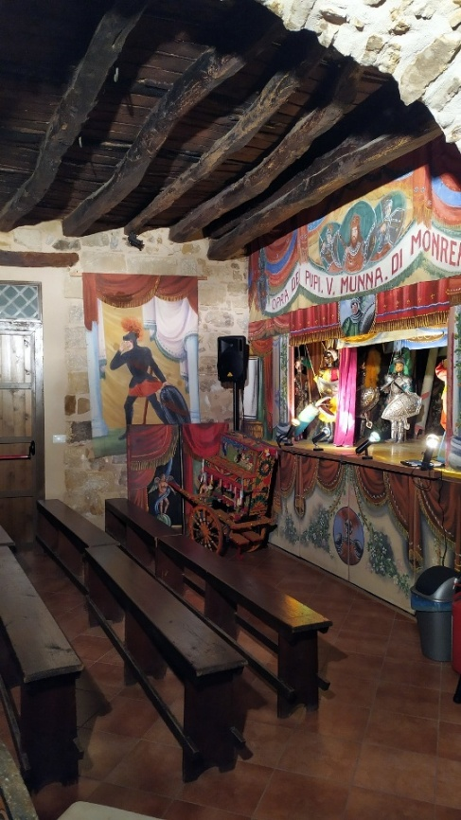
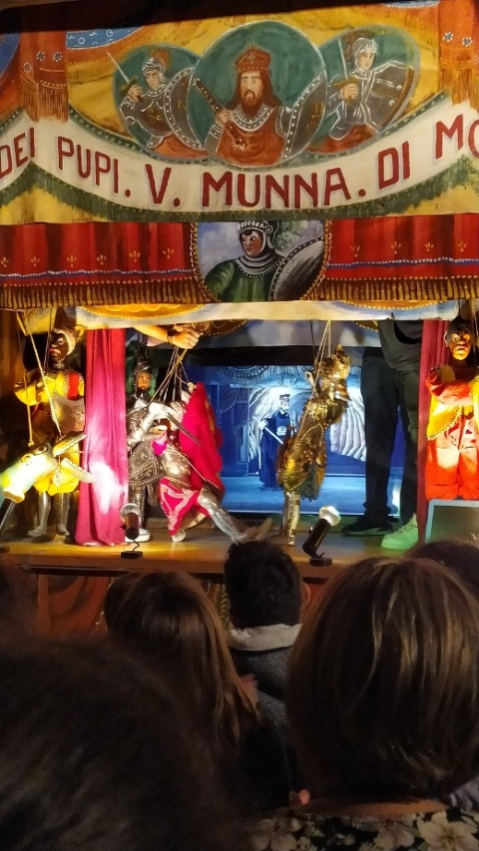
Mezzojuso: The puppet theatre – very popular in Sicily since the early 19th century among the working classes.

Slide 10
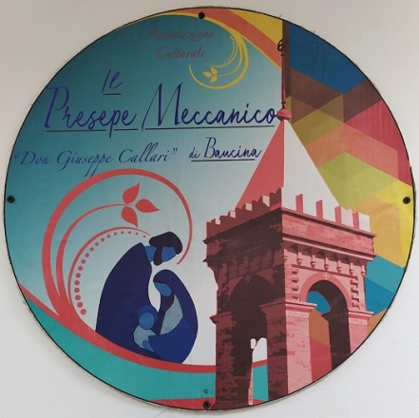
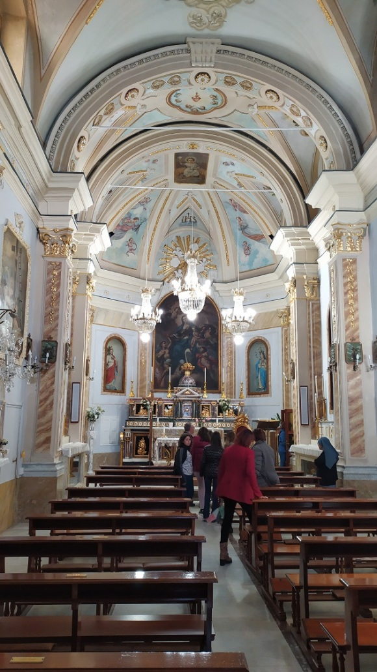
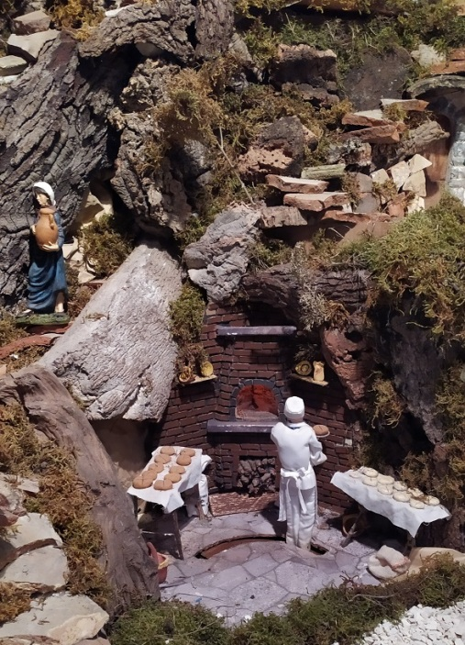
Baucina: mechanical crib and the church of Santa Fortunata, the patron saint of Baucina

Slide 11
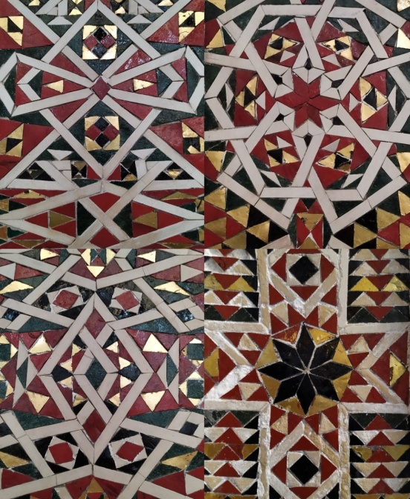
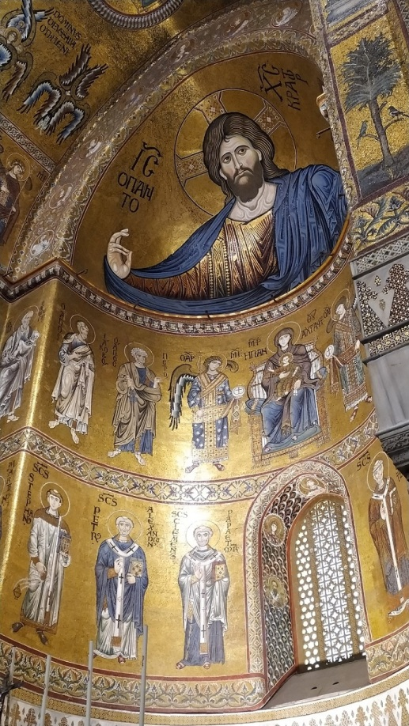
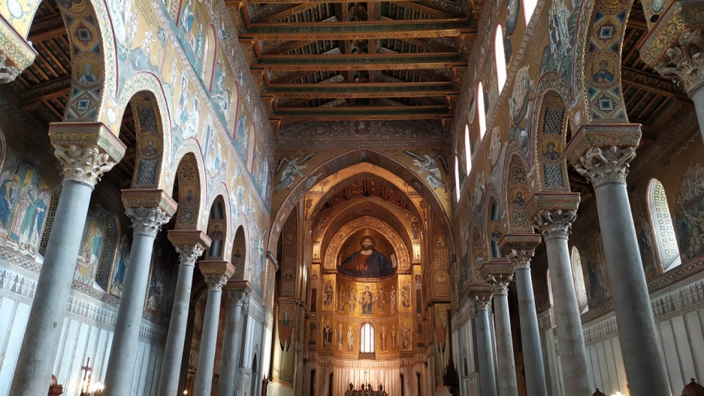
Monreale: Monreale cathedral is one of the richest and most beautiful churches in Italy, combining Norman, Byzantine, Italian and Saracen styles.

Slide 12
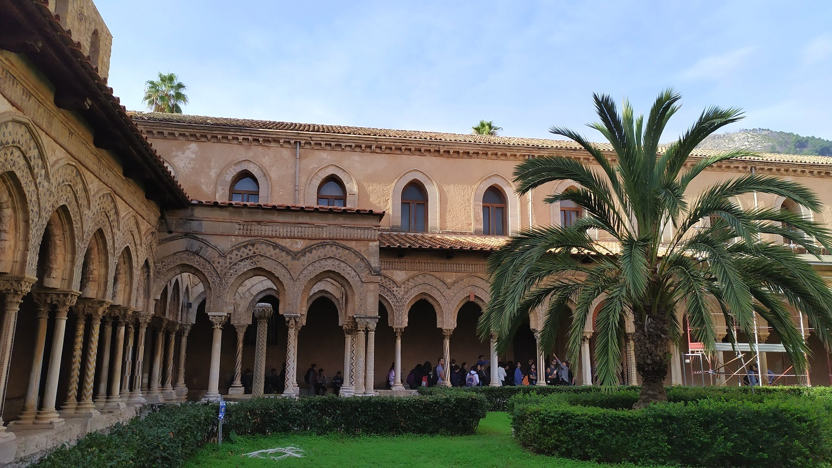
The benedictine cloister by the cathedral

Slide 13
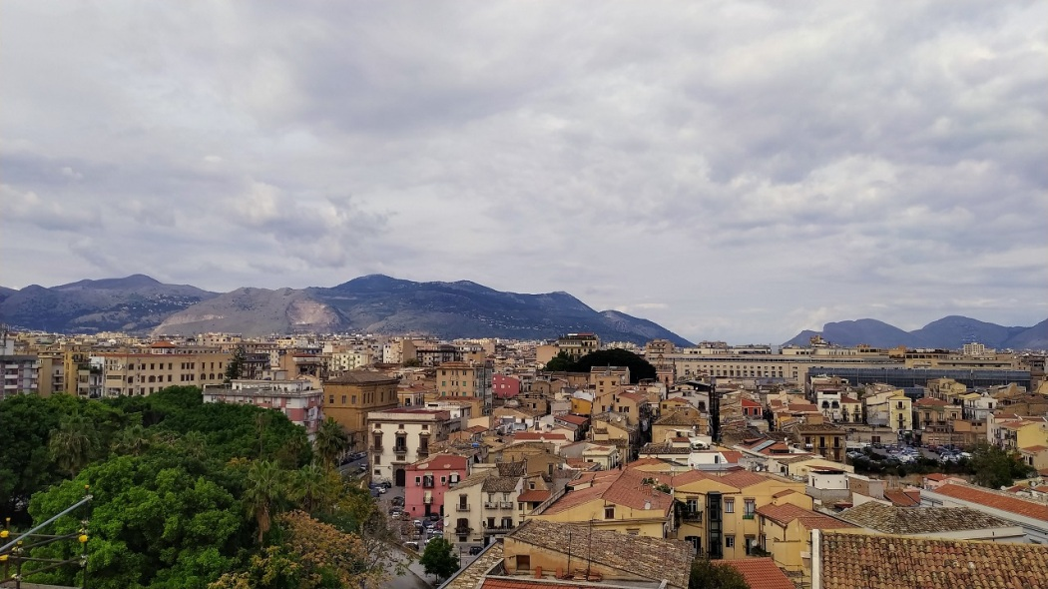
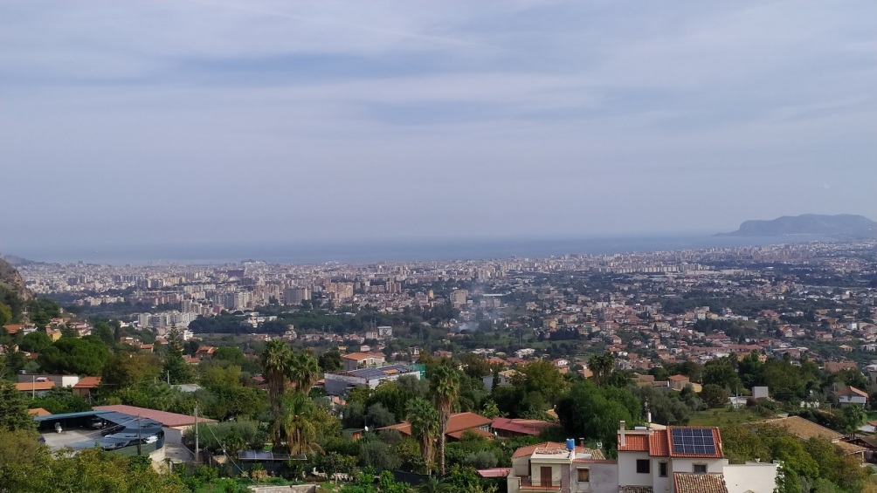
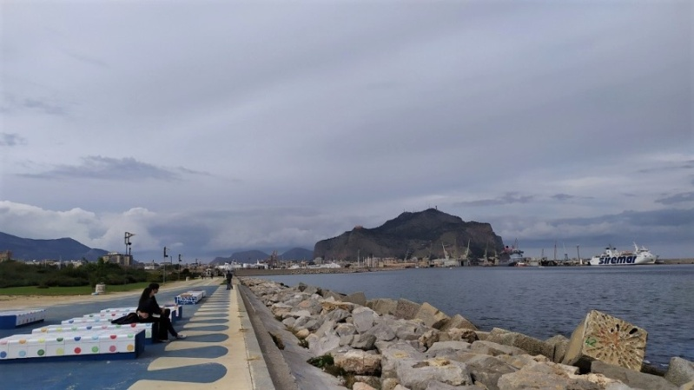
Palermo is the capital of Sicily and the largest city. During the centuries there were different influences – Roman, Norman, Greek, Arabic -which are visible in the architecture.

Slide 14
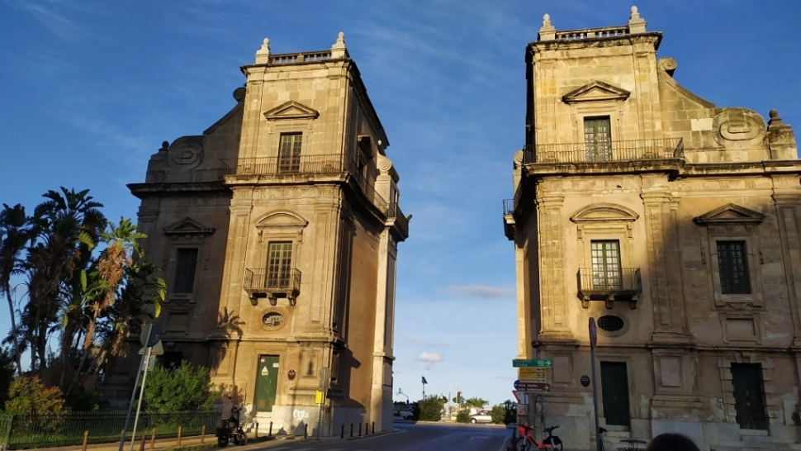
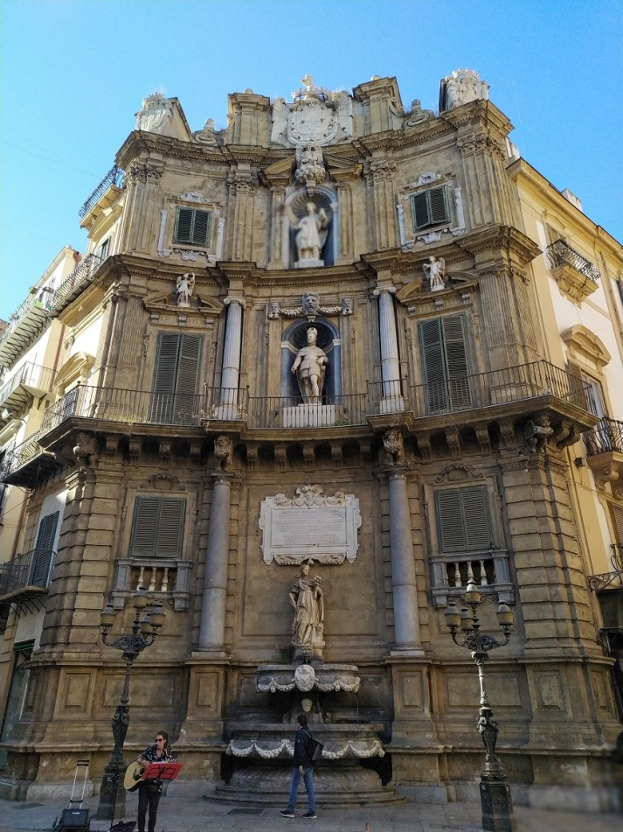
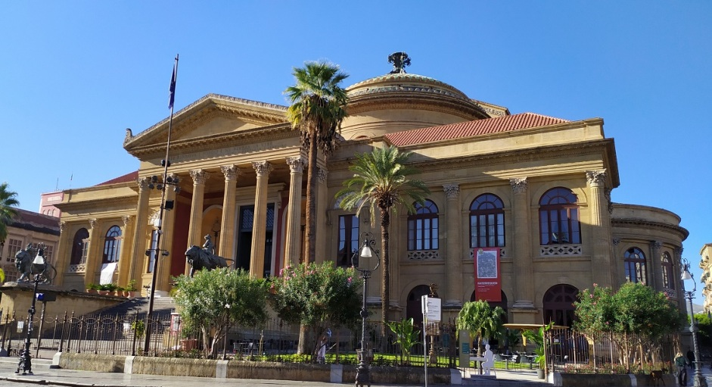
Porta Felice
Cuatro canti
Teatro Massimo

Slide 15
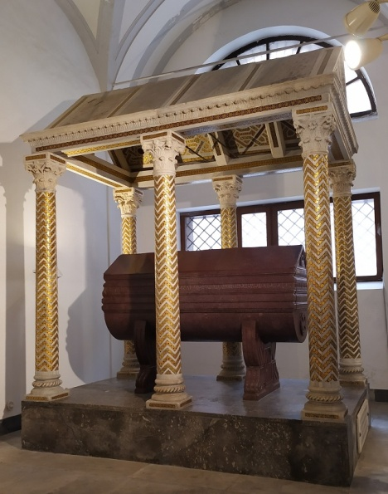
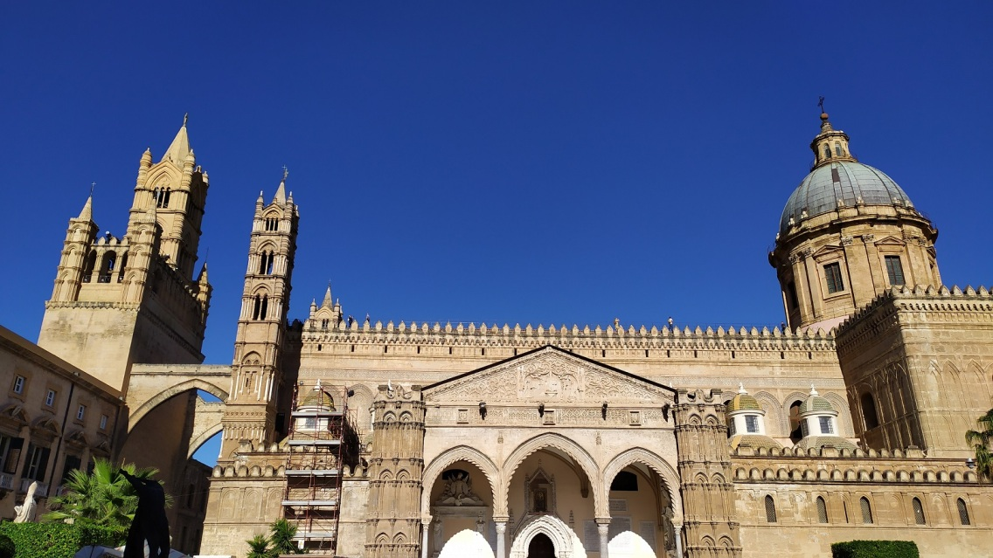
Palermo cathedral was built in the 12th century and the Norman style prevails.

Slide 16
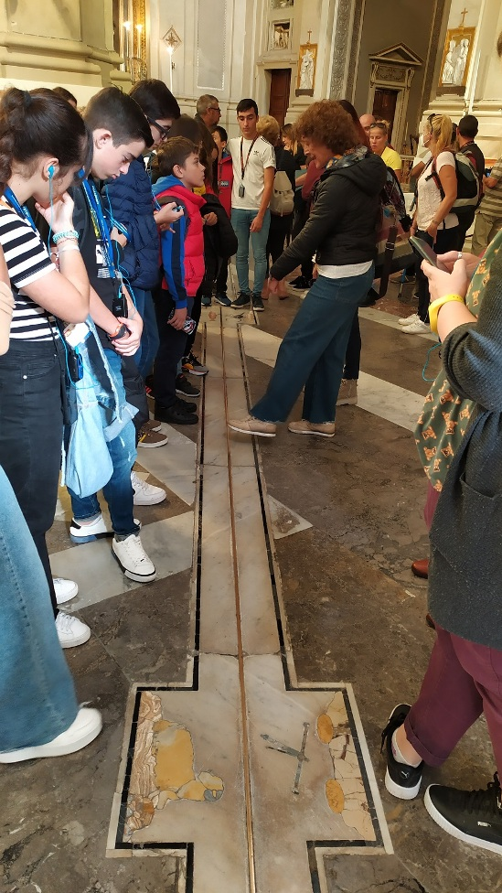
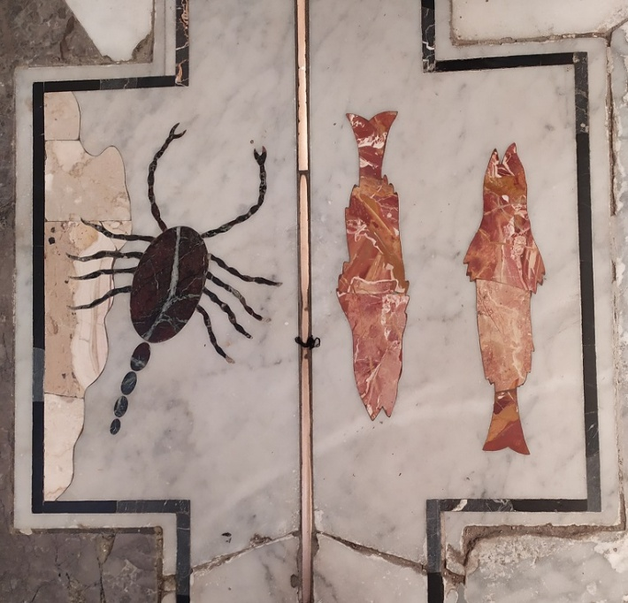
The cathedral has a heliometer (a meridian) dating to 1690. There is a bronze line, la Meridiana, on the floor, running precisely north-south. Its purpose was to standardise the measurement of time and the calendar, because in Sicily day was measured from the moment of dawn.

Slide 17
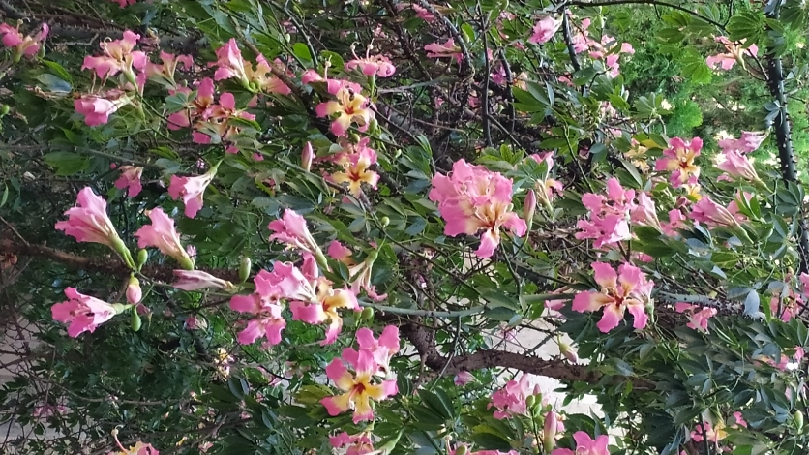
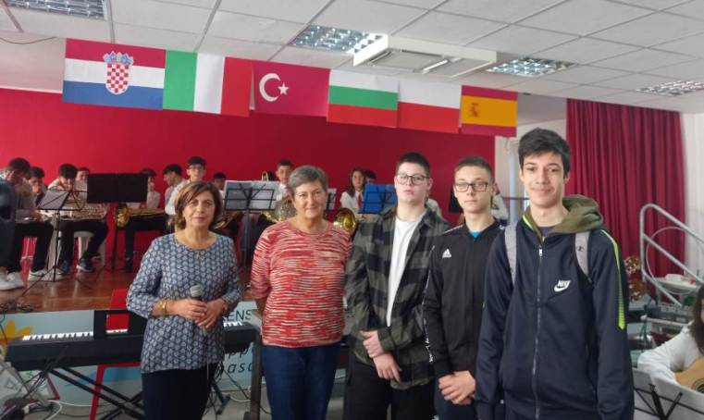
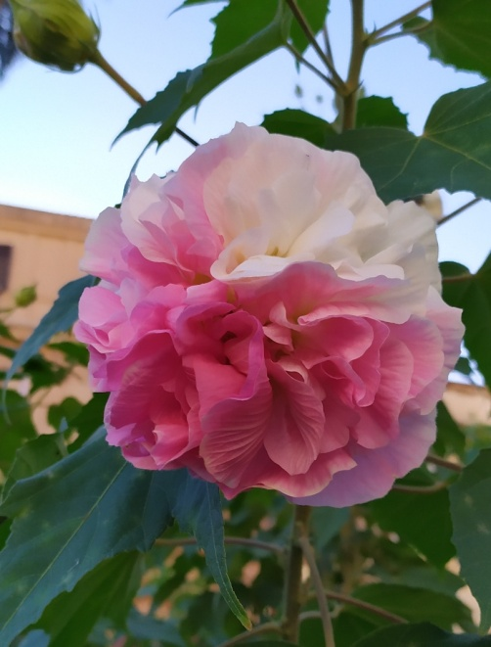
After a wonderful week with our Italian hosts and other project partners we are ready to continue our activities and are looking forward to meeting them again in Bulgaria.

