Slide 1
Osnovna škola Bartola Kašića Vinkovci Erasmus+ project 2020-2023 How Roman are you? 2020-1-DE03-KA229-077527_5
MEETING IN GREECE
May 2023

Slide 2
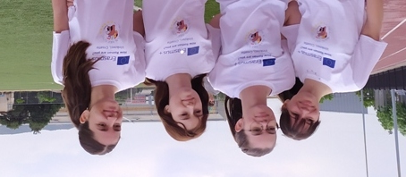
Osnovna škola Bartola Kašića is one of six partner schools in the Erasmus+ project “How Roman are you?”. Coordinating school is from Germany and other partners are from Italy, Portugal, Spain and Greece. The sixth short-term exchange of pupils took place from 30 April untill 6 May 2023 in Volos, Greece. Pupils and teachers from five countries were hosted by 4th High School of Volos. Our team consisted of four pupils: Bruna Klepo, Tena Pavoković, Martina Rajković and Mare Vukić. They were accompanied by three teachers.

Slide 3
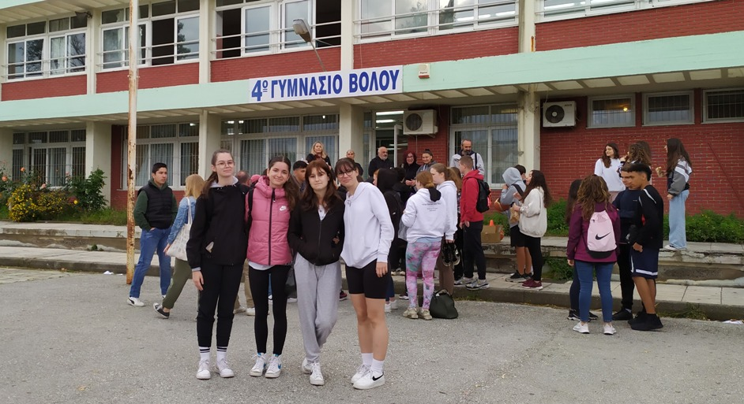
Host school was 4th Gymnasium Volos. All foreign students were hosted by Greek students’ families during the meeting.

Slide 4
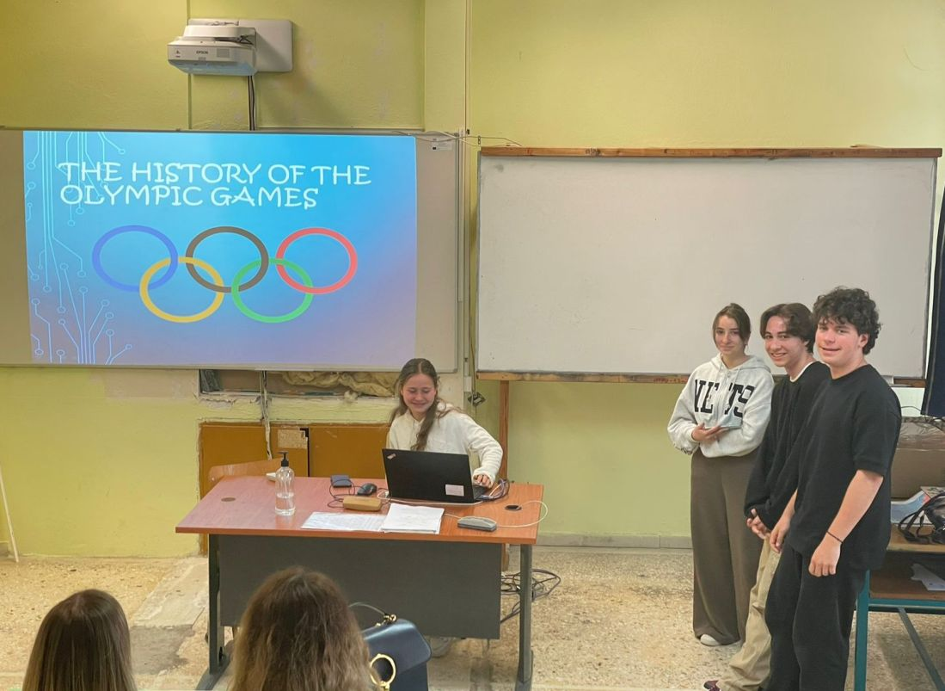
The topic of the meeting was SPORT and all teams presented their research on the History of Olympic Games and sports in their countries.

Slide 5
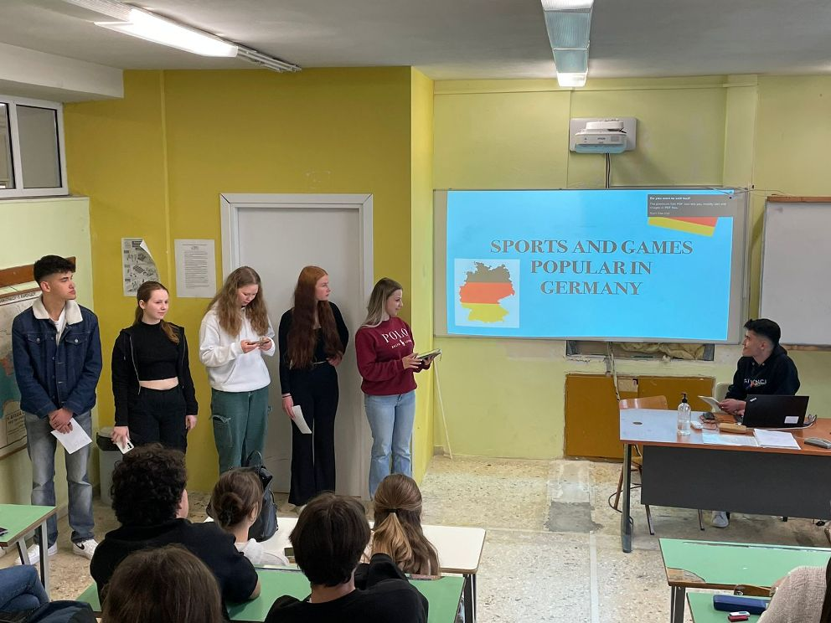
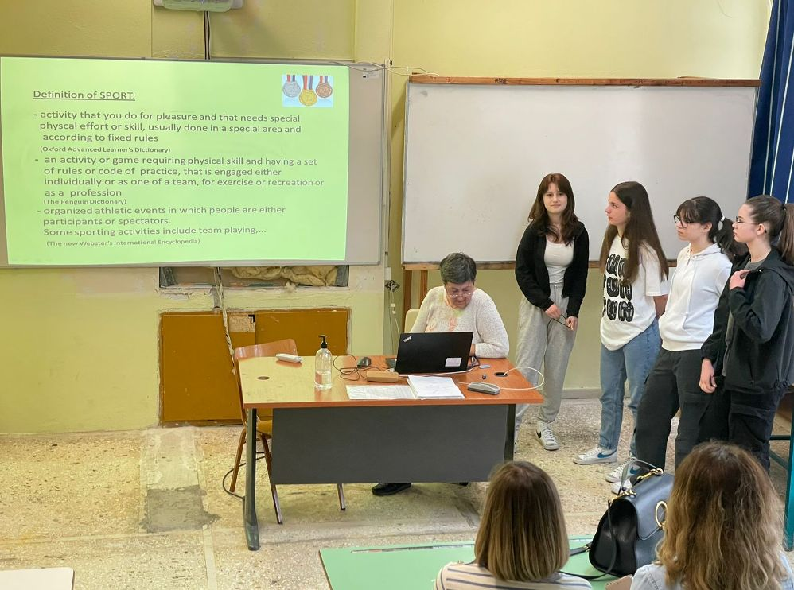
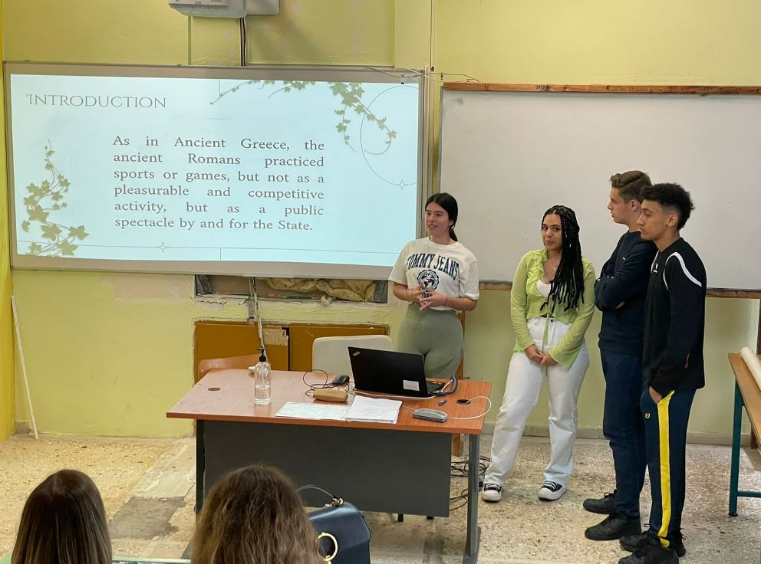
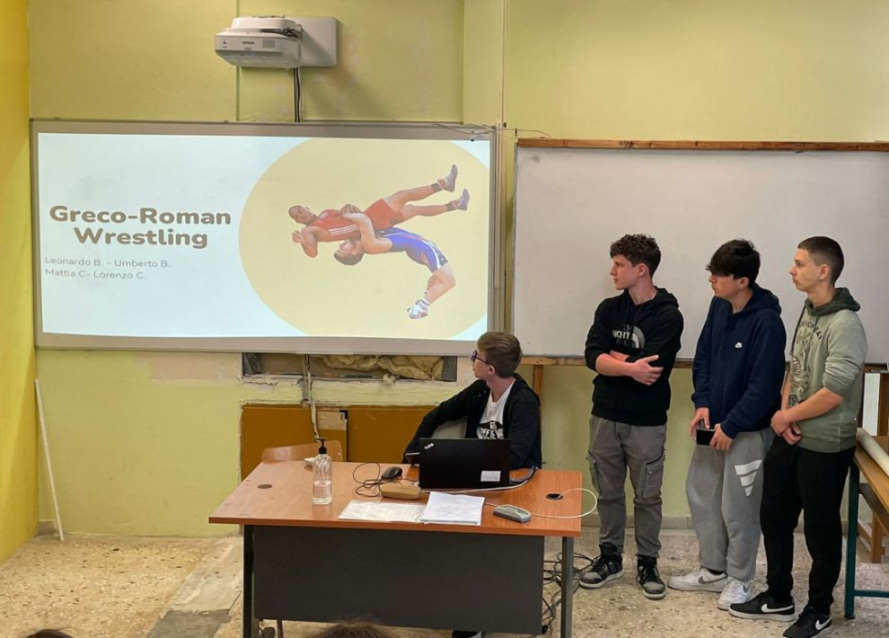

Slide 6
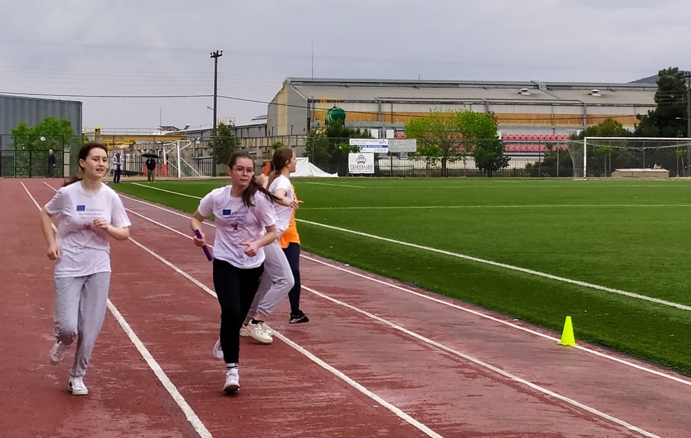
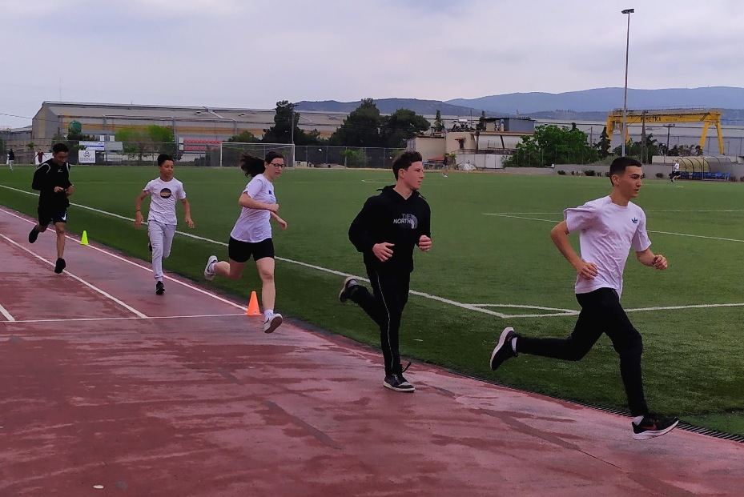
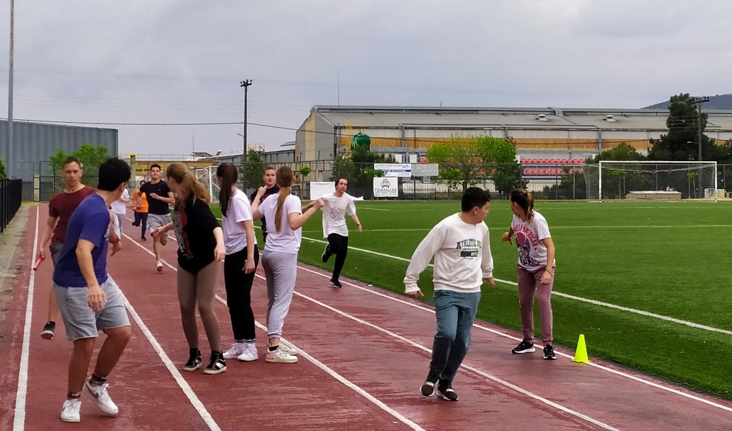
Students also competed in sports at the city stadium. They all did their best, but the best team was the Italian team.

Slide 7
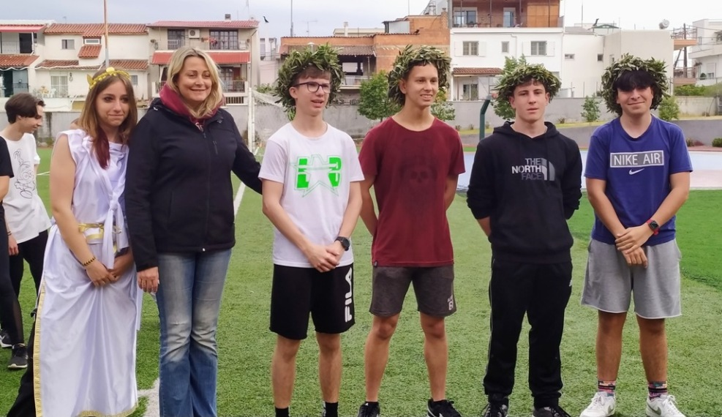
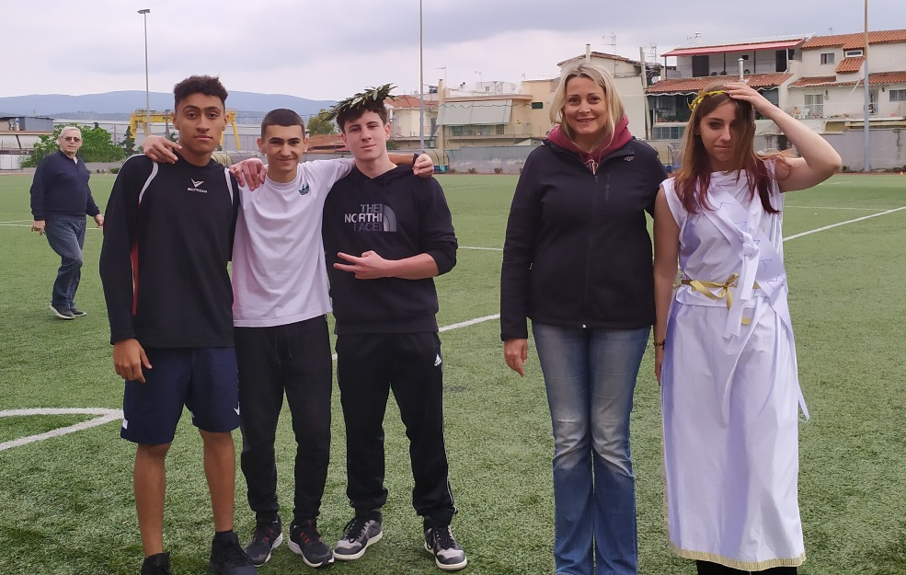
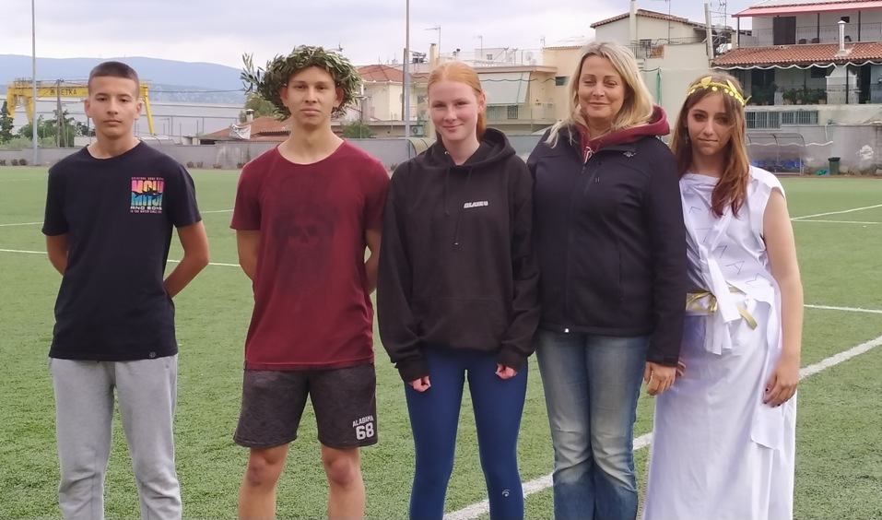
The winners got olive leaves wreath, like in ancient times.

Slide 8
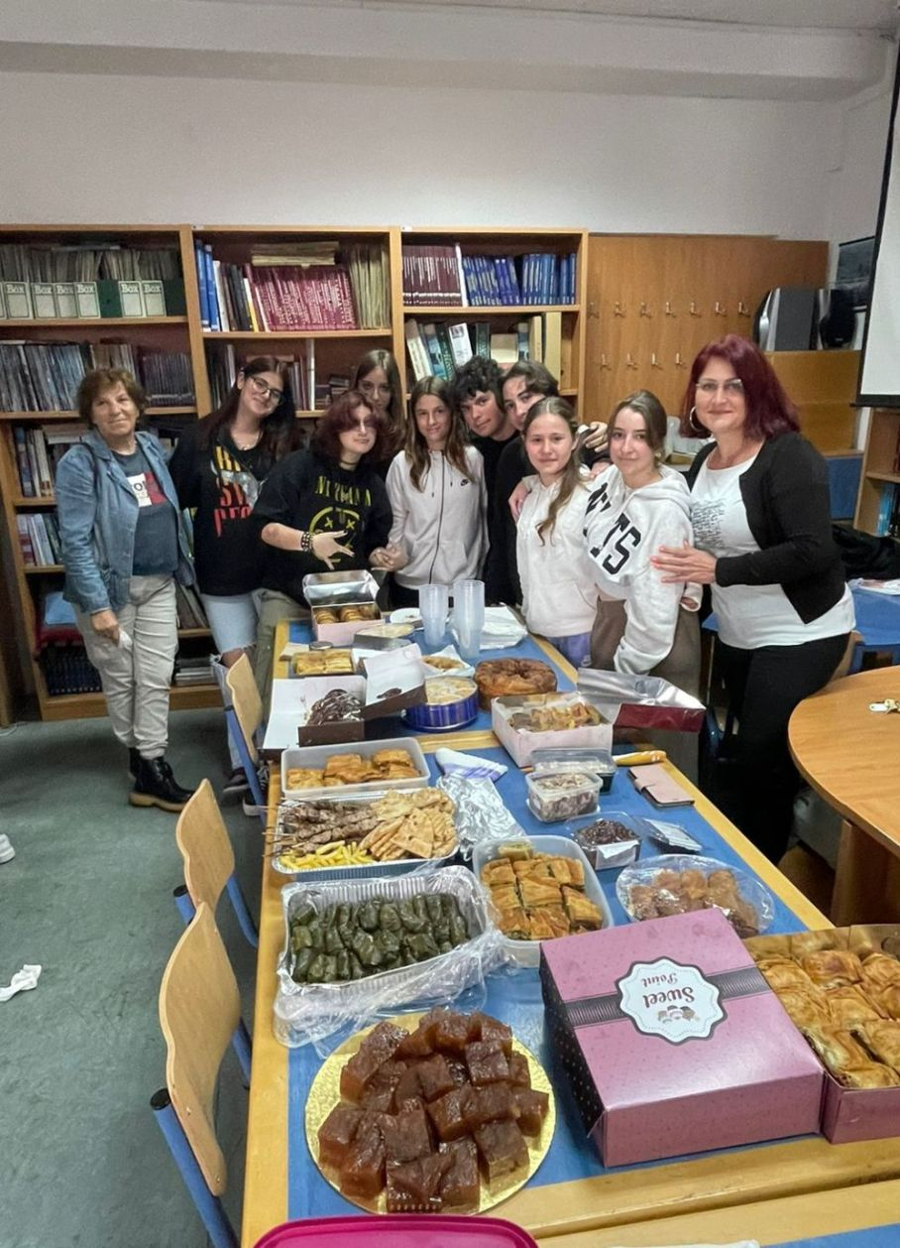
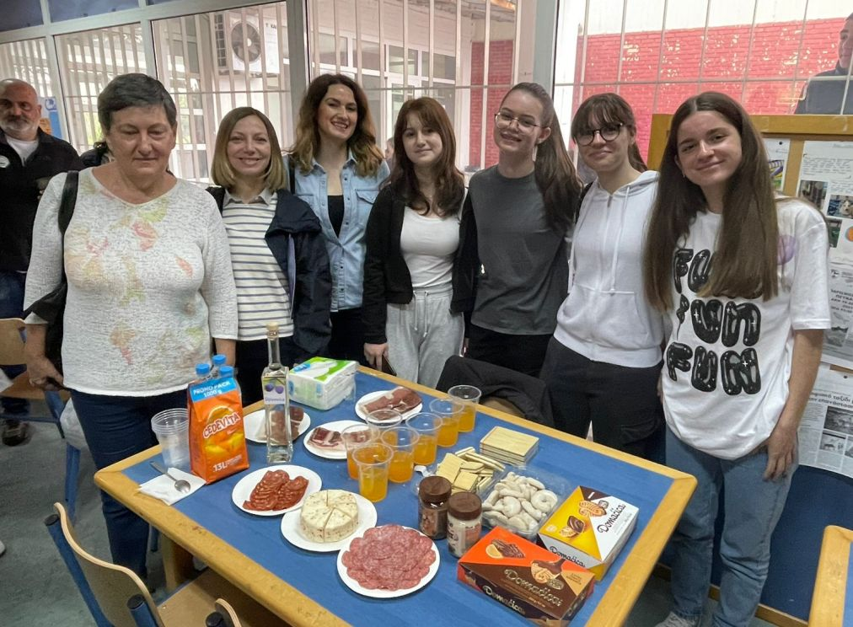
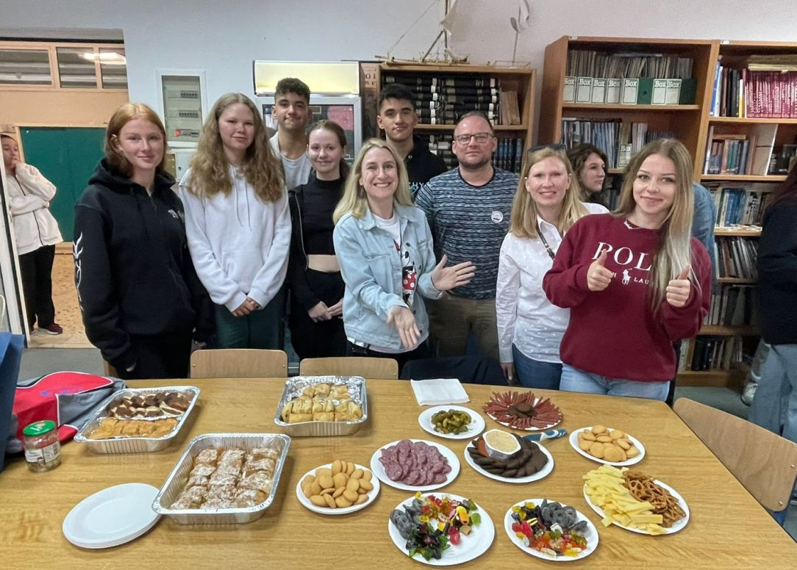
Food fair: all teams brought some traditional tasty food from their countries.

Slide 9
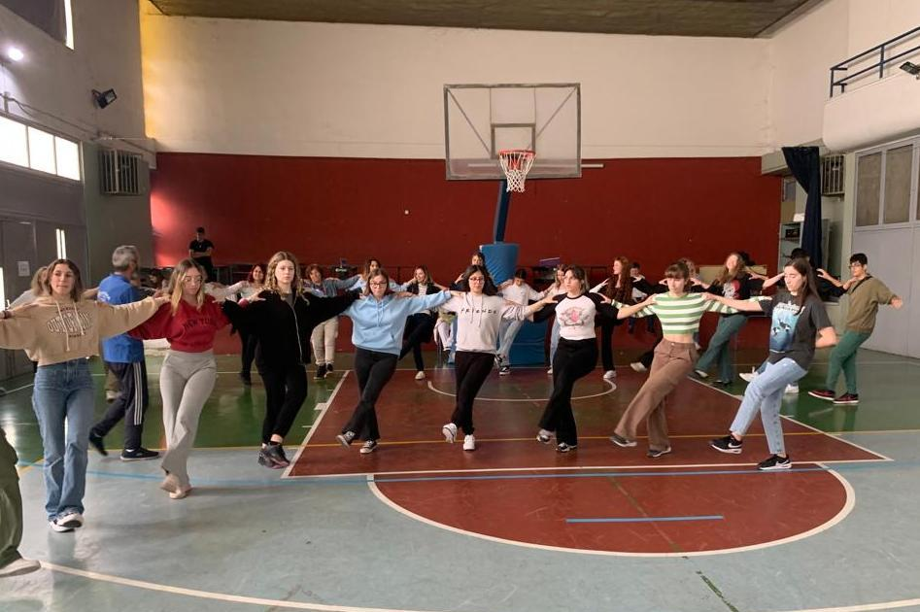
We learned to dance traditional Greek dances.

Slide 10
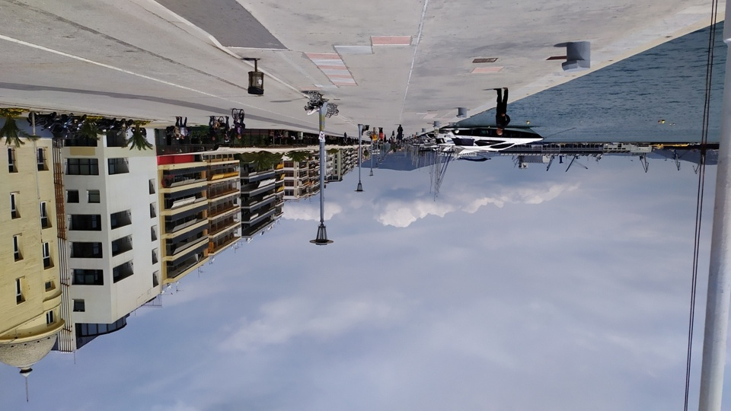
Volos is a beautiful coastal city in Thessaly at the foot of Mount Pilio (Pelion).

Slide 11
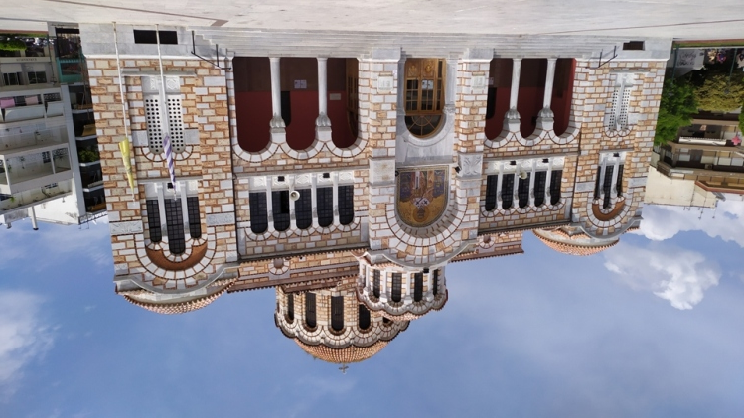
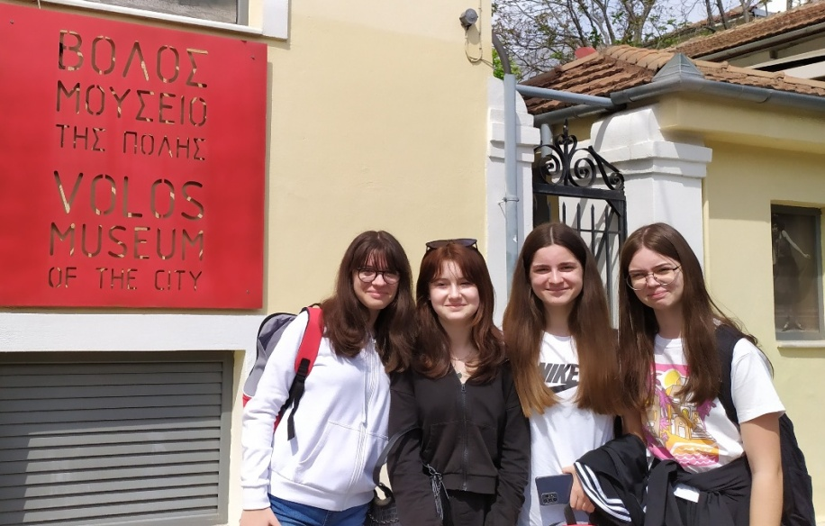
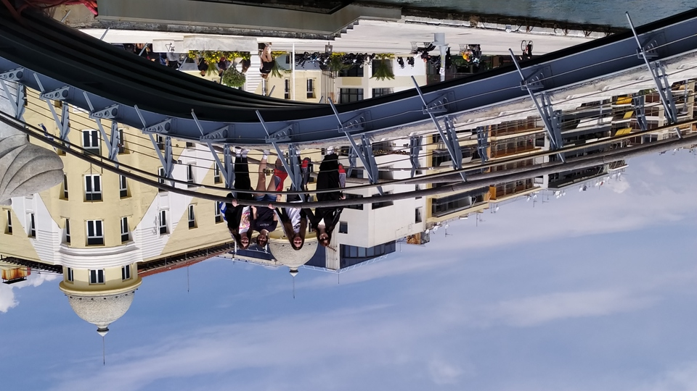
First we visited the museum and then some other sights.
St. Nicholas Metropolitan Cathedral

Slide 12
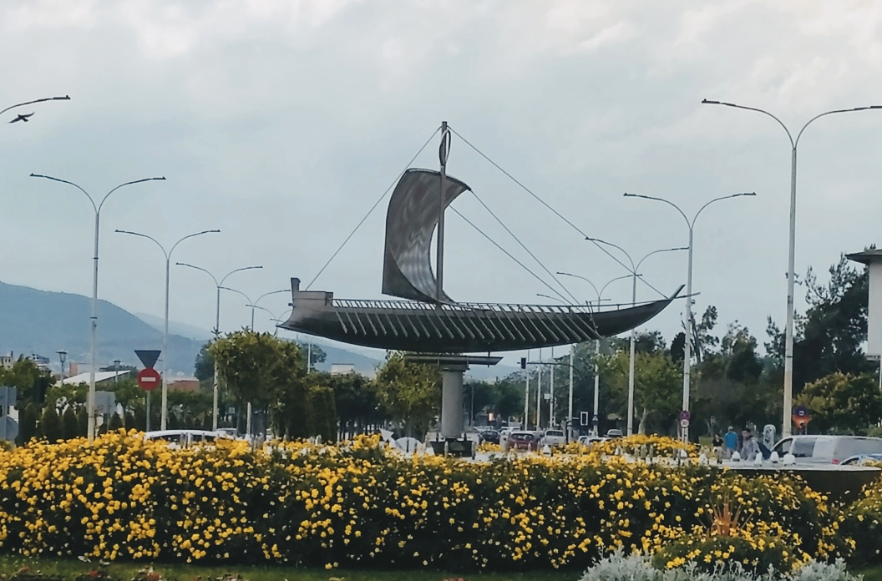
It was from Volos that the mythical hero Jason set out on the ship Argo in search of the Golden Fleece. He was accompanied by the Argonauts.

Slide 13
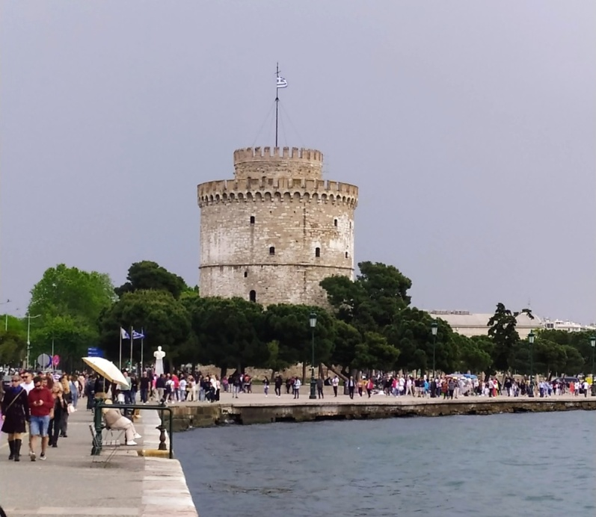
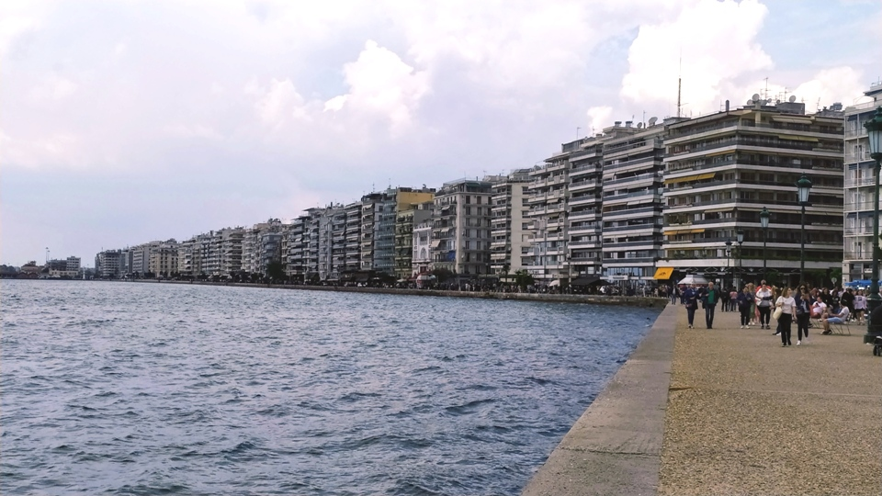
We visited Thessaloniki, which is the second largest city in Greece.
The White Tower

Slide 14
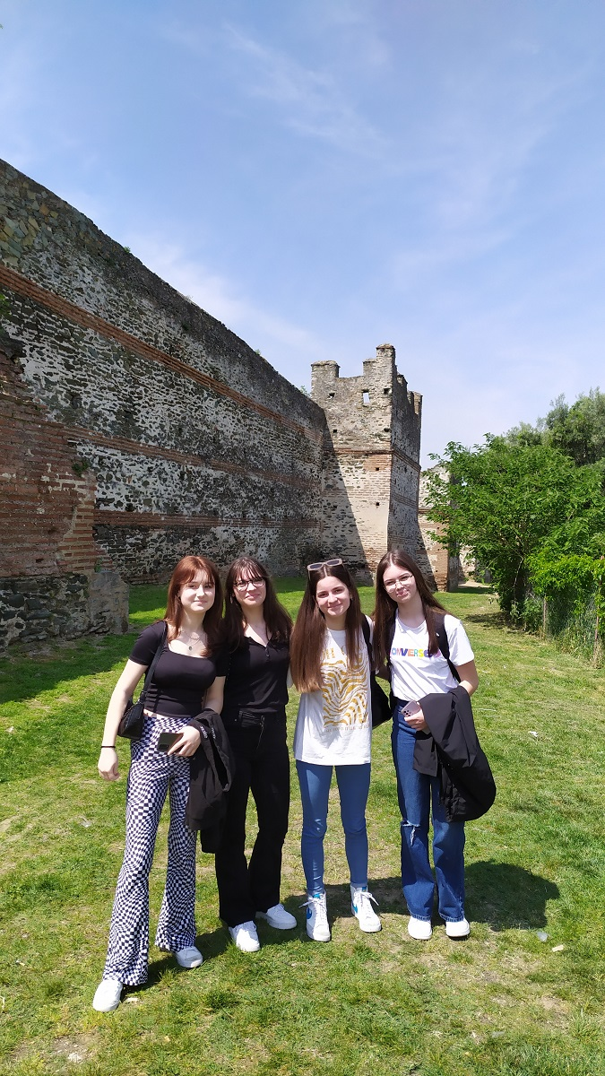
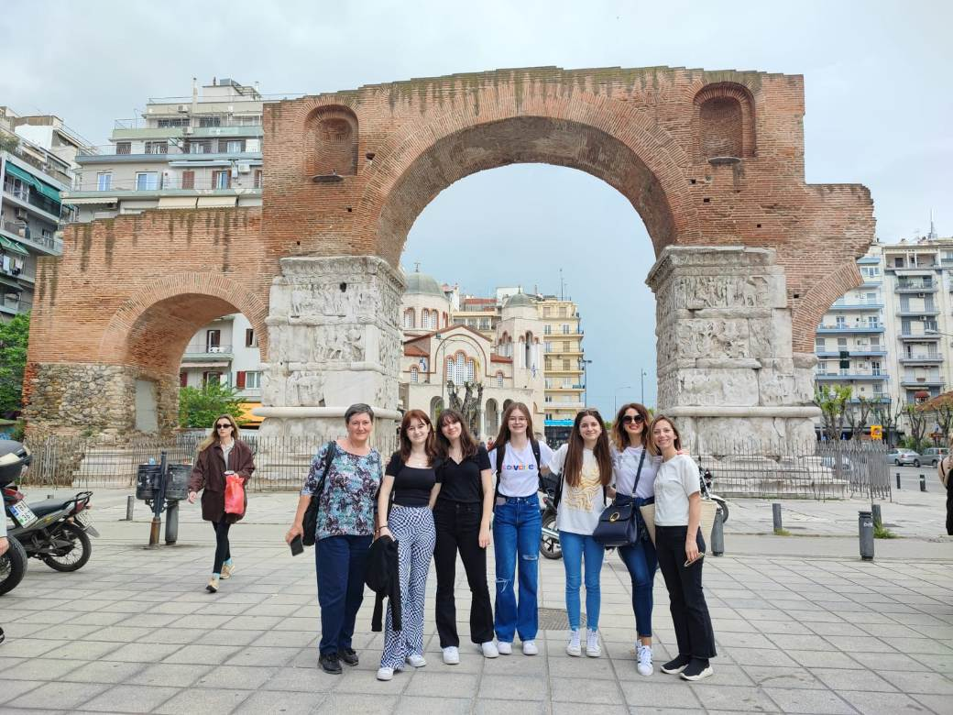
The city walls of Thessaloniki, which date back to the 4th century BC, are the result of a long building process.
Arch of Galerius, built between 298 and 305 AD.

Slide 15
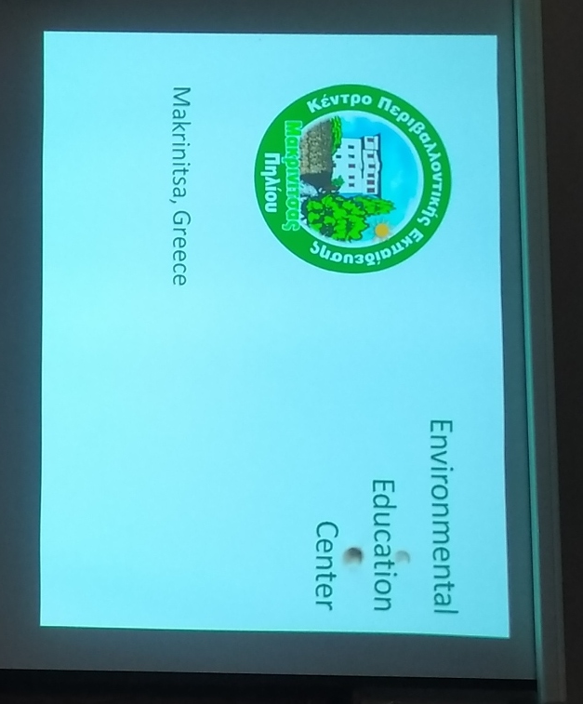
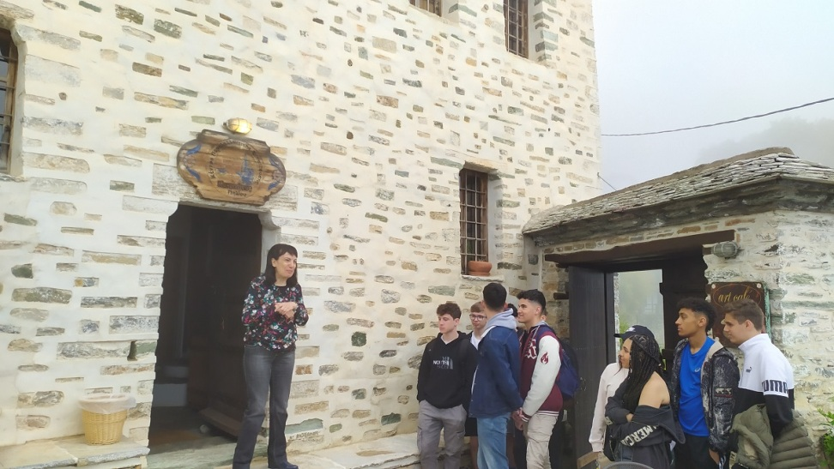
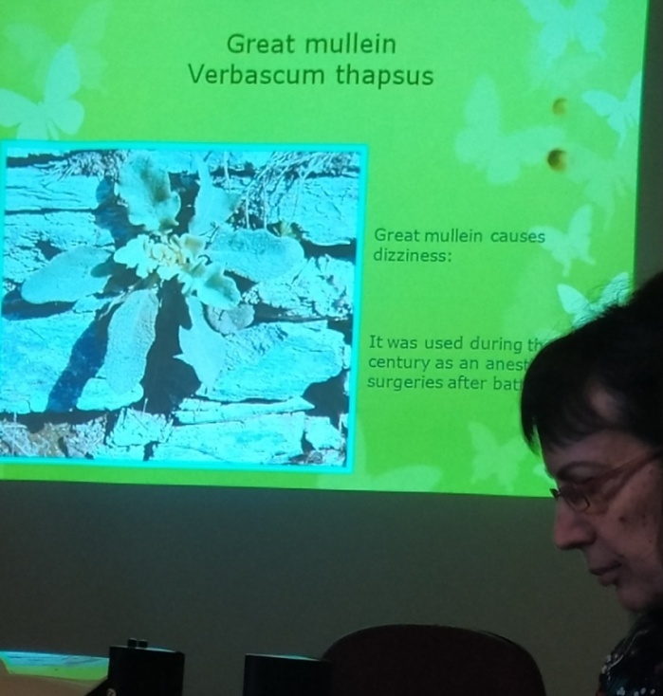
Makrinitsa is a village located on the green slopes of Mount Pelion, 16 km from Volos. We visited Environmental Education Center where we learned about the traditional architecture and protection of biodiversity.

Slide 16
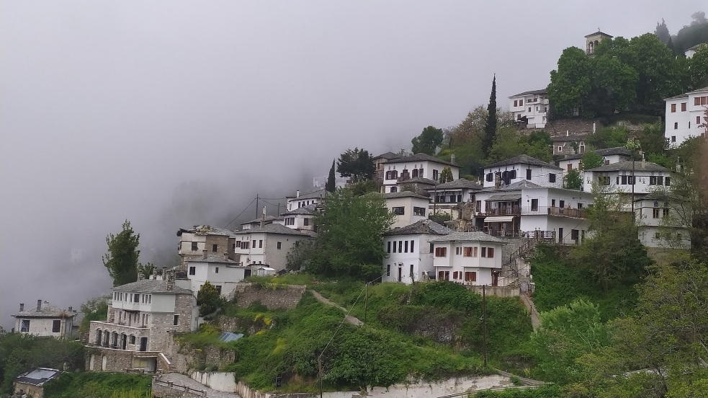
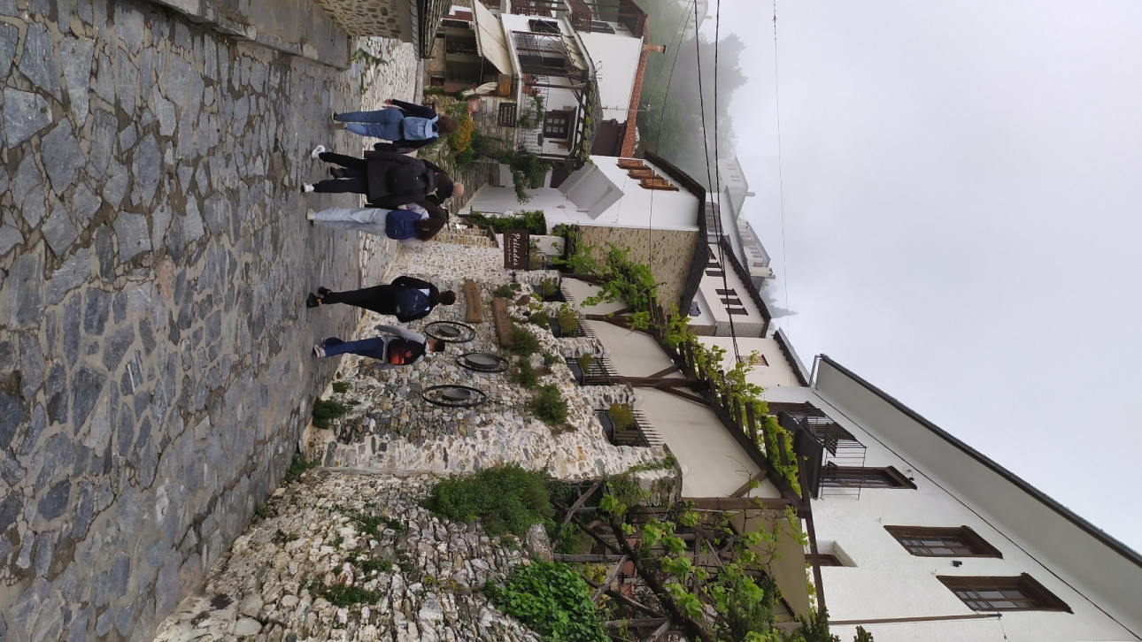
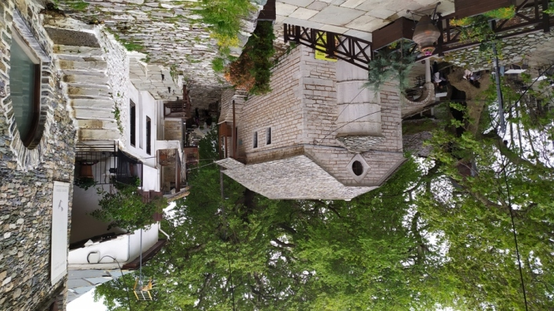

Slide 17
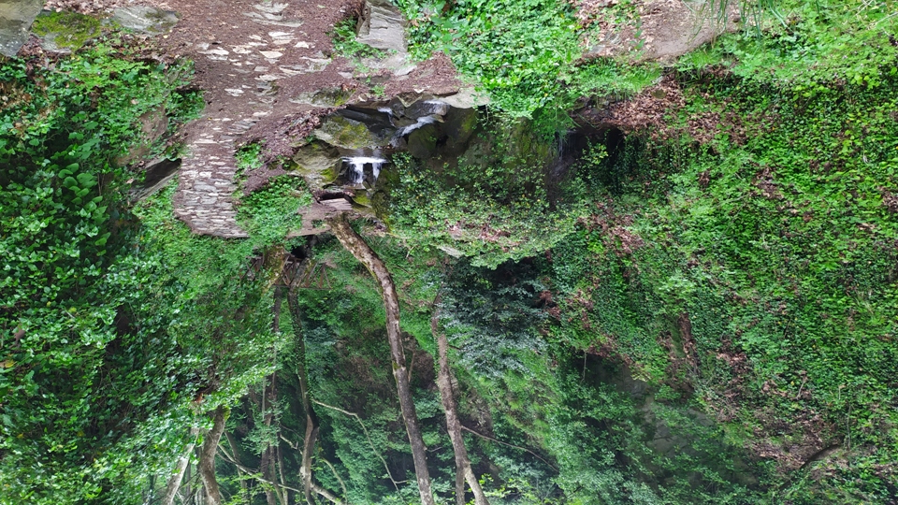
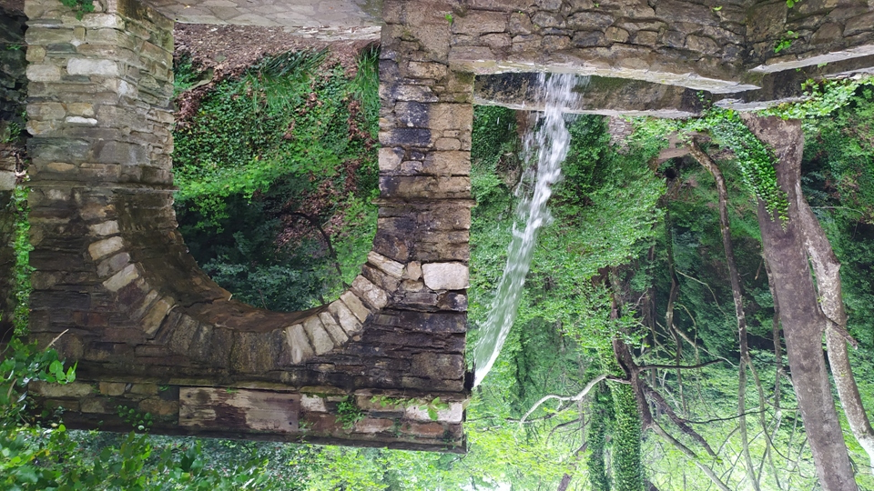
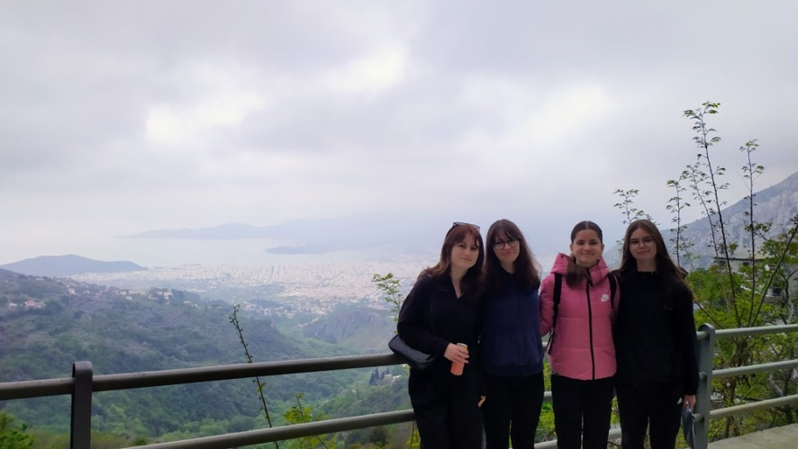
Mount Pelion is the most beautiful mountain in Greece. It has thick forests and numerous water springs.

Slide 18
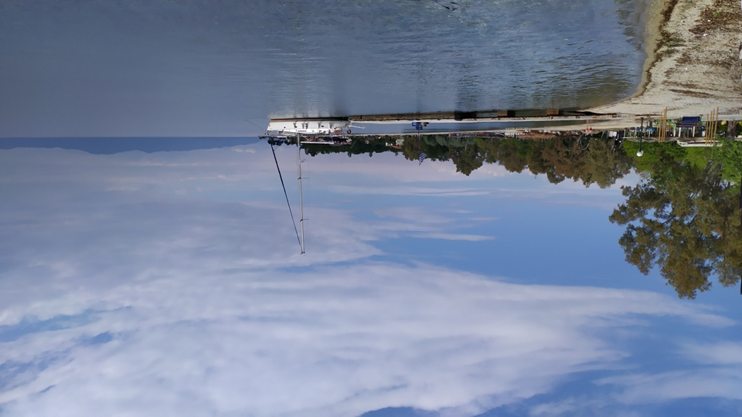
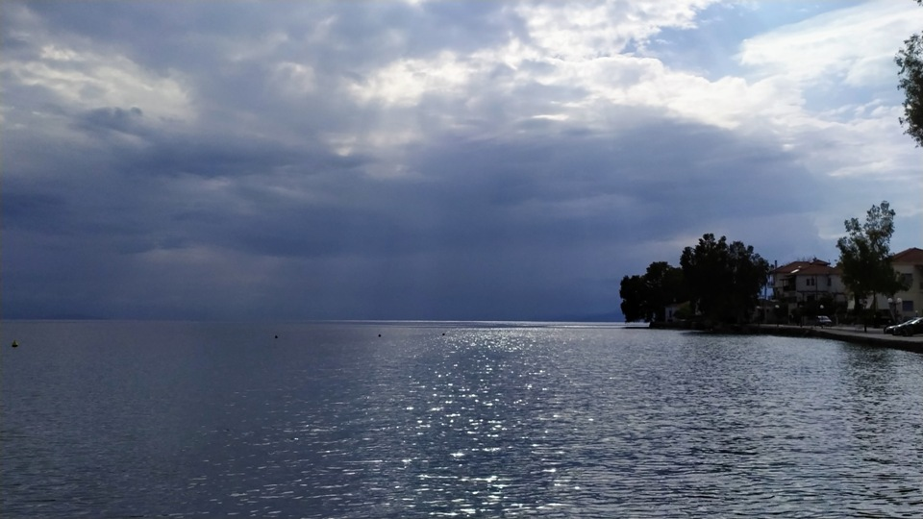
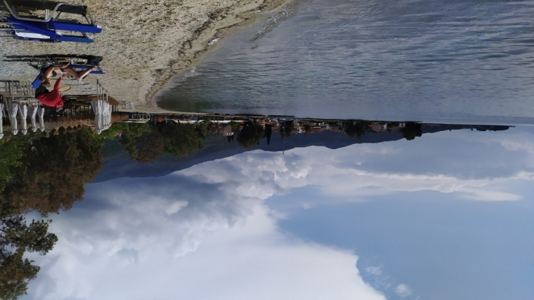
Kala Nera is a small coastal village 17 km southeast of Volos. It has beautiful beaches and is very popular summer destination.

Slide 19
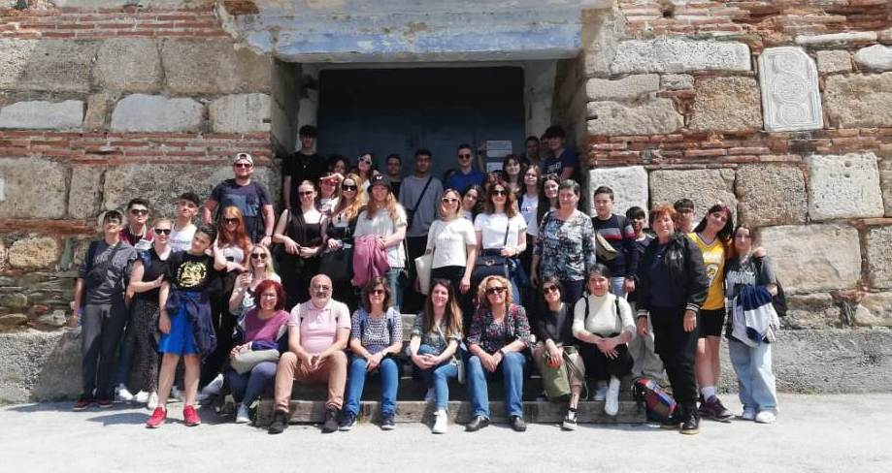
During our stay in Volos, we learned a lot, broadened our horizons, made friends and had fun.

