Slide 1
Osnovna škola Bartola Kašića Vinkovci Erasmus+ project 2020-2023 S.O.F.T. – Start our future today 2020-1-PL01-KA229-081533_4
MEETING IN BULGARIA
April 2023

Slide 2
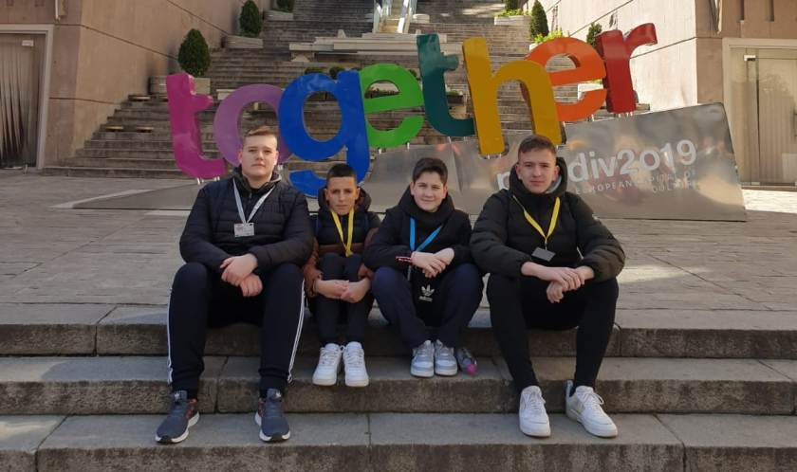
The sixth short-term exchange of pupils of Erasmus+ project “S.O.F.T. – Start our future today” took place in Sofia, Bulgaria. Host school was 107 Primary school “Khan Krum” and its pupils and teachers hosted guests from Poland, Italy, Spain, Turkey and Croatia. Our team consisted of four pupils: Luka Dožić, Josip Gabud, Fran Košutić and Luka Majić. They were accompanied by four teachers.

Slide 3
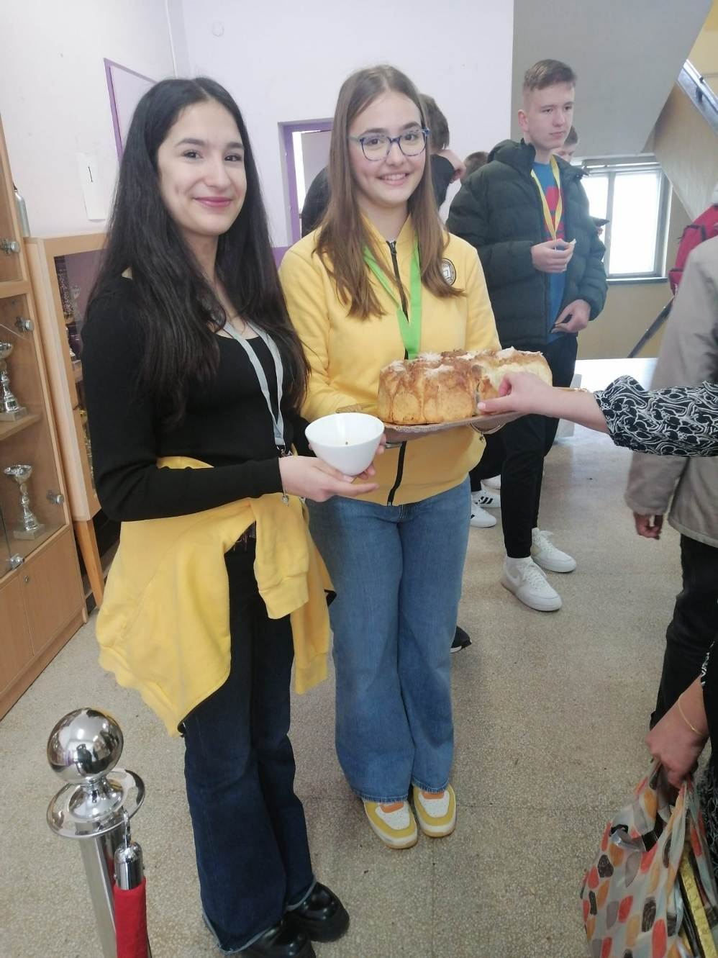
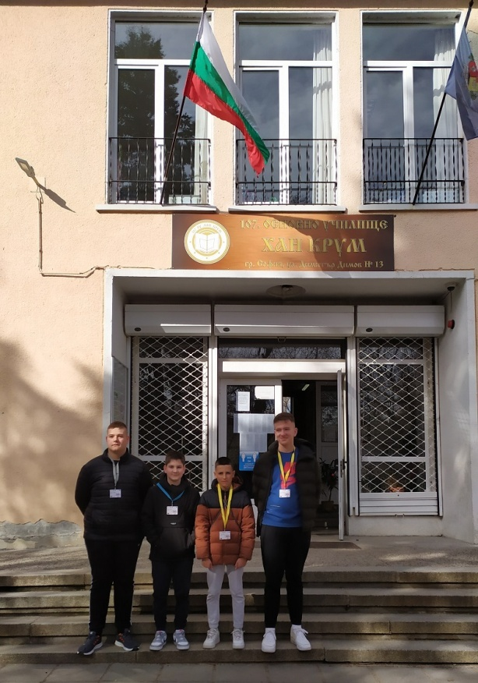
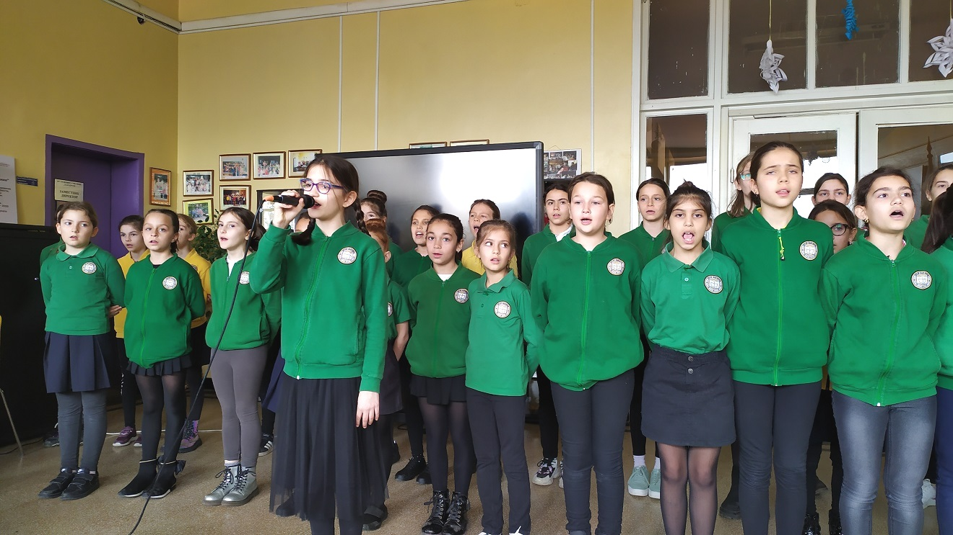
We were welcomed with bread and honey and a very interesting performance.

Slide 4
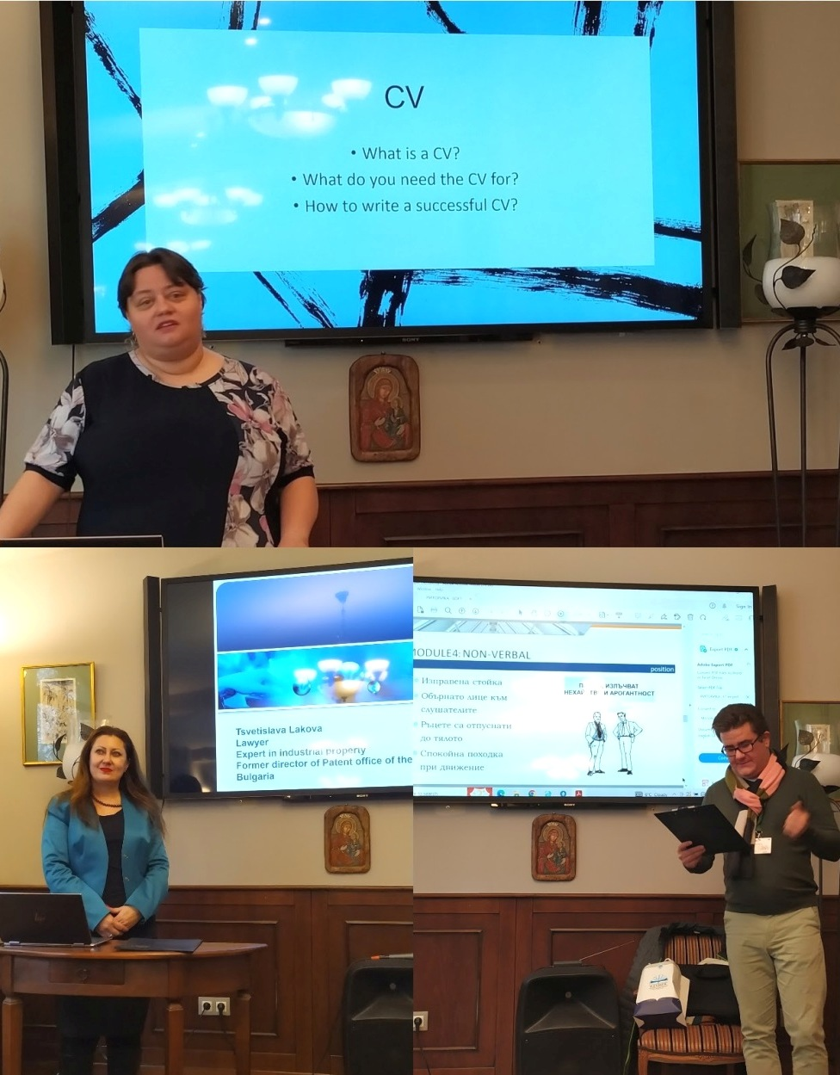
We attended lessons and workshops:
How to protect your invention and property rights
- How to write a CV and present your skills during a job interview - workshop on rethorics

Slide 5
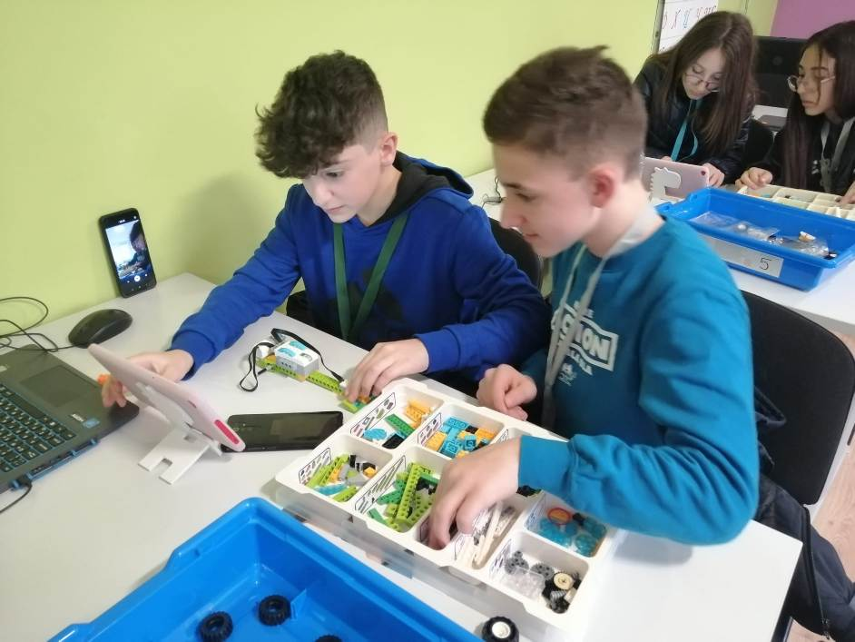
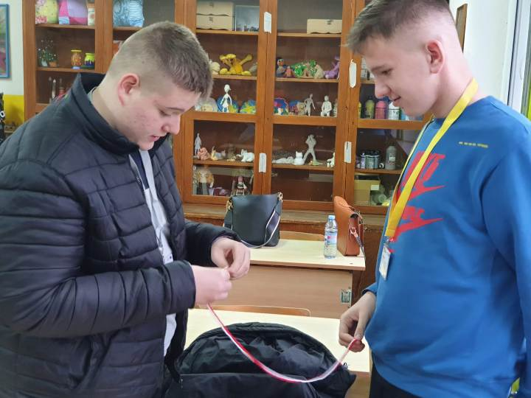
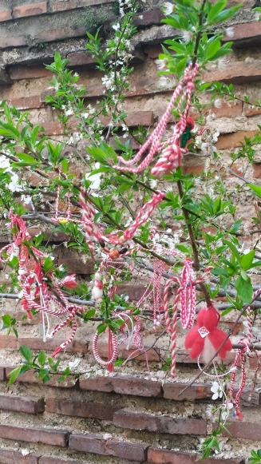
Modern and traditional –
Robotics workshop Learning how to make Martenitsa,
tradition related to welcoming spring

Slide 6
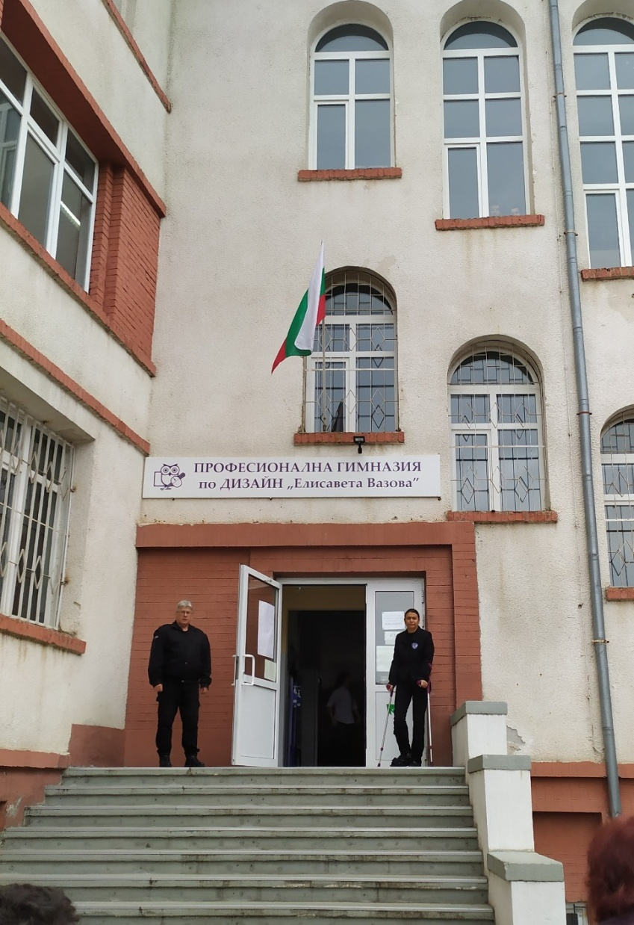
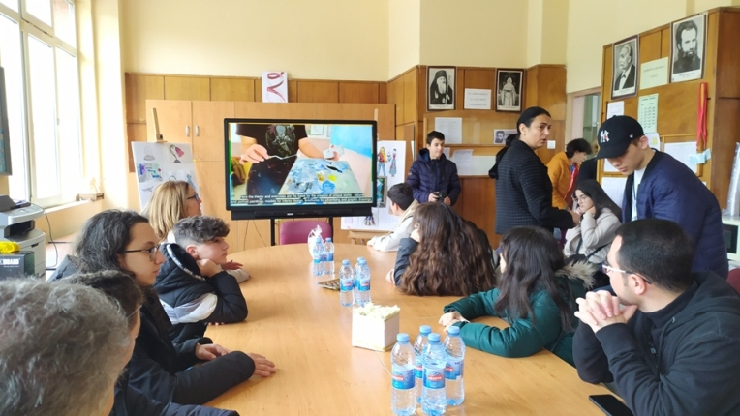
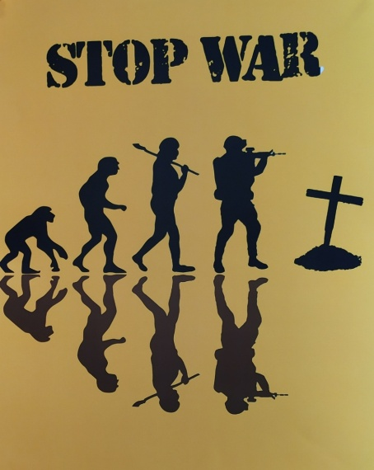
We visited Vocational secondary school of design “Elisaveta Vazova”

Slide 7
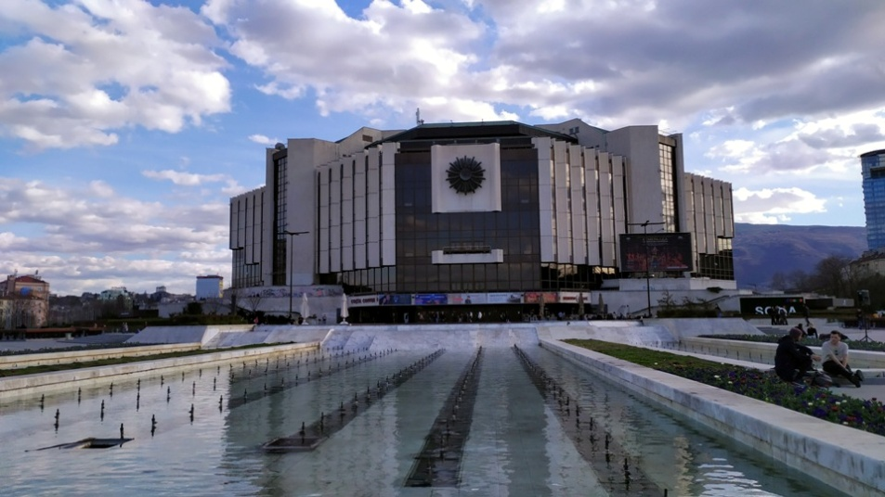
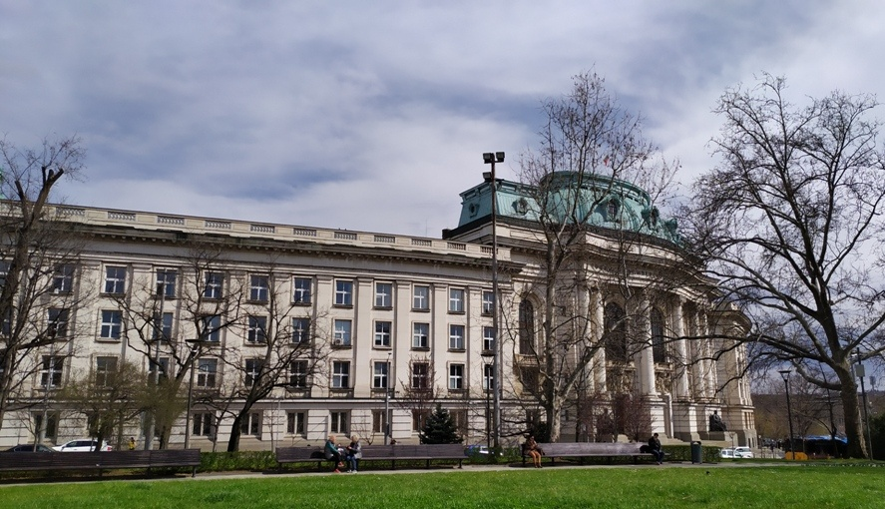
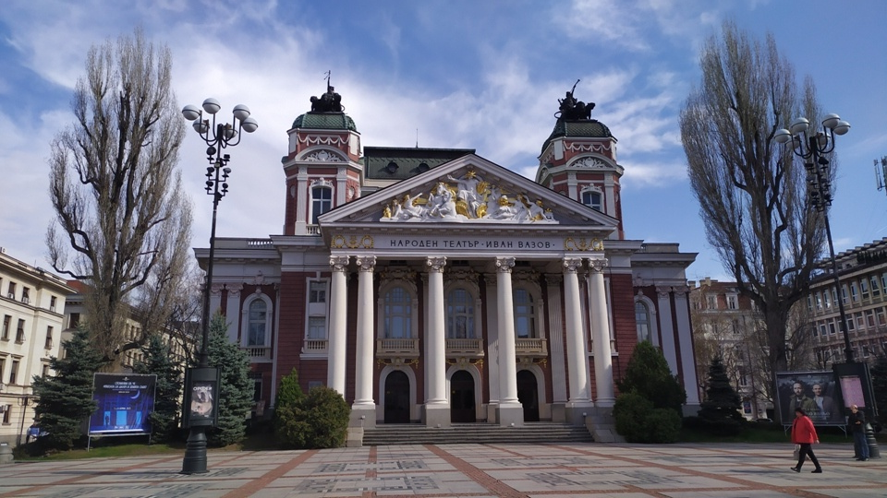
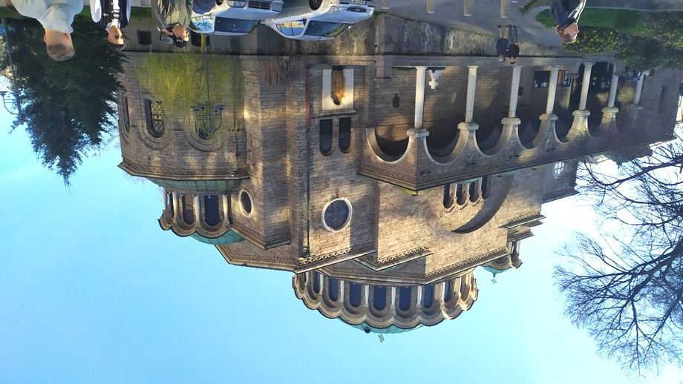
The sights of Sofia
National palace of culture
University of Sofia
National theatre “Ivan Vazov”
Sveta nedelya church

Slide 8
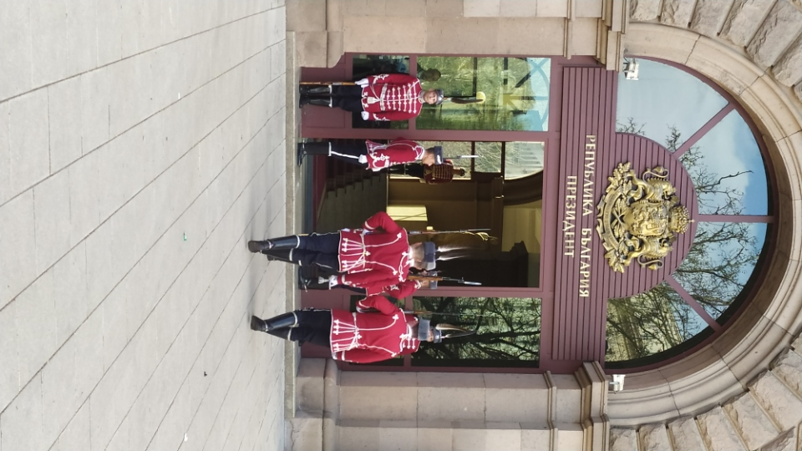
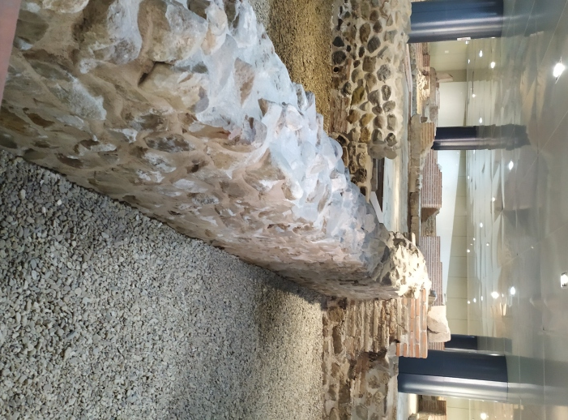
President’s palace – changing of the guards
Remains of Roman settlement Serdica

Slide 9
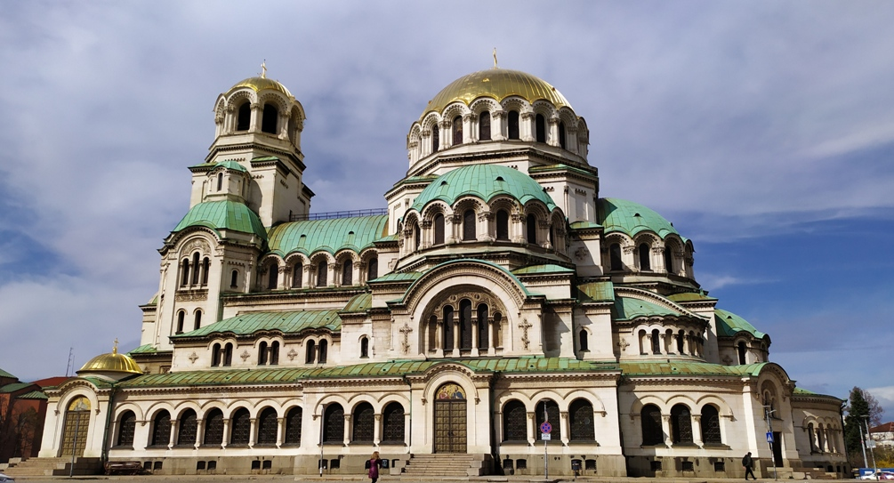
St. Alexander Nevsky Cathedral, the largest cathedral in the Balkans. It was created in honour to the Russian soldiers who died during the Russo-Turkish War of 1877-1878.

Slide 10
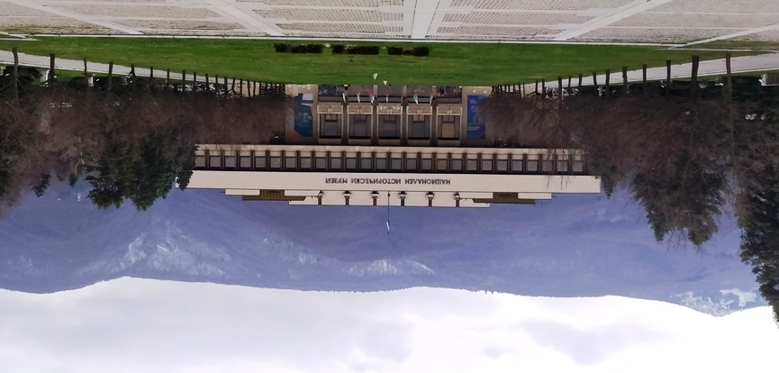
The National Museum of History has the most impressive collection of national treasures and is the largest museum in Bulgaria. It is in the building which was a residence of the President of Bulgaria.

Slide 11
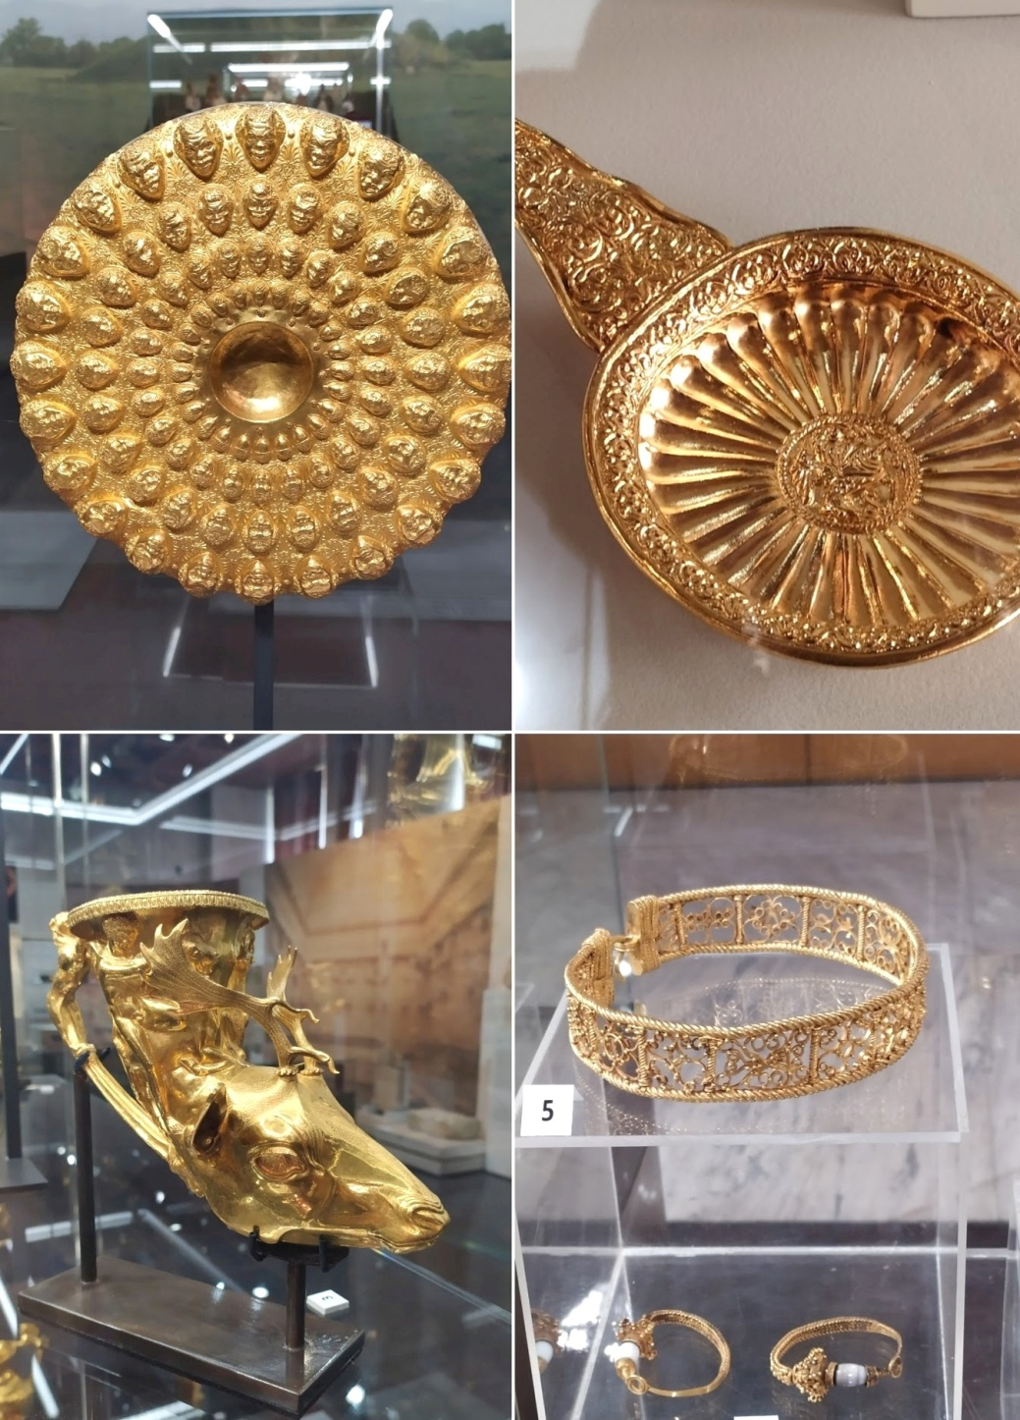
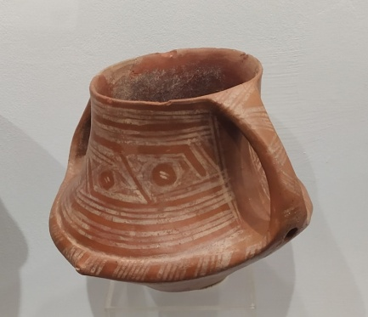
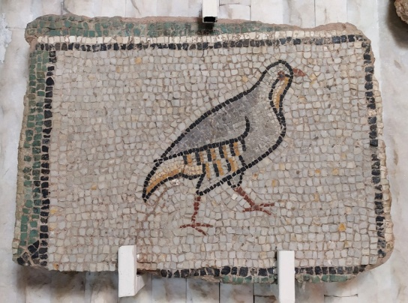
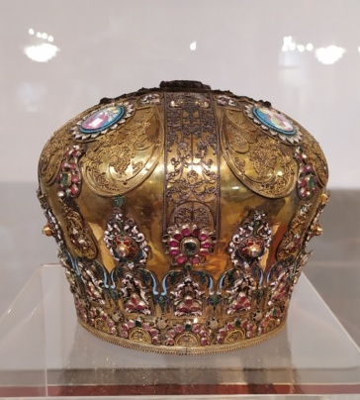
The museum houses thousands of valuable exhibits, the most valuable are objects made of pure gold – the Thracian treasure

Slide 12
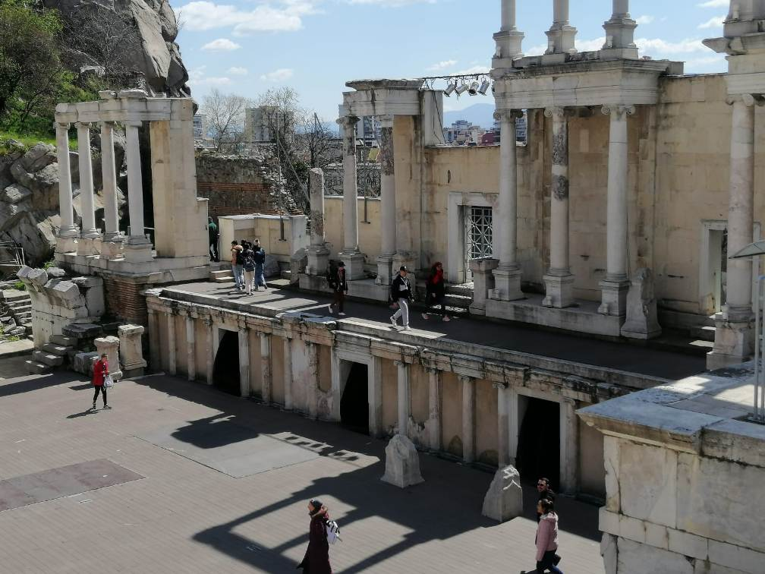
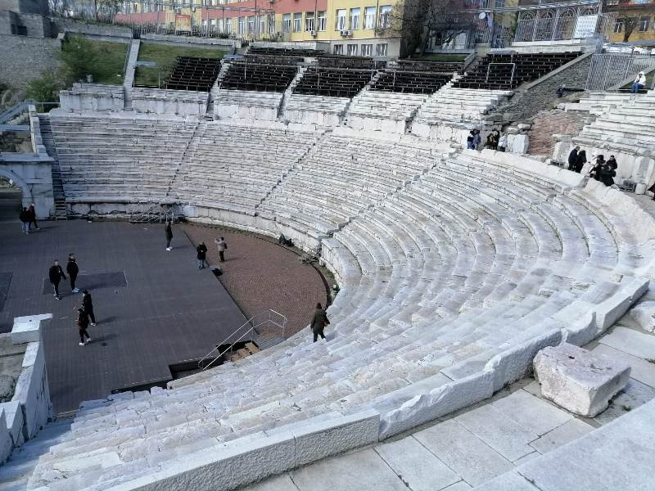
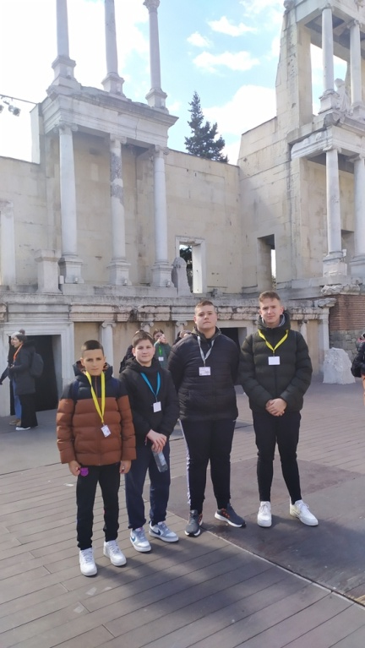
Plovidv, the second largest city in Bulgaria. It is the cultural capital of Bulgaria and was the European Capital of Culture in 2019.
The Roman theatre of Philippopolis is one of the world's best- preserved ancient Roman theatres.

Slide 13
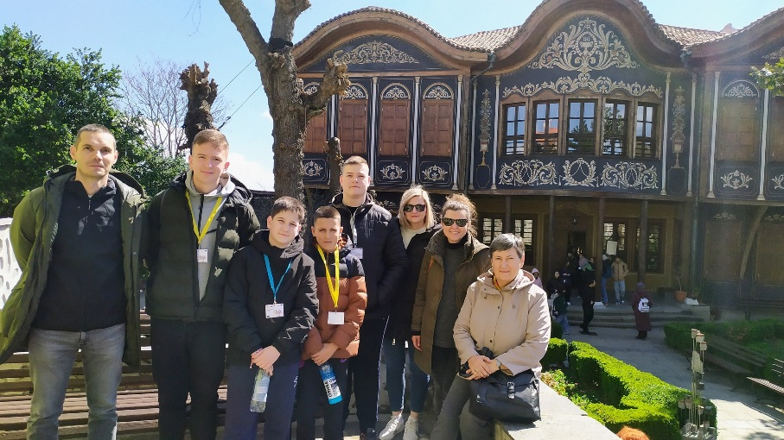
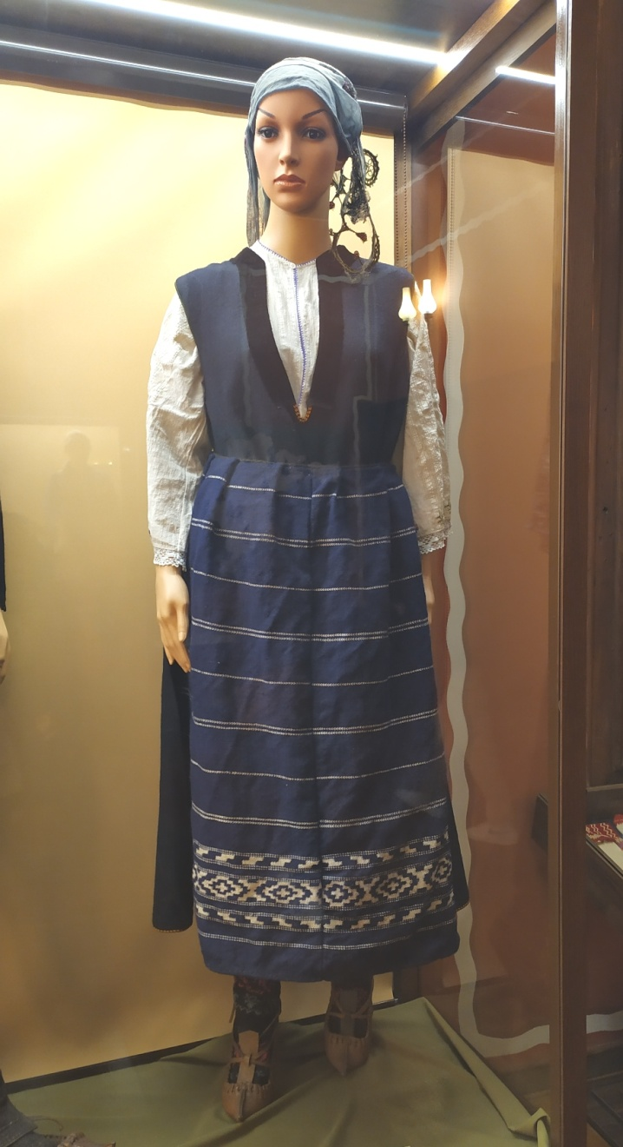
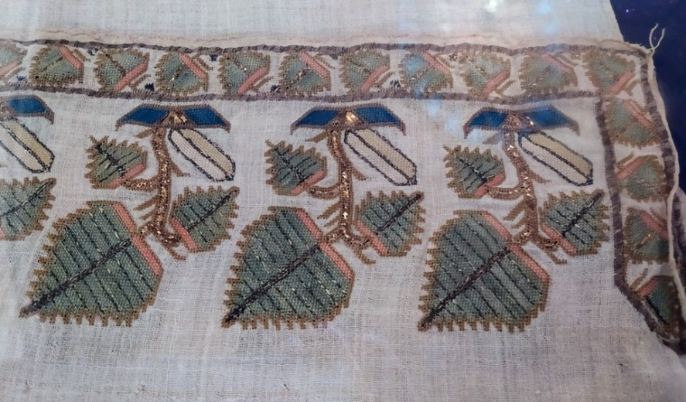
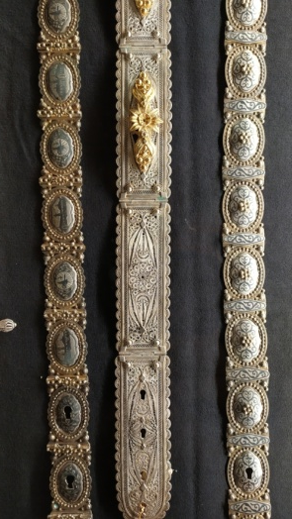
Regional Ethnographic Museum

Slide 14
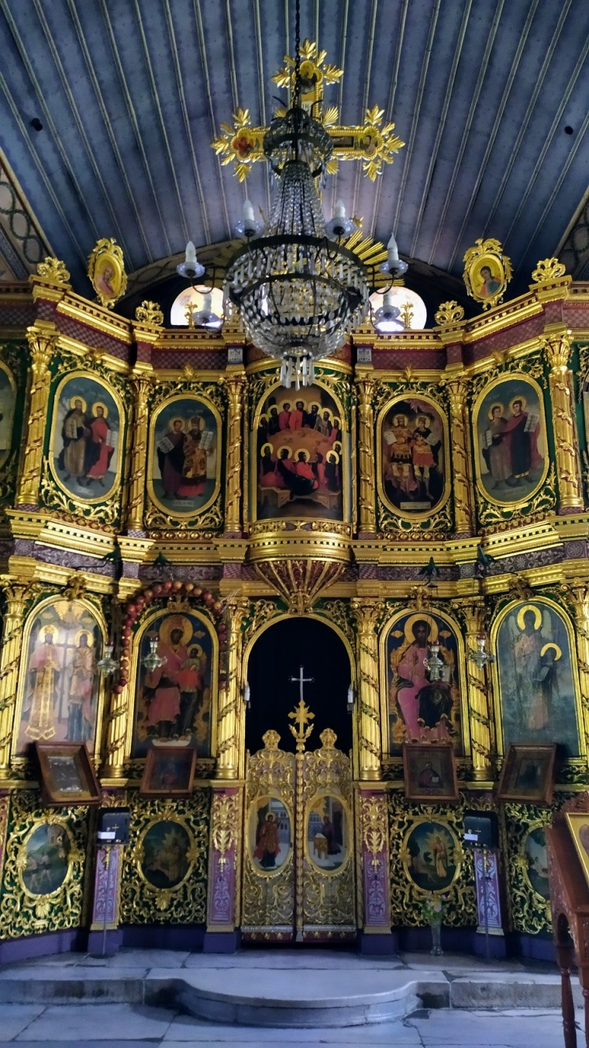
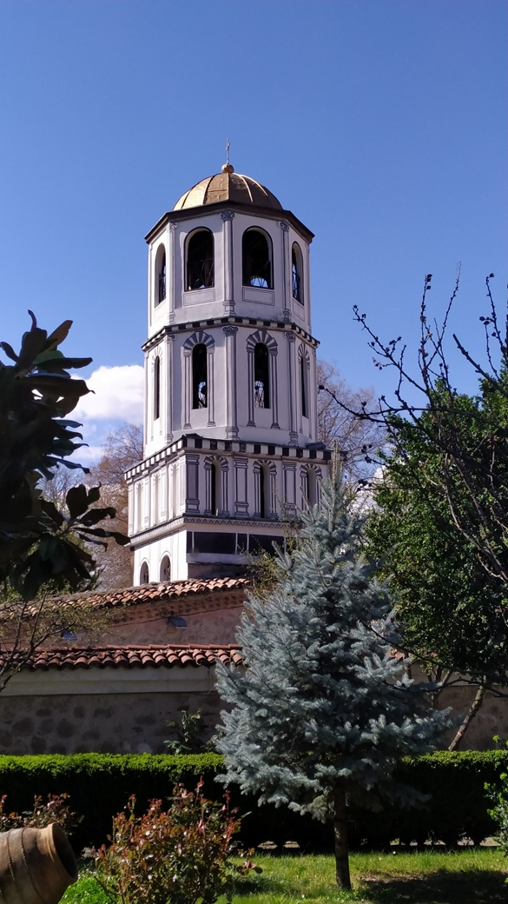
The Church of St Constantine and Helena

Slide 15
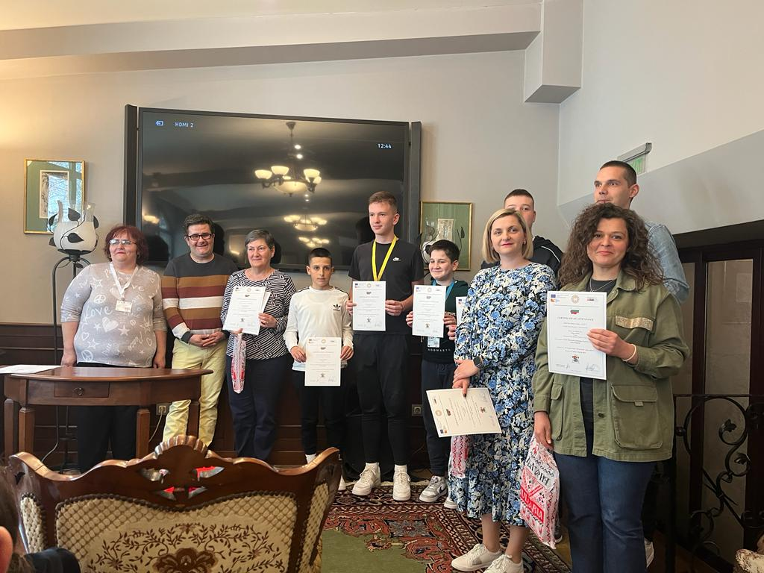

Slide 16
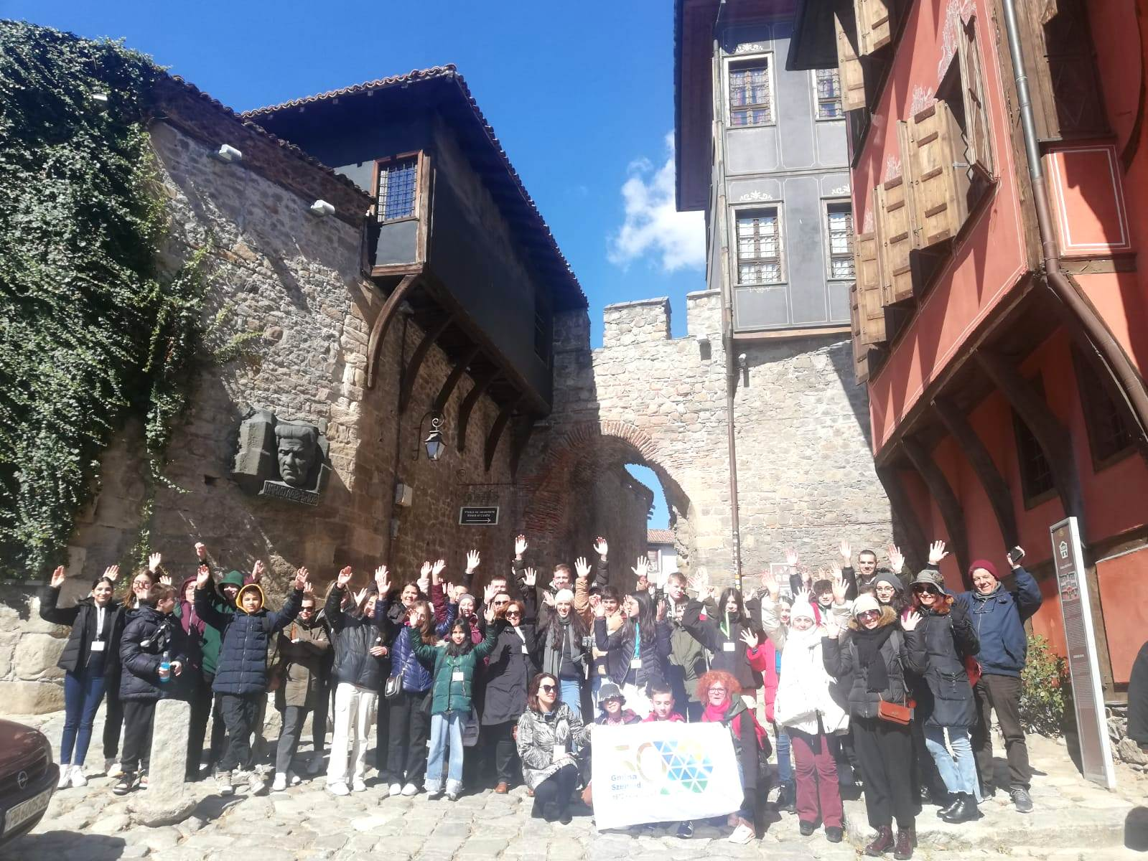
We will continue using project results and developing our soft skills!

