Slide 1
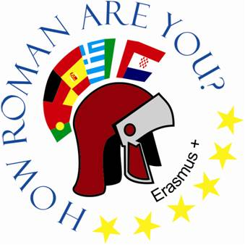
The oldest town in Europe – VINKOVCI
Osnovna škola Bartola Kašića Vinkovci Erasmus+ project 2020-2022 How Roman are you?

Slide 2
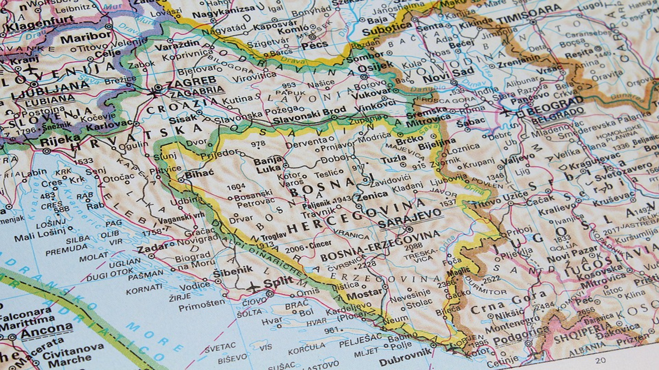
Vinkovci is a town in eastern Croatia in the province of Slavonia

Slide 3
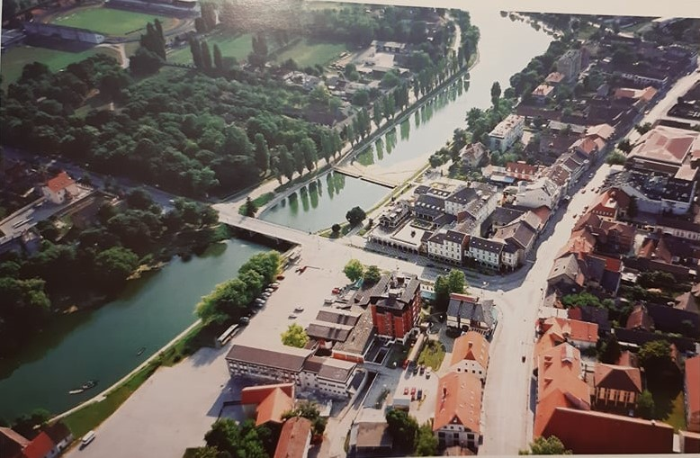
Vinkovci is a town located along the river Bosut.
A settlement with a population continuity of 8000 years.
Archaeological excavations in the area of ​​Vinkovci show the permanence of Neolithic settlements.
Attachment 1

Slide 4
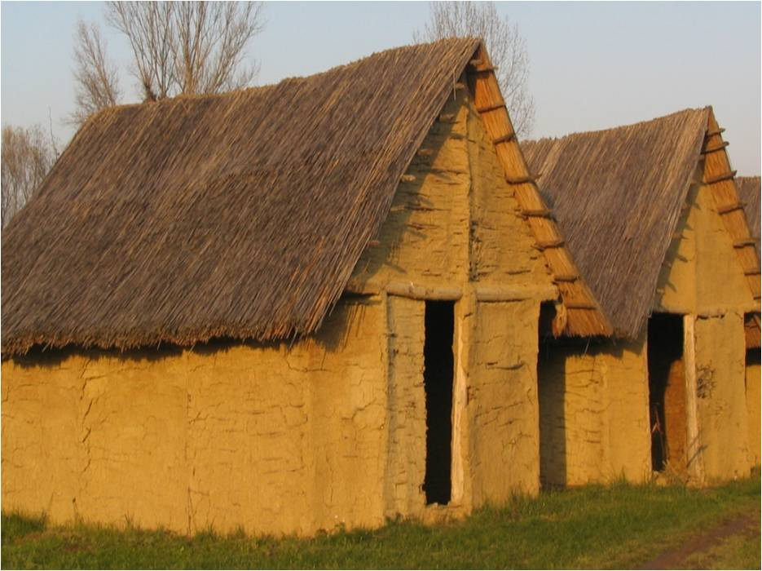
The first communities of farmers inhabited this area sometime around 6200 BC. bringing pottery, domesticated animals and plants.

Slide 5
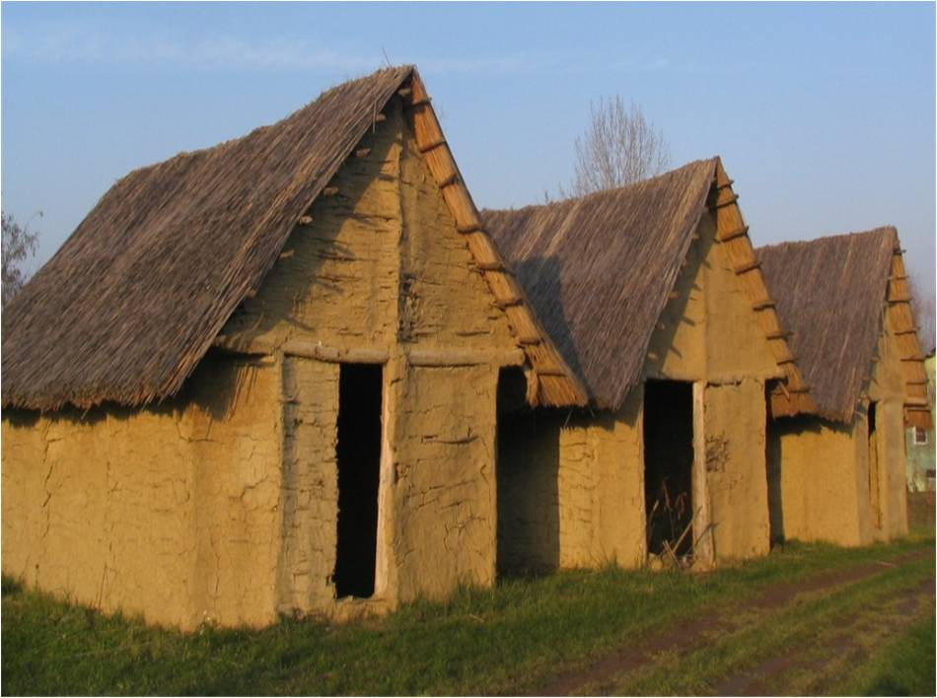
The oldest culture that appeared in the area of ​​Vinkovci was the Starčevo culture, and the most famous Sopot culture, which was named after the fortified hillfort Sopot, which is located near the city.

Slide 6
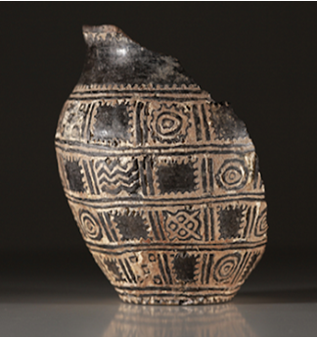
Orion - the oldest Indo-European calendar (2600 B.C.) found in Vinkovci - the Vučedol culture

Slide 7
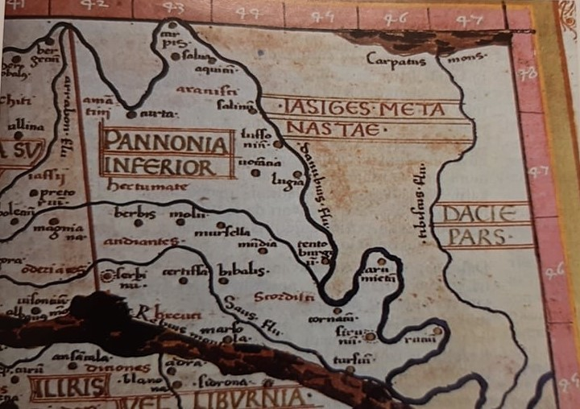
At the end of the 4th century B.C. the Celts come to the Vinkovci area.
About 8 year A.D. the Romans conquered the Celts and conquered the area of ​​Vinkovci. 212 A.D. Cibalae gained the status of Colonia Aurelia Cibalae
Fragment of the map made by K. Ptolomeus. Position of the Roman settlement and disposition of the Celtic trebes who used to live in the vicinity of today’ s Vinkovci., Ćirić, Vladimir, Vinkovci grad na dlanu, Zebra, Vinkovci 2013., str. 57.

Slide 8
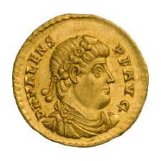
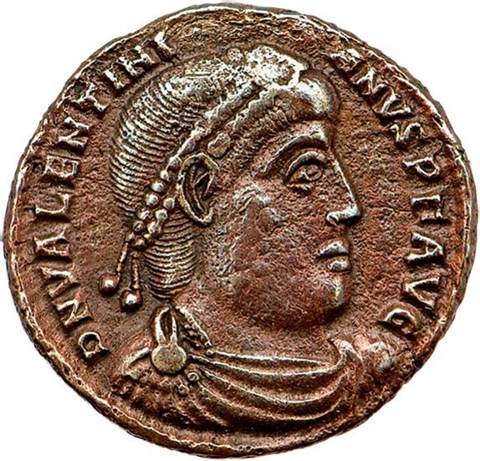
Two Roman emperors, Valens and Valentinian I, were born in Vinkovci
ROMAN EMPEROR VALENTINIAN I.
ROMAN EMPEROR VALENS
from 364 to 375 emperor in the West of the Roman Empire.
In 364, he appointed his brother Valens ruler of the Eastern Roman Empire.
After his death in 375, the Western Empire quickly declined, so Valentinian is often considered the last great emperor of the Western Empire.
from 364 ruler of the Estern Roman Empire.
he died in the battle of Hadrianopolis 378

Slide 9
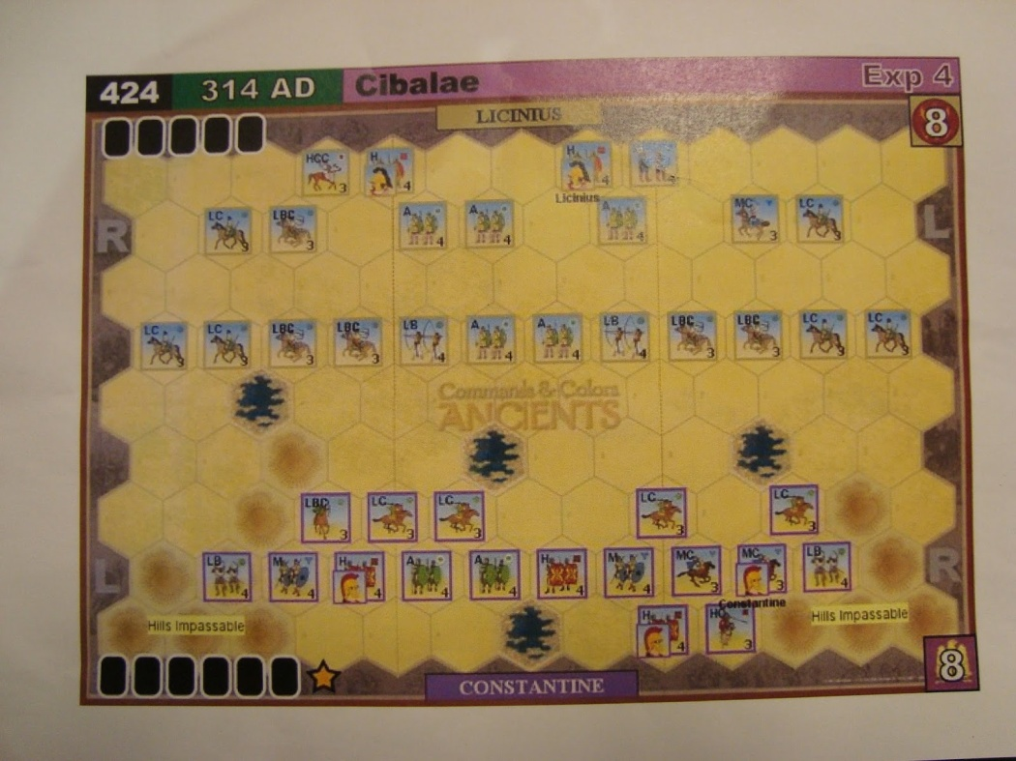
Battle of Cibalae
The Battle of Cibalae was fought in 316 (or 314, it is not sure) between the two Roman emperors: Constantine I and and Licinius. The site of the battle was near the town of Cibalae (it was Roman province of Panonia Secunda). The battle lasted all day. Constantine won despite being outnumbered and Licinius lost 20000 soldiers.

Slide 10
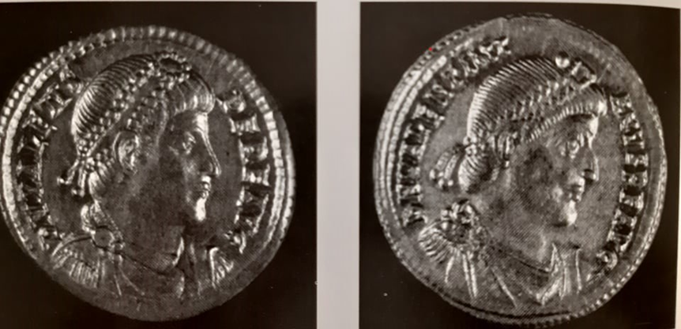
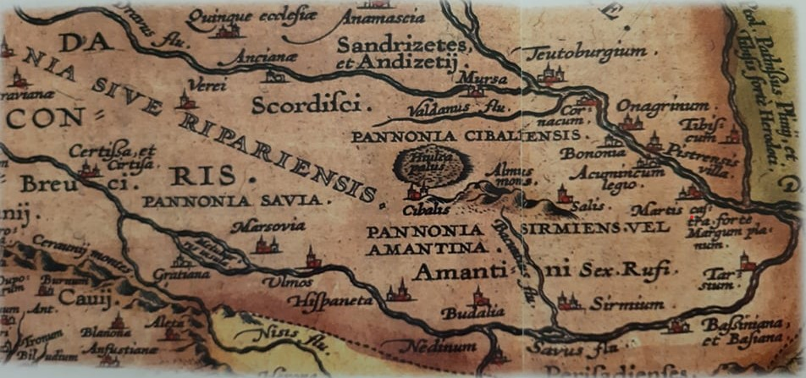
Arriving in the area of ​​Vinkovci, the Romans built their settlement – Cibalae.
Cibalae was probably named after the Illyrian name for the hill.
Cibalae had water supply, sewerage, thermal baths, shops, temples, craft workshops and residential areas.
Two Roman emperors, Valens and Valentinian I, were born in Vinkovci., page 64.
Fragment of a map from Ortelius atlas, str. 58.
Cibalae was last mentioned in 527, and the remains of Cibalae were destroyed by the Avars and Slavs. At the end of the 8th century, these areas were conquered by the French, and from the 11th century the area of ​​Vinkovci was ruled by the Hungarians.

Slide 11
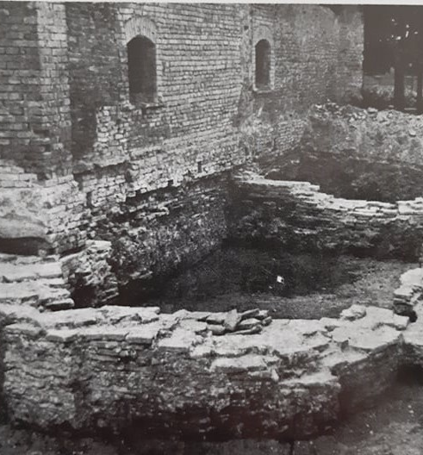
At the end of the 11th century and the beginning of the 12th century, along the western edge of the ruins of the Roman Cibalae, near the restored church of St. Elias, the settlement of Vinkovci was formed and developed.
The first written mention of the town of Vinkovci dates back to 1332.
In the Middle Ages, next to the settlement of St. Ilije also announced the name VINKO, WANKO, WINKOWCZE, WINKOFTZI I VINKOVCI

Slide 12
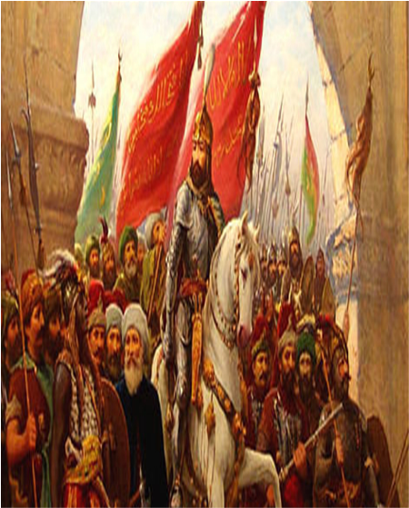
In the 15th century the Turks of the Osman empire gradually conquered Slavonia. The maket – town od St. Elias came under Turkish dominance in 1536. The Ottoman Turks did not leave a big mark in Vinkovci.

Slide 13
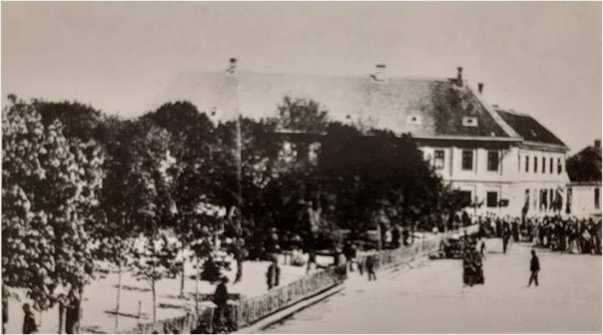
At the begining of the 18th century Vinkovci became a part of the Military Frontier of the Habsburg Monarchy.
Vinkovci was a significant administrative, military and border headquarters.
During this period, a new urban „heart” of Vinkovci was developed.

Slide 14
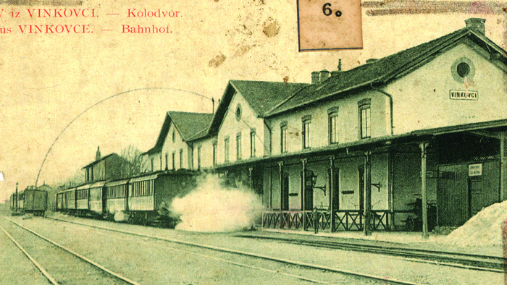
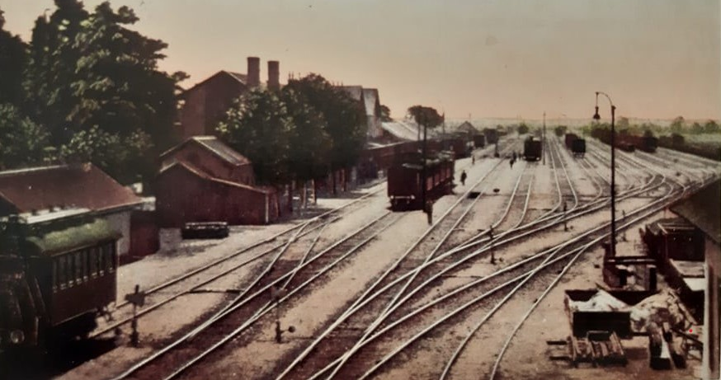
Railway station
In the second half of the 19th century (after 1873) Vinkovci became an important railway traffic hub.

Slide 15
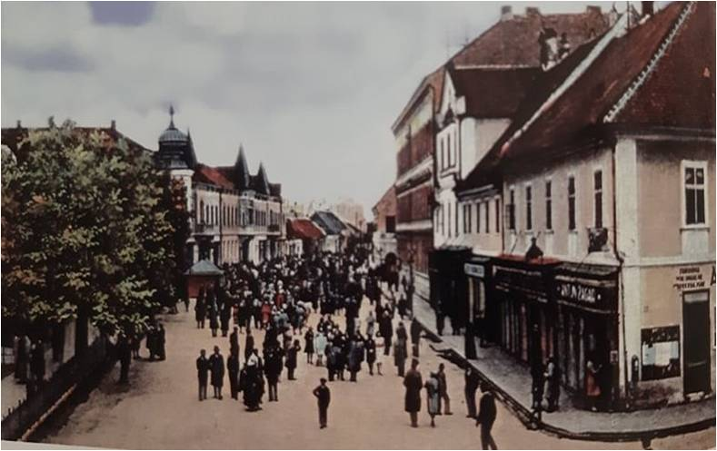
At the end of the 19th and the beginning of the 20th century, a number of civic, charitable and cultural societies and clubs were founded in Vinkovci.
Vinkovci did not receive a formal confirmation of the status of the city until 1923.
Before the Second World War, Vinkovci had 16,000 inhabitants

Slide 16
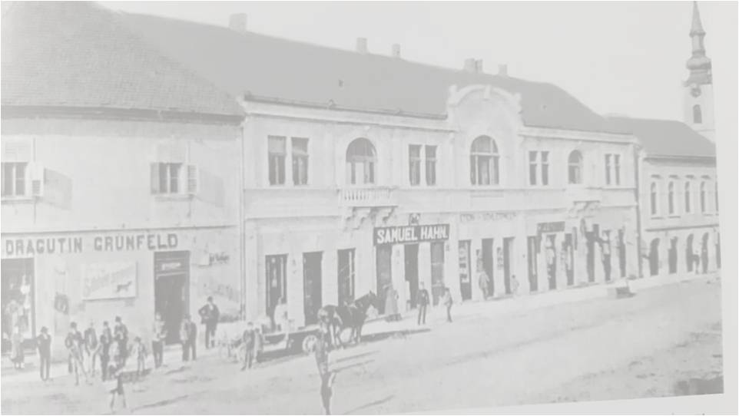
Between the two wars, the appearance of Vinkovci changed. Construction of water supply and sewerage begins, gas lighting and electricity have been introduced. The streets of Vinkovci were paved. The development of industry, banking, trade and crafts began

Slide 17
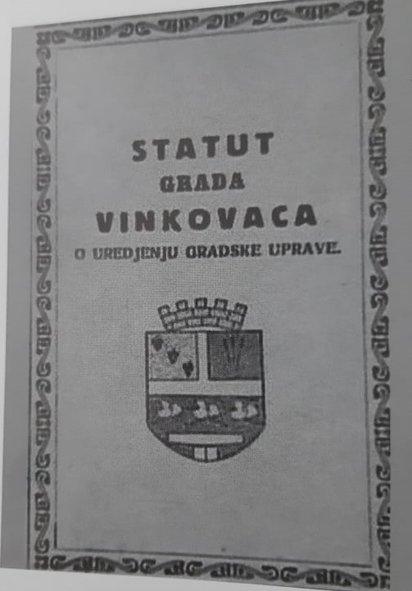
On November 5, 1920, Vinkovci received the status of a city, and in 1923 the coat of arms of the city.
The Vinkovci coat of arms was made by the Croation painter Franjo Rački

Slide 18
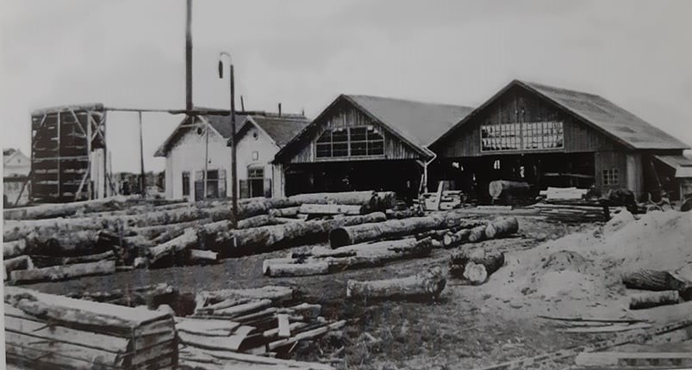
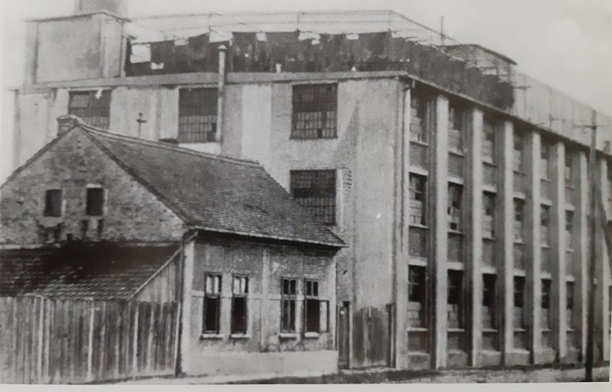
The wood processing industry
The leather mill
Smaller industrial factories started to develop and they were owned by Germans, Hungarians and Jews.

Slide 19
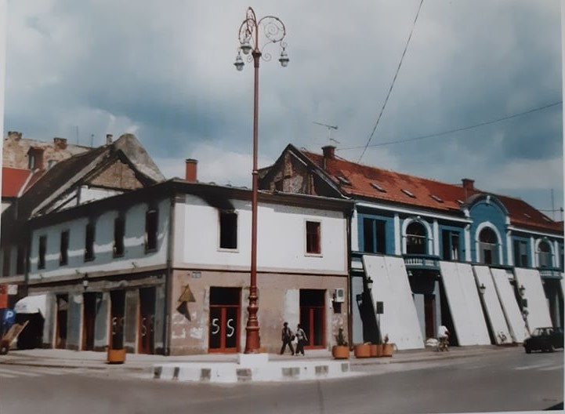
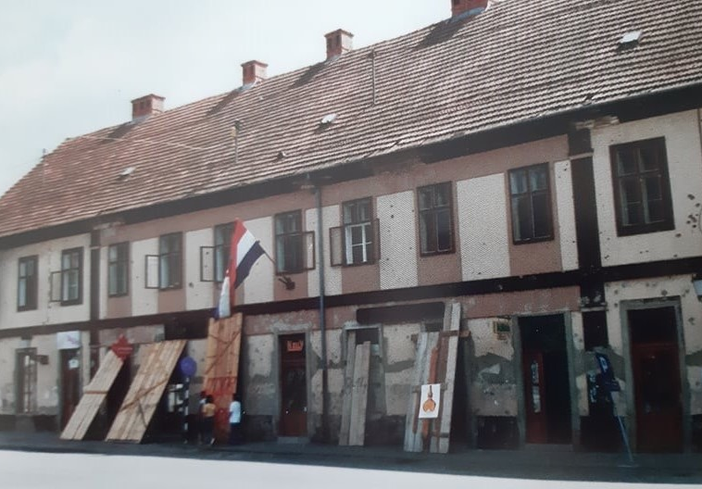
The Homeland War
During the Homeland War (1991 – 1995) Vinkovci was devestated much heavier than in the First and Second World War.
Many people lost their lives.
During the Homeland war the economic development of the city ceased to function.

Slide 20
The city of culture
Vinkovački list has been published from 1952 up till now
A local Vinkovci radio station has been on the air from 1953.

Slide 21
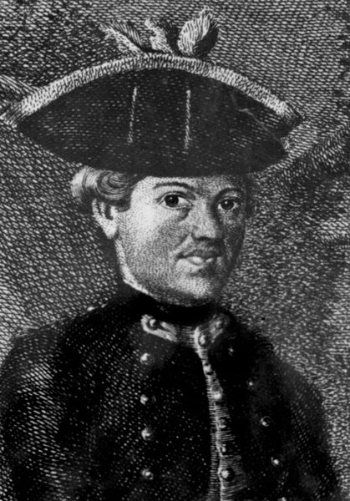
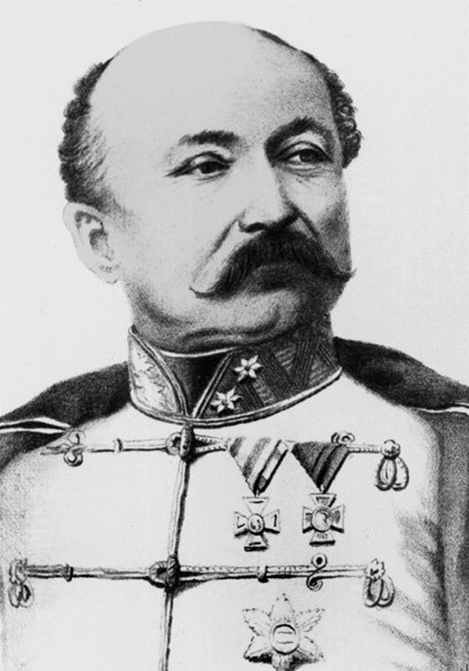
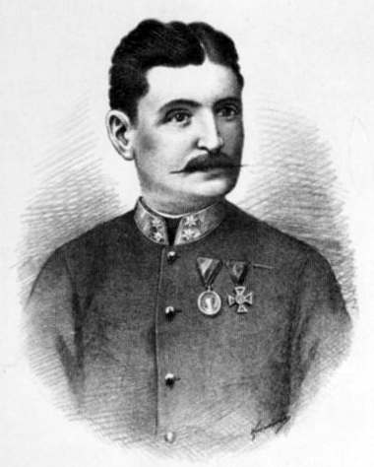
Famous people from Vinkovci
Matija Antun Relković (1732-1798)
- Writer
Josip Šokčević (1811-1896)
- Croatian governor (appointed by Emperor Franz Joseph I) from 1860 to 1867
Josip Runjanin (1821-1878)
- Composer of the Croatian national anthem

Slide 22
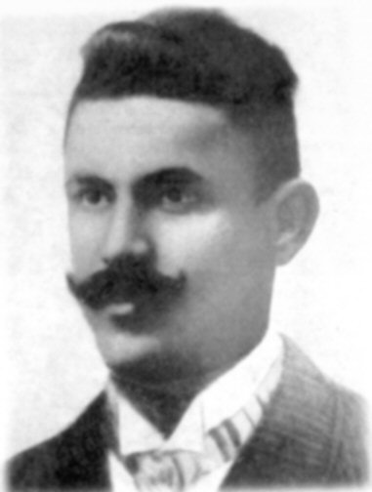
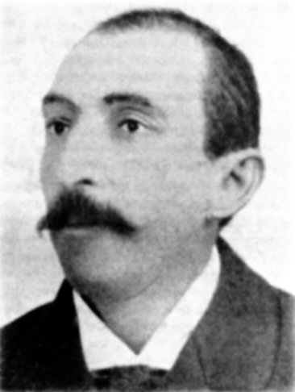
Ivan Kozarac (1885-1910)
- Writer
Josip Kozarac (1858-1906)
- Writer

Slide 23
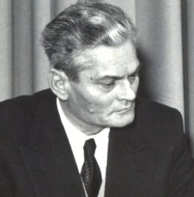
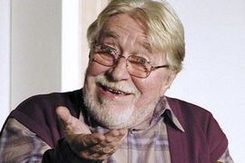
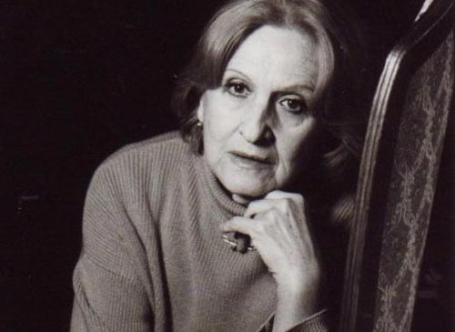
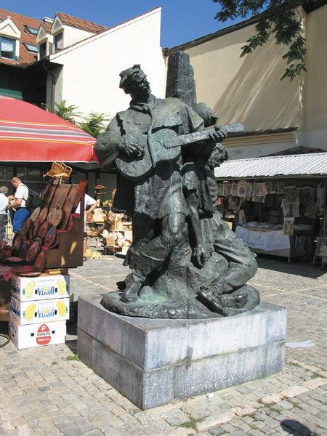
20th century
Vanja Radauš
- Sculptor
Vanja Drach
-actor
Nada Subotić
- actress

Slide 24
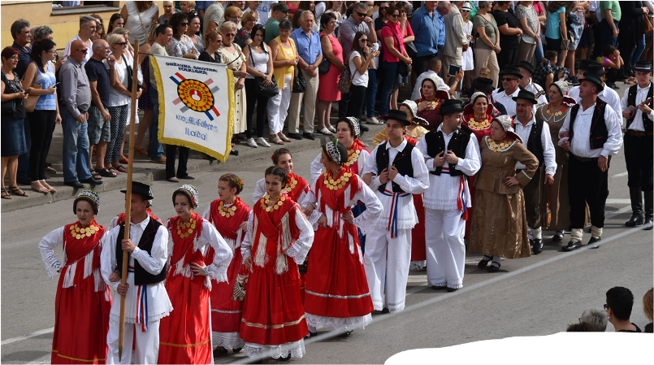
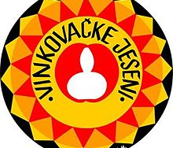
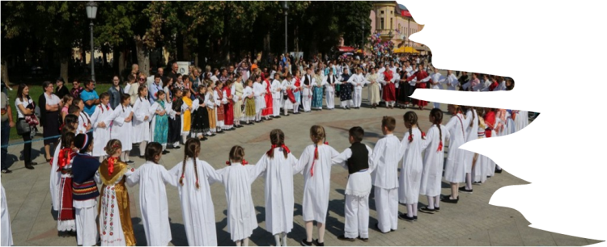
The Autumn Festival in Vinkovci
This festival was established in 1966.
It is the most famous folk review in Croatia

Slide 25
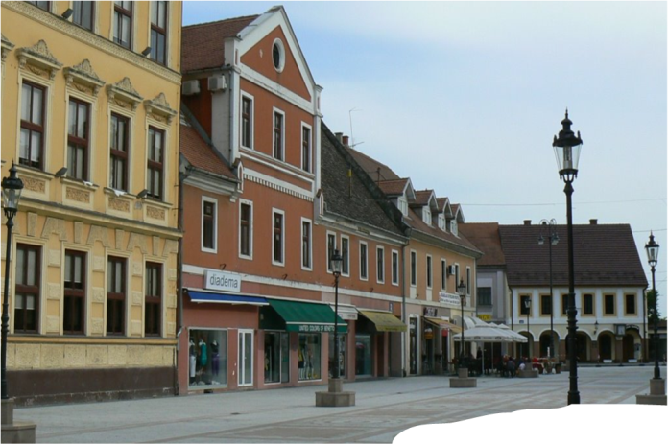
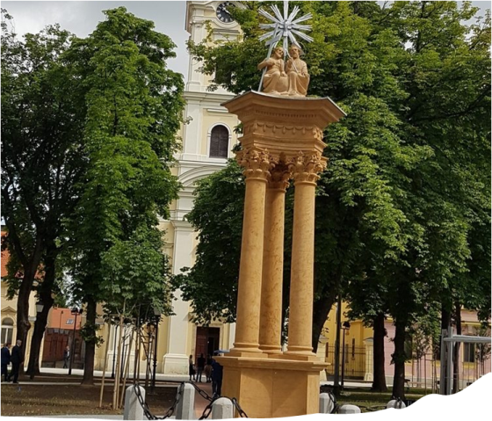
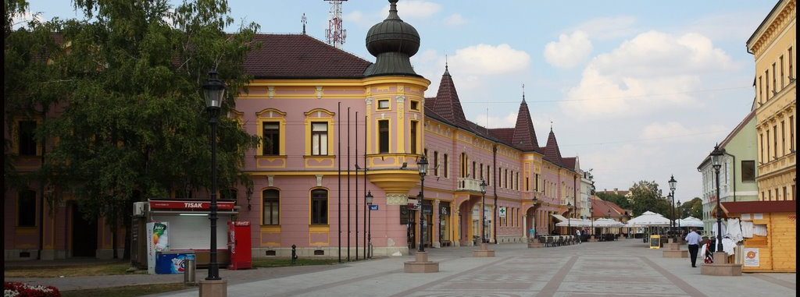
The streets of Vinkovci

Slide 26
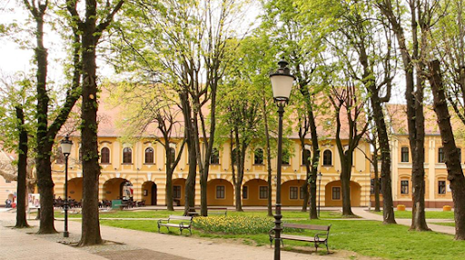
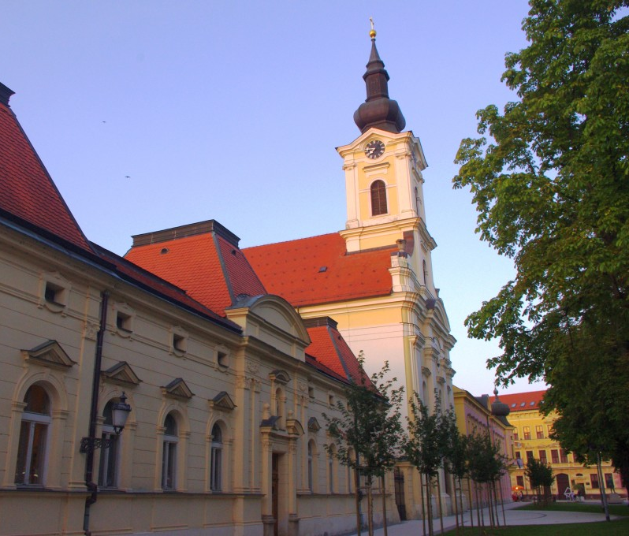
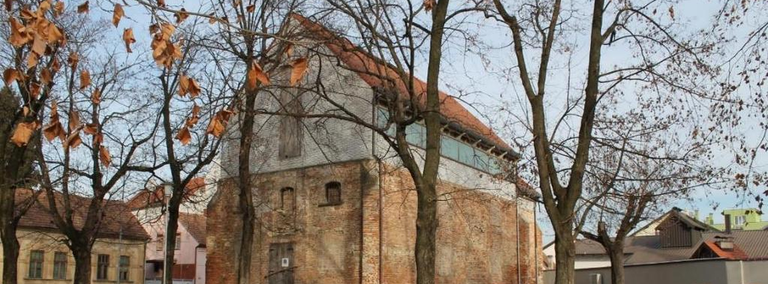
The streets of Vinkovci

Slide 27
Sources:
Ćirić, Vladimir, Vinkovci – grad na dlanu, Zebra, Vinkovci 2013.
https://www.google.com/search?q=vinkova%C4%8Dki+list&source=lnms&tbm=isch&sa=X&ved=2ahUKEwjm9bvlkdruAhVxhosKHZfAD7YQ_AUoAXoECAUQAw&biw=1366&bih=609#imgrc=jSlOeeIxGaY5xM
https://www.google.com/search?q=matija+antun+reljkovi%C4%87&source=lnms&tbm=isch&sa=X&ved=2ahUKEwjx9djCmdruAhXDpIsKHccFD7YQ_AUoAXoECAUQAw&biw=1366&bih=609#imgrc=hNfDv_wRwmZ4HM
https://www.google.com/search?q=ivan+i+josip+kozarac+bra%C4%87a&source=lnms&tbm=isch&sa=X&ved=2ahUKEwi-6bTWmtruAhXPiIsKHeRsDrUQ_AUoAXoECAgQAw&biw=1366&bih=609#imgrc=eEWFBJFPrrLDvM
https://www.google.com/search?q=vanja+radau%C5%A1&source=lnms&tbm=isch&sa=X&ved=2ahUKEwie9ePqndruAhWFuIsKHQaIALUQ_AUoAXoECAgQAw&biw=1366&bih=609#imgrc=rScn29oWxYCUaM
https://www.google.com/search?q=vanja+radau%C5%A1&source=lnms&tbm=isch&sa=X&ved=2ahUKEwie9ePqndruAhWFuIsKHQaIALUQ_AUoAXoECAgQAw&biw=1366&bih=609#imgrc=w_HD5451t504_M
https://www.google.com/search?q=vanja+drach&source=lnms&tbm=isch&sa=X&ved=2ahUKEwjrtsjtvdruAhVjoosKHVwiCLUQ_AUoAXoECAsQAw&biw=1366&bih=609#imgrc=uw-ppPIhVaW0LM
https://www.google.com/search?q=nada+suboti%C4%87&source=lnms&tbm=isch&sa=X&ved=2ahUKEwjF36ivvtruAhUSxYsKHYvdAmcQ_AUoAXoECAcQAw&biw=1366&bih=657#imgrc=uUMOULH1vt25OM

Slide 28
https://www.google.com/search?q=vinkova%C4%8Dke+jeseni&source=lnms&tbm=isch&sa=X&ved=2ahUKEwjYruyav9ruAhXGl4sKHdFdD60Q_AUoAXoECAsQAw&biw=1366&bih=657#imgrc=okRh4yvqfOiVpM
https://www.google.com/search?q=vinkova%C4%8Dke+jeseni&source=lnms&tbm=isch&sa=X&ved=2ahUKEwjYruyav9ruAhXGl4sKHdFdD60Q_AUoAXoECAsQAw&biw=1366&bih=657#imgrc=YPTwKvjaJEBNRM
https://povijest.hr/drustvo/narodi/turci-ili-osmanlije-koja-je-razlika/https://www.google.com/search?q=josip+%C5%A1ok%C4%8Devi%C4%87&sxsrf=ALeKk03v1eiWsByE_f74TjeCD9jkxm3okw:1611061167902&source=lnms&tbm=isch&sa=X&ved=2ahUKEwiQzf7EhqjuAhXltYsKHWWOCFQQ_AUoAXoECAQQAw&biw=1366&bih=609#imgrc=fNbiQqREzNT3BM

