Slide 1
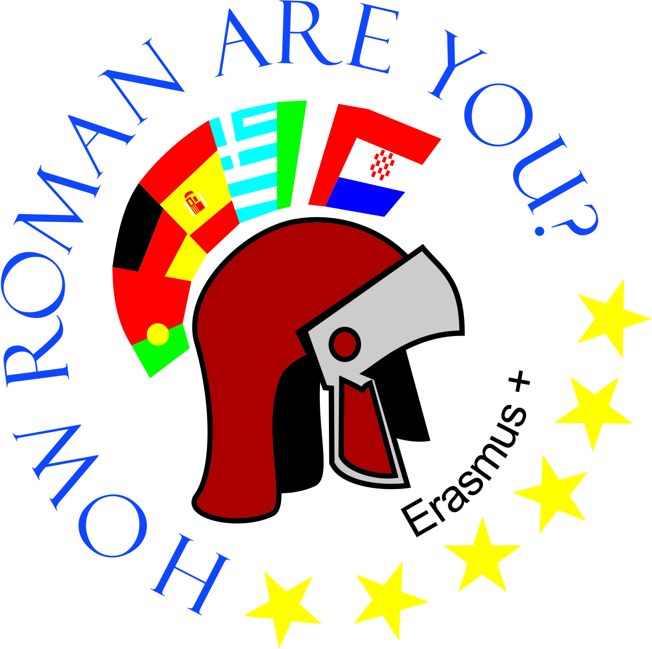
OŠ Bartola Kašića Erasmus+ project 2020-2023 How Roman are you? 2020-1-DE03-KA229-077527_5
History of Croatia from the beginning of the 20th century

Slide 2
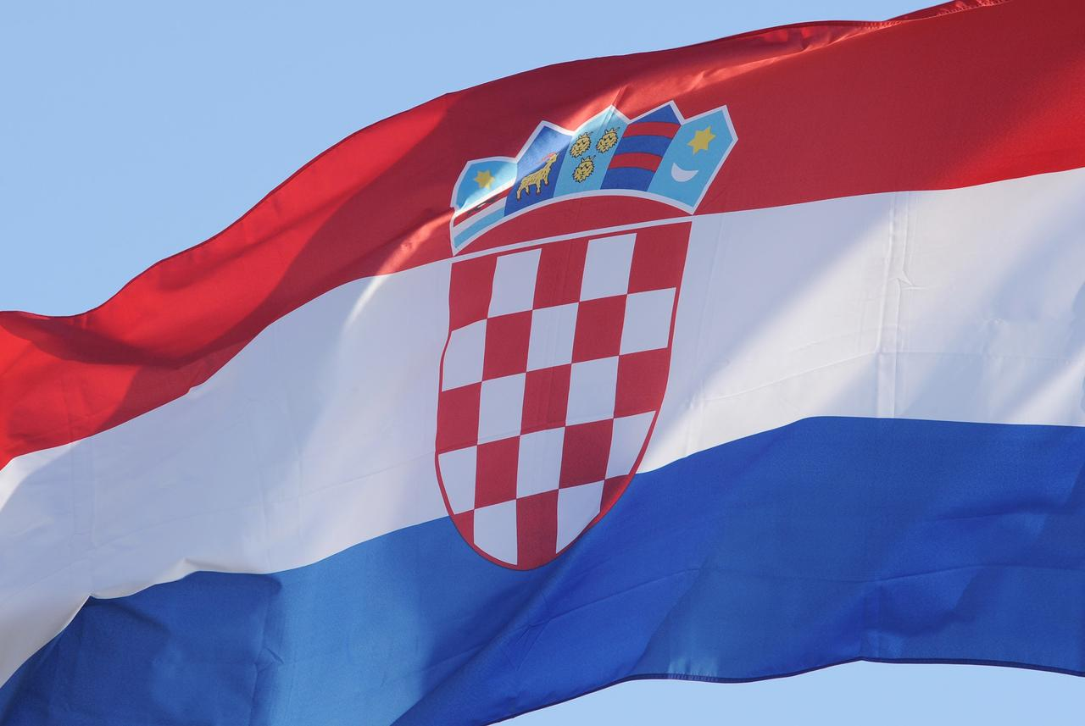
Croatia from 1900 until now

Slide 3
Dictatorship in Croatia
dictatorship = a political regime in wich an individual or group has unlimited and complete power
under the dictatorship was the Habsburg Monarchy, the Kingdom of Serbs, Croats and Slovenes, the independent state of Croatia and Yugoslavia

Slide 4
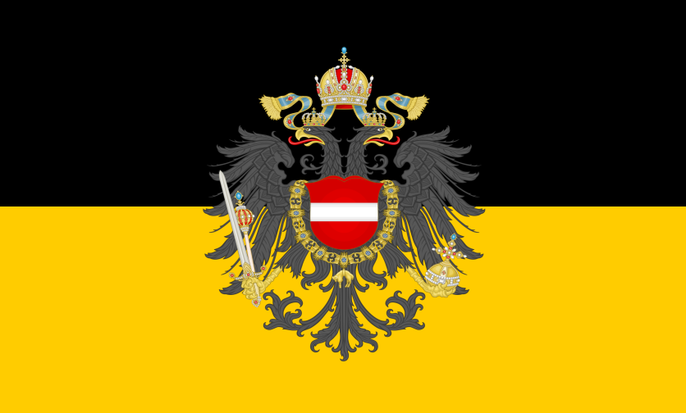
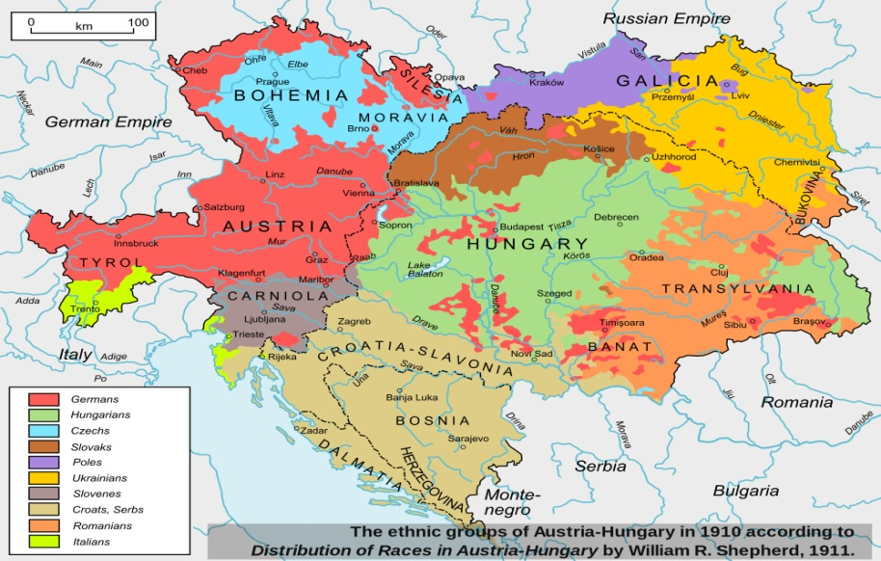
Habsburg Monarchy
Habsburg Monarchy = the name of the state ruled by the Austrian branch of the Habsburg dynasty
the capital was Vienna
the Monarchy was called the Austrian Empire from 1804 to 1867 , and Austria-Hungary from 1867 to 1918
the flag of the Habsburg Monarchy
Austro-Hungarian Empire

Slide 5
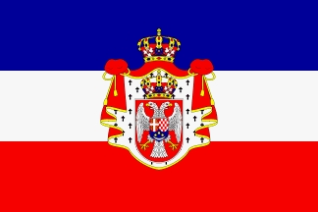
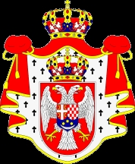
Kingdom of Serbs, Croats and Slovenes
the Kingdom of Serbs, Croats and Slovenes has benn called the Kingdom of Yugoslavia since 1929
it included the territory of Slovenia, Croatia, Serbia, Montenegro, Macedonia and Bosnia and Herzegovina
it was createdon December 1. 1918 and ceased to exist with the establishment of the Democratic Federal Yugoslavia
the capital was Zagreb
the flag of the Kingdom of Serbs, Croats, Slovenes
crest of the Kingdom of Serbs, Croats and Slovenes

Slide 6
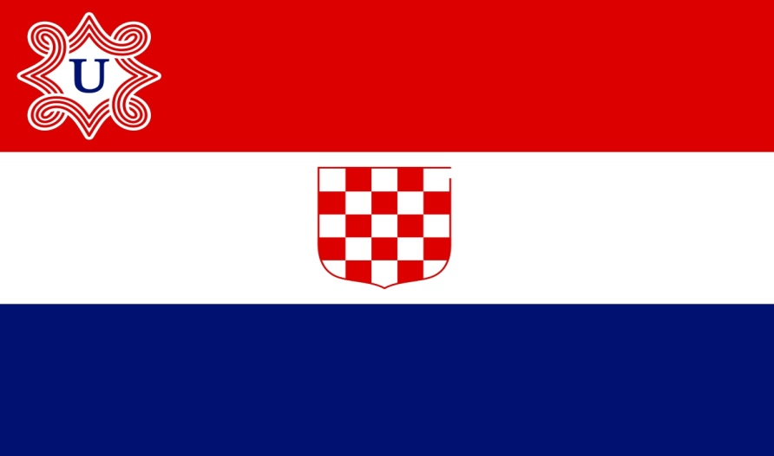
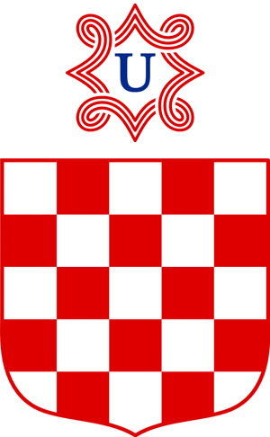
Independent State of Croatia
the Independent State of Croatia was a puppet state created during the World War II
it was influenced by Nazi Germany and Fascist Italy
it was founded on April 10. 1941 during the April War - aggression of the Axis Powers on the Kingdom of Yugoslavia
the capital was Zagreb
the flag of Independent State of Croatia
crest of the Independent State of Croatia

Slide 7
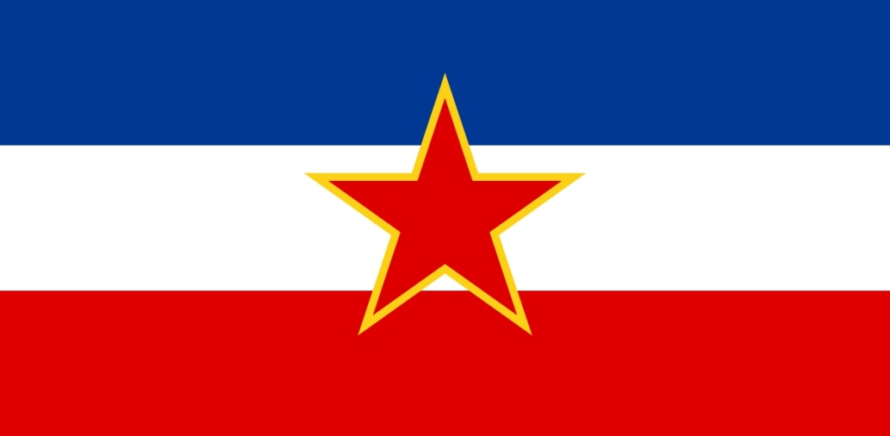
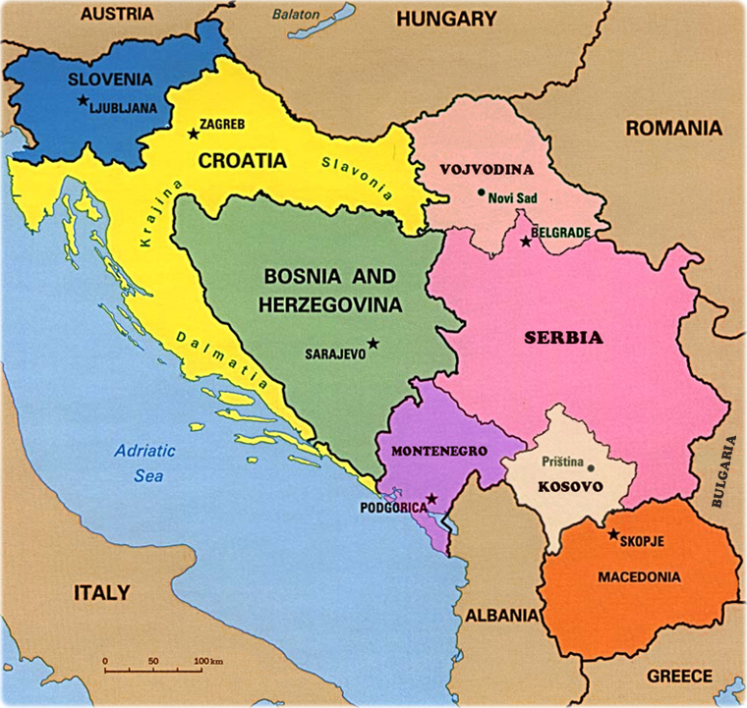
Socialist Federal Republic of Yugoslavia
Yugoslavia – the name for the former socijalist state that included Slovenia, Croatia, Serbia, Bosnia and Herzegovina, Montenegro, North Macedonia and Kosovo
it was proclaimed in 1943 on the territory of the Kingdom of Yugoslavia under the name Democratic Federative Yugoslavia and it existed until 1992
the capital was Beograd
the flag of Yugoslavia
countries in Yugoslavia

Slide 8
Croatia = democracy
democracy = a form of government in which political decisions are made most often through elections or referendums in which all citizens participate
How do we choose authorities for:
the Croatian parliament
the government of the Republic of Croatia
the county
The President

Slide 9
How do we choose authorities?
for the Croatian parliament:
members of the Croatian Parliament are elected in direct elections, by secret ballot.
regular elections for members of the Croatian Parliament are held every four years. the President of the Republic of Croatia makes the decision to call elections for members of the Croatian Parliament. citizens of the Republic of Croatia over the age of 18 have the right to vote, on the basis of general and equal voting rights
2. for the government: after the official announcement of the results of the election of representatives to the Croatian Parliament (parliamentary elections), the President of the Republic of Croatia entrusts the mandate to form the Government to the person who, based on the allocation of seats in the Croatian Parliament and the consultations carried out, enjoys the trust of the majority of all representatives

Slide 10
3. for the county
the prefect and deputy prefects are elected in direct elections for a period of four years.
regular prefect elections are held every fourth year, simultaneously with elections for members of representative bodies of local and regional self-government units.
elections are announced by the Government of the Republic of Croatia
4. for the president:
the President of the Republic of Croatia is elected on the basis of universal and equal suffrage, in direct elections by secret ballot for a term of five years.
the decision to call elections is made by the Government of the Republic of Croatia.
this means that in the elections for the President of the Republic of Croatia, citizens of the Republic of Croatia who happen to be outside the country's borders at the time of the election, as well as those citizens of the Republic of Croatia who do not reside in the Republic of Croatia, are entitled to vote

