Slide 1
Osnovna škola Bartola Kašića Vinkovci Erasmus+ project 2020-2022 How Roman are you? 2020-1-DE03-KA229-077527_5
FREETIME ACTIVITIES

Slide 2
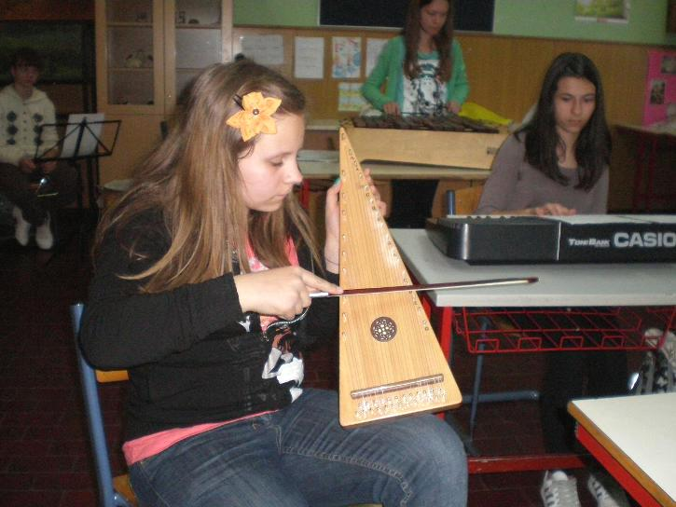
Pupils in grades 7 and 8 have 14 different school subjects and more than 30 lessons per week. Every day they have to do homework and they do not have much free time left. At school they are offered different extracurricular acitivites to choose from according to their preferences. School orchestra - they can learn to play several instruments, including some unusual ones, like the psaltery

Slide 3
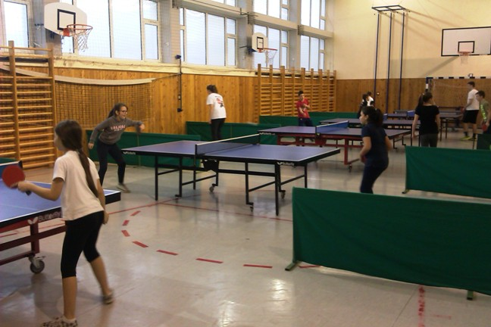
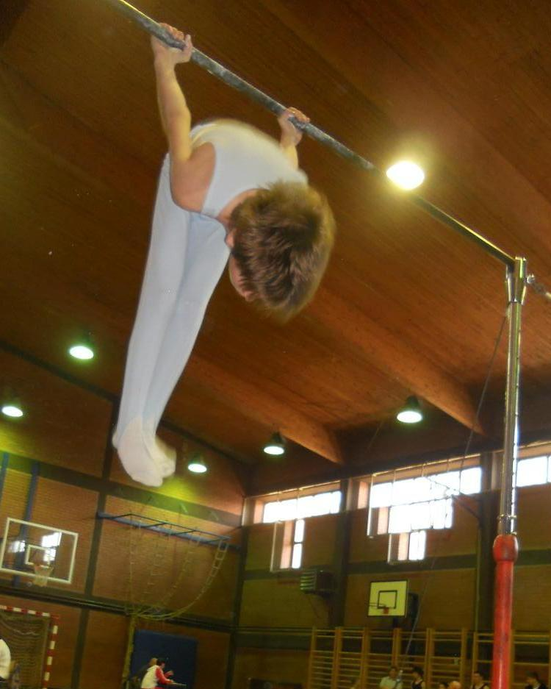
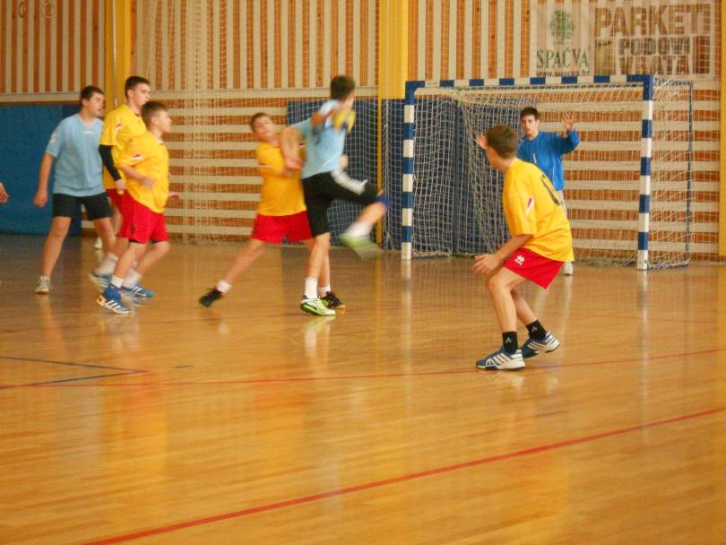
The school has numerous sports teams, pupils can train table tennis, basketball, gymnastics athletics, handball, volleyball, football (we have a girls’ team, too)

Slide 4
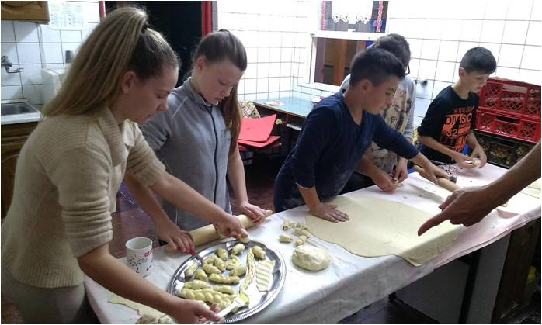
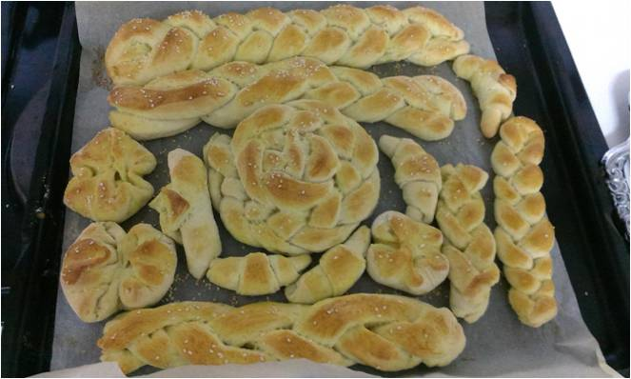
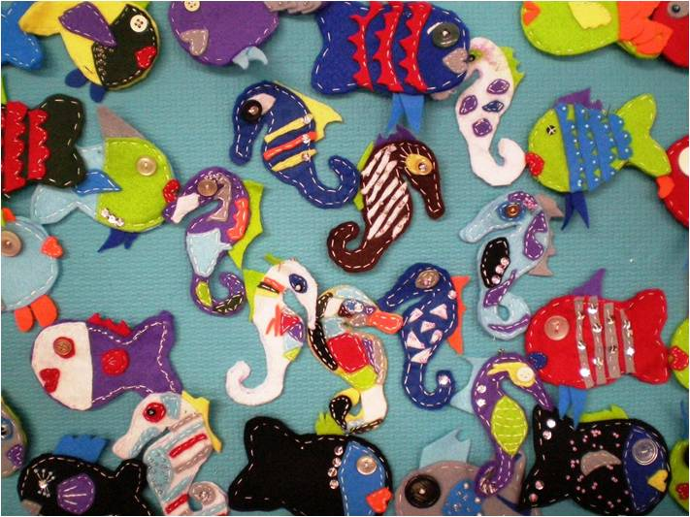
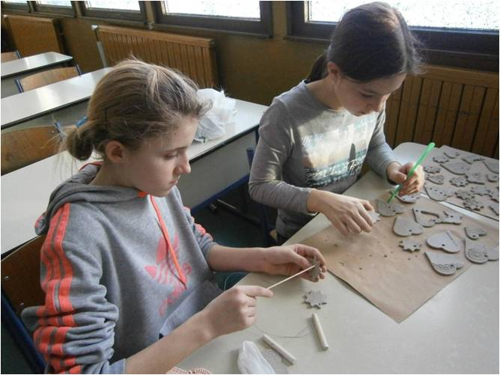
Pupils develop their creativity in school cooperative “Perunika”

Slide 5
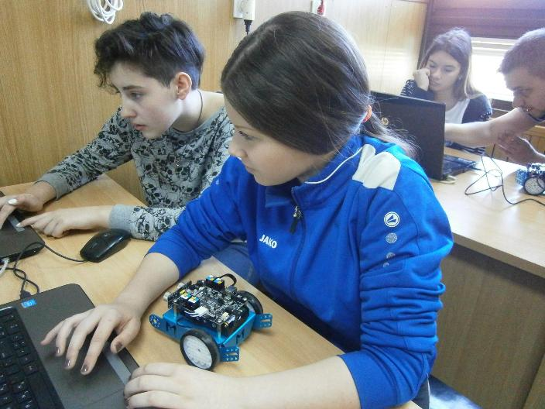
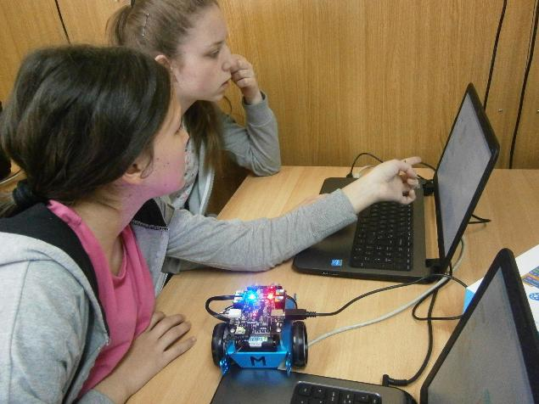
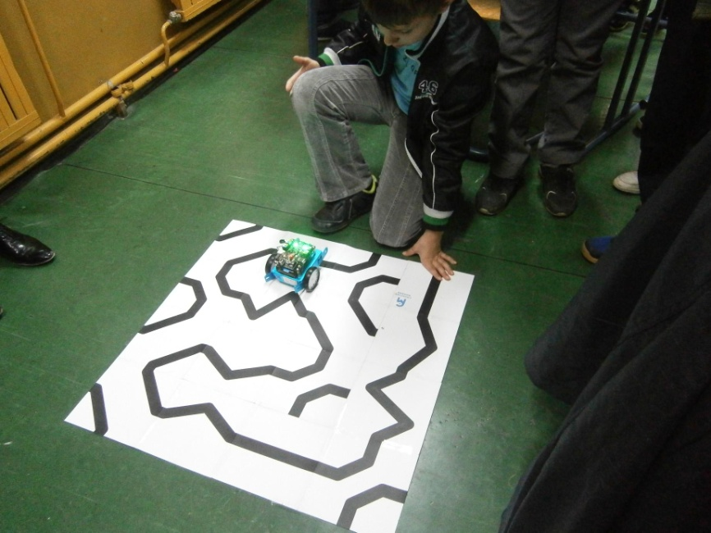
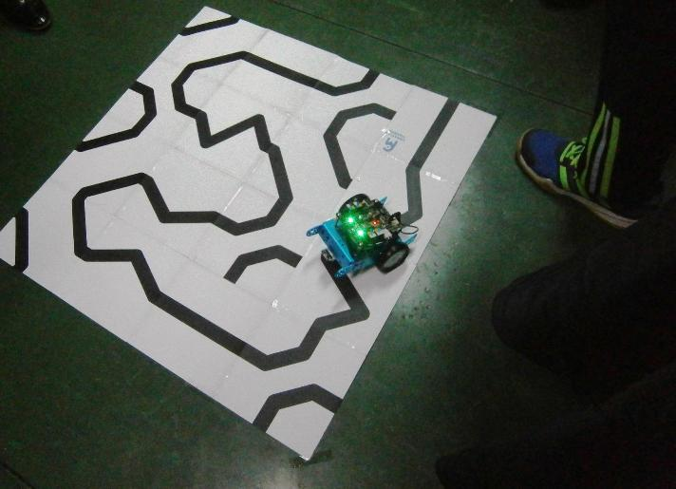
Robotics has been very popular for several years

Slide 6
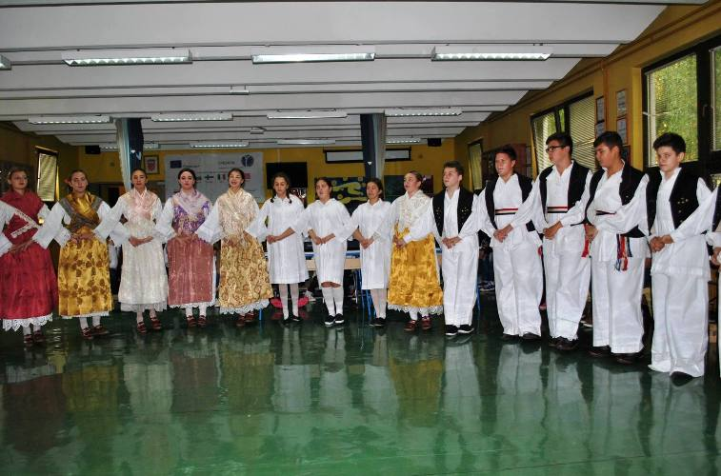
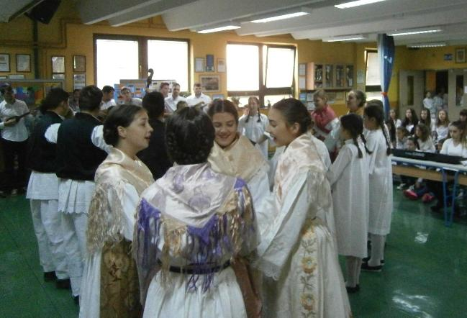
Pupils take part in lots of organised activities outside the school. In every class, 2-3 pupils go to music school,
2-3 pupils go to a foreign language school and 2 pupils go to a folklore club (pupils learn traditional folk songs and dances, travel to other cities and countries to represent Vinkovci and Croatia at different events.

Slide 7
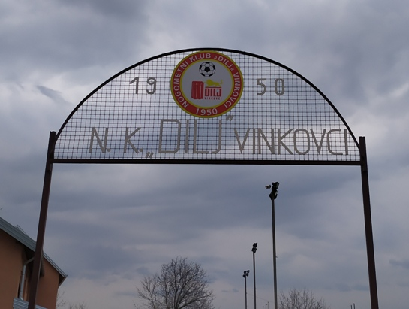
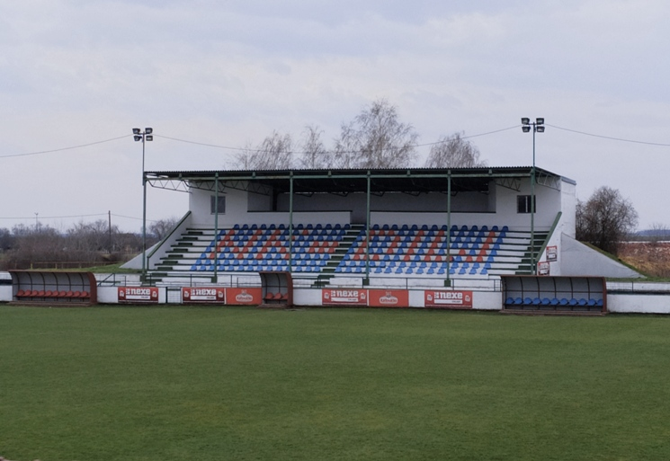
Vinkovci has numerous sports clubs, but the most popular sport at the moment is football. At least 4 boys from every class train football, most of them are members of the local football club “Dilj”.

Slide 8
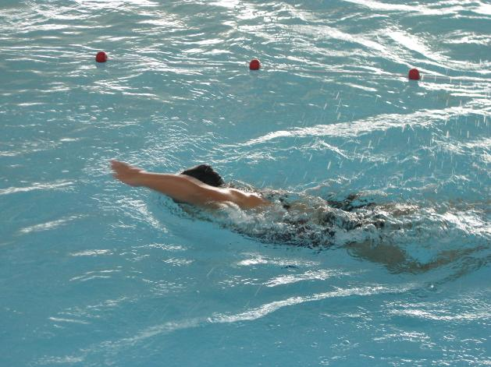
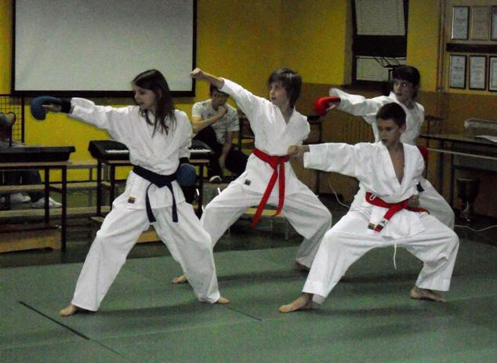
Swimming and martial arts are also very popular
Some pupils also train handball, volleyball, tennis, table tennis, cycling and are members of fishing clubs (on average 1 pupil in each class.)

Slide 9
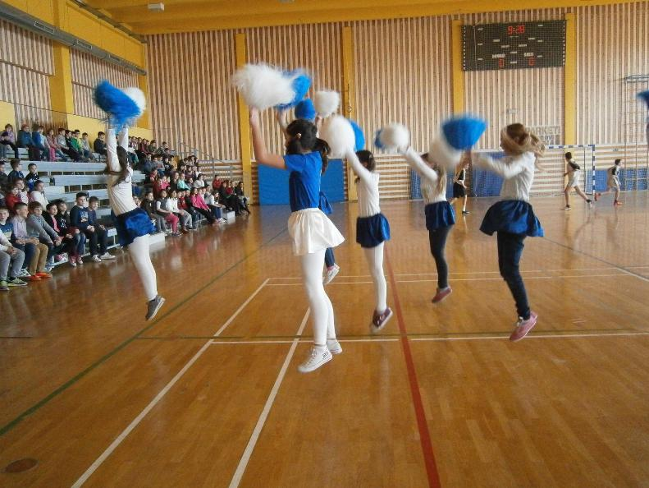
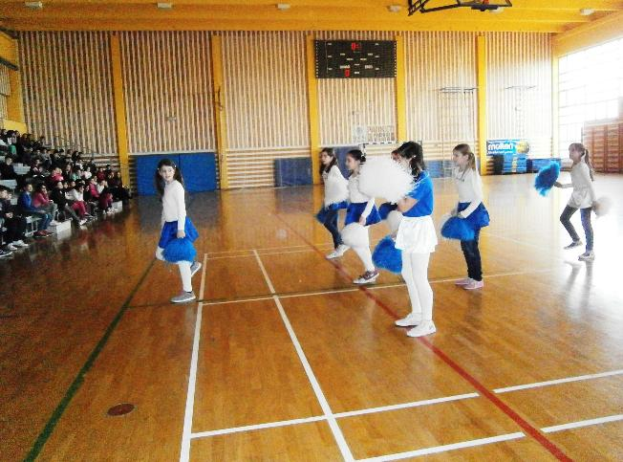
Cheerleading is very popular among girls

Slide 10
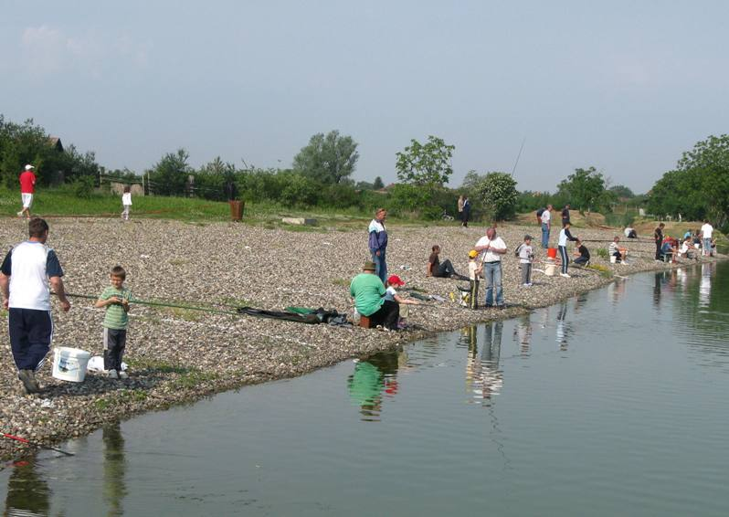
Activities that are not organised Some pupils play chess with their family members. Lots of boys go fishing with their friends and their elders (at least 2 from every class)

Slide 11
Our survey showed that pupils also like watching TV, writing (mostly poems and short stories), drawing, model building, playing video games (SCGO – Counter Strike – Global Offensive, Fortnite, Call of Duty, etc.), communicating via social networks: Tik Tok, YouTube, Instagram, Snapchat, etc. As our 2 cinemas were destroyed during the war (1991-1995), pupils go to the cinema to Vukovar (20 km away) or to Osijek (40 km away).

Slide 12
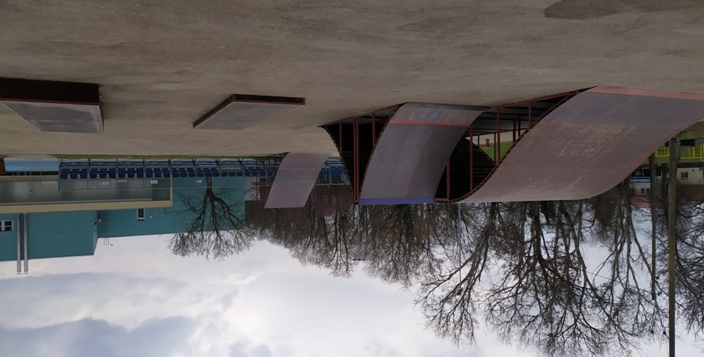
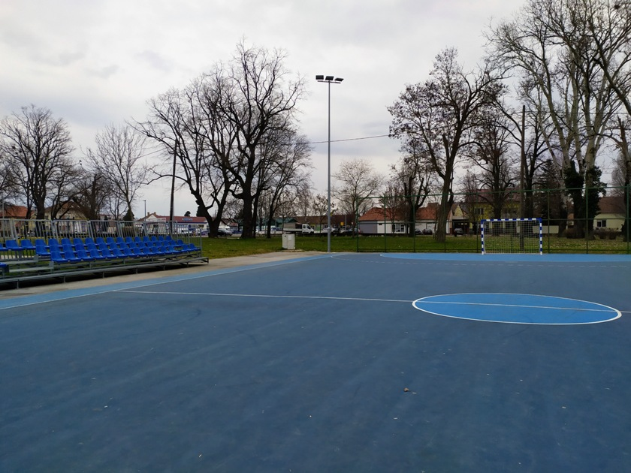
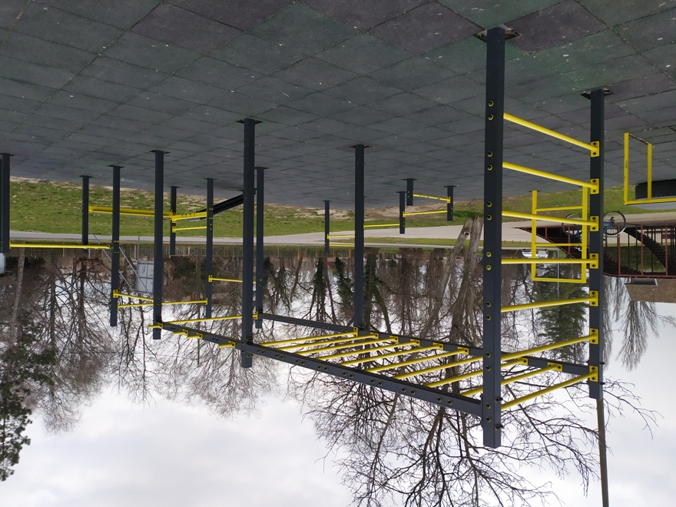
Young people have the opportunity to exercise in the skate park and on playgrounds that are accessible to everyone, there are also street workout devices.

Slide 13
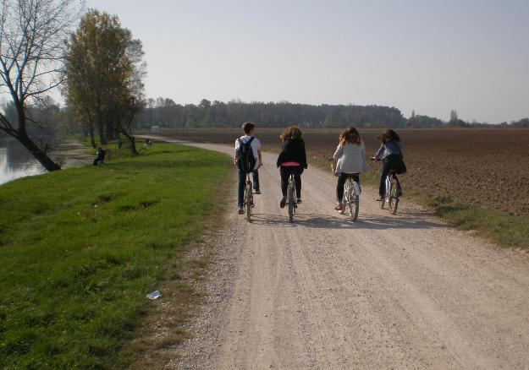
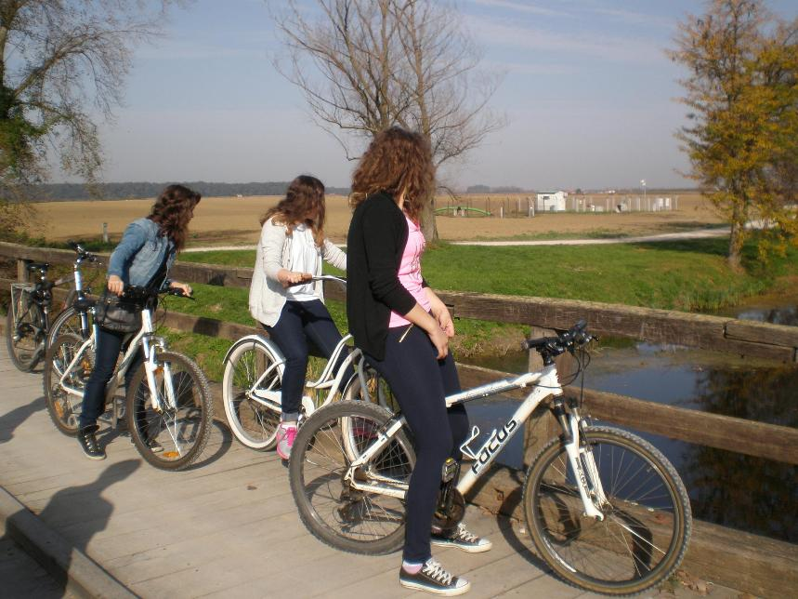
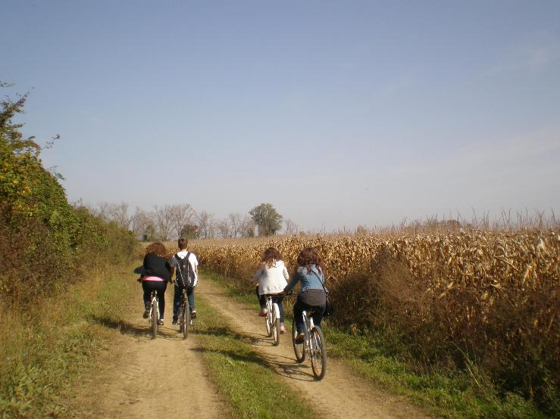
Pupils go for bike rides along the Bosut River with their friends. Skateboarding and rollerskating are popular activities, too.

Slide 14
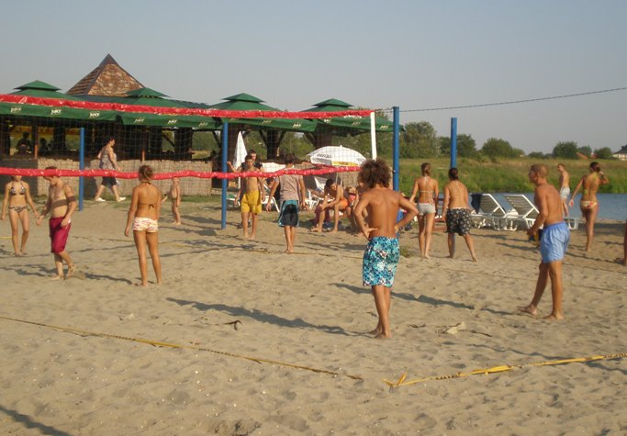
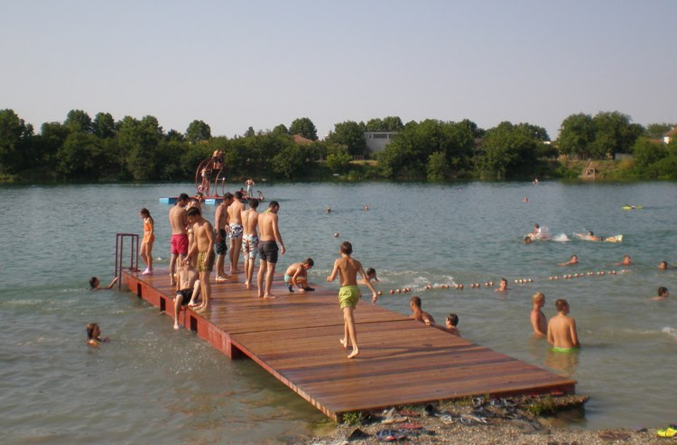
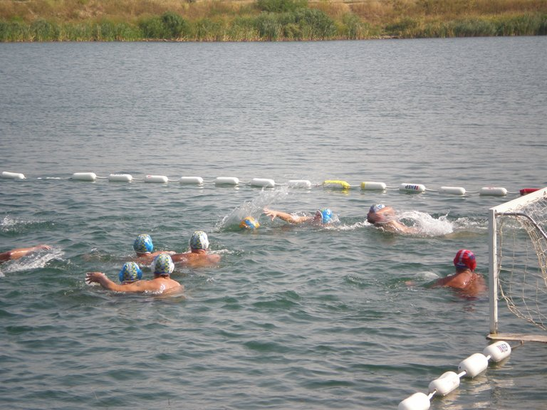
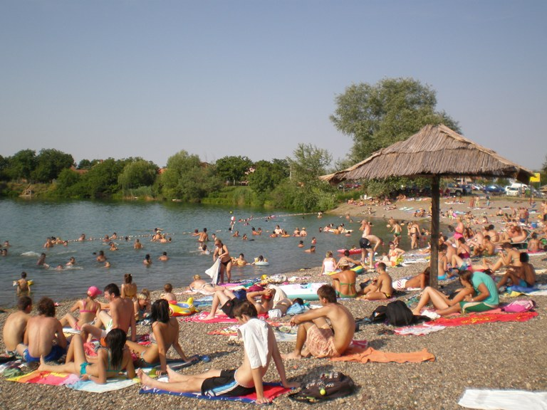
Banja lake is a place where young people spend summer holidays, they can play volleyball, waterpolo or just have fun

