Slide 1
Osnovna škola Bartola Kašića Vinkovci Erasmus+ project 2020-2022 How Roman are you? 2020-1-DE03-KA229-077527_5
FREE TIME
Tina Rosandić & Maja Pavelić

Slide 2
Teenagers these days spend their free time differently
Some spend their time:
watching tv,
going out with friends,
shopping,
playing games,
playing sports
and other activities

Slide 3
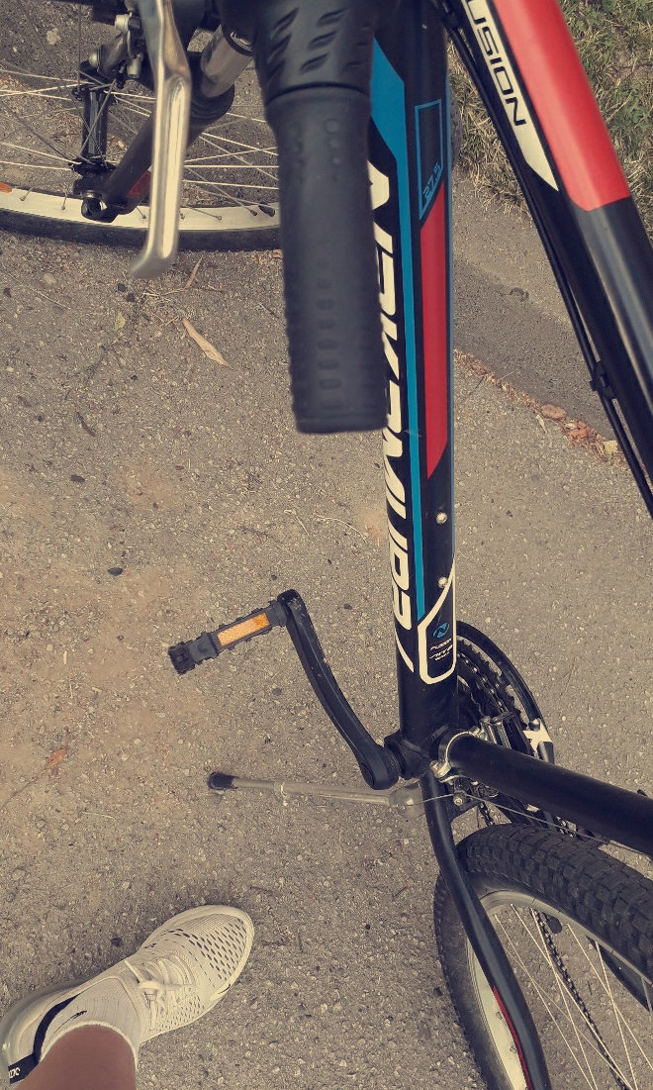
Going out
Some teenagers like to go out, alone or with friends, maybe take bikes , skateboards or

Slide 4
Sports
Many spend their time doing sports
Some do it profesional and some for fun
Sports like: volleyball, football, soccer, basketball, swimming, karate, handball, cheerleading and so many more
But there are teens who like working out at home

Slide 5
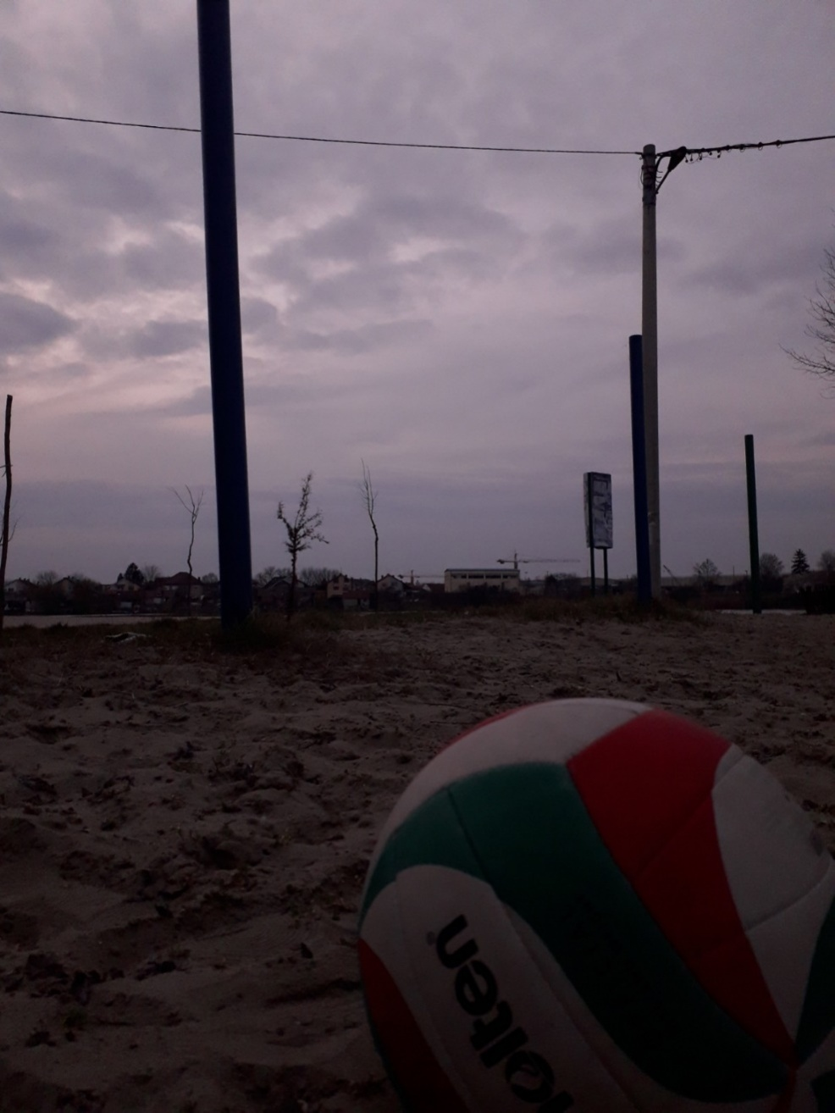
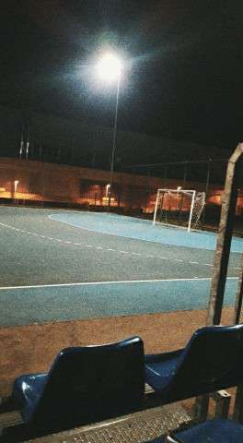
Volleyball
Soccer

Slide 6
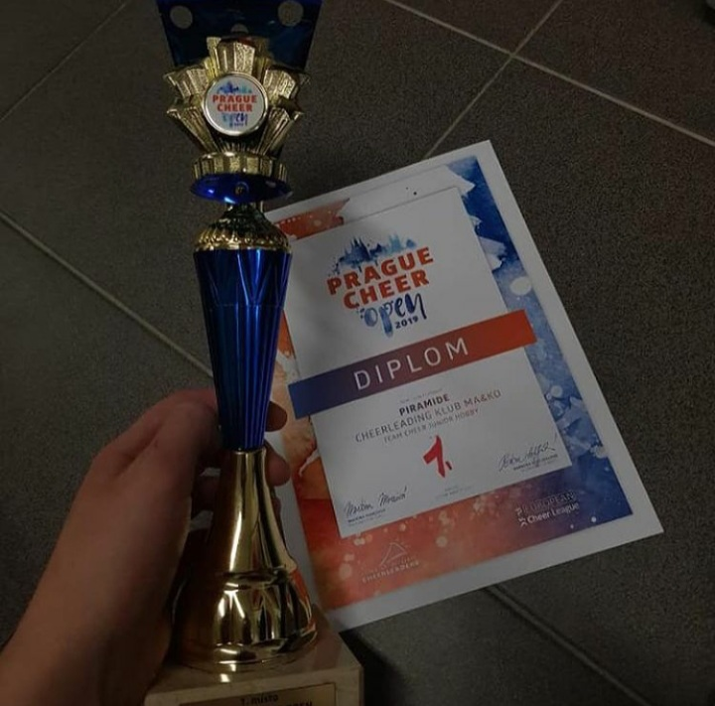
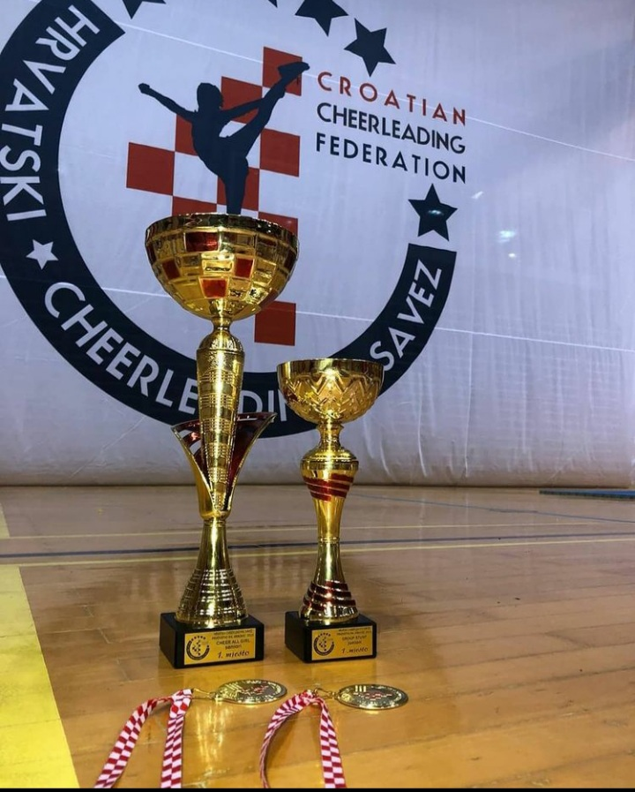
Cheerleading

Slide 7
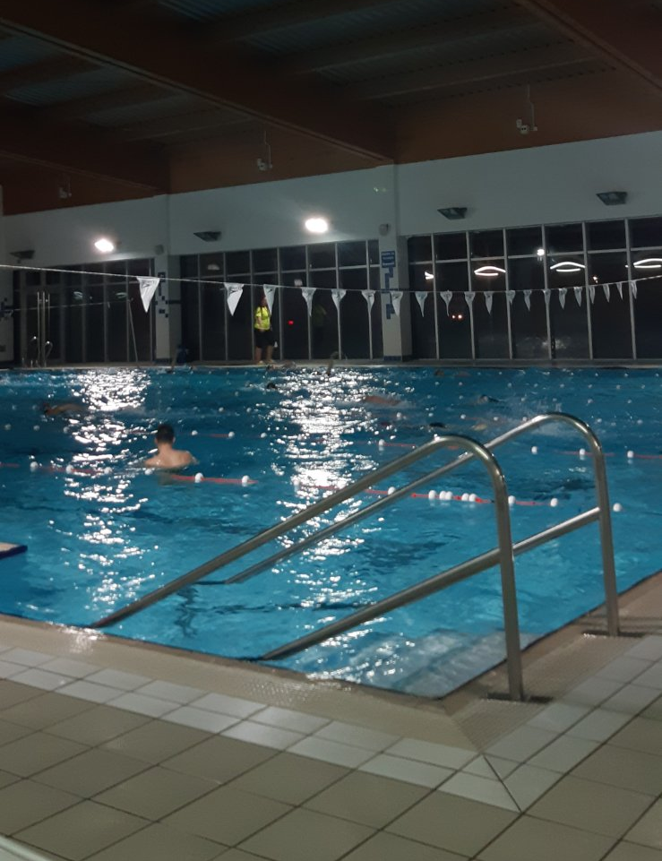
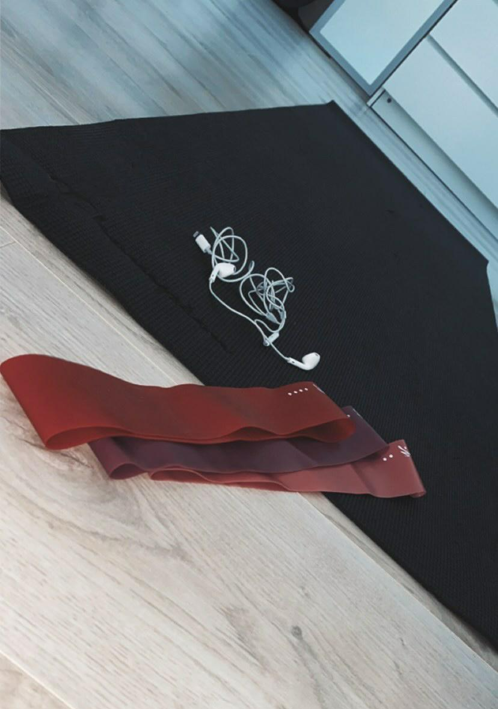
Swimming
Working out

Slide 8
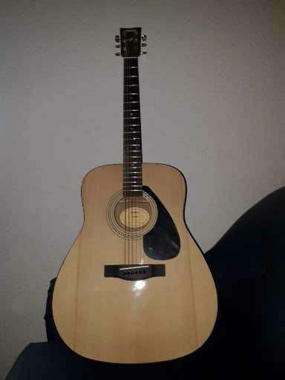
Music
Teenagers may find themselves in music
Not only listening to it but also writing and playing

Slide 9
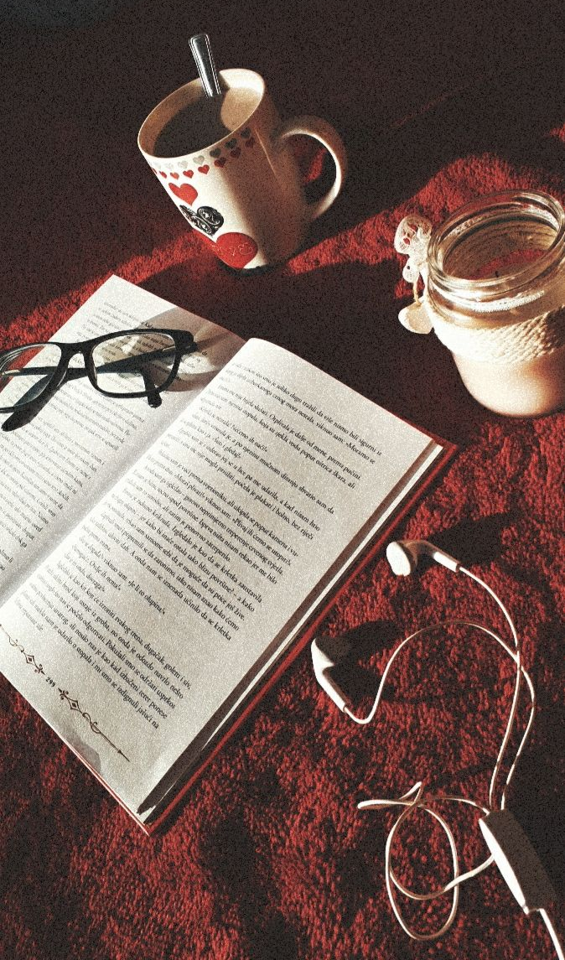
Reading
Belive it or not, sometimes teenagers read books too
Not only books but comics, magazines and newspapers too

Slide 10
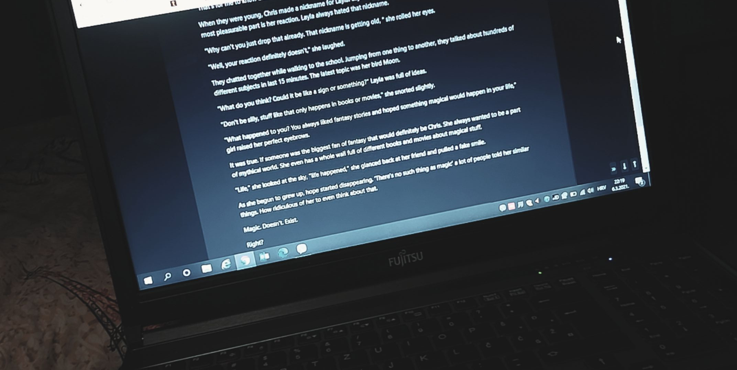
Writing
Creativity can be found in a lot of teenagers these days
Some use their creativity to

Slide 11
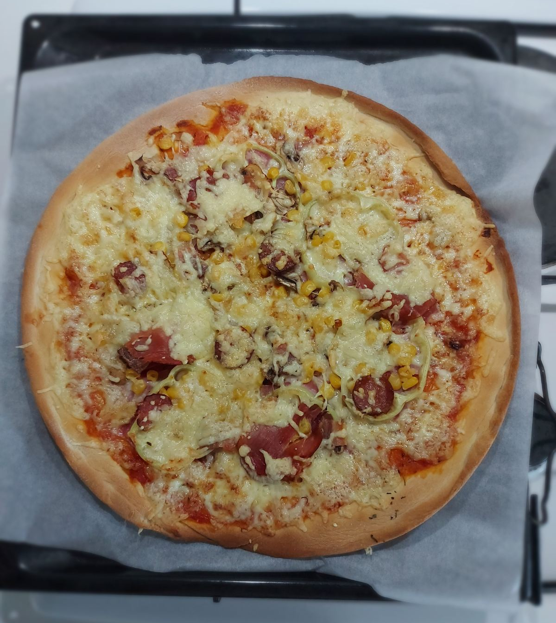
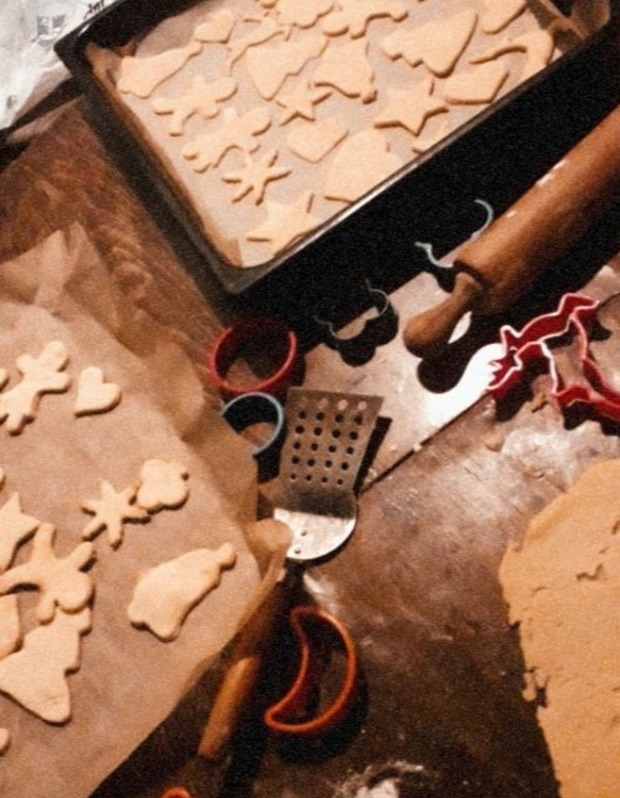
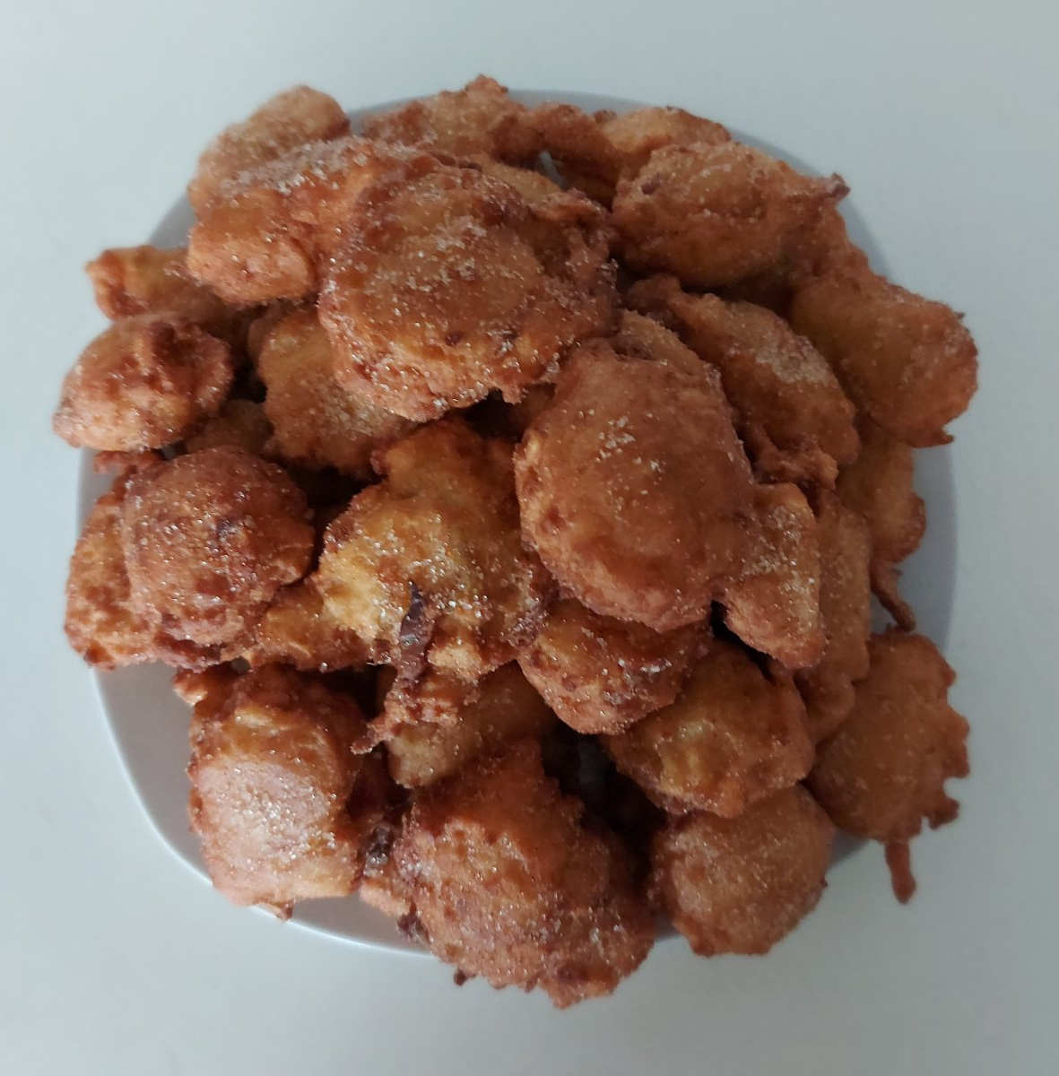
Cooking
It may not seem that teenagers actually like cooking but some find it

Slide 12
The End
Thank you for watching!

