Slide 1
OŠ Bartola Kašića Vinkovci Erasmus+ project 2020-2023 S.O.F.T. – Start our Future Today 2020-1-PL01-KA229-081533_4
Five young Croatian entrepreneurs

Slide 2
5 YOUNG CROATIAN ENTREPRENEURs
Luka Majić 7.b

Slide 3
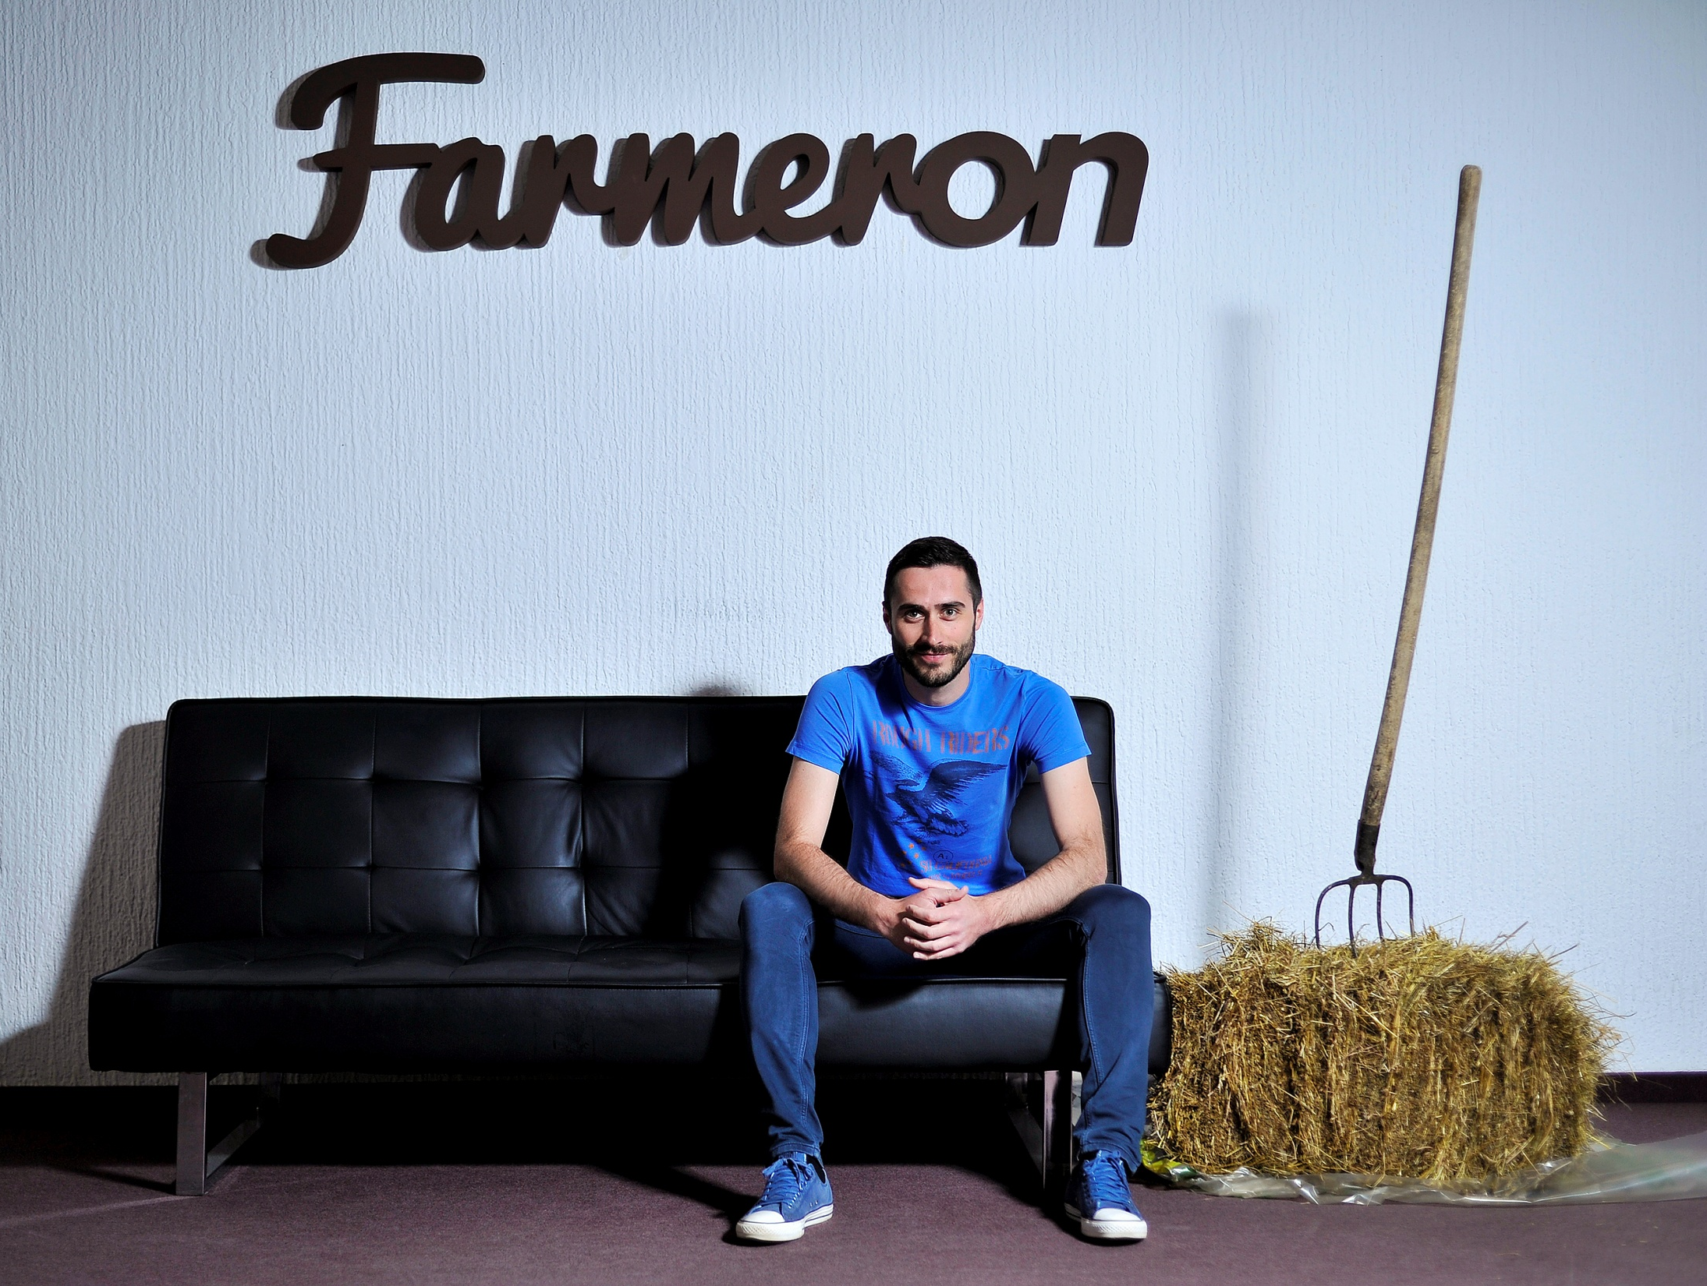
Matija Kopić-Farmeron
Matija Kopić the owner of the company Farmeron founded five years ago is software that allows farmers to track data about their livestock
Matija was born in 1986. In Viljevo near Donji Miholjac
He graduated on the subject of optimization of agricultular production process using IT

Slide 4
Farmeron
Farmeron is an app that helps farmers around the world manage their farm performance, from production volume to animal health, increasing the amount and production of food needed by customers around the world

Slide 5
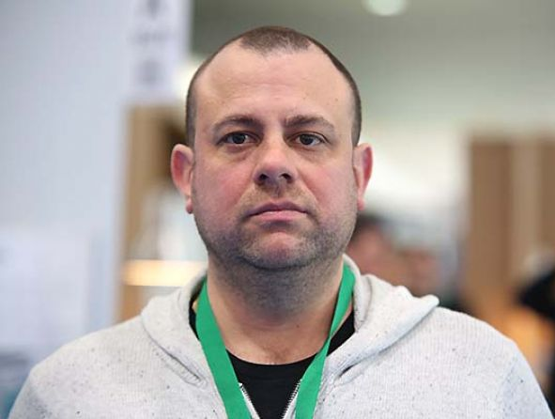
Damir Podhorski-Escape
Damir is working and building an story for company named Escape already 18 years
Damir is master of economics, minister of escape finance
He stayed in Croatia and he is saying to young Croatian people to stay and try to succed in Croatia

Slide 6
Escape
Escape is internet marketing agency
Its first ever company in Croatia that became a certifited partner for Google Analytics
Escape is specialized in advertising optimization with Google tools but recently it works with social networks
It was founded when founders were in college and now about 30 specialized people works with it

Slide 7
Martina Petrović
In 2014 Martina is choosen to be best Croatian farmer that year
She was very young in that year but her hard work payed off
She was first ever women farmer that won that award

Slide 8
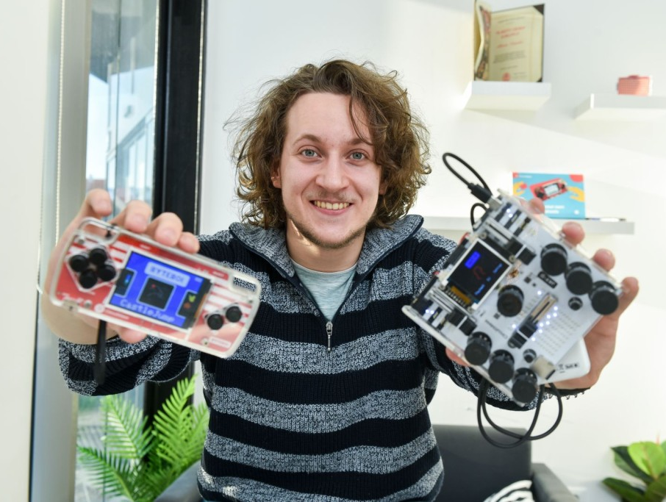
Albert Gajšak
Albert Gajšak is inventor of gaming console MAKERbuino which is similar to Nit endo Gameboy console
In first months he became global seller and sold about 1800 consoles all around world

Slide 9
MAKERBUINO
Albert´s MAKERbuino is masterpiece of console why?
Albert made a console when you get it you get own pieces and you can put pieces together by yourself
Not only you can set pieces together by yourself you can do your own game by yourself on console

Slide 10
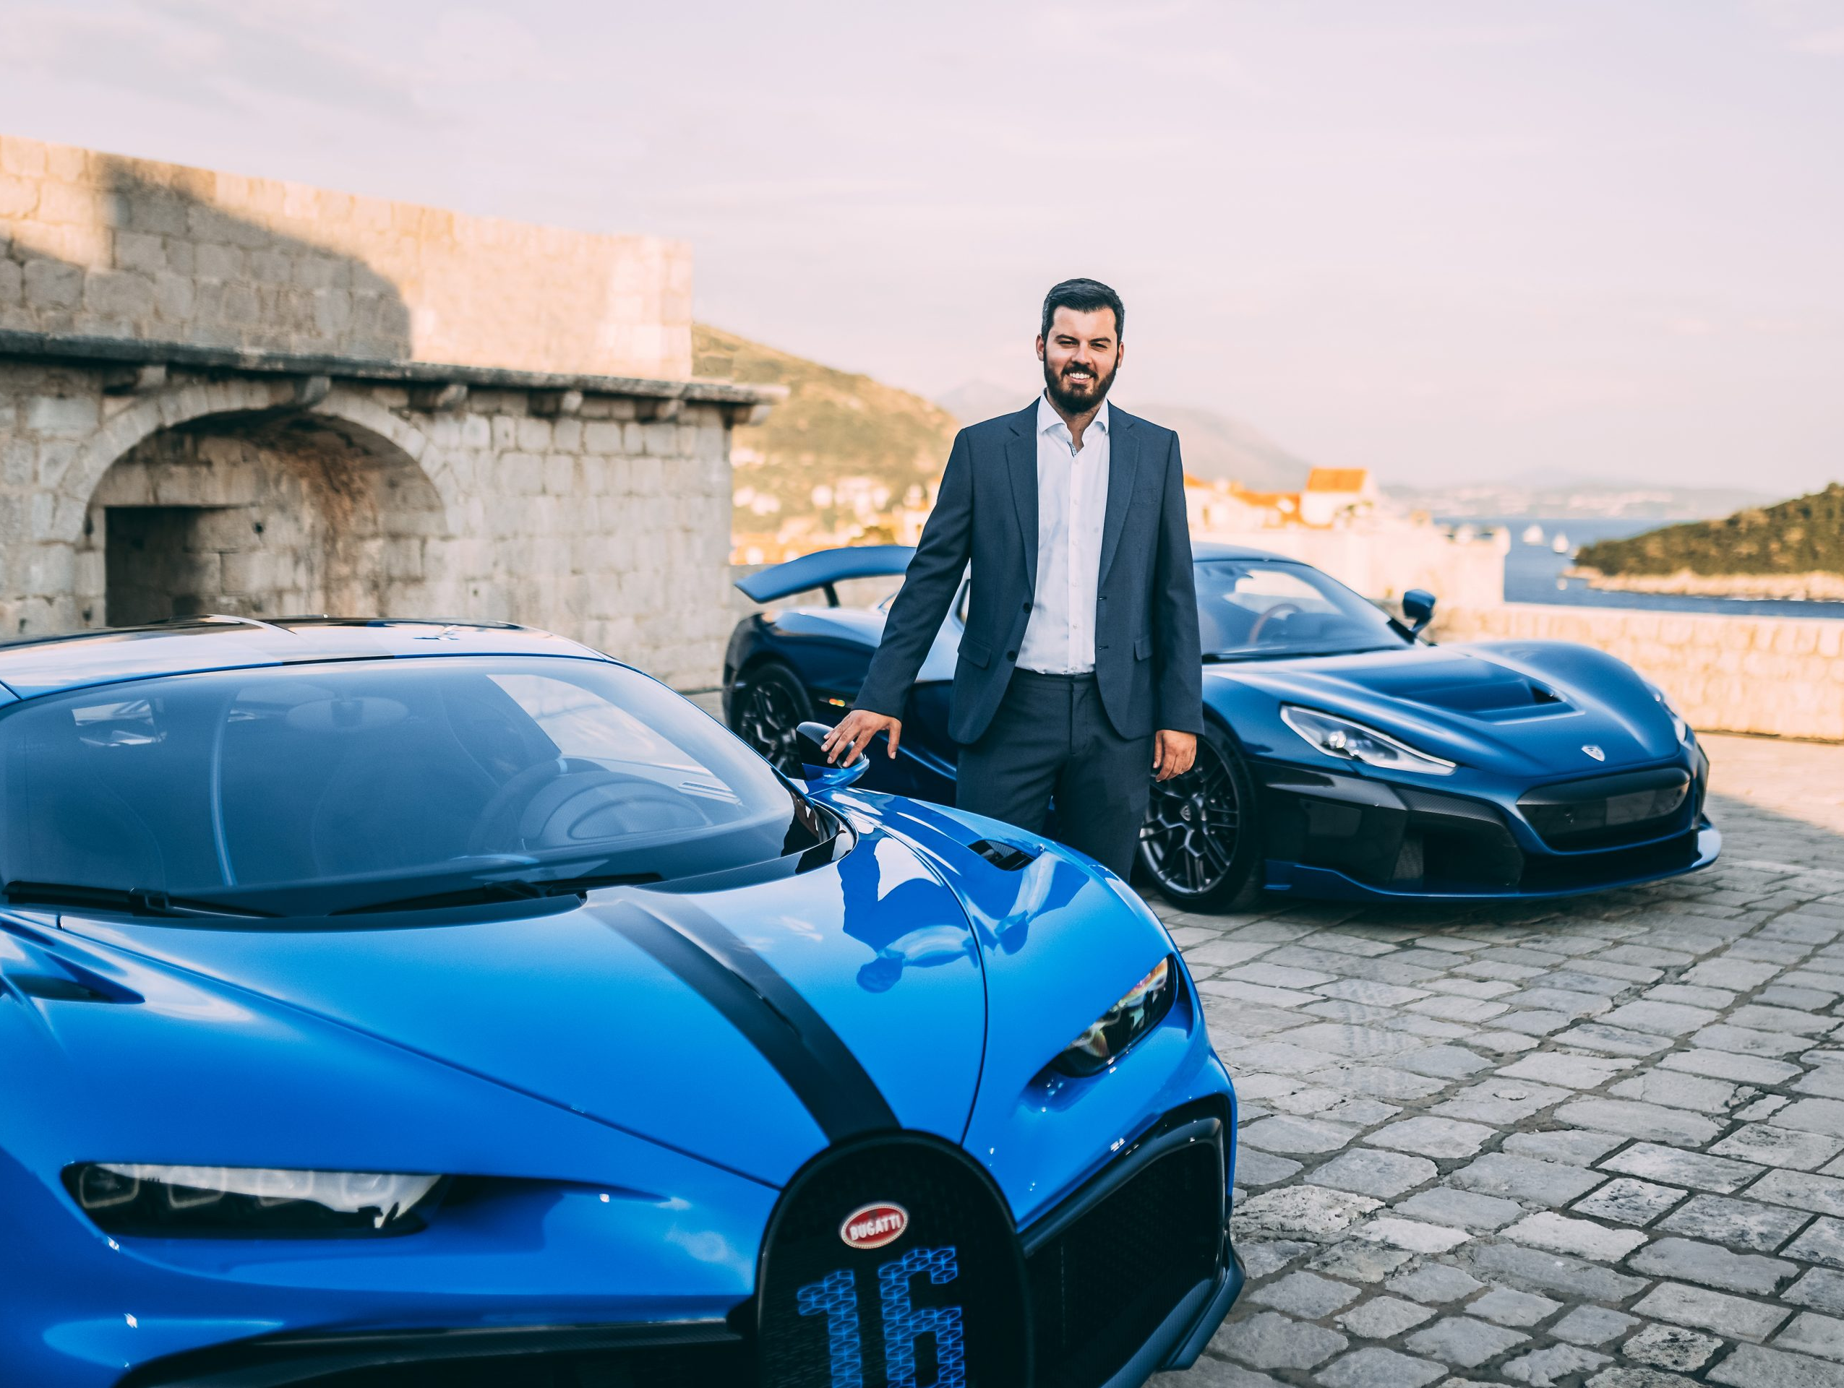
Mate Rimac
Mate Rimac is born 12. February 1988 he is young Croatian entrepeuer and inovator
He is owner and director of company Rimac automobili and Greyp Bikes
With his first money he bought BMW E30 and after his engine exploded he started building electric car

Slide 11
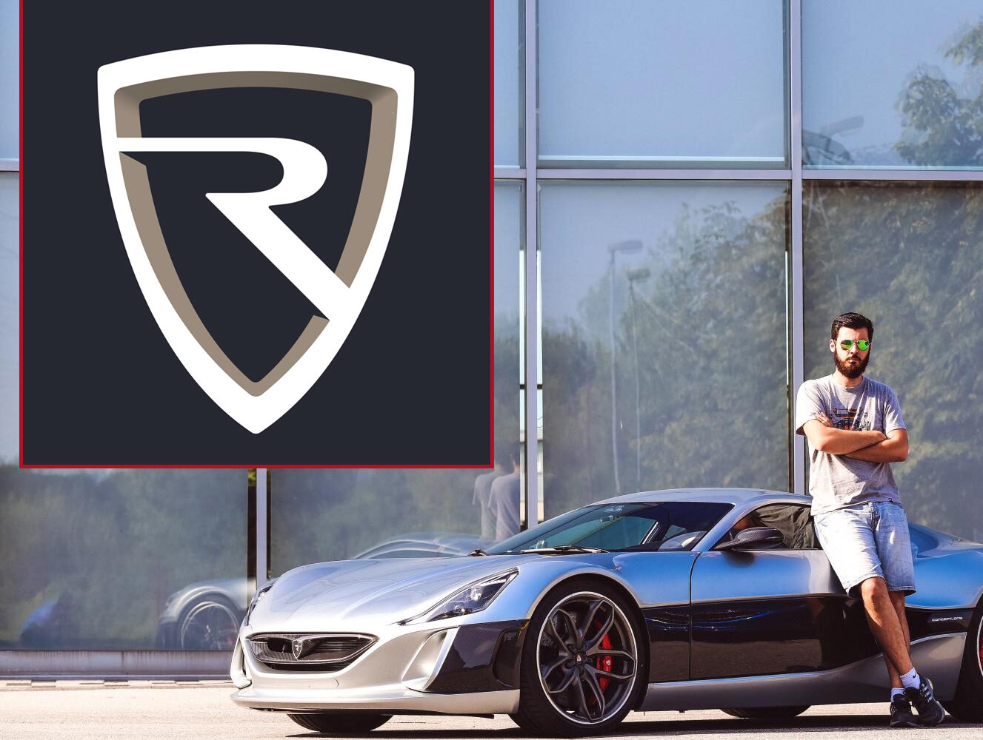
Rimac automobili
Rimac automobili is technology powerhouse in Croatia
Everything started when Mate started working in his dad garage with his old car
Mate now owns one of best car powerhouse in world and that´s not the end because Rimac don’t want to stop he wants to develop even more all around the world

