Slide 1
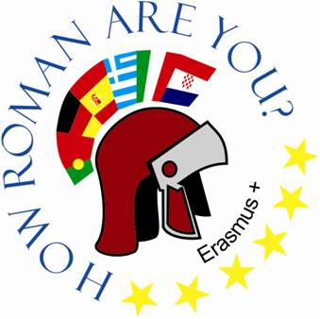
Osnovna škola Bartola Kašića Vinkovci Erasmus+ project 2020-2022 How Roman are you?
CROATIAN LANGUAGE

Slide 2
Standard Croatian is the official language of the Republic of Croatia.
Croatian is one of the South Slavic languages, it has been called differently throughout history, and one of the names was “Illyrian”.
The Croatian language was first mentioned in 1275 in the document “Istarski razvod”. Croatian is one of three official languages of Bosnia and Herzegovina. It is also official in the regions of Burgenland (Austria), Molise (Italy) Vojvodina (Serbia).

Slide 3
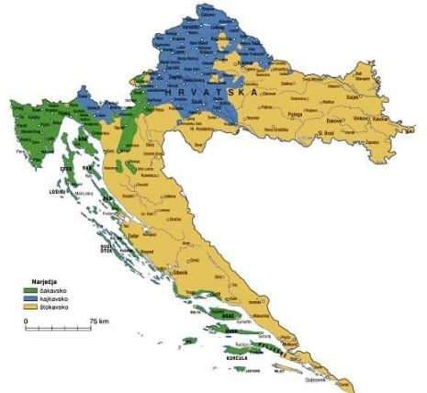
Croatian is written in the Roman alphabet (Roman/Latin script)
Dialects
Croatian has three main dialects (words used for the word “what” in each dialect are ča and kaj and što):
Čakavian – spoken along the Croatian coast, on many islands and in the Lika region
Kajkavian – spoken in northern and northwestern Croatia
Štokavian – spoken in the rest of Croatia

Slide 4
More than 1300 years ago, when the Croats arrived in present-day Croatia, they did not have their own script. A small number of educated people, wrote in the language of Western civilization - Latin.
Numerous monuments and documents written in Latin have been preserved.
Latin has long been the language of official communication between Croats. Even after the predominance of the Croatian language in literacy and literature in Croatia, Latin legal, diplomatic, scientific, literary and other texts were written in parallel with Croatian, especially from the 14th to the middle of the 19th century. Latin was spoken in the Croatian Parliament until In 1847. At the suggestion of Ivan Kukuljević Sakcinski, the Croatian language was declared the official language.

Slide 5
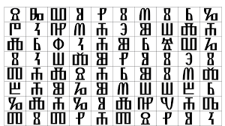
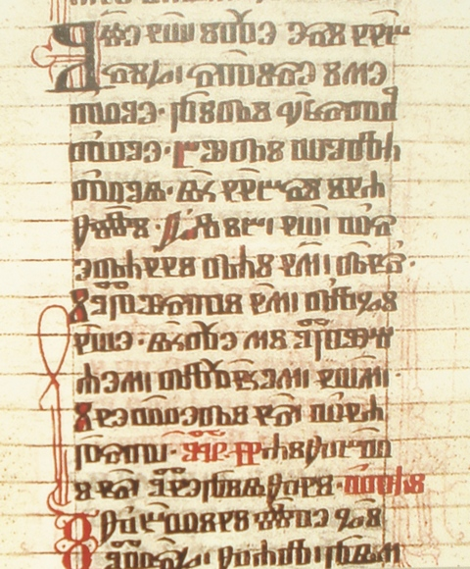
The original alphabet used by both the Serbs and Croats was Glagolitic. It was created by the monks Cyril and Methodius in the 9th century for Old Church Slavonic, the liturgical language of the time.

Slide 6
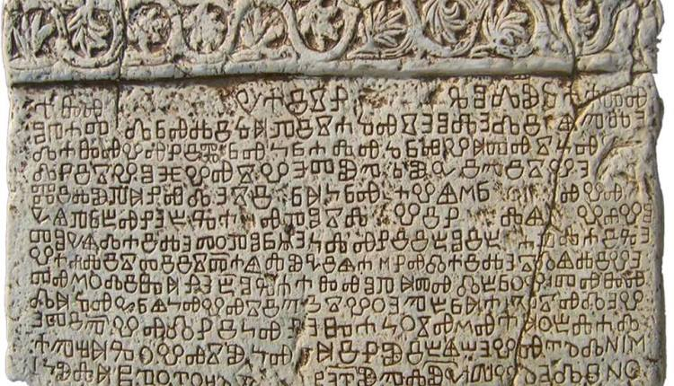
Baška tablet ( Bašćanska ploča) is one of the first monuments containing an inscription in Croatian language, dating from c. 1100 AD.

Slide 7
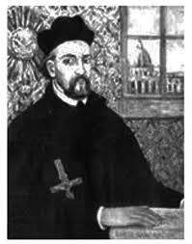
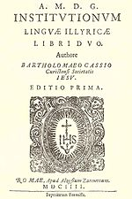
Bartol Kašić (1575-1650) was a priest and grammarian during the Counter Reformation. He wrote the first Croatian grammar and translated the Bible into Croatian.
https://hr.wikipedia.org/wiki/Bartol_Ka%C5%A1i%C4%87

Slide 8
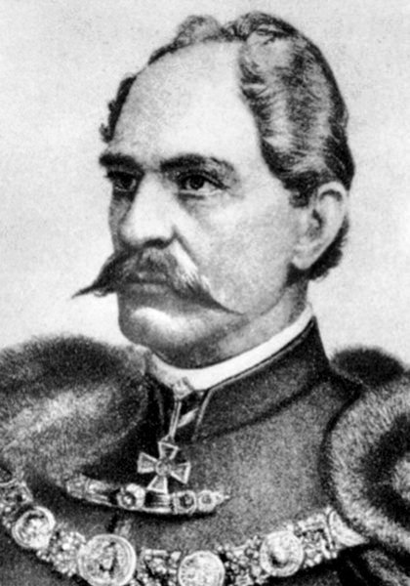
In 1843 Ivan Kukuljević Sakcinski was the first man to speak Croatian in the Parliament. The speech promoted the struggle for national liberation, asking for Croatian to become the official language in schools and offices, with its gradual introduction in the public life. He also pointed out the danger of replacing Croatian with other languages.
In 1847 at the suggestion of Ivan Kukuljević Sakcinski, Croatian was declared the official language.
https://www.enciklopedija.hr/natuknica.aspx?id=34496

Slide 9
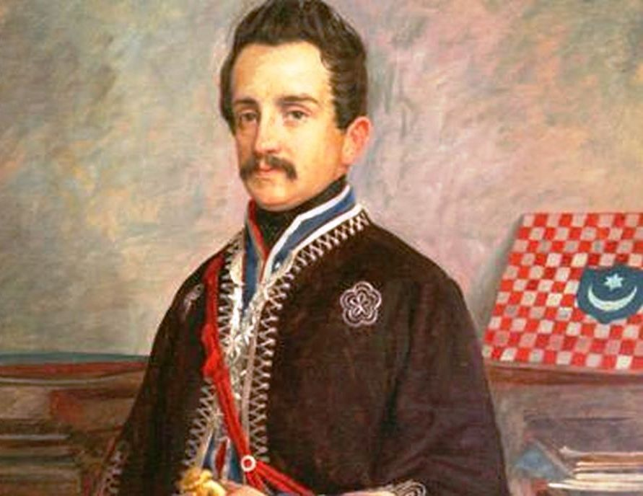
Illyrian period
The Illyrian movement was a 19th-century pan-south Slavic political and cultural movement in Croatia that had the goal to standardize the regionally differentiated and orthographically inconsistent literary languages in Croatia, and finally merge them into a common South Slavic literary language. The leader of the Illyrian movement Ljudevit Gaj standardized the Latin alphabet in 1830–1850 and worked to bring about a standardized orthography.
https://narod.hr/kultura/20-travnja-1872-ljudevit-gaj-sto-niste-znali-poznatom-ilircu

Slide 10
Throughout history, Croatia was a part of different kingdoms, monarchies, it was occupied and lots of words of German, Italian, Hungarian and Turkish origin are still used in everyday communication. Words from German – north, east of Croatia Turkish – north of the river Sava Italian – along the Adriatic coast Hungarian – north, east

Slide 11
Everyday language | German | Croatian
beštek pegla cigla tašna/taška deka šparati rerna veš flaša hoklica frtalj jakna šnita lojtre | das Besteck das Bügeleisen der Ziegel die Tasche die Decke sparen die Röhre die Wäsche die Flasche der Hocker das Viertel die Jacke die Schnitte die Leiter | pribor za jelo glačalo opeka torba pokrivač štedjeti pećnica rublje boca stolica bez naslona četvrtina jakna, kaputić kriška ljestve

Slide 12
Everyday language | Turkish | Croatian
bašča česma čorba sijaset pendžer avlija ćuprija šećer čarapa jogurt, jastuk kutija komšija pare mušterija ortak | bahçe Çeşme çorba sayısız pencere avlu köprü şeker çorap yoğurt yastık kutu komşu para müşteri ortak | vrt zdenac, izvor juha, gusta juha mnogo, mnoštvo prozor dvorište most šećer čarapa jogurt jastuk kutija susjed novac kupac partner

Slide 13
Everyday language | Italian | Croatian
kušin borša botun tramontana kužina brodet, marenda panceta bevanda šugaman, ređipet, mudante, ponistra pijat skalina đardin | cuscino borsa bottone tramontana cucina brodetto marenda pancetta bevanda asciugamano reggiseno mutande finestra piatto le scale giardino | jastuk torba puce, gumb sjeverni vjetar kuhinja riblja juha užina panceta, slanina vino miješano s vodom ručnik grudnjak gaće prozor tanjur stepenica vrt, perivoj

Slide 14
Everyday language | Hungarian | Croatian
čipka palačinka gumb pijaca punđa šator pandur soba cipela hajduk orijaš | csipke palacsinta gomb piac punja sátor rendőr szoba cipő hajduk óriások | čipka palačinka gumb, puce tržnica punđa šator policajac (pogrdno) prostorija, soba cipela hajduk div, gorostas

Slide 15
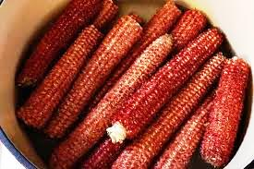
Facts about Croatian language:
Croatian language has seven cases: nominative, genitive, dative,accusative, vocative, locative and instrumental.
Gender: noun in Croatian are either masculine, feminine or neuter. Nouns, adjectives, pronouns and numbers are always declined, which means that they change depending on the case that they're in.
OKLASAK: this word has the highest number of synonims in Croatian language – more than 100: ajdamak, bat, batakljuša, bataljika, batučak, batuček, batuk, baturak, baturice, čepina, čokotinja, ćuka, kic, klas, klasina, klasinec, klasovina, klasovinje, kočanj, kocen, komaljika, komušina, kukuruzina, kumina, kureljica, kuruška, oklipak, okoma, okomak, okomina, okrunica, orušek, otučak, paćika, patura, paturica, rucelj, rucl, rulina, ...
Bare corn cob

Slide 16
Sources:
https://en.wikipedia.org/wiki/Croatian_language
https://www.croatiaweek.com/15-facts-about-the-croatian-language-you-probably-didnt-know/
https://www.learncroatian.eu/blog/croatian-language-basics-dialects-alphabet-and-pronunciation
https://www.croatiatraveller.com/Language.htm
https://www.mustgo.com/worldlanguages/croatian/
https://hrvatskiporebiblog.wordpress.com/izvannastavne-aktivnosti/glagoljaska-druzina/glagoljica/
https://novosti.hr/dan-hrvatske-glagoljice-i-glagoljastva/
https://www.croatianhistory.net/etf/glstil.html
https://hrvatskiporebiblog.wordpress.com/hrvatski-jezik/povijest-hrvatskoga-jezika/
https://www.profil-klett.hr/germanizmi-u-hrvatskom-jeziku
https://www.srednja.hr/svastara/turske-rijeci-koje-svakodnevno-koristimo-u-hrvatskom-jeziku/

