Slide 1
Osnovna škola Bartola Kašića Vinkovci Erasmus+ project 2020-2023 How Roman are you? 2020-1-DE03-KA229-077527_5
SPORTS IN CROATIA
May 2023

Slide 2
Humans started playing games thousands of years ago for enjoyment and recreation, but games are very important, they improve quality of life because: - they give us opportunity to learn new things - they help our physical development - they strenghten motor skills (coordination, balance,...) - they help develop creativity
- games help acquire social skills and improve our communication skills - help develop a positive attitude - develop problem solving skills

Slide 3
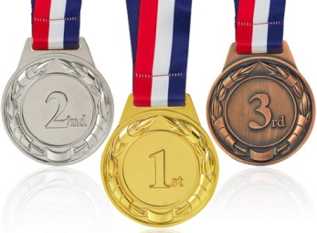
Definition of SPORT: - activity that you do for pleasure and that needs special physcal effort or skill, usually done in a special area and according to fixed rules (Oxford Advanced Learner’s Dictionary) - an activity or game requiring physical skill and having a set of rules or code of practice, that is engaged either individually or as one of a team, for exercise or recreation or as a profession (The Penguin Dictionary) - organized athletic events in which people are either participants or spectators. Some sporting activities include team playing,... (The new Webster’s International Encyclopedia)

Slide 4
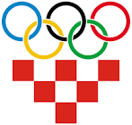
Croatia is a small country with population of only 3,8 million people, but there are numerous sports that are very popular and our athletes have achieved great results at competitions. There are about 12,500 sports associations in Croatia. Sport in Croatia is financed from the State Budget, state and public contributions, sponsorship and membership fees.
The largest sports association is the Croatian Olympic Committee (Hrvatski Olimpijski Odbor – HOO), which was founded in 1991.
Since 1992 Croatian athletes have won 52 Olympic medals.

Slide 5
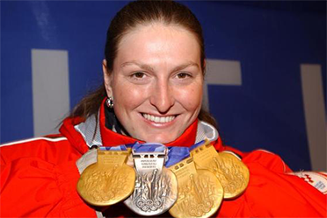
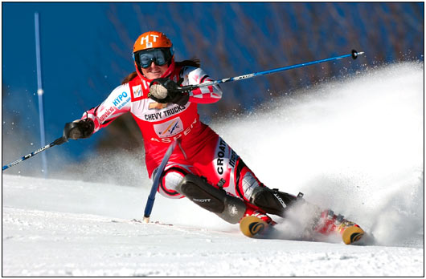
Croatian athlete Janica Kostelić is considered to be the greatest female ski racer of all times. She is a four-time Olympic gold medalist, she also won five gold medals at the World Championships. In World Cup competition, she won thirty individual races, three overall titles, three slalom titles, and four combined titles.

Slide 6
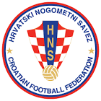
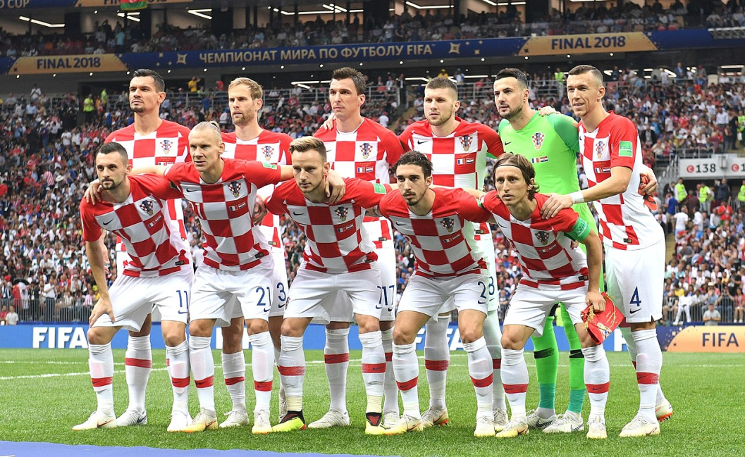
The most popular team sport is football, with almost 1,500 registered clubs and 110,000 participants. Since Croatia became independent, Croatian team won 3 World cup medals: 1998 (France) – third place 2018 (Russia) – second place 2022 (Qatar) – third place
Players wear recognisable red and white squares, the best player is Luka Modrić.

Slide 7
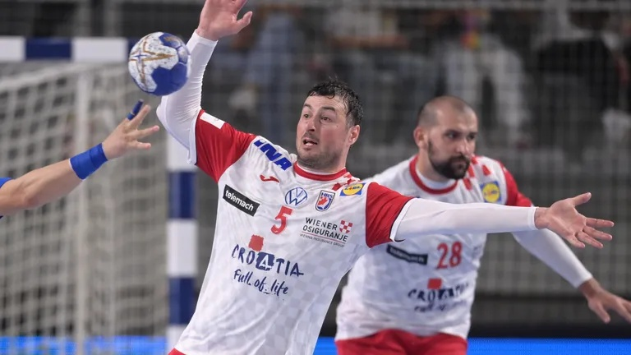
Handball team has been competing since 1991, which is the year of the independence, and won the 2003 World Championship, and finished second in 1995 and in 2005, and third in 2009 and in 2013.
Ivano Balić is probably the most prominent Croatian handball player, as he won the world handball player of the year award in 2003 and in 2006. Domagoj Duvnjak also won this award in 2013.

Slide 8
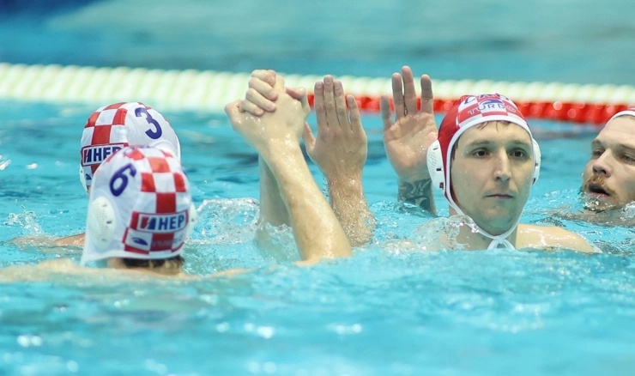
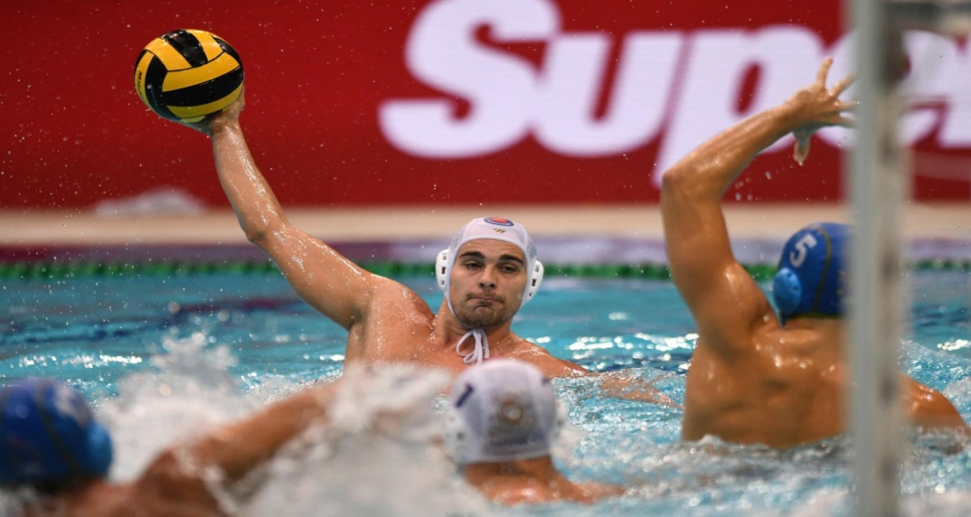
Water polo is popular in the cities along the Adriatic Sea.
Croatian water polo team started competing after the independence of the country, and earned worldwide success since then: they took the gold medal at the 2007 and 2017 editions of the World Championships, and finished third 3 times and second once.

Slide 9
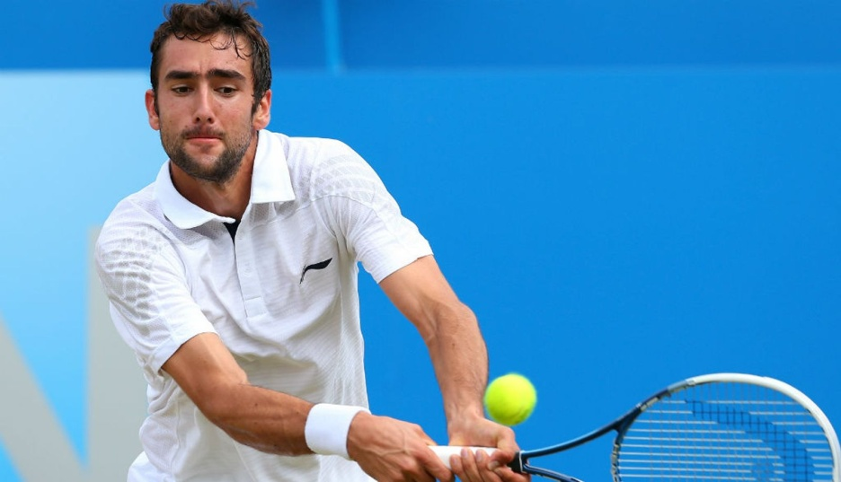
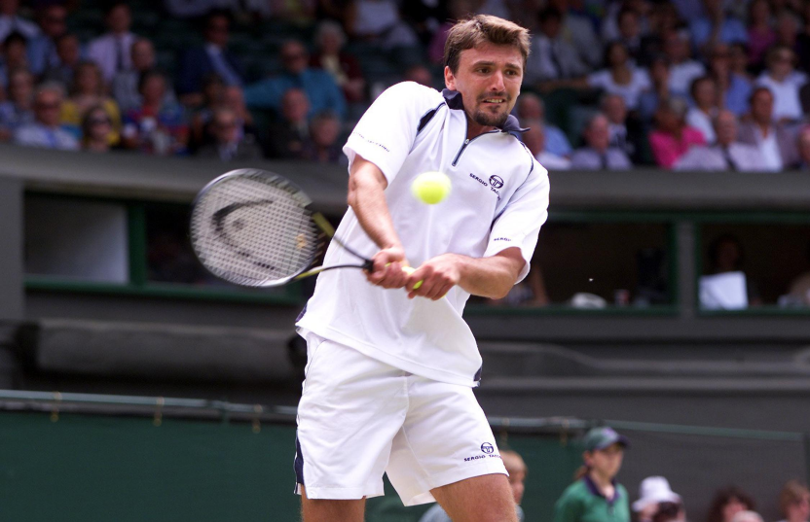
It took the Croatian tennis team only a year after independence to rise up. Since then, they won three Olympic medals: in 1992 (Goran Ivanišević in men’s singles, and Goran Ivanišević and Goran Prpić in men’s doubles) and in 2004 (Ivan Ljubičić and Mario Ančić in men’s doubles). They won the Davis Cup title in 2005 and in 2018.
Famous Croatian Tennis players are Goran Ivanišević, Marin Čilić, Ivan Ljubičić,...

Slide 10
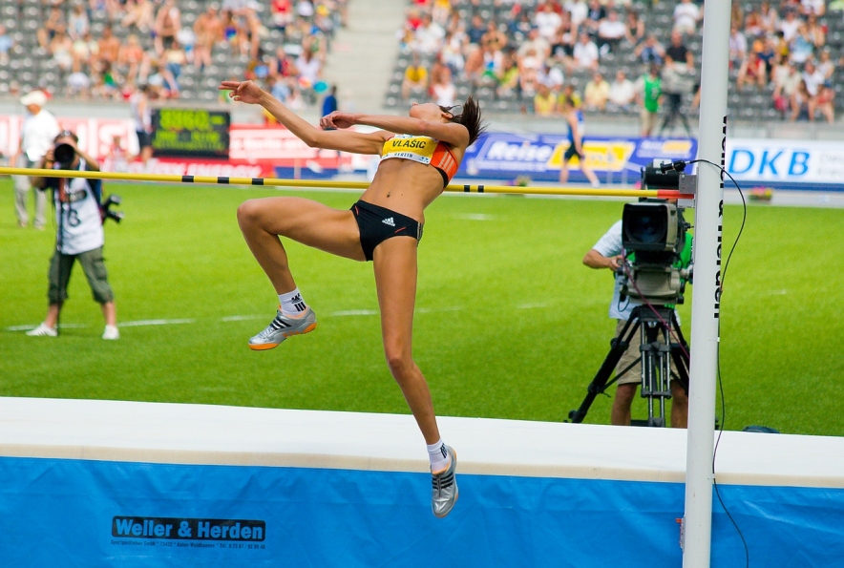
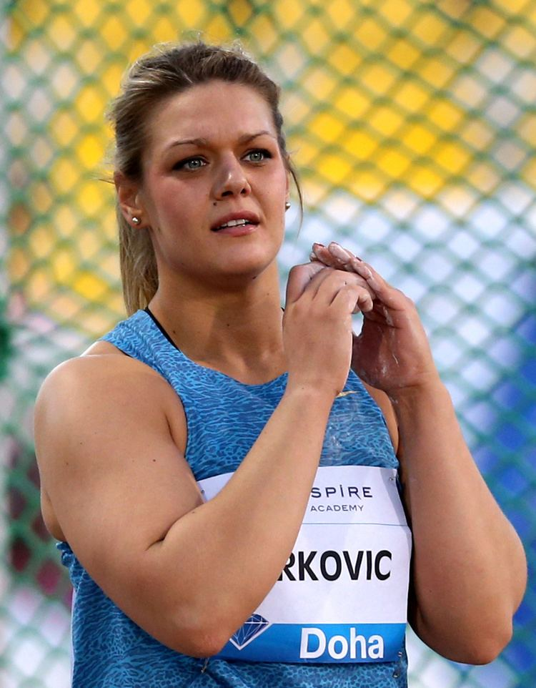
Athletics
Blanka Vlašić is a Croatian athlete who specialized in the high jump. She is a two-time world champion and double Olympic medallist
Sandra Perković is a discus thrower. She is a two-time Olympic ( London, Rio) and world (2013,2017) champion and a record six-time European champion. She is also a six-time Diamond League winner.

Slide 11
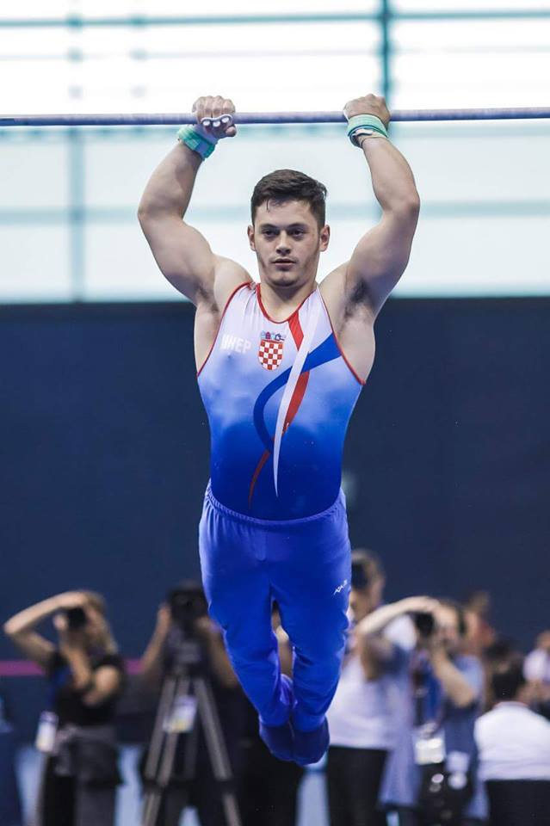
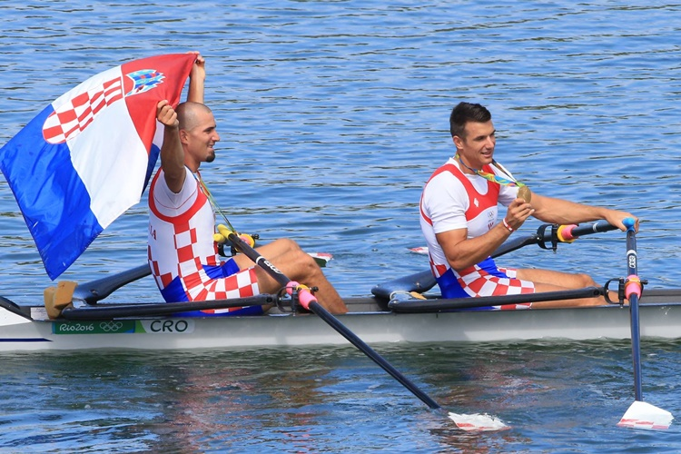
Croatian athletes are very successful in numerous other sports and have won lots of medals: Gymanstics: Filip Ude, Tin Srbić Rowing: brothers Martin and Valent Sinković

Slide 12
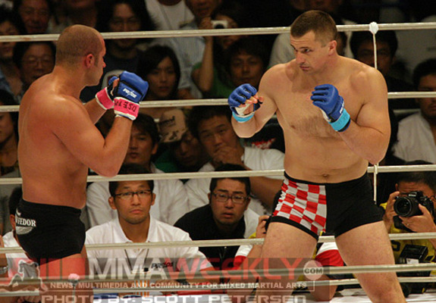
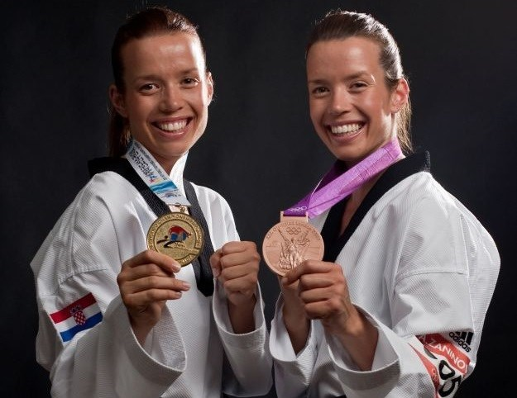
MMA : Mirko Filipović, also known as Cro Cop
Taekwondo: Ana and lucija Zaninović

Slide 13
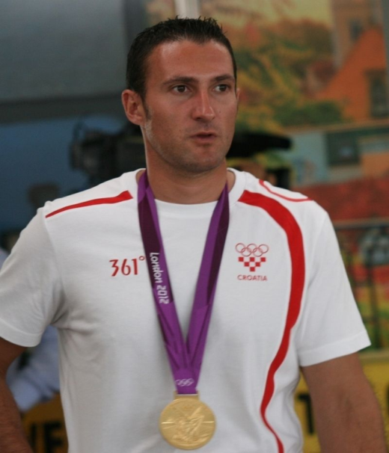
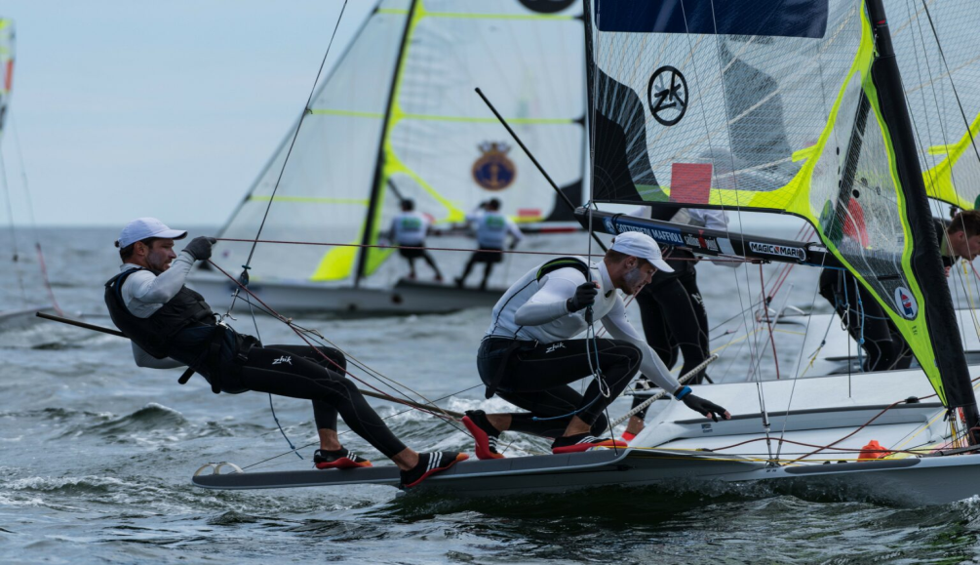
Shooting: Giovani Cernogoraz
Sailing: Šime Fantela

Slide 14
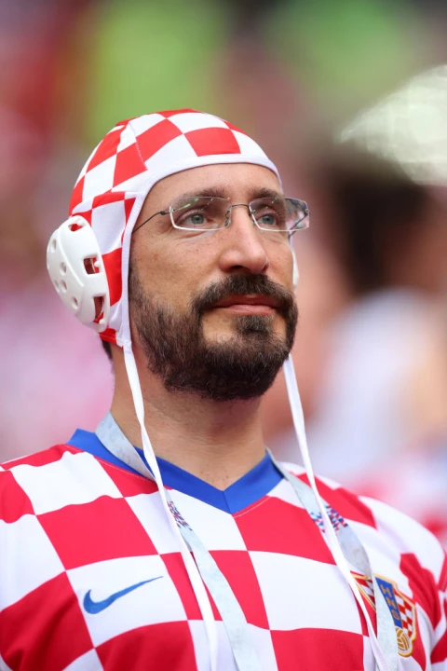
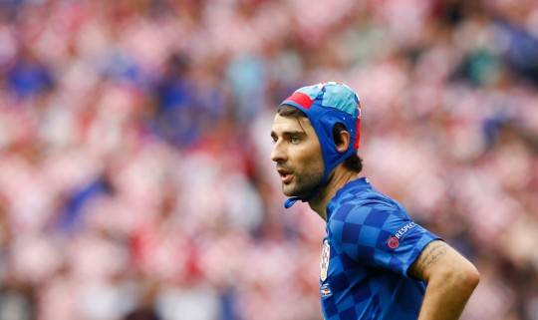
Why do Croatian football Fans often wear water polo caps?
The water polo hat trend dates back to Euro 2016 during a match between Croatia and Czech Republic.
Defender Vedran Ćorluka had injured his head in a previous match against Turkey, opening up a deep cut. It was hard to stop bleeding and the doctor used the cap that he had got from a famous Croatian water polo player.

Slide 15
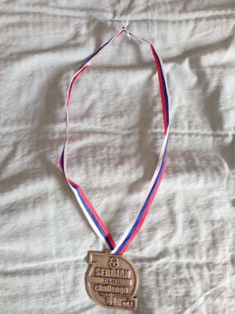
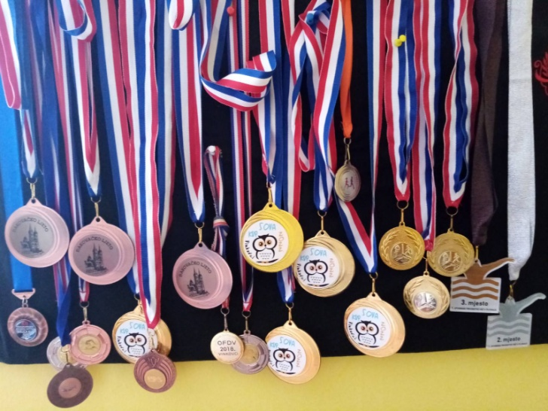
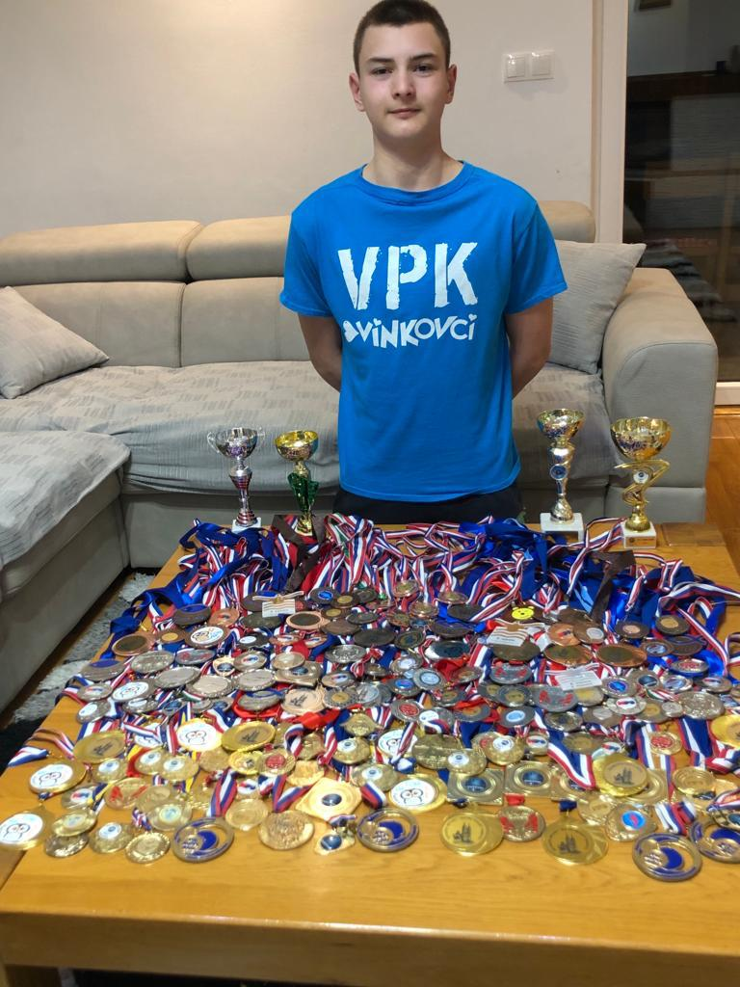
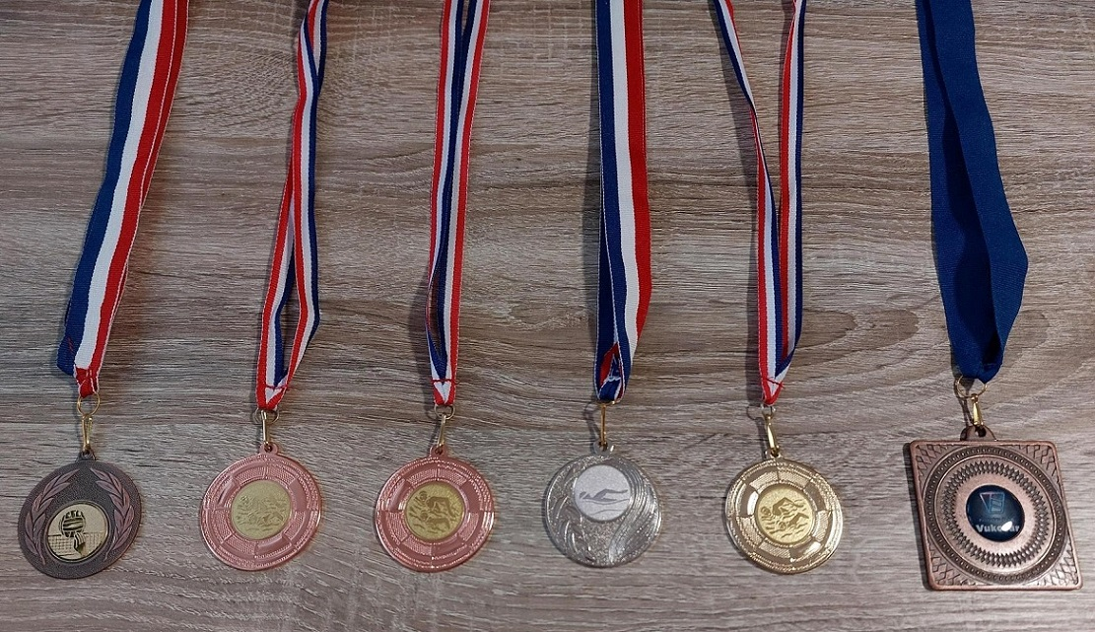
Our school has 150 pupils in grades 5 through 8. More than 90 of them are active members of sports clubs in Vinkovci. Currently the most popular sports are football, swimming and volleyball. Pupils go to competitions and win medals.

Slide 16
Sources:
https://www.kevmrc.com/most-popular-sports-in-croatia
https://alchetron.com/Sandra-Perkovi%C4%87
https://www.grad-vinkovci.hr/sport
https://www.hoo.hr/
https://croatia.hr/en-gb/greatest-sports-legends-of-croatia
https://www.myistria.com/en/croatia-s-sports-legends-most-important-personalities-of-croatian-sports
https://www.thedubrovniktimes.com/lifestyle/feature/item/13620-the-greatest-croatian-sports-people-of-all-time
https://www.paralympic.org/croatia

